Slide 1


AIRLINE RESERVATION SYSTEM
DINESH PRABU K.B
17MSS015
UNDER THE GUIDENCE OF: S. SURESH M.Sc., M.Phil.,
ASSISTANT PROFESSOR
DEPARTMENT OF SOFTWARE SYSTEMS

Slide 2
ABSTRACT
Airline Reservation System Project will help the user to book their flight tickets without visiting booking counter or to any other booking vendors, thus saving their money and time.
Airline Reservation System Project will be accessible by the user from any location through 24X7.
User can book their tickets by placing their necessary details such as: - date of journey, total number of candidates, number of adults and child’s, their respective age, type of seats, date of returning (if required but not necessary), address details, payment mode etc.
After successful registration the user will get printout for the tickets they have booked.
Technology used VB.net for front end and SQL server for back end.

Slide 3
INTRODUCTION
The main implementation requirements for this project are, the client tier must not be changed, which means that the format of all the communication message have to be preserved.
Check digit validation, time, stamps etc. Are supplied by already existing routines which we are obliged to use.
All the technical documentation formats are also fixed and have to be followed.
Some customer implementation techniques have to be followed.
A facility for viewing the single passenger record is made available.

Slide 4
SYSTEM SPECIFICATION
Hardware Specification
Processor - Intel®Core™i5-2450M CPU@2.50Ghz
Installed Memory (RAM) - 4.00GB
System type - 64-bit OS, x64-based processor
Storage - 500GB HDD
Software Specification
Operating System - Microsoft Windows 10
Editor - Microsoft Visual Studio
System Requirements
Hard Disk Capacity - 10GB
Internal Memory - 512MB

Slide 5
SYSTEM STUDY
EXISTING SYSTEM
In the existing system there is no provision for senior citizen concession and there is no facility for viewing single passenger record.
PROPOSED SYSTEM
In proposed system there is provision for senior citizen concession and there is facility for viewing single passenger record.
Some functionality, Like check digit validation, time, stamps etc. Are supplied by already existing routines which we are obliged to use.
The format of communication in modules are fixed and non-changeable.

Slide 6
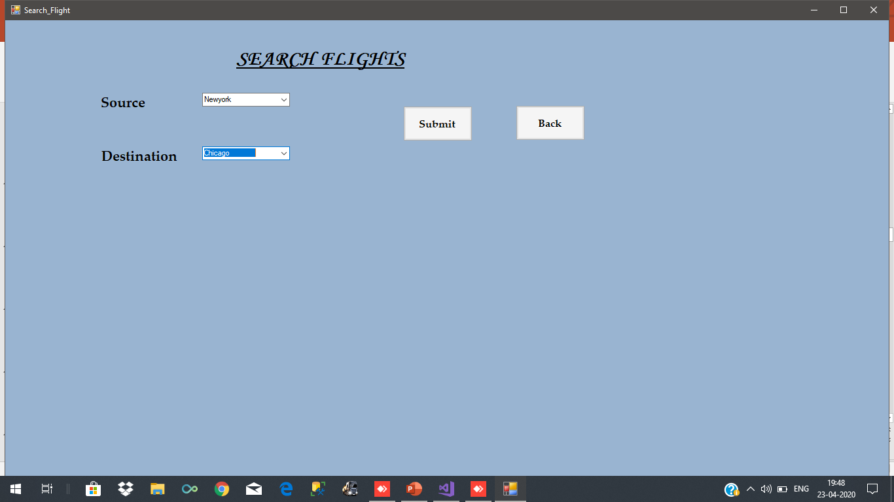
INPUT DESIGN

Slide 7
DATABASE DESIGN
CREATE TABLE [dbo].[Aircraft] (
[AircraftTypeId] NCHAR (10) NOT NULL,
[AirlineName] VARCHAR (50) NOT NULL,
[FirstClassSeats] NCHAR (10) NOT NULL,
[BusinessClassSeats] NCHAR (10) NOT NULL,
[EconomyClassSeats] NCHAR (10) NOT NULL,
CONSTRAINT [PK_Aircraft] PRIMARY KEY CLUSTERED ([AircraftTypeId] ASC)
);
CREATE TABLE [dbo].[Flights] (
[FlightNo] NCHAR (10) NOT NULL,
[DepartureTime] NCHAR (10) NULL,
[ArrivalTime] NCHAR (10) NULL,
[AircraftTypeID] NCHAR (10) NULL,
[SectorID] NCHAR (10) NULL,
CONSTRAINT [PK_Flights] PRIMARY KEY CLUSTERED ([FlightNo] ASC),
CONSTRAINT [FK_Flights_Sector] FOREIGN KEY ([SectorID]) REFERENCES [dbo].[Sector] ([SectorID]),
CONSTRAINT [FK_Flights_Aircraft] FOREIGN KEY ([AircraftTypeID]) REFERENCES [dbo].[Aircraft] ([AircraftTypeId])
);

Slide 8
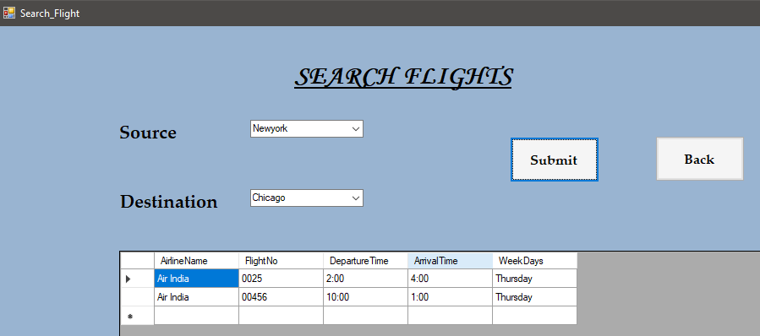
OUTPUT DESIGN

Slide 9
TESTING METHODOGIES
Software Testing Methodology is defined as strategies and testing types used to certify that the Application Under Test meets client expectations.
UNIT TESTING
Unit testing focuses first on the modules, independently of one another, to locate errors.
This enables to detect errors in coding and logic that are contained within the module alone.
The module interface is tested to ensure that the information flows in and out of the program unit under test.
E.g. checking each and every unit in a jobholder details form.

Slide 10
INTEGRATION TESTING
Integrated testing is proceeded with bottom up approach.
In bottom up integration testing, an individual module is first tested from a test harness. Once a set of individual modules has been tested.
They are then combined into a collection of modules, known as builds, which are then tested by a second harness.
This process can combine until the build consists of the entire application.

Slide 11
SYSTEM TESTING
System testing is a level of testing that validates the complete and fully integrated software product.
The purpose of a system test is to evaluate the end-to-end system specifications.
Usually, the software is only one element of a larger computer-based system.
Ultimately, the software is interfaced with other software/hardware systems.
System Testing is actually a series of different tests whose sole purpose is to exercise the full computer-based system.

Slide 12
ACCEPTANCE TESTING
Acceptance testing involves planning and executing of functional tests, performance tests and stress test in order to demonstrate that the implemented system satisfies its requirements.
Functional test causes involve excising the code with nominal input values for which expected results are known. Giving different input values tests it.
The final process should be a software audit where the complete software project is checked to ensure that it meets production management requirement.
This ensures that all requirement documentation has been produced, is in the correct format and is of acceptable quality.

Slide 13
SYSTEM IMPLEMENTATION AND MAINTENANCE
The process of putting the developed system in actual use is called system implementation.
The system can be implemented only after thorough testing is done and if it is found to be working according to the specifications.
The maintenance phase of the software cycle is the time in which a Software product performs useful work. After a system is successfully implemented, it should be maintained in a proper manner.
The maintenance activity occurs because it is unreasonable to assume that software testing will uncover all latent errors in a large software system.

Slide 14
CONCLUSION
When looking for solid airline reservation system software, you want to find a solution that gives you the easy way of booking ticket.
Naturally, you first want to find the software that meets your needs, both now and in the future.
Nowadays most products and system are becoming more complex in nature, and there is an increasing demand relative to new technology application at a time when our natural resources are no longer in a safe position.

Slide 15
FUTURE ENHANCEMENTS
The future developments which can be made in this project are:
We will make updates in design and features.
Along with the real fund transfer through banking system we will provide customer with peer to peer ticket transfer facility.
Service will be provided to mobile phones with other mobile OS.

Slide 16
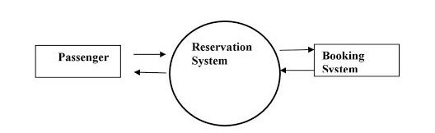
DATA FLOW DIAGRAM
LEVEL 0

Slide 17
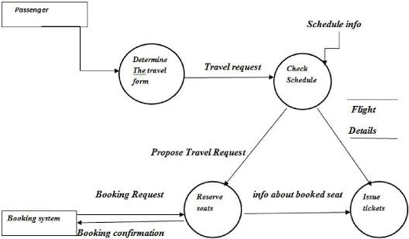
LEVEL 1

Slide 18
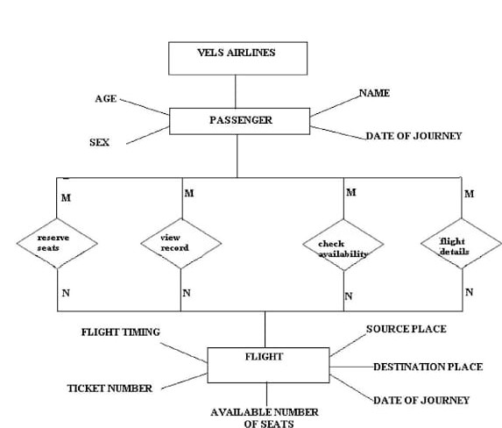
ER DIAGRAM

Slide 19
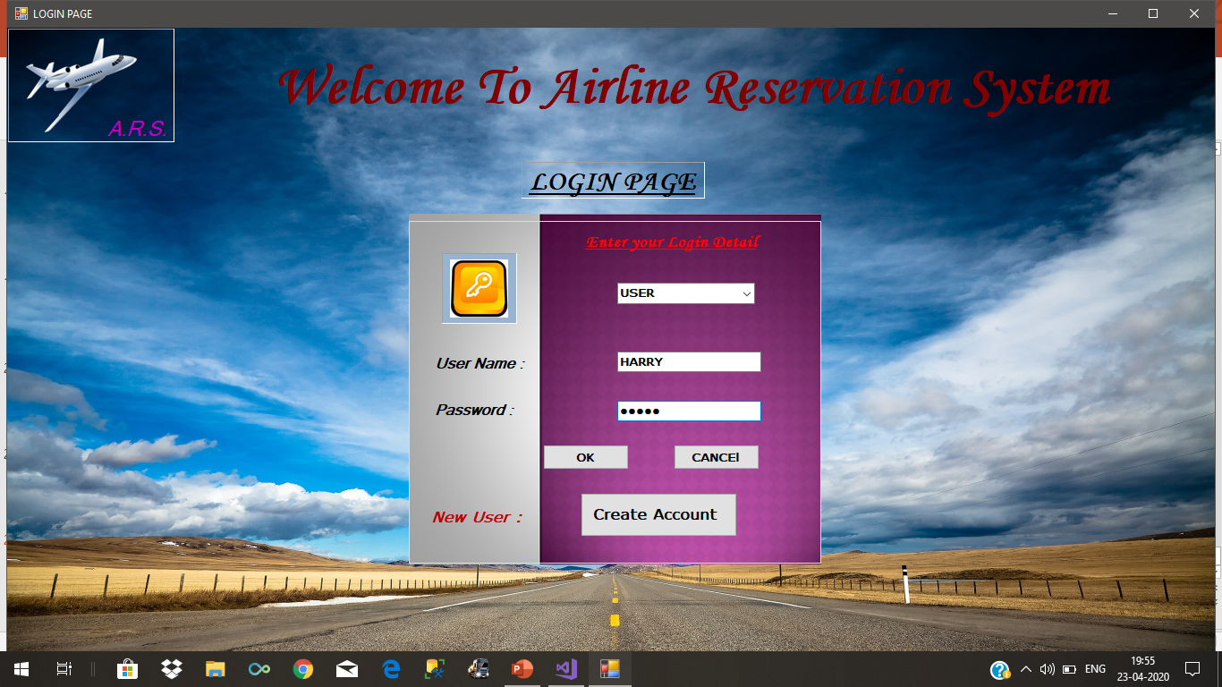
SAMPLE SCREENSHOTS

Slide 20
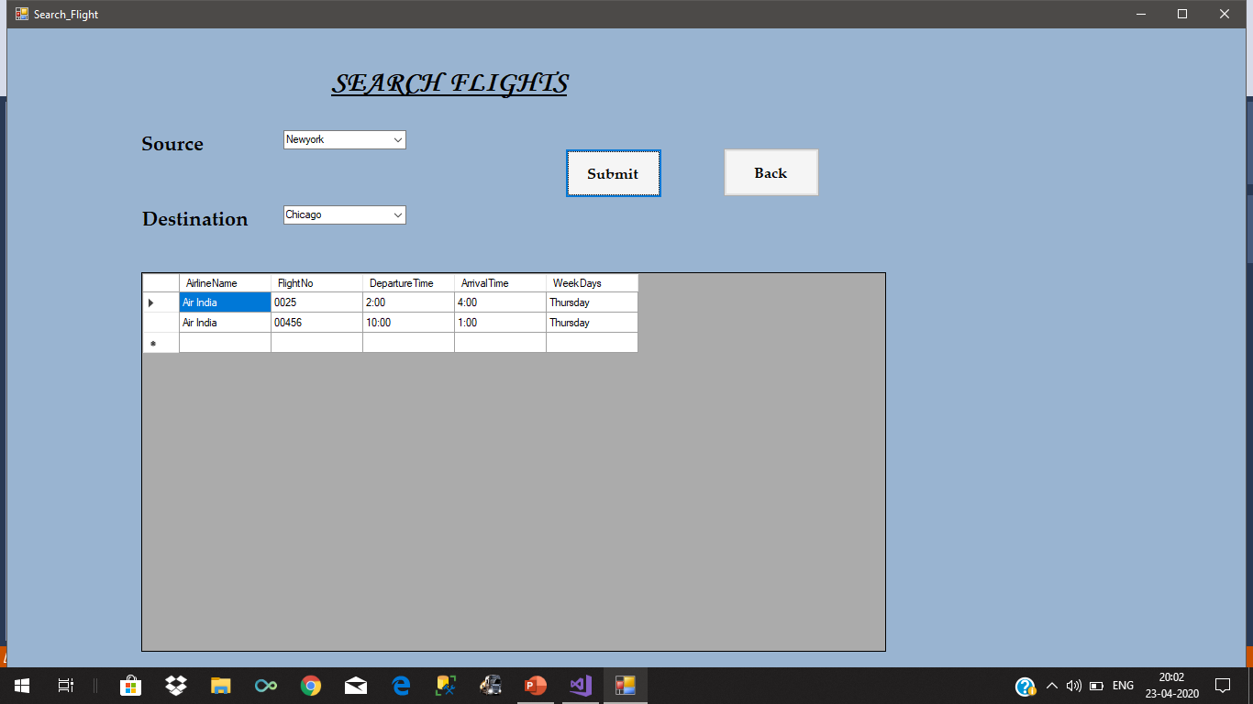
SEARCH FLIGHTS

Slide 21
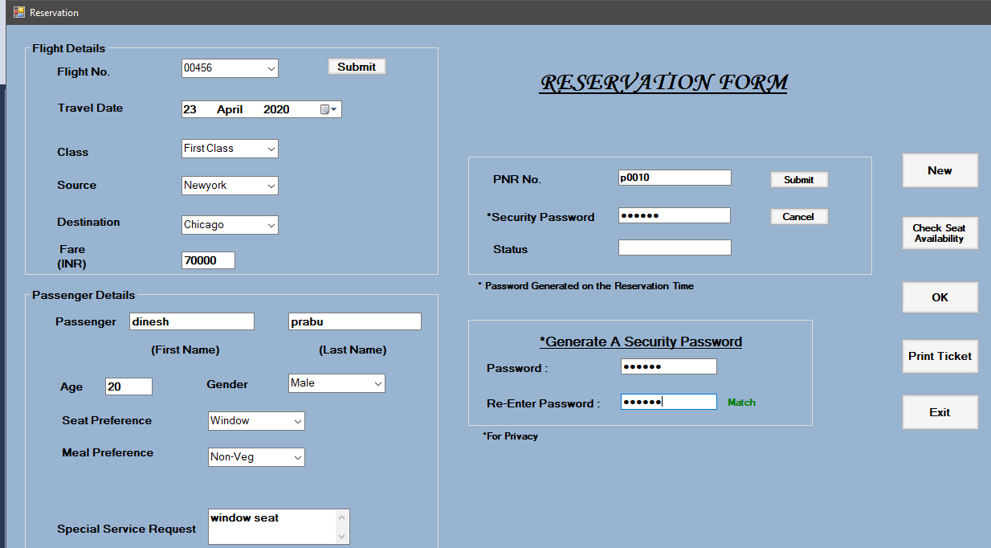
RESERVATION FORM

Slide 22
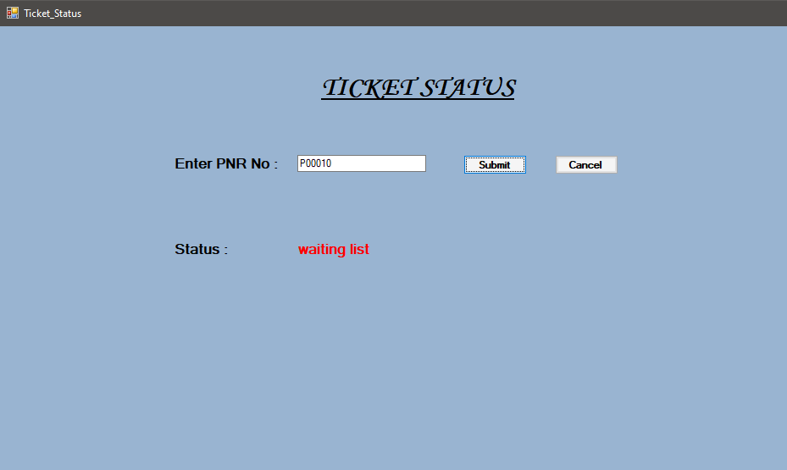
TICKET STATUS

Slide 23
THANK YOU

