Slide 1
Brain Wave Pattern Analysis
Using Python with R for Enhanced Visualization
FINAL TASK
Presented By Zak Groenwold, Dinesh Seveti, Samuel Arne
CSCI 310/593
Group 13

Slide 2
Objective
The goal of this project is to develop a method to analyze brain wave data and visualize the patterns corresponding to specific thought categories. By integrating Python for analysis and R for plotting, we leverage the strengths of both platforms to create detailed and intuitive visualizations.
Making a unified version for the current 6x2 code files into 2x1 code file to automate reading all subdirectory files by category.

Slide 3
Brain Waves and Categorization
Brain waves are electrical impulses in the brain created by the activity of neurons. These waves are categorized based on their frequency and are measured using techniques like EEG (electroencephalography).
Mapping specific brain wave patterns to thought categories (like "take off" or "landing") is critical for advancing BCIs and understanding neural activity.

Slide 4
Methodology
Data Collection: Obtain brain wave data (e.g., EEG readings).
Data Processing: Use Python to clean, analyze, and prepare the data.
Visualization: Send the processed data to R for plotting high-quality graphs.
Pattern Interpretation: Interpret plots to map patterns to thought categories

Slide 5
Tools and Technologies
Python for Preprocessing and structuring data for analysis we use: Libraries like numpy for numerical processing, pandas for data manipulation, rpy2 to integrate R with Python.
R for creating visualizations that effectively represent brain wave patterns: Libraries like ggplot2 for high quality plotting, lattice for specialized plots.
Python and R integration where data is processed in python and passed to R using the rpy2 library.

Slide 6
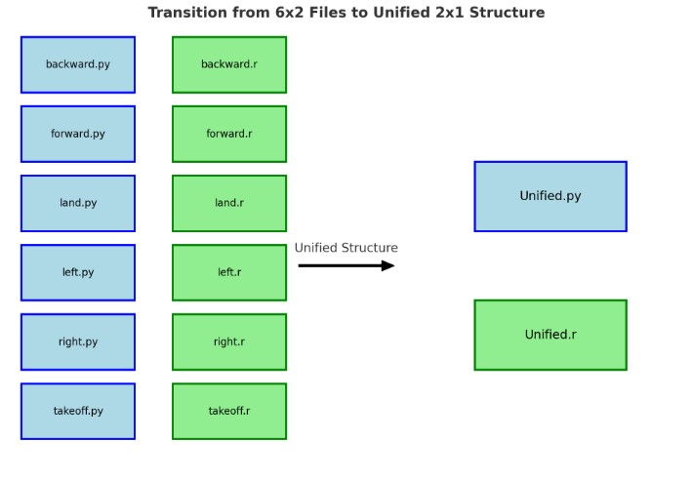
Demonstration
Script Workflow
Directory and Script Setup:
base_dir: Specifies the root directory containing subdirectories (backward, forward)
with brainwave data files.
r_script_path: Path to the R script (Plot-Generation.R) used for generating plots.
output_folder: Directory where the generated plots will be saved.
Folder Validation:
Ensures the base_dir and output_folder exist. If not, the script creates the output_folder.
Processing Each Subdirectory:
Iterates through a predefined list of folders (backward, forward, etc.).
Checks if each folder exists within the base_dir. Skips folders that are missing.
Calling the R Script:
For each folder, the execute_r_script function:
Passes the folder path (file_path) and output_folder as arguments to the R environment.
Executes the R script (Plot-Generation.R) using robjects.r.source().
The R script reads the data, generates plots, and saves them to the output_folder.
Interactive End:
Keeps the plots open until the user presses Enter, ensuring they can view them before closing.

Slide 7
Conclusion
Brain Wave Analysis:
Developed a robust method to analyze and visualize brain wave patterns for specific thought categories. Leveraged Python for preprocessing and R for high-quality visualizations.
Unified Workflow:
Combined 12 scripts into 2 unified files Unified-Reading.py and Plot-Generation.R to streamline automation and enhance maintainability. Automated file discovery and category-based processing for all subdirectory files.
The benefits of the unified structure gives us the best efficiency on processing multiple categories with a single run, reducing and redundancy. And Scalability for easy adaption and new thought categories or handling larger datasets. Centralized codebase simplifies debugging and updates.

