Slide 1
NOVA: A React-Compatible High-Performance Build Platform
FIRST REVIEW
October 2026
Presented By:
Student Names:
Kirutiga G (RA2311008050003)
Dinesh Kanna R (RA23110080500010)
Nithish M (RA23110080500033)
Supervised By:
Name: Dr Jubilant Kizhakkethottam
Designation: Head of the Department
Department: Information Technology
Institution: SRM Institute of Science and Technology,
Tiruchirappalli
First Review Presentation

Slide 2
Problem Statement
• Web applications rely on separate tools for compilation, bundling, dependency analysis, and asset optimization.
• Separate stages may repeat code analysis and make semantic information difficult to reuse.
• Developers must coordinate multiple tools to achieve efficient builds and optimized application output.
• A unified, compiler-driven platform is needed to reduce redundant processing and improve build efficiency.
2/12

Slide 3
Project Objectives
1
Design a React-compatible build pipeline without introducing a new UI syntax.
2
Use Binary IR to preserve semantic information between compilation and bundling.
3
Generate a dependency graph to track module relationships and affected files.
4
Develop an optimization algorithm with caching and safe, targeted transformations.
5
Evaluate build time, incremental rebuilds, output size, and correctness against a baseline.
3/12

Slide 4
Literature Review
Existing tools provide strong individual capabilities; Nova investigates a shared semantic pipeline.
Technology | Existing focus | Relevance to Nova
Vite | Development server and production builds | Explore shared semantic analysis across stages
Webpack | Module graph, bundling, code splitting, asset handling | Explore reusable IR and targeted invalidation
esbuild | Fast JavaScript/TypeScript transformation and bundling | Investigate application-aware analysis
LLVM | Compiler infrastructure and intermediate representations | Apply IR design principles to a React build pipeline
Research question: can shared semantic representation, dependency-aware invalidation, and stage-specific caching reduce repeated work while preserving application behavior?
4/12

Slide 5
Proposed Methodology
• Accept a React / JavaScript / TypeScript project and normalize its build configuration.
• Parse supported source files into an Abstract Syntax Tree (AST).
• Perform semantic analysis and generate Binary IR together with dependency-graph information.
• Check source fingerprints and reuse valid cached AST, IR, and graph data where possible.
• Select and apply safe optimization passes, validating the IR after transformations.
• Bundle reachable modules, process CSS/assets, validate output, and collect benchmark metrics.
5/12

Slide 6
Architecture Diagram
Core pipeline with shared semantic data and cross-cutting caches
Source Project
React / JS / TS
Parser
AST
Semantic Analyzer
Symbols / imports
Binary IR
Semantic metadata
Optimizer
Safe passes
Bundler
Chunks / assets
Dependency Graph
Module edges • reverse dependencies
Optimized Binary IR
Validated transformed representation
Production Output
JavaScript • CSS • assets
CACHE MANAGER — INCREMENTAL BUILDS
AST Cache • Binary IR Cache • Dependency Graph Cache • Optimization Cache • Chunk Cache
[Optional future module: WebGPU-based 3D rendering — not required by the core pipeline]
6/12

Slide 7
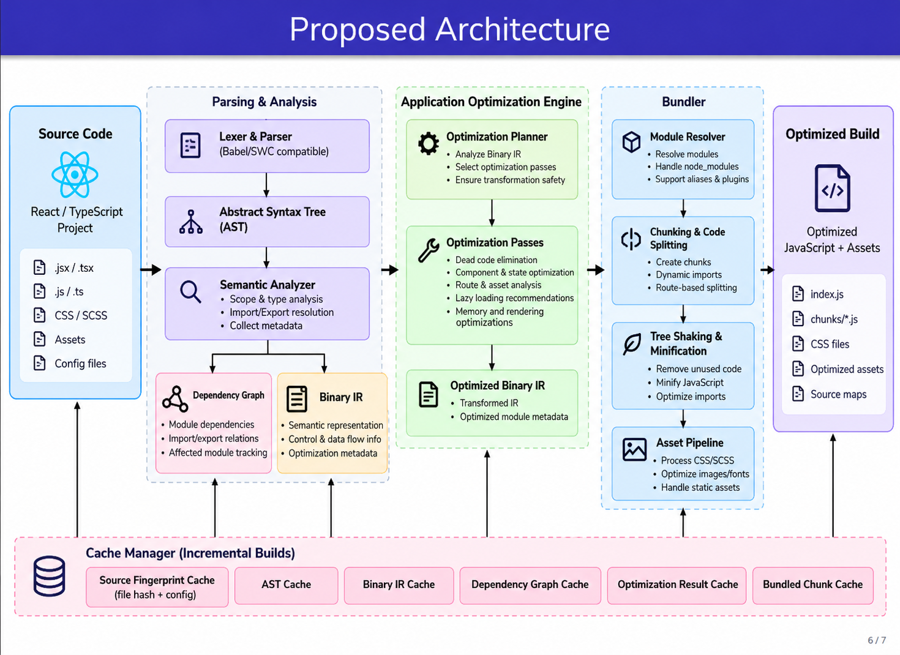

Slide 8
Module Description
Module | How it works
CLI + Configuration | Reads settings and starts the build.
Parser + AST | Converts supported source files into syntax trees.
Semantic Analyzer | Resolves symbols/imports and extracts semantic metadata.
Binary IR Generator | Creates the shared intermediate representation.
Dependency Graph | Tracks module relationships and affected modules.
Cache Manager | Reuses valid AST, IR, graph, and output artifacts.
Optimization Planner + Engine | Selects and applies safe, supported optimization passes.
Bundler + Asset Pipeline | Creates chunks and processes CSS/assets.
Output Validator | Checks generated files and collects build metrics.
7/12

Slide 9
Project Workflow Chart
1. Input Project
React / JS / TS
2. Parse
Generate AST
3. Semantic Analysis
Resolve symbols / imports
4. Build Representation
Binary IR + graph
8. Validate
Correctness / metrics
7. Bundle
Chunks and assets
6. Optimize
Safe passes
5. Cache Check
Reuse or regenerate
When a source file changes, Nova compares fingerprints, updates dependency edges, identifies affected modules, and rebuilds only artifacts whose cache keys no longer match.
8/12

Slide 10
Proposed Algorithm: Binary-IR-Guided Incremental Optimization
Combines semantic reuse, dependency analysis, caching, and safety-aware optimization.
1. Fingerprint
source + config
2. Reuse or build
AST / Binary IR
3. Update dependency
graph
4. Find affected
modules
5. Select safe
optimization passes
6. Validate optimized
Binary IR
7. Bundle and reuse
unchanged chunks
Expected benefit to test: unchanged modules can reuse valid cached analysis; affected stages are recomputed when dependency and cache fingerprints show reuse is safe. Runtime improvements must be measured separately from build-time improvements.
9/12

Slide 11
Implementation Methods
• Core implementation: Rust; compatibility target: React, JavaScript, TypeScript, JSX/TSX.
• Parser and AST: integrate a proven parser for supported syntax rather than implementing the full language grammar from scratch.
• Binary IR: define a versioned schema for modules, symbols, dependencies, source spans, and optimization metadata.
• Dependency graph and cache: use content fingerprints, reverse edges, and stage-specific cache keys.
• Bundler integration: implement output planning and connect supported tree shaking, code splitting, and asset processing.
• Testing: compare against a Vite-based baseline using correctness fixtures, cold builds, incremental rebuilds, and output-size measurements.
10/12

Slide 12
Expected Outcomes
• A working prototype of the Nova React-compatible build platform.
• A shared Binary IR connecting compilation, optimization, and bundling.
• Dependency-aware incremental analysis and stage-specific caching.
• A tested implementation of Binary-IR-Guided Incremental Optimization.
• Measured comparisons of build time, incremental rebuild time, output size, and correctness against a baseline.
• Documented limitations and a roadmap for future extensions, including optional WebGPU-based 3D rendering.
11/12

Slide 13
References & Research Notes
Initial sources to consult and cite in the final review document:
• Vite documentation — https://vite.dev/guide/
• Webpack documentation — https://webpack.js.org/concepts/
• esbuild documentation — https://esbuild.github.io/
• LLVM documentation — https://llvm.org/docs/
• React documentation — https://react.dev/
The proposed design is a hypothesis to evaluate; performance and correctness must be established through implementation and benchmarks.
12/12

