Slide 1
NOVA: A React-Compatible High-Performance Bundler
ZERO-TH REVIEW
October 2026
Presented By:
Student Name(s):
Kirutiga G (RA2311008050003)
Dinesh kanna R (RA23110080500010)
Nithish M (RA23110080500033)
Supervised By:
Name: Dr Jubilant Kizhakkethottam
Designation: Head of the Department
Department: Information Technology
Institution: SRM institute of science and Technology,Tiruchirappalli
Replace placeholders with your official details

Slide 2
Problem Statement
• Web applications rely on separate tools for compilation, bundling, dependency analysis, and asset optimization.
• Separate stages may repeat code analysis and make semantic information difficult to reuse.
• Developers must coordinate multiple tools to achieve efficient builds and optimized application output.
• A unified, compiler-driven platform is needed to reduce redundant processing and improve build efficiency.
2/7

Slide 3
Project Objectives
1
Design a React-compatible build pipeline without introducing a new UI syntax.
2
Use Binary IR to preserve semantic information between compilation and bundling.
3
Generate a dependency graph to track module relationships and affected files.
4
Develop an optimization algorithm with caching and safe, targeted transformations.
5
Evaluate build time, incremental rebuilds, output size, and correctness against a baseline.
3/7

Slide 4
Proposed Solution & Working Flow
Nova integrates key build-tool capabilities into one React-compatible platform using a shared Binary IR.
React /
JSX
Parser +
AST
Semantic
Analysis
Binary IR +
Dependency Graph
Optimization
Engine
Bundler
Optimized JavaScript
+ Assets
Working flow
• Parse source code and build an AST.
• Semantic analysis generates Binary IR and dependency relationships.
• The optimizer reuses cached analysis and applies supported safe optimizations.
• The bundler creates JavaScript chunks and processes CSS/assets.
4/7

Slide 5
Core Modules and Responsibilities
Module | Responsibility
Parser + AST | Converts supported source files into syntax trees.
Semantic Analyzer | Resolves symbols/imports and extracts semantic metadata.
Binary IR | Stores reusable module, symbol, component, and source metadata.
Dependency Graph | Tracks module relationships and identifies affected modules.
Optimization Engine | Selects and applies safe, supported optimization passes.
Bundler + Cache | Builds chunks, optimizes assets, and reuses valid build results.
5/7

Slide 6
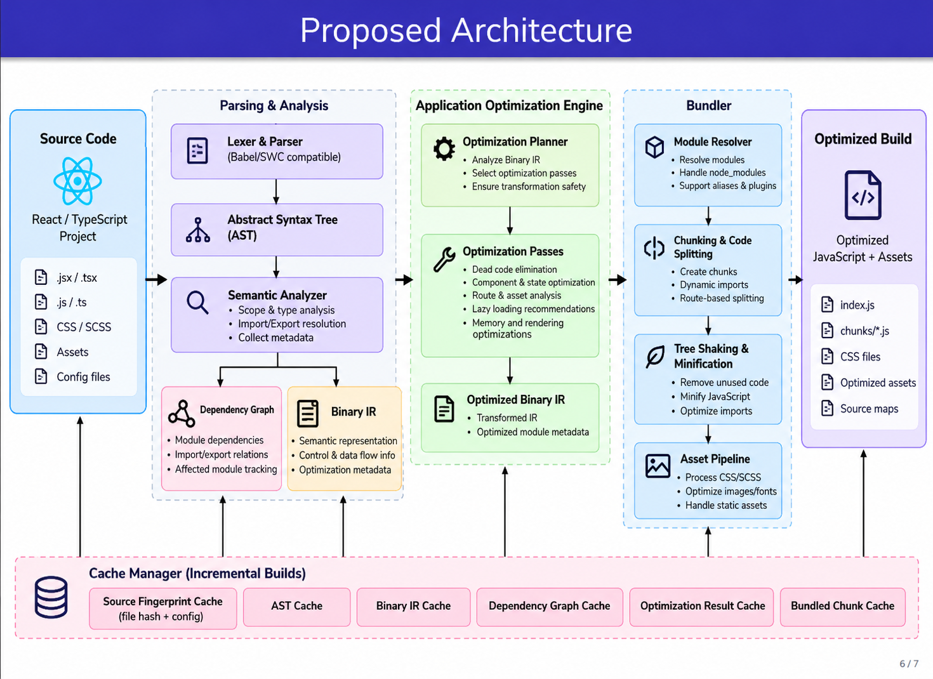
Proposed Algorithm: Binary-IR-Guided Optimization
Combines semantic reuse, dependency analysis, caching, and safety-aware optimization.
1. Fingerprint
source + config
2. Reuse or build
AST / Binary IR
3. Update dependency
graph
4. Find affected
modules
5. Select safe
optimization passes
6. Validate optimized
Binary IR
7. Bundle and reuse
unchanged chunks
Expected benefit to test: unchanged modules can reuse valid cached analysis; affected stages are recomputed when dependency and cache fingerprints show that reuse is safe. Runtime improvements must be measured separately from build-time improvements.
6/7

Slide 7
Questions!
Thank You
Questions & Suggestions
Nova — Keep React. Rebuild the engine beneath it.
7/7

