Slide 1

Sprocket Central Pty Ltd
Data analytics approach
Analytics - Engagement Manager - Dineshkumar Anbalagan

Slide 2
AGENDA
Introduction
Data Exploration
Model Development
Interpretation

Slide 3
INTRODUCTION
Why? How? & What? – Three most frequently used questionnaires used by analysts
while solving any kind of problems. The questionnaires we asked while doing this analysis are
What is our end goal?
Who is the benefactor?
What additional features are required and can be derived from an existing dataset?
What analysis methods can be done to get better results?
Why a certain feature will perform better comparing with others?
What if we use that instead of this?
and etc…

Slide 4
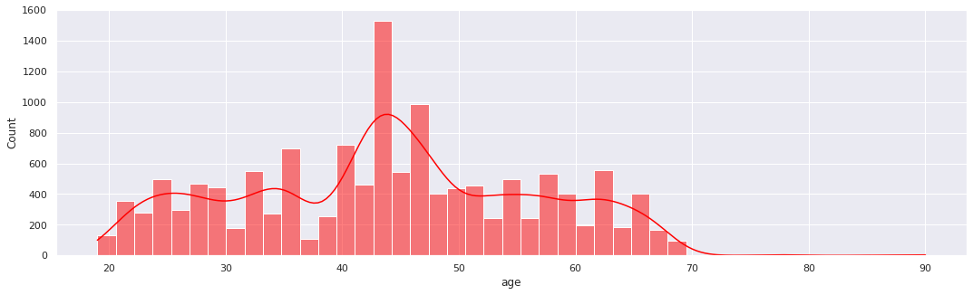
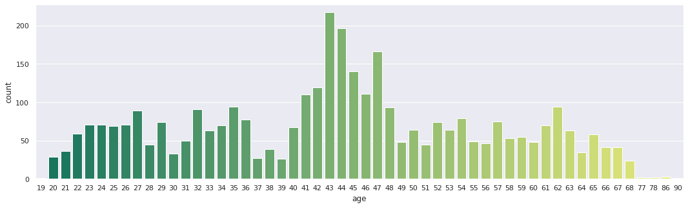
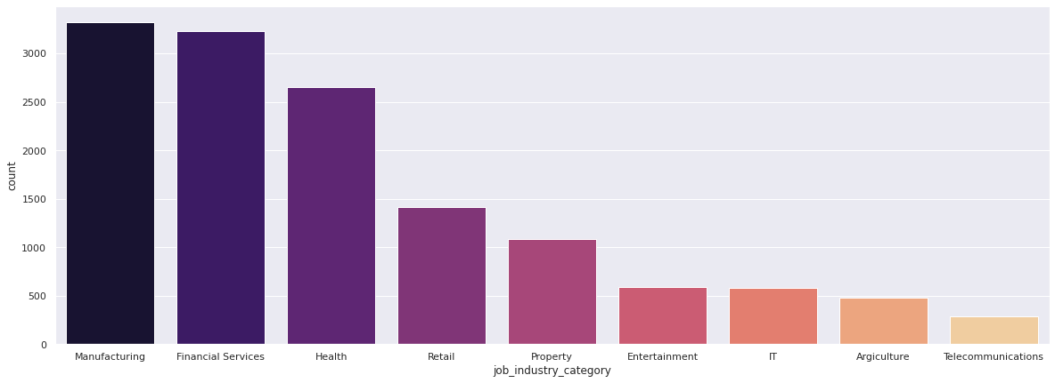
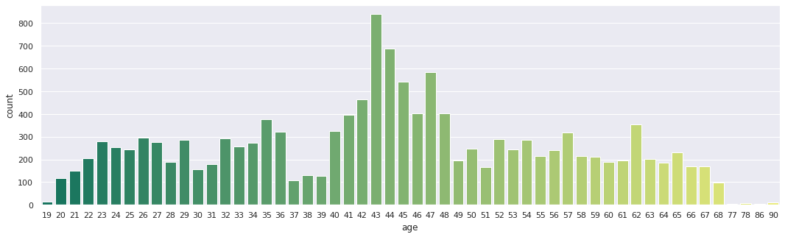
DATA EXPLORATION
A stage which helps analysts to get familiar with the dataset, also the stage which acts as a foundation for further analysis. Here are some of the key insights extracted from the provided dataset.

Slide 5
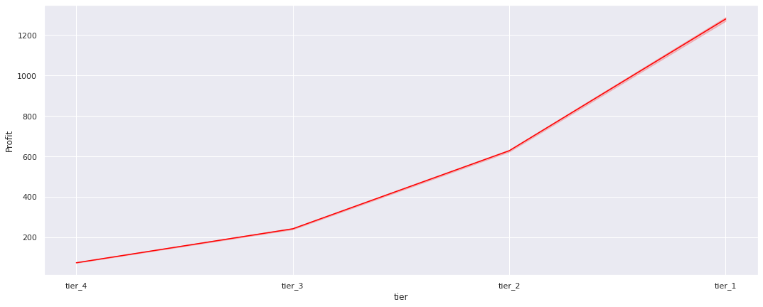
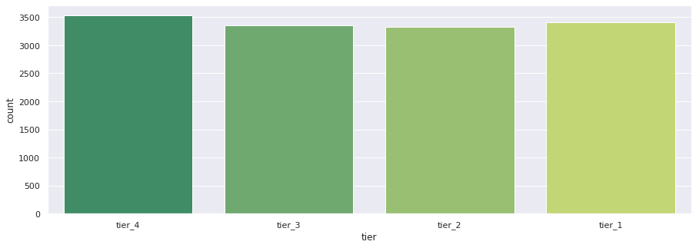
MODEL DEVELOPMENT
Customers are classified into 4 different tiers based on their purchase history such as tier_1, tier_2, tier_3 & tier_4.
As you can see from the profit-tier curve, most of our profits are from the tier_1 customers followed by tier_2, tier_3 & tier_4.
However, from the another graph it shows that tier_4 customers are our most frequent ones followed by tier_1, tier_3, & tier_2.
Hence, further detailed analysis is required.

Slide 6
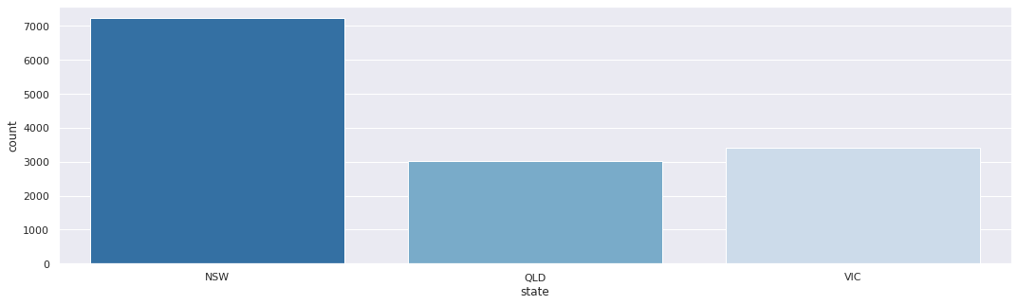
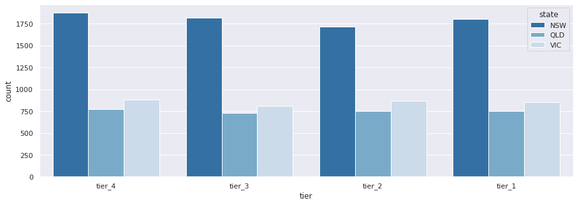
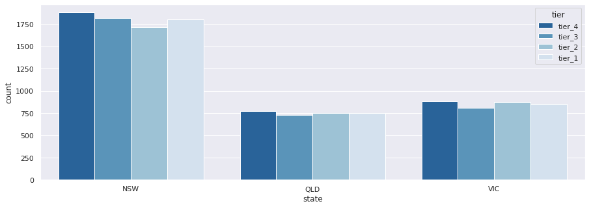
STATE WISE CUSTOMER DISTRIBUTION
TIER WISE DISTRIBUTION
STATE WISE CUSTOMER DISTRIBUTION OF TIERS

Slide 7
MODEL DEVELOPMENT
Hence the model is gonna be developed based on the following factors:
Tier
Location
Profit and
Brand and product size, line and class which people prefer.

Slide 8
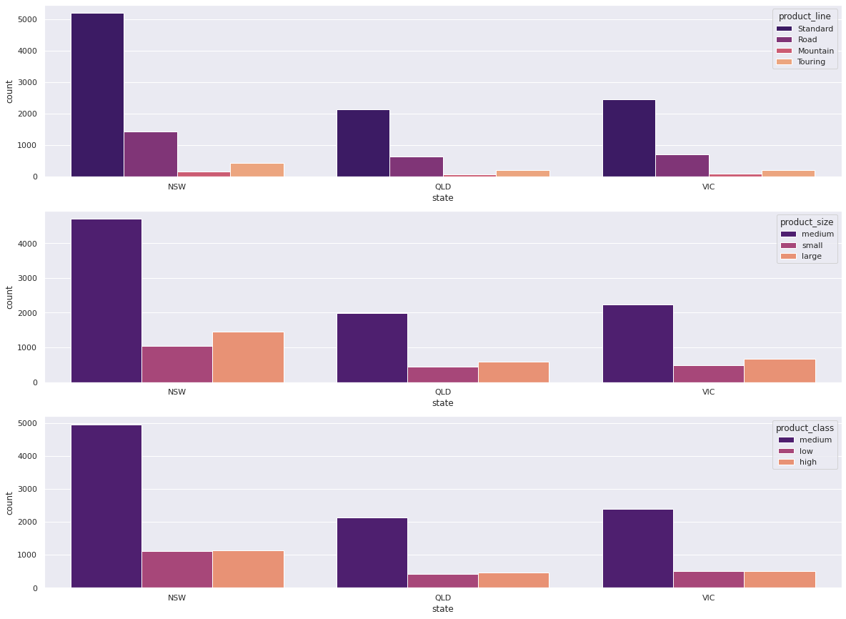
INTERPRETATION
State wise distribution of product size, product line and product class.

Slide 9
INTERPRETATION
Distribution of customers with respect to job industry category.

Slide 10
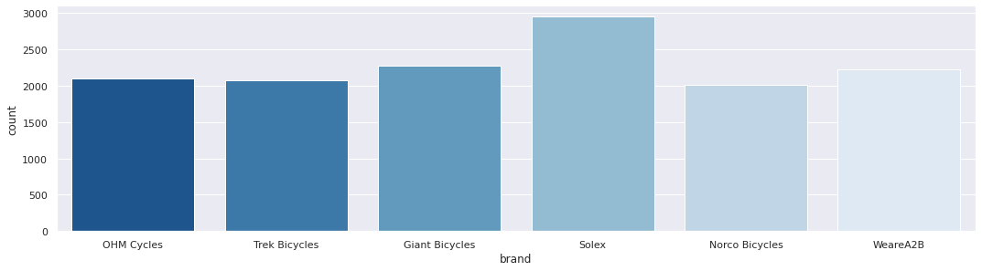
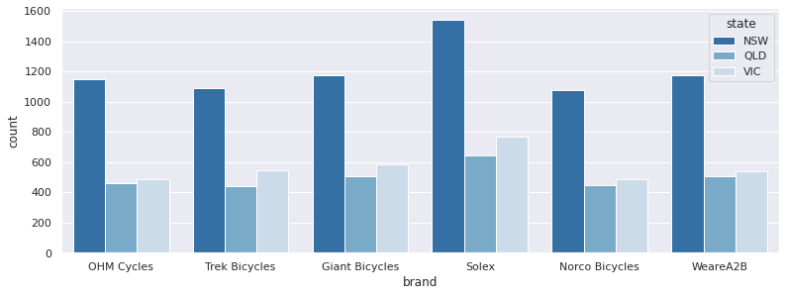
INTERPRETATION
Brand wise distribution.

Slide 11
APPENDIX
From slide 8 – Most of the customers are from NSW and they prefer standard in product line and medium in product size and class.
From slide 9 - Most of the customers are from the age group of 40 – 50 and most of them are coming from manufacturing, Financial and Health care sectors.
From slide 10 - Mostly people prefer to buy solex brand comparing to others especially highest sales is recorded in NSW.

Slide 12
Thank you

