Slide 1
Digital Memory Map System
AI-Based Smart Asset Tracking & Visual Memory System
Team Members:
DINESH KUMAR C(CB2316)
LUKMAN AHAMED M(CB2331)
SARUKESH J(CB2350)

Slide 2
Abstract
This project proposes an AI-powered visual asset tracking system for MSMEs. Using CCTV/webcams, YOLOv8 detects tools, raw materials, equipment and finished goods. Their last known location and timestamp are stored in a database, enabling workers to quickly locate assets. The system improves productivity, reduces downtime and offers an affordable Industry 4.0 retrofit solution.

Slide 3
Introduction
• MSMEs lose productive time searching for tools and materials.
• Existing RFID/GPS systems are expensive.
• AI and Computer Vision provide a low-cost alternative.
• Proposed system creates a visual memory of factory assets.

Slide 4
Problem Statement
• Misplaced tools delay production.
• Manual inventory tracking causes errors.
• Existing solutions require additional hardware.
• Need for an affordable AI-based asset tracking solution.

Slide 5
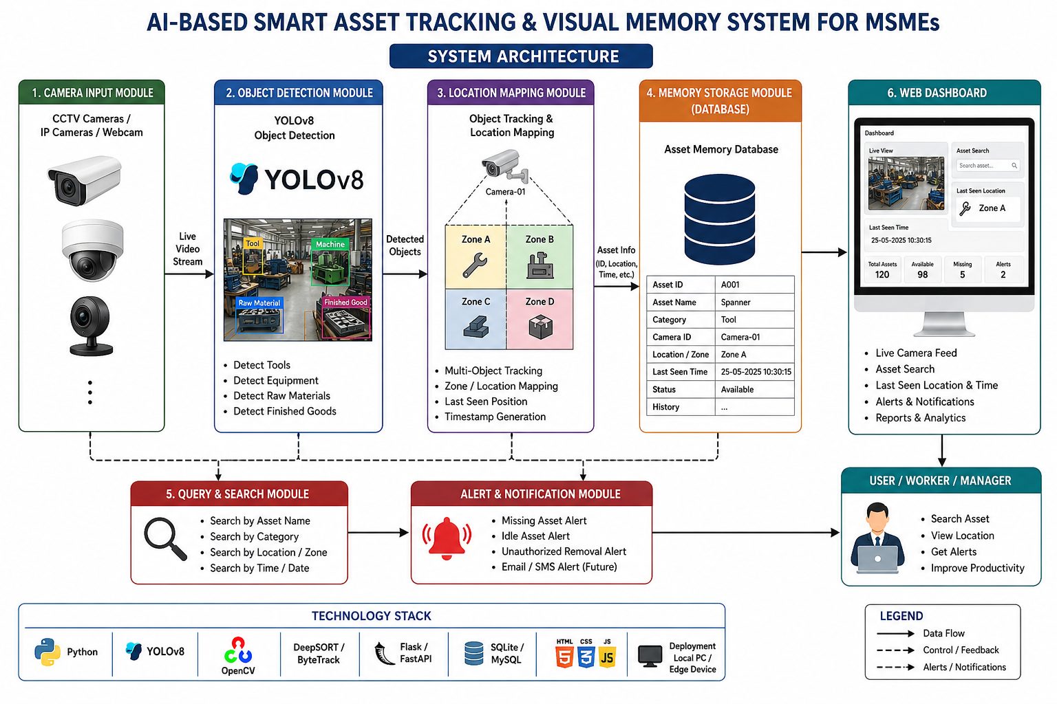
System Architecture
Camera Input
↓
YOLOv8 Object Detection
↓
Location Mapping
↓
Asset Database
↓
Web Dashboard & Alerts

Slide 6
Modules
1. Camera Input Module
2. Object Detection Module
3. Location Mapping Module
4. Memory Storage Module
5. Query & Search Module
6. Web Dashboard

Slide 7
Working
• Cameras continuously monitor work areas.
• YOLOv8 detects industrial assets.
• System stores asset name, location and timestamp.
• User searches asset.
• Dashboard displays last seen location instantly.

Slide 8
Applications
• Manufacturing industries
• Warehouses
• Automotive workshops
• Tool rooms
• Electronics assembly units

Slide 9
Advantages
• Low-cost retrofit solution
• No RFID tags required
• Reduces search time
• Improves productivity
• Real-time monitoring
• Easy integration

Slide 10
Future Scope
• Mobile application
• Voice-based search
• Predictive asset movement
• Multi-camera tracking
• ERP integration

Slide 11
Conclusion
The proposed system enables MSMEs to digitally track industrial assets using AI and Computer Vision. It supports Industry 4.0 adoption, improves operational efficiency, and can be developed into a commercially viable prototype.

