Slide 1
123 Propertyhub Login page UI

Slide 2
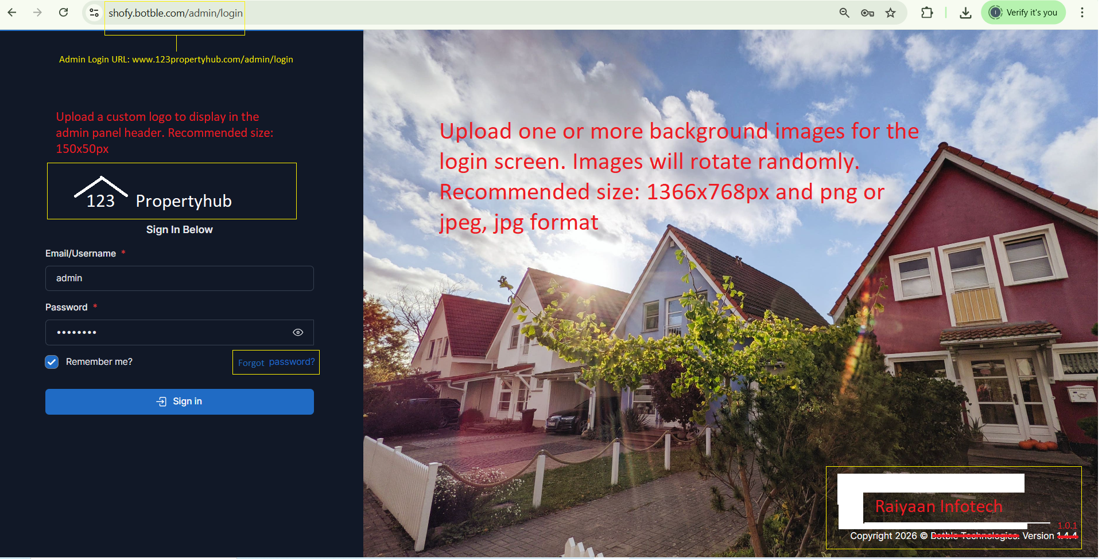

Slide 3
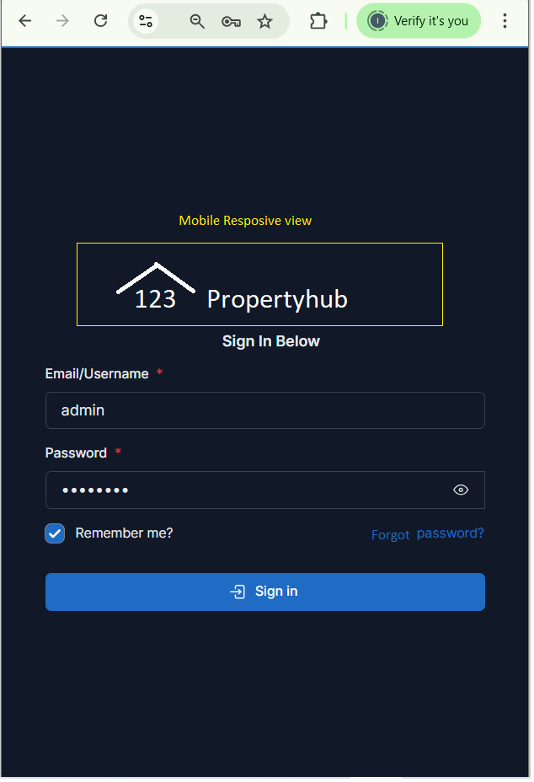

Slide 4
123 Propertyhub Forgot password page UI
Functional will do later

Slide 5
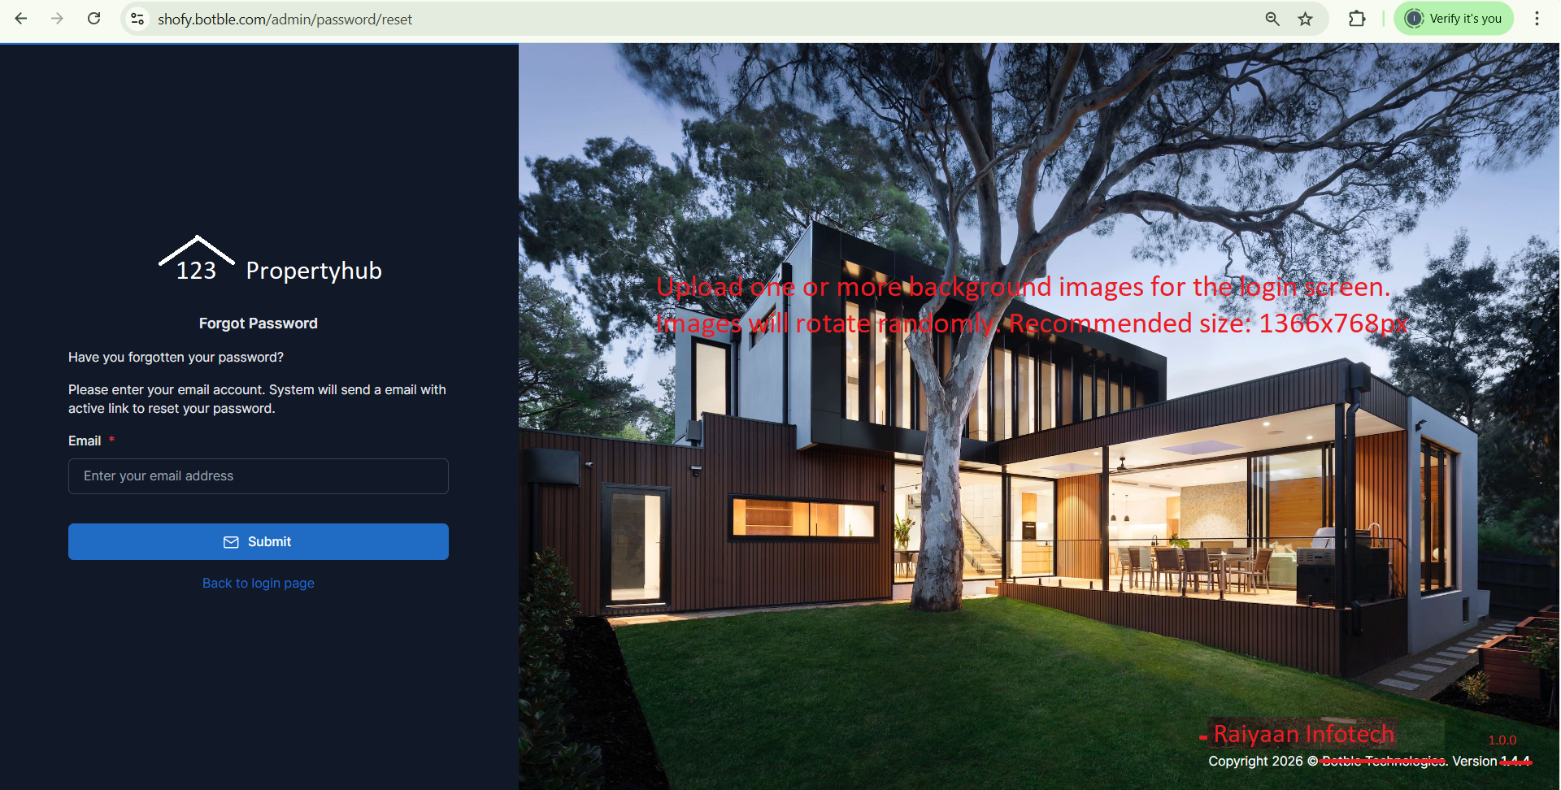

Slide 6
123 Propertyhub – Admin Portal

Slide 7
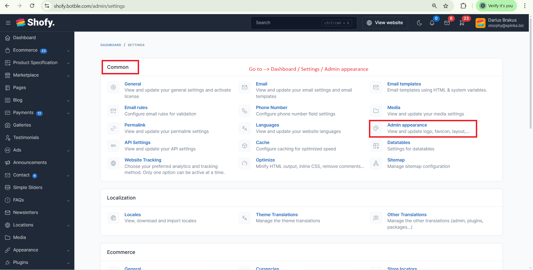

Slide 8
