Slide 1
DIGITAL PORTFOLIO STUDENT NAME : DINESH R REGISTER NO AND : 2422K2199 NM ID : 5A25E0BE2FA535791AA495D12014DB54 DEPARTMENT : BSC COMPUTER SCIENCE COLLEGE : PURATCHI THALAIVI AMMA GOVERNMENT ARTS AND SCIENCE COLLEGE PALLADAM UNIVERSITY : BHARATHIYAR UNIVERSITY

Slide 2
DIGITAL PORTFOLIO DINESH R-24UCS027

Slide 3
AGENDA
1. Problem Statement 2. Project Overview 3. End Users 4. Tools and Technologies 5. Portfolio design and Layout 6. Features and Functionality 7. Results and Screenshots 8. Conclusion 9. Github Link

Slide 4
PROBLEM STATEMENT
Lack of a centralized platform to showcase my academic projects and skills Difficulty in communicating technical knowledge and achievements to recruiters and peers. Need for a professional online presence beyond a traditional resume. Limited visibility of my work and projects without a dedicated website. Challenge of organizing different projects, experiences, and contact details in one place.

Slide 5
PROJECT OVERVIEW
This website is designed as a personal portfolio to highlight my academic background, skills, and projects. It serves as a professional platform to present my work in an organized and accessible manner. The site includes key sections: Home, About Me, Projects, and Contact. Projects are showcased with descriptions to demonstrate problem-solving skills and technical knowledge. The portfolio helps recruiters, peers, and collaborators to easily understand my expertise and achievements. Built with simple, responsive design to ensure accessibility across devices.

Slide 6
END USERS
Recruiters and Employers – to evaluate my skills, projects, and academic achievements. Faculty Members / Mentors – to review and assess my academic and technical progress. Peers and Collaborators – to explore my work and potentially collaborate on projects. General Audience – anyone interested in learning about my background, skills, and interests. Future Clients – individuals or organizations who may want to work with me on projects.

Slide 7
TOOLS AND TECHNOLOGIES
Traditional Tools – pencils, pens, charcoal, watercolor, acrylics, and canvas
Digital Tools – drawing tablets, stylus pens, and digital sketchpads
Software – Adobe Photoshop, Illustrator, Krita, or Procreate (whichever you use).
Photography & Editing – cameras or smartphones for capturing artwork, along with basic photo editing apps
Website Platform – HTML, CSS, and GitHub Pages for hosting and showcasing my artwork portfolio.

Slide 8
PORTFOLIO DESIGN AND LAYOUT
Clean and Minimal Design – ensures the focus remains on the artwork
Homepage Introduction – brief welcome message and overview of my artistic identity.
About Section – highlights my background, inspirations, and journey as an artist.
Gallery/Projects Section – displays selected artworks with descriptions.
Responsive Layout – optimized for viewing on desktop, tablet, and mobile.
Navigation Bar – simple menu for easy access to Home, About, Projects, and Contact.
Contact Section – allows viewers, art enthusiasts, and potential clients to connect with me.

Slide 9
FEATURES AND FUNCTIONALITY
Interactive Navigation – easy access to different sections like Home, About, Portfolio, and Contact.
Artwork Showcase – organized gallery to highlight different categories of my art.
Responsive Design – adapts to various screen sizes (desktop, tablet, and mobile).
About the artist – can be able know the artist with picture.
Gallery- can be able to see the creations or samples of the artist and it allows to inquire it.
Project Descriptions – short write-ups explaining the story, style, or technique behind each artwork.
Contact Form/Details – allows visitors, recruiters, or art enthusiasts to reach out directly.
Fast Loading – lightweight design for quick access to content.
GitHub Hosting – reliable and free platform for publishing the portfolio online.

Slide 10
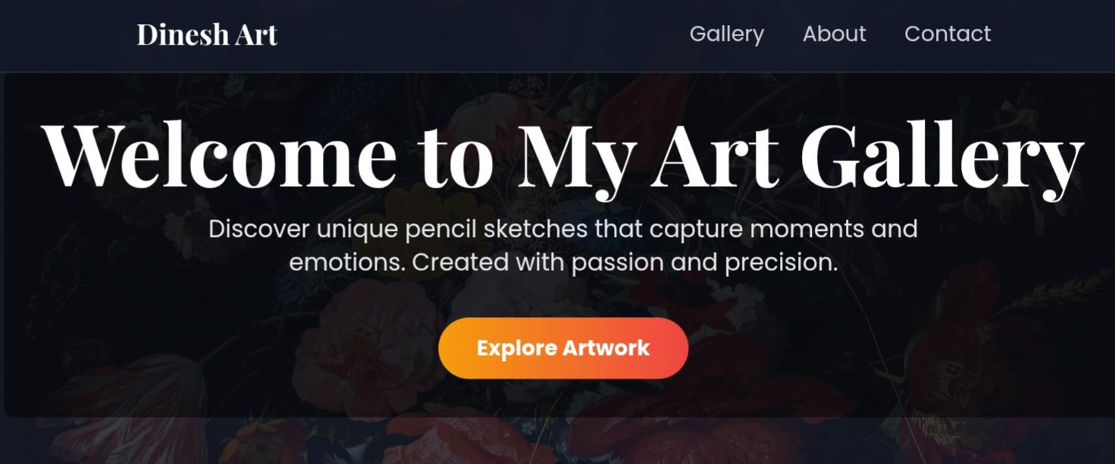
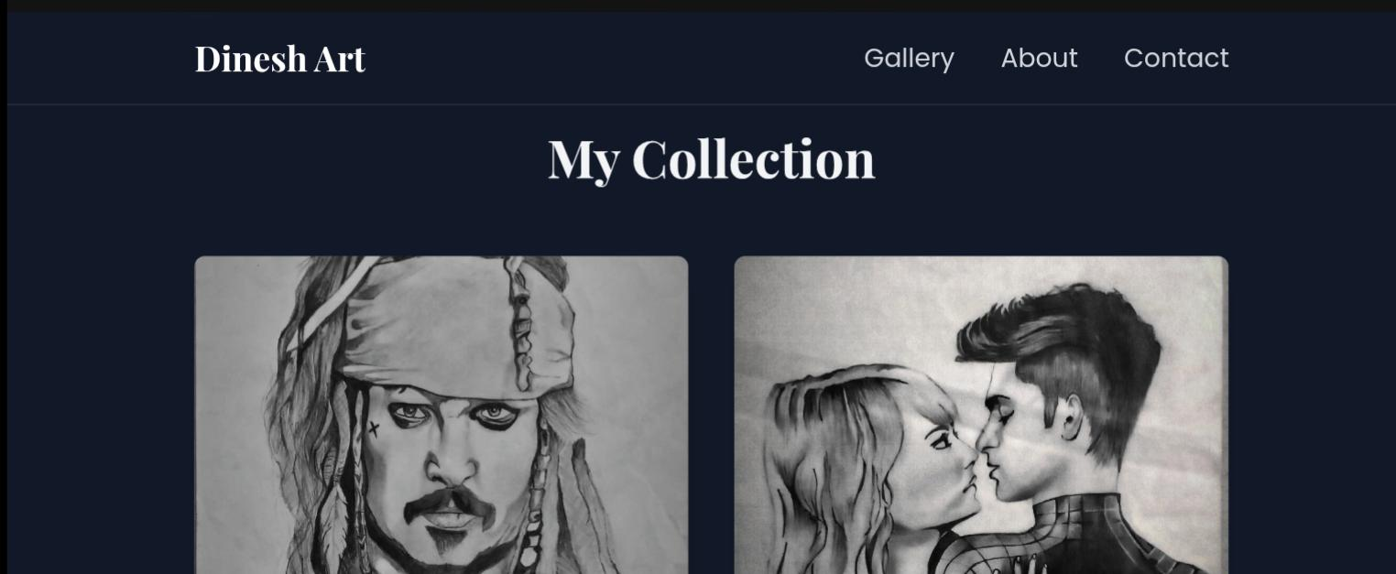
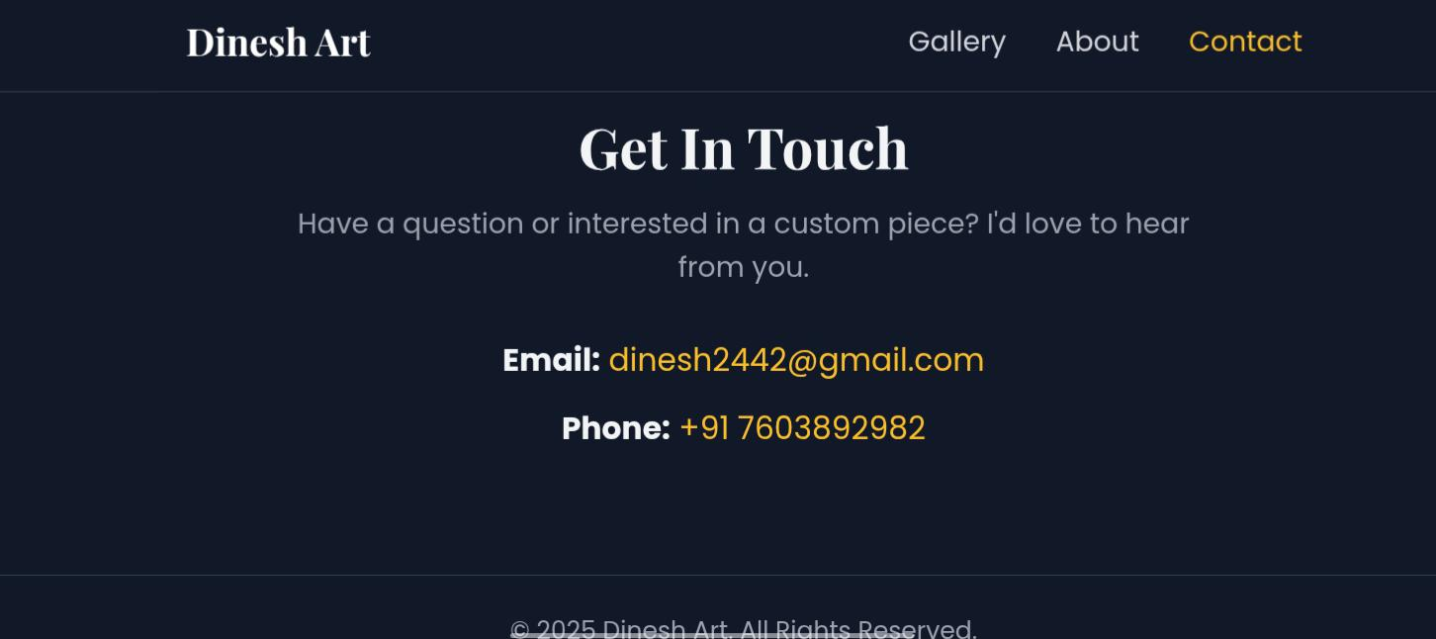
RESULTS AND SCREENSHOTS
The website effectively showcases my artwork and creative journey.
Enhanced my professional presence by providing an accessible platform for recruiters, clients, and art enthusiasts.
Improved accessibility of my projects with a responsive design across devices.
Organized presentation of my artworks, making it easier for users to explore.
Website hosted on GitHub Pages, ensuring free and reliable access anytime.

Slide 11
GITHUB LINK
https://sibu-07.github.io/website-projets-3/

Slide 12
CONCLUSION
‘Dinesh Art’ is not just a website but my digital portfolio that showcases my creativity to the world.
It provides a simple and professional way for people to explore my artwork anytime and anywhere.
The website also builds a direct connection between me and art enthusiasts through easy communication.
By combining design and technology, ‘Dinesh Art’ highlights my identity as an artist in the digital space.
With future developments, the website will grow into a more engaging platform for art lovers and buyers.

Slide 13
THANK YOU

