Slide 1


Bank of Baroda Hackathon - 2022
Technology Partner
Your Team Name : TRIO
Your team bio :Thiagarajar College of Engineering,Madurai.
Date :20/09/2022

Slide 2
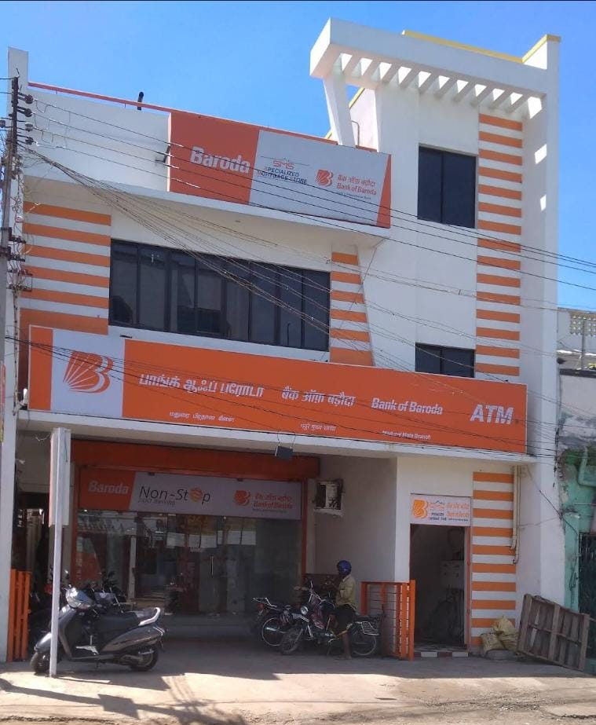
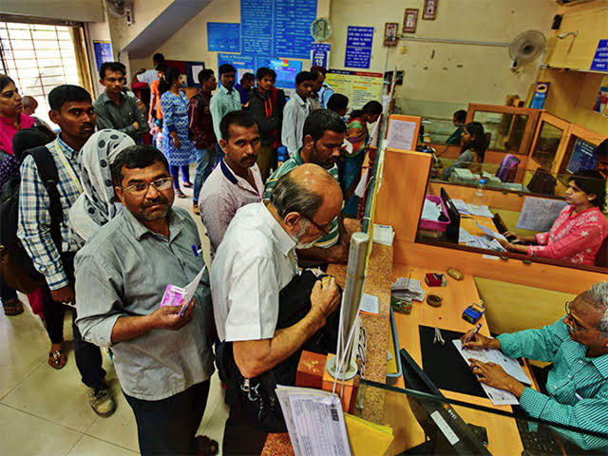
Problem Statement?
Why did you decide to solve this Problem statement?
We decided to solve the problem of getting video analytics of different parameters from the video recording will help the bank to resolve many operational issues at one particular branch such as:
To reduce the queue forming by giving token to the customers in the form of closed loop, which means the customer can enter any counter when there is less amount of queue in the particular counter.

Slide 3
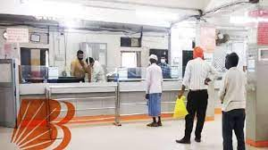
User Segment & Pain Points
Which user /advertiser segment would be early adopter of your product & why?
The bank officials and the customer of the bank would be early adopted by our product.
By our product, the bank officials and the customers of the bank are benefitted by reducing the queue in the counter and to increase the customer satisfaction.

Slide 4
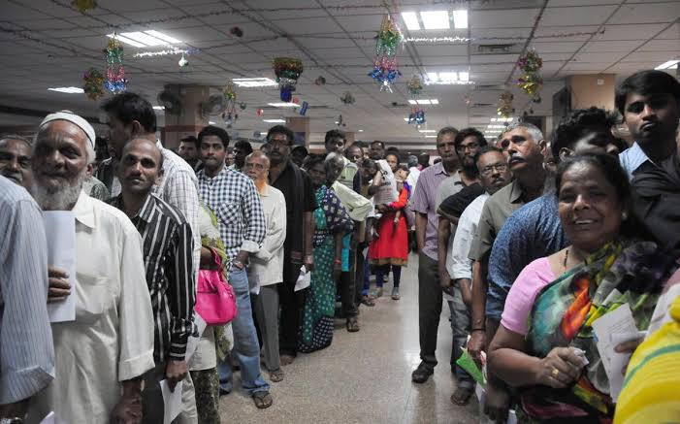
Pre-Requisite
What are the alternatives/competitive products for the problem you are solving?
The existing solution of our product is that the bank can provide the token based on random method and in the form of open loop.
So that the crowd can be increased in one particular counter even when the remaining counter are free.

Slide 5
Azure tools or resources
Microsoft Azure AI Fundamental - Natural Language Processing Microsoft Azure AI Fundamentals: Explore computer vision Microsoft Azure AI Fundamentals

Slide 6
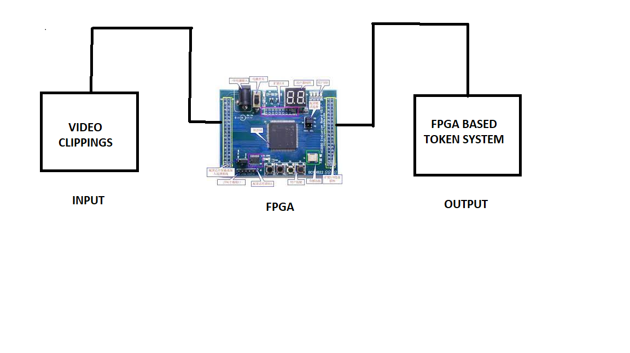
Any Supporting Functional Documents
Present your solution, talk about methodology, architecture & scalability
ARCHITECTURE:

Slide 7
Key Differentiators & Adoption Plan
How is your solution better than alternatives and how do you plan to build adoption?
By our product, the input to the FPGA was given as the video clippings that was collected by the survillence camera.
From this the FPGA can implement the operation of how the input was operated and the resulted output was given as a closed loop token system.
From the token system was changed so that the token was given to the customers based on the crowd in the particular counter.

Slide 8
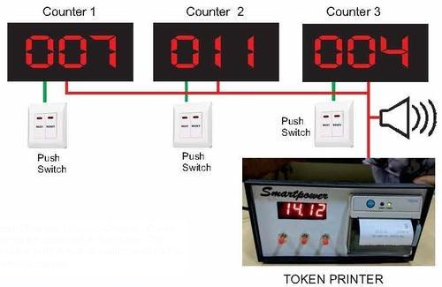
GitHub Repository Link & supporting diagrams, screenshots, if any
SEP-SEM-05/fuel-token-issuer-and-queue-management-system-admin

Slide 9
Thank You
Vinoth Thiagarajan V (Mentor)
Praveena M
Mukesh M
Dinesh R

