Slide 1

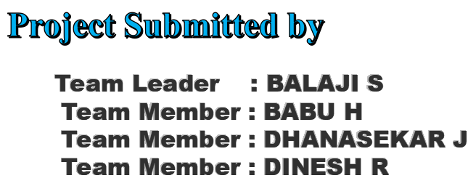
JOB APPLICATION TRACKING SYSTEM

Slide 2
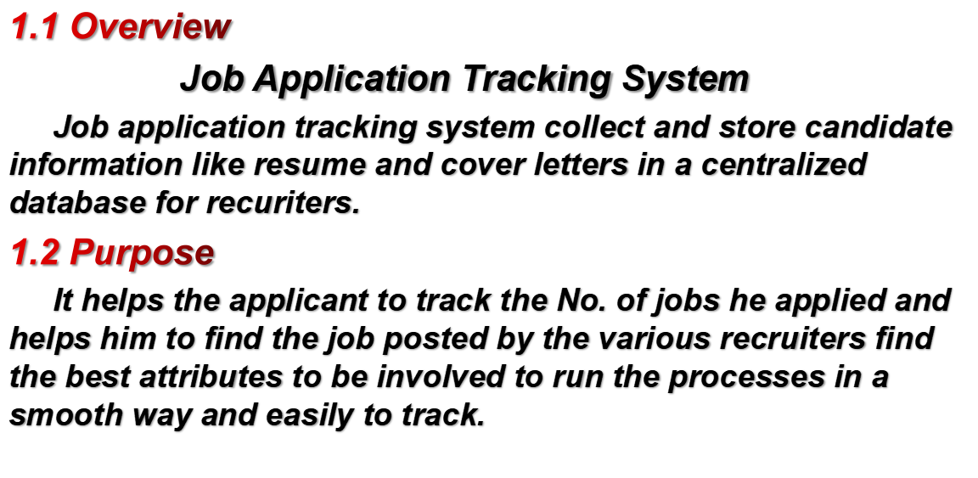
INTRODUCTION

Slide 3
MILE STONE 1: SALE FORCE
1. creattion A Developer Org.
2. Account Activate.
MILE STONE 2: OBJECT
1. Create A Custom Object For Recruiter
2. Create A Jobs, Candidate, Job Application Object And Job.
MILE STONE 3: FIELDS
1. Create The Custom Fields
2. Create of Master Detail Relationship.
3. Create A New Custom Field.
4. Creat A New Custom Field
MILE STONE 3: TAB
1. Profile
2. User
3.Sharing Rules
4. Reports

Slide 4
MILE STONE 4: PROFILE
1. Create A Cutom Profile.
2.Create A Profile With The Profile Name As “Sales Manager”
MILE STONE 5: USER
1. To Create A User
2. Create A User With A Username As “Ganesh Gelli”.
MILE STONE 6: Sharing Rules
1. Create A Sharing Rule
2. Create A Sharing Rule To Share The Records of Job Application To HR Manager.
MILE STONE 7: REPORTS
1. Create A Report
2. Create A Report Using The Objects Jobs , Candidate And Job Application.

Slide 5
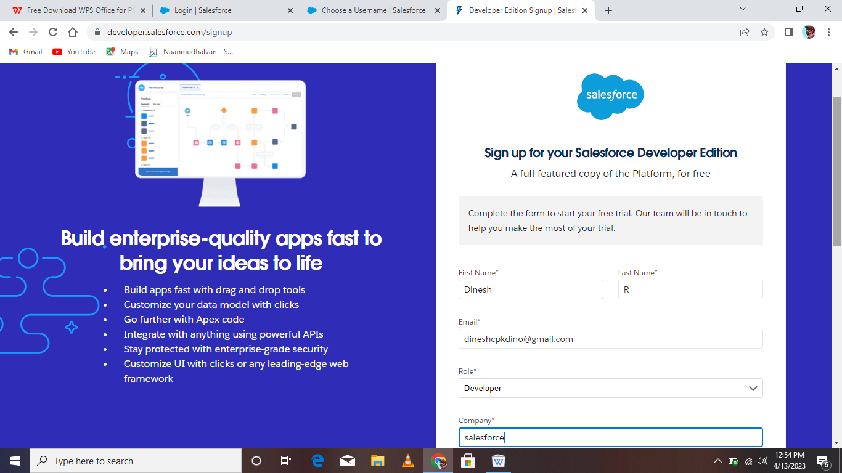
MILE STONE 1
Create Developer Account
1. Go To Developers Salesforce.com
2. Click on sign up.
3. Enter the yours details and sign up me

Slide 6
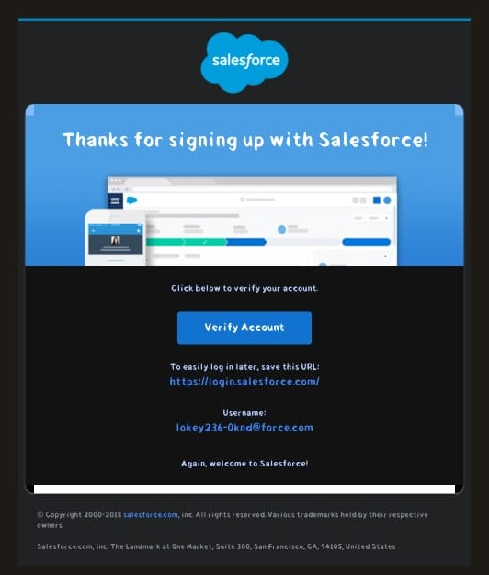
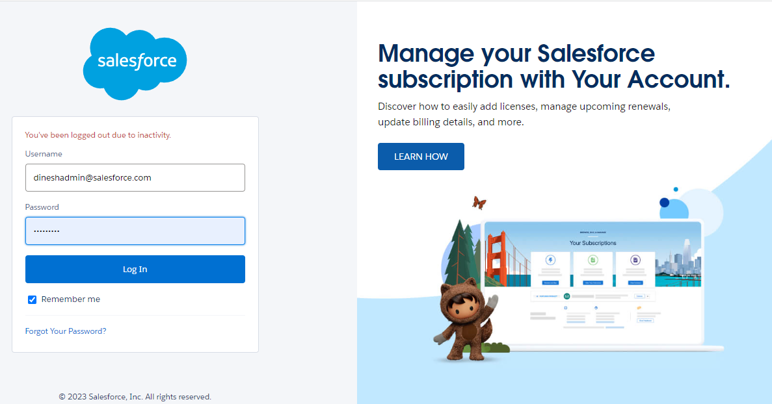
4. Go To mail and verify account activity
5. Open salesforce page and enter your user name and password

Slide 7
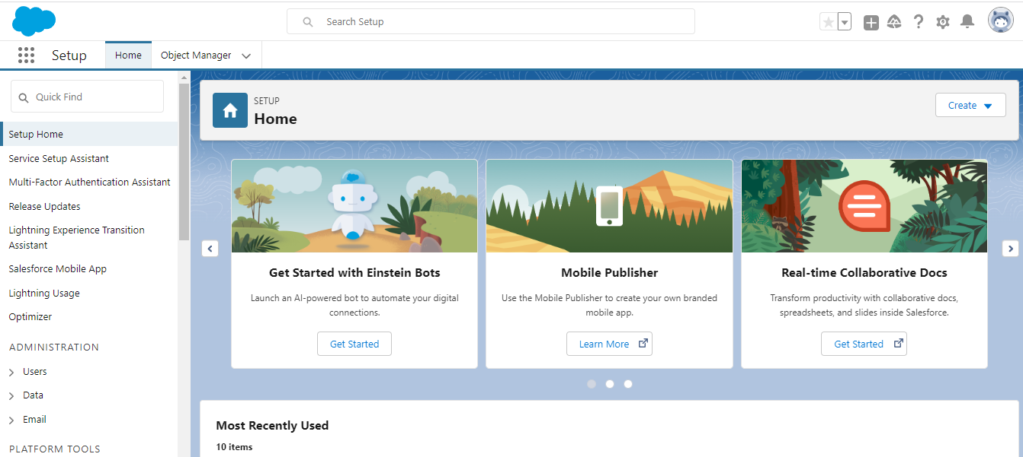

Slide 8
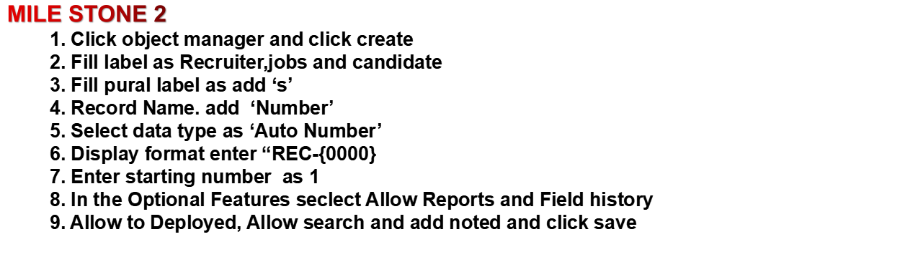
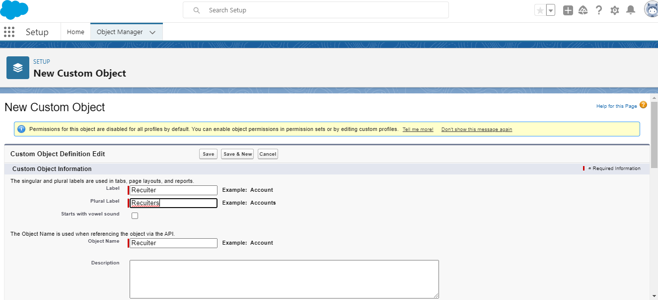

Slide 9
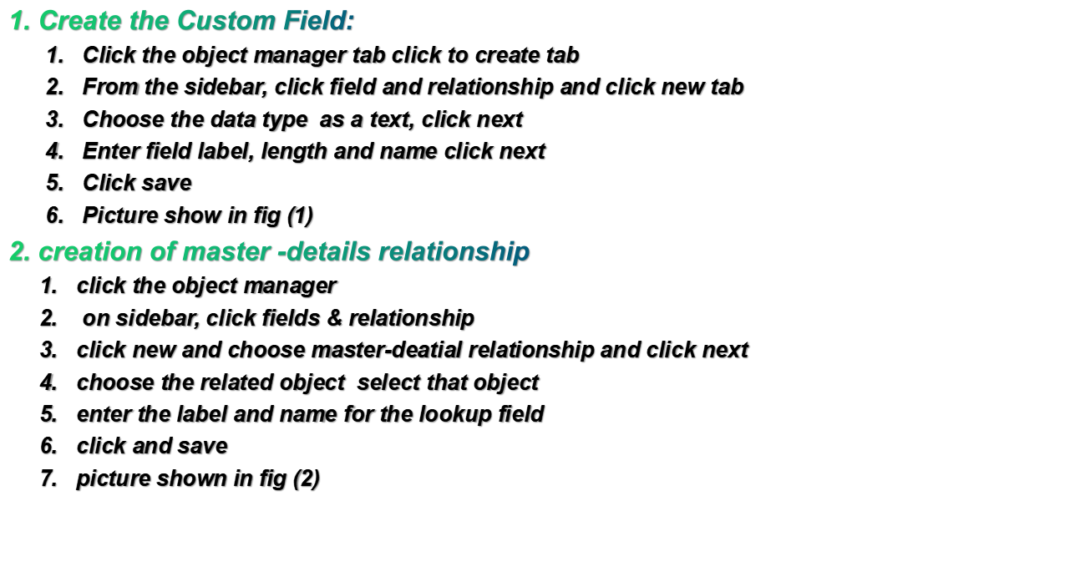
MILE STONE 2

Slide 10
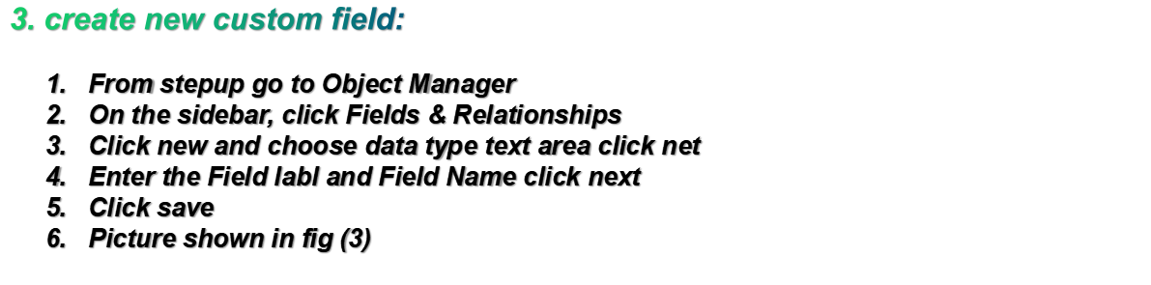
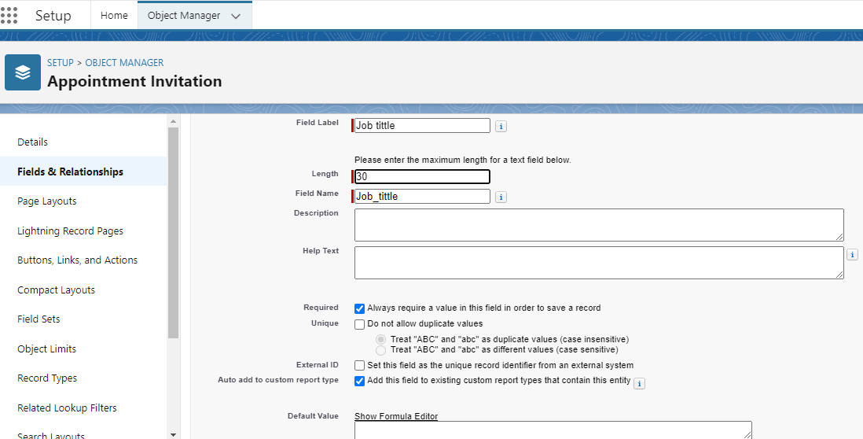
fig (1)

Slide 11
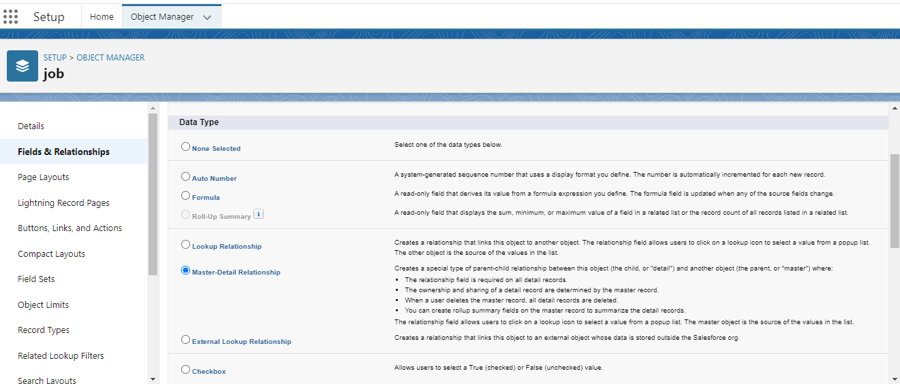
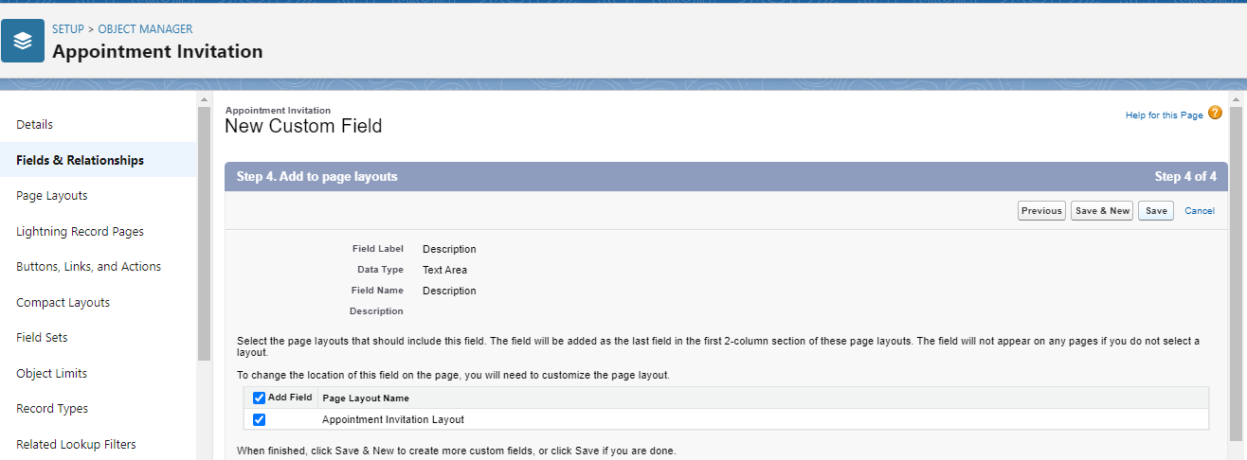
fig (2)
fig (3)

Slide 12
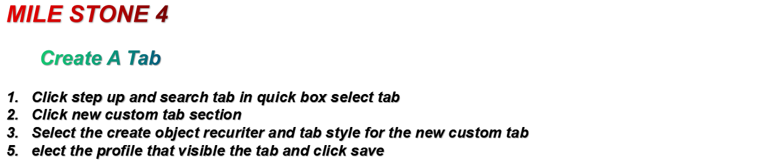
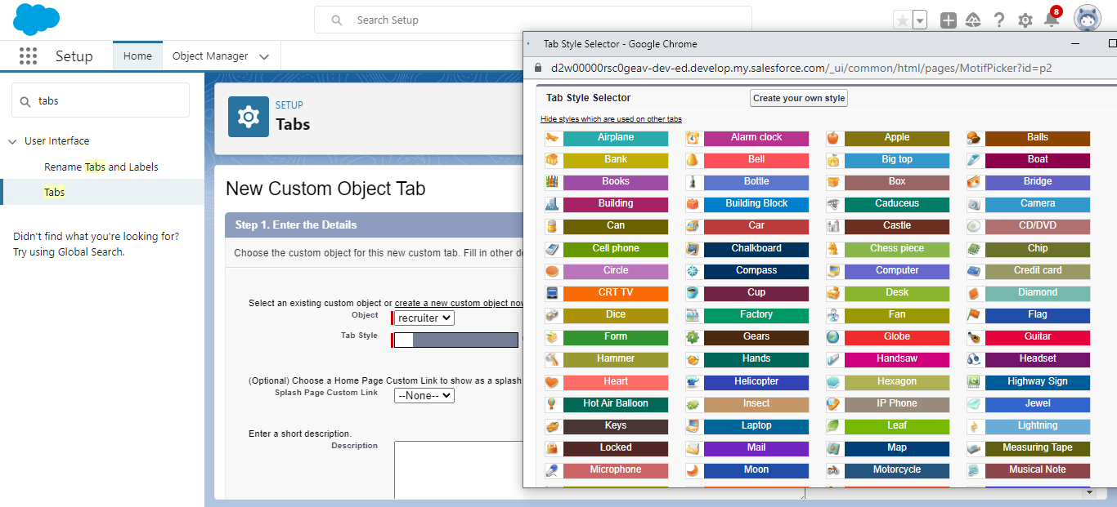

Slide 13
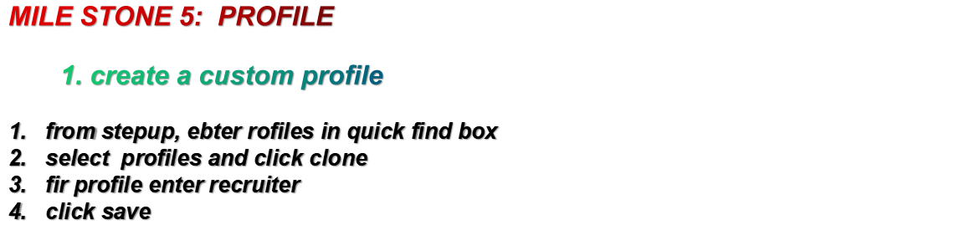
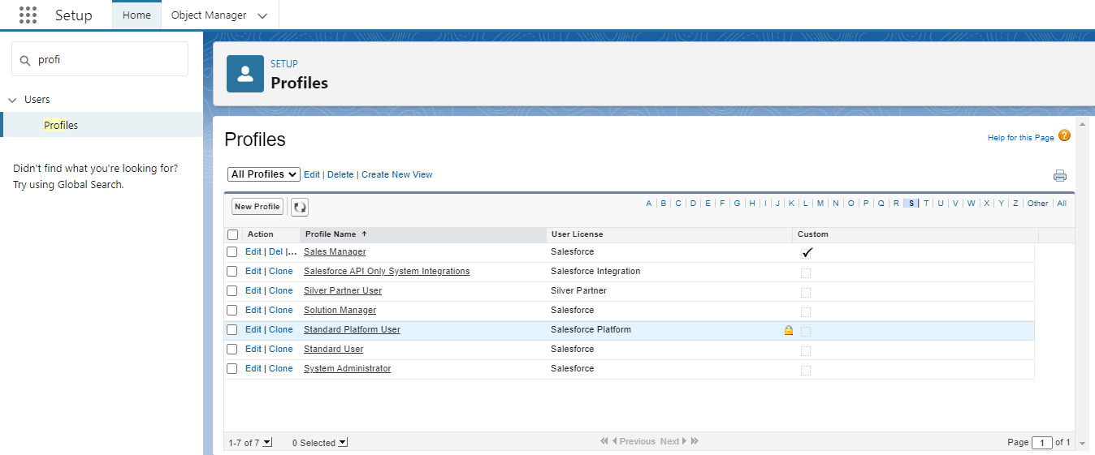

Slide 14
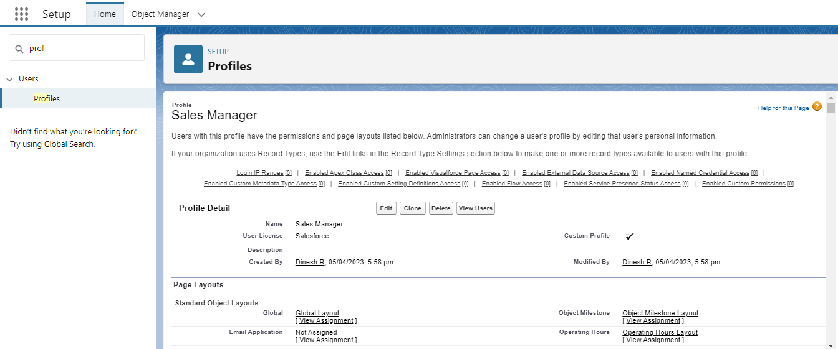

Slide 15

From stepup , enter user in quick find box, then select user
Click new user
Enter the user name HR and last name as manager
Enter the user’s name and eail address and a unique user name in the from an email address. By default,the username is the same as the email address.
Then create a new role Hr manager
Select user license as standard platform user
Select profile
Click save

Slide 16
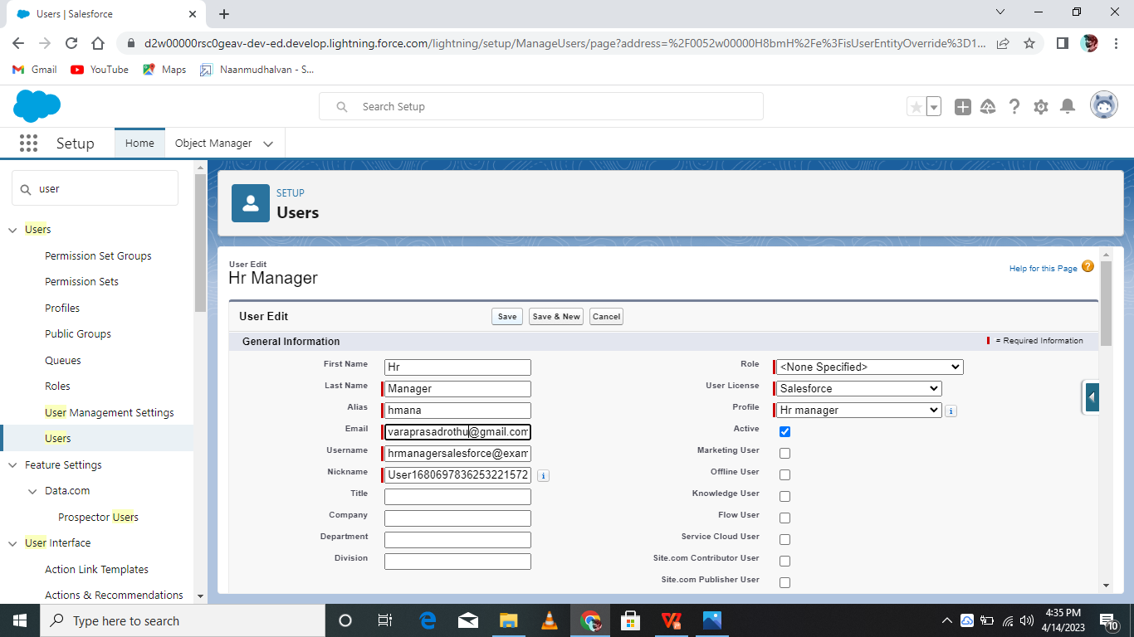

Slide 17


Slide 18

Go to quick find and search sharing setting.
Scroll down and find the candidate object where a sharing rule needs to be added, and then click on new to create a new sharing rule.
Add the label of sharing rule you to make.
Select your rule type based on he crieria.
Select the field can immediately check field fom he candidate object.
Select the operator as equal and value true.
And in selecting the user to share with the section select roles and in hat select Hr Manager.
And in the section of select the level of access for the user give access Read/Write.
Click save.

Slide 19
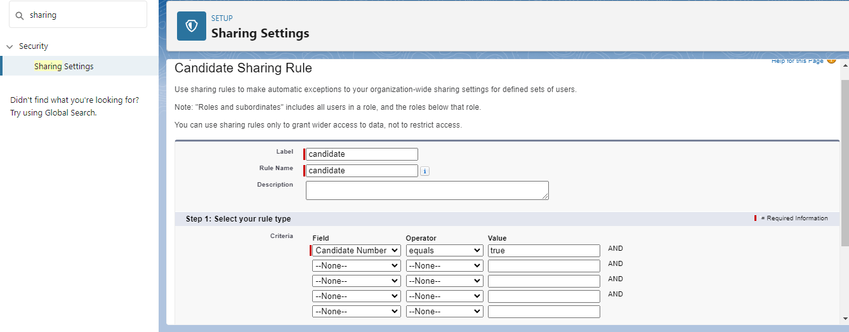

Slide 20
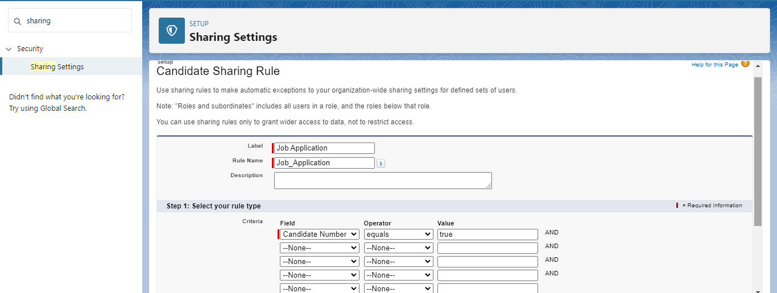

Slide 21

Click on app launcher search for reports.
Click on the new report and set category has account and contacts
And the repot type has accounts.
In the details section select the option start report.
In the filter pane select all account to show me.
and all time is created.
In the outline pane, group rows select rating and in group columns select account name .
In the columns section and type and billing city.
Save the report bygiven label name and save the folder as public.

Slide 22
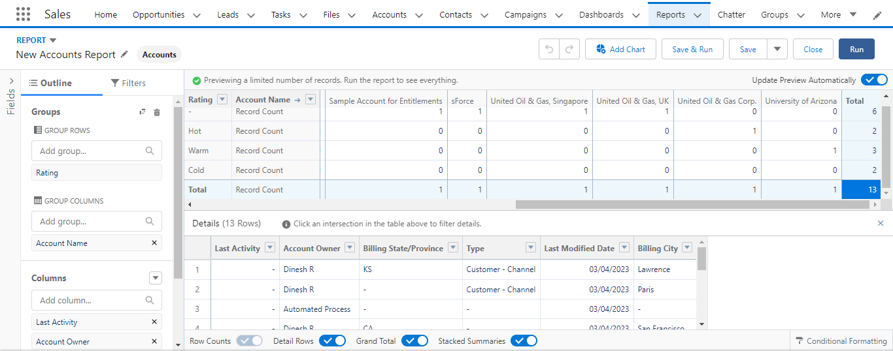

Slide 23
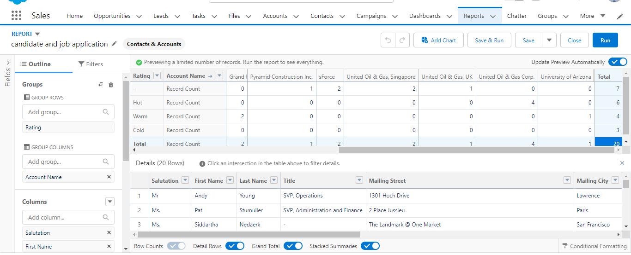

Slide 24



Slide 25


