Slide 1
Container Network Performance
Karlo Zatylny

Slide 2
Containers - So hot right now
You’re building your application and you have questions.
Which orchestrator?
Which container type?
Which Operating System?
Which networking layer?
Flannel, Docker, Calico, ...
?

Slide 3
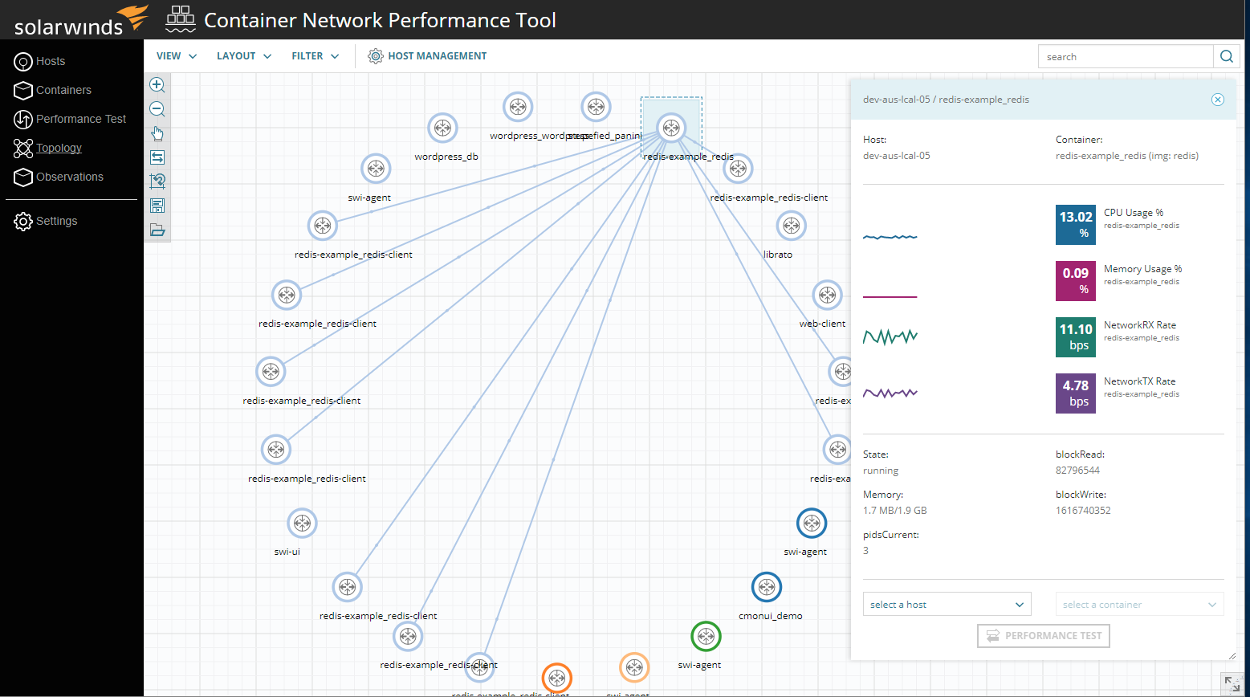
SolarWinds CMON - It’s a free tool!

Slide 4
Who is talking to what?
Within your application, you also want to know which containers are communicating with each other for optimal deployment and security
?
?

Slide 5
Price paid for software networks
Container software adds a layer for network routing, DNS, and other network functions
Containers
Container Networking Layer
Physical Network

Slide 6
Push as many bits as you can
When you have important bandwidth needs, you need to know how much you can push from one container to another.
Where there is software, there are limits!
bridge host overlay underlay

Slide 7
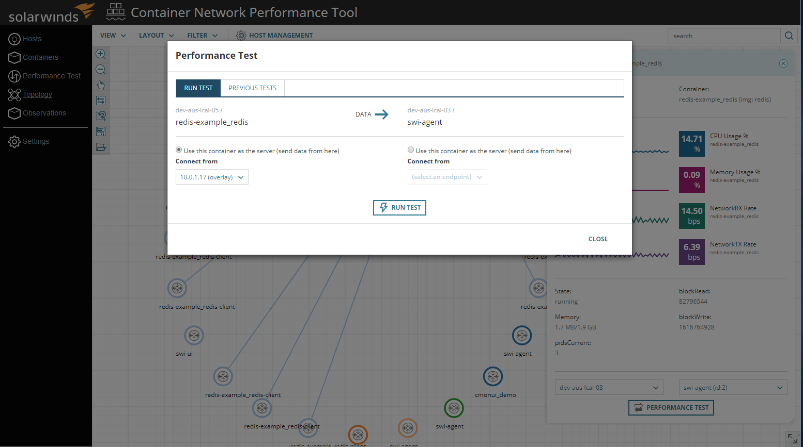
How much can you send and receive?

Slide 8
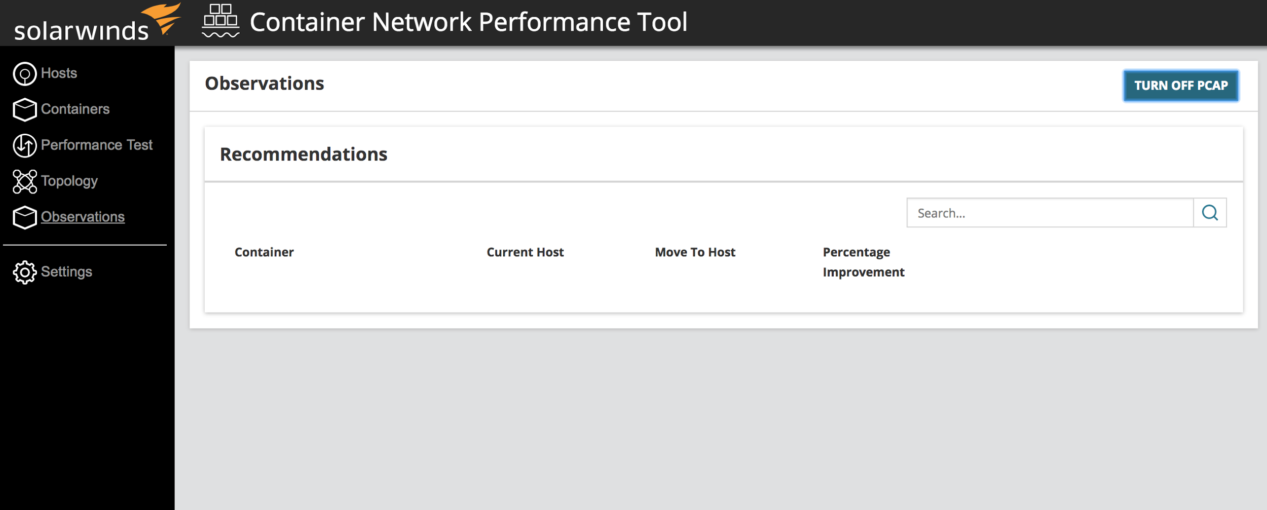
Playing Chess with Containers
CMON Observations tell you where to place containers relative to each other to minimize latency

Slide 9
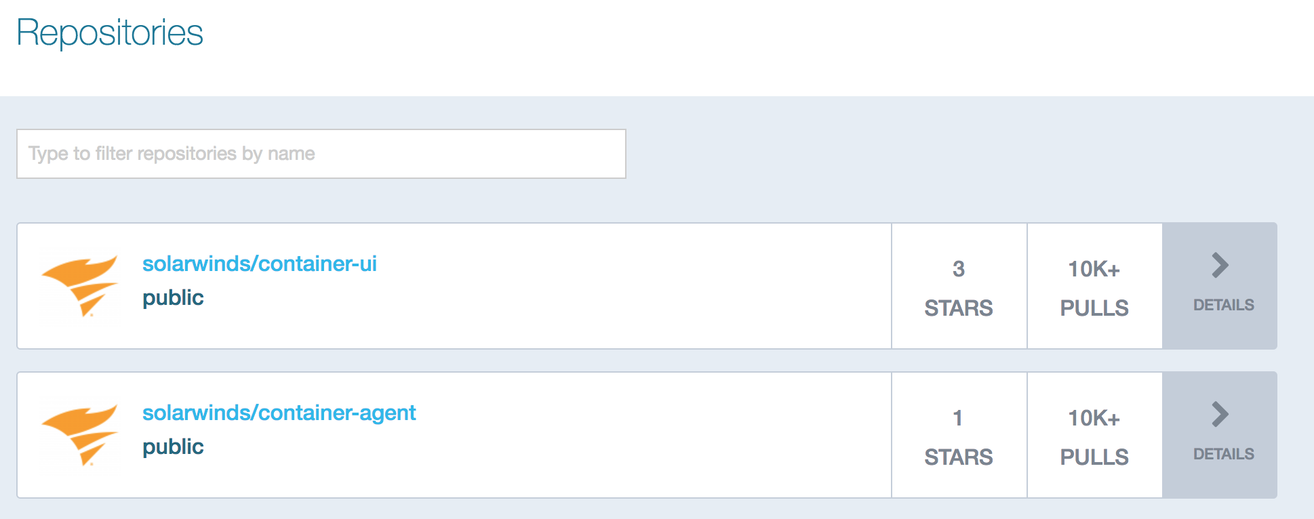
It’s on DockerHub!

Slide 10
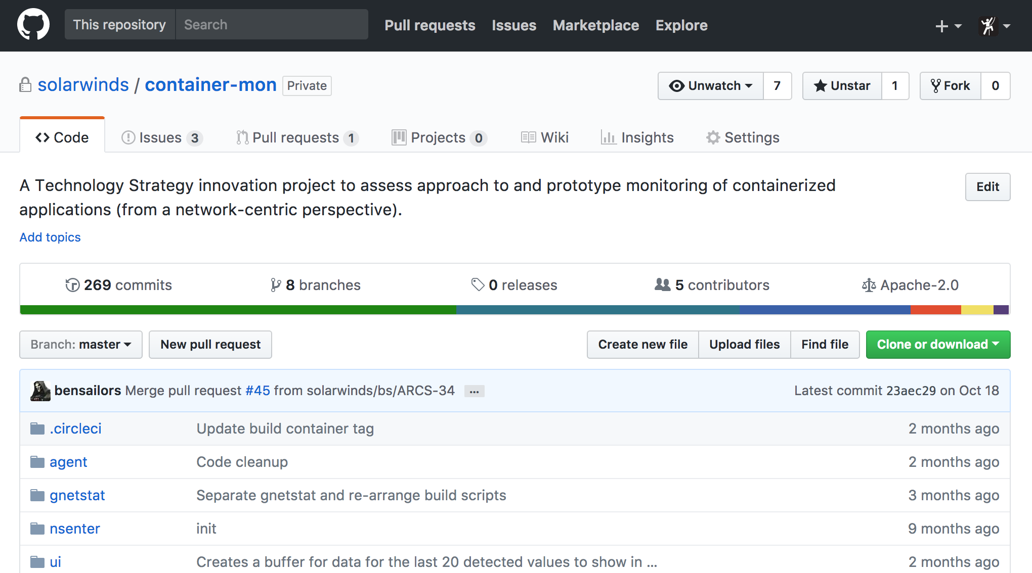
Open issues on GitHub - we’re open!
https://github.com/solarwinds/containers

Slide 11
Legal stuff that lawyers want me to show

