Slide 2
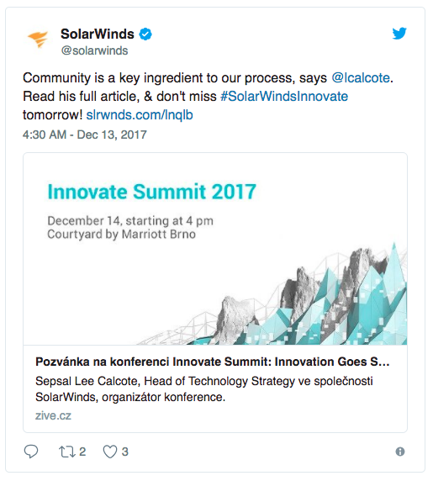
#SolarWindsInnovate

Slide 3
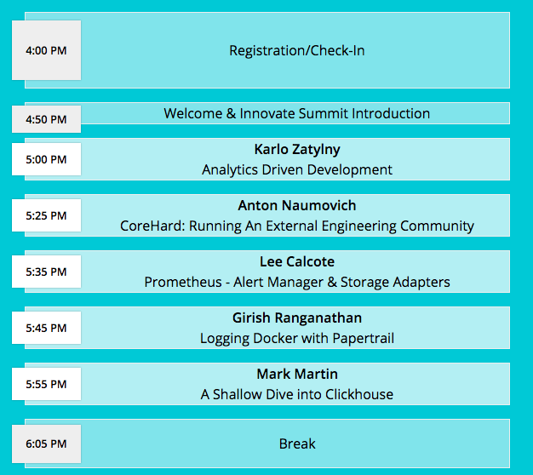

Schedule

Slide 4
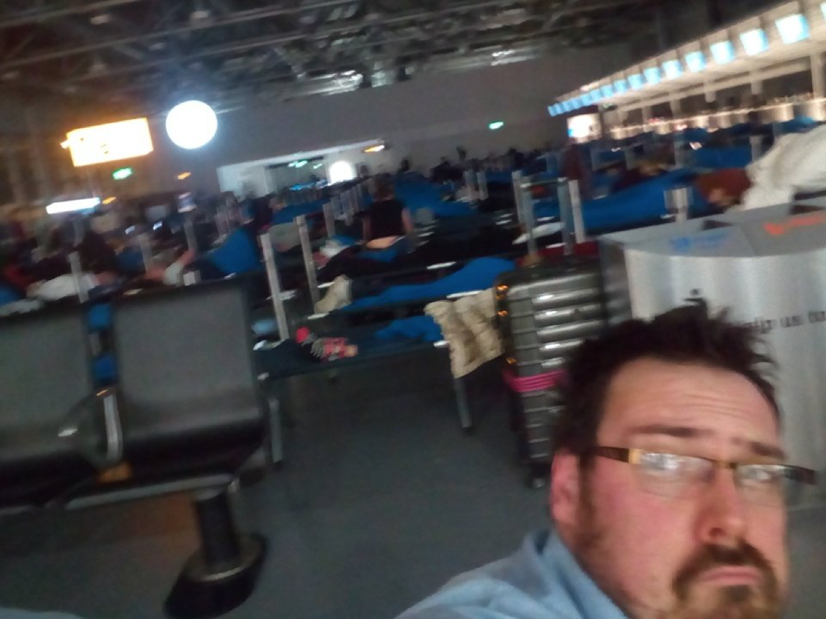
Not everyone could make it
Oliver sends his regrets.

Slide 5
The SolarWinds and SolarWinds Cloud trademarks are the exclusive property of SolarWinds Worldwide, LLC and its affiliates and may be registered or pending registration with the U.S. Patent and Trademark Office and in other countries. All other SolarWinds and SolarWinds Cloud trademarks, service marks, and logos may be common law marks or are registered or pending registration. All other trademarks mentioned herein are used for identification purposes only and are trademarks (and may be registered trademarks) of their respective companies.

