Slide 1

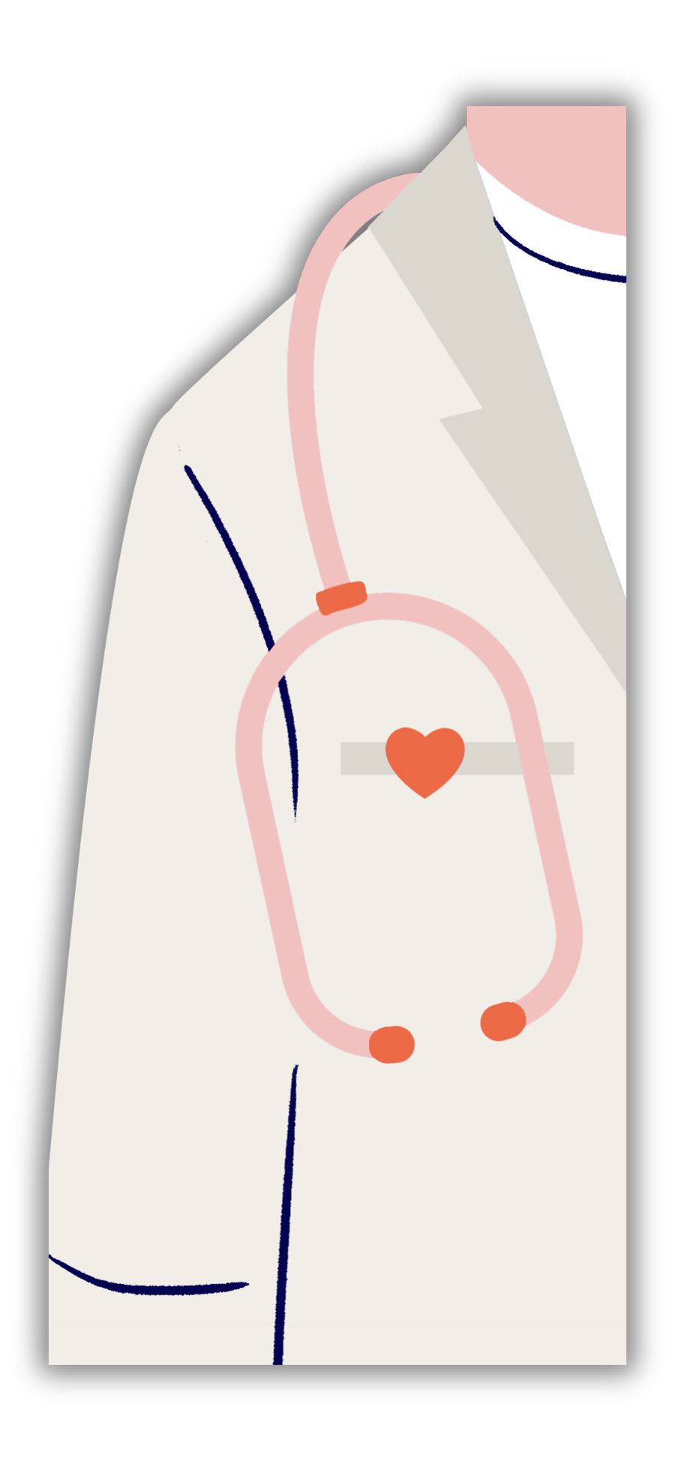


SAFE BAND
AI-POWERED SMART HEALTH
MONITORING SYSTEM
R26-IT-057

Slide 2






INTRODUCTION
  Safe Band is a multi-component IoT health platform built around an Android smartwatch.
  It continuously monitors patient vitals, detects emergencies using Machine Learning, dispatches ambulances automatically, and supports clinical staff through intelligent dashboards all designed specifically for Sri Lanka's healthcare landscape.
Emergency Detection
Smart Ambulance Dispatch
Ward Monitoring & Alerts
Heart Risk Prediction

Slide 3


PROBLEMS
  Emergency healthcare systems in Sri Lanka still rely on manual processes and delayed communication
  Most existing healthcare solutions:
  Provide only basic monitoring
  Lack real-time emergency response
  Are not connected with hospitals and ambulance services
• Patients with critical conditions are not continuously monitored.
• Ambulance dispatch and hospital coordination are often delayed.
• Existing smart wearables mainly focus on fitness tracking, not emergency healthcare.
• Hospitals face difficulties in monitoring multiple patients efficiently.
• Lack of AI-powered predictive healthcare and centralized emergency management systems.

Slide 4

IMPACT / GRAVITY
• Delayed emergency response increases the risk of preventable deaths.
• Lack of continuous monitoring reduces early detection of critical conditions.
• Difficulty in tracking patient health conditions for hospitals and healthcare staff.
• Manual ambulance dispatch reduces emergency response efficiency.
• Lack of predictive healthcare systems increases pressure on hospitals.
• AI-powered monitoring improves faster emergency response and patient safety.
• Real-time alerts and hospital notifications enhance healthcare coordination.

Slide 5
Main Objectives
  To design and develop an AI-powered smart wearable system that continuously monitors critical vital signs such as Heart Rate, Blood Pressure, SpO2, and ECG in real time.
  To build a Machine Learning-based Emergency Detection System that can automatically identify critical health conditions and trigger instant alerts.
  To develop a Smart Ambulance Dispatch System that uses GPS and Machine Learning to identify the nearest hospital and speed up emergency response.
  To create a centralized Hospital Ward Monitoring system that helps doctors and nurses track multiple patients and prioritize emergency cases efficiently.
  To implement a predictive Heart Risk Assessment model that identifies high-risk patients in advance, enabling proactive and personalized healthcare monitoring.

Slide 6

TARGET USERS & BENEFICIARIES
  Primary Users: Cardiac patients, elderly individuals, and patients with chronic health conditions
  Secondary Users: Doctors, nurses, ambulance staff, and emergency healthcare teams
  Institutions / Society: Hospitals, emergency response services, and the Sri Lankan healthcare sector

Slide 7

SOLUTIONS
• Single integrated platform for patient monitoring, emergency detection, hospital notification, and ambulance dispatch
• Real-time monitoring of vital signs including Heart Rate, and ECG.
• Machine Learning-based emergency detection and health risk prediction
• Smart ambulance dispatch system with nearest hospital identification using GPS tracking
• Centralized hospital ward dashboard for real-time patient monitoring and alert management
• Automated emergency alerts and hospital notifications for faster medical response
• Predictive healthcare analytics to identify critical conditions before emergencies occur
• Cloud-based scalable architecture for future healthcare system expansion and integration

Slide 8
THANK YOU
R26-IT-057

