Slide 1
FAIRifying Rivers
A FAIR Data Engineering Project
Denislav Dinev – s3137090
Group 7

Slide 2
Outline for Today
Introduction
Data Description
Stakeholder Analysis
FAIRification Goals
FAIRification Process
Questions
Metadata Creation

Slide 3
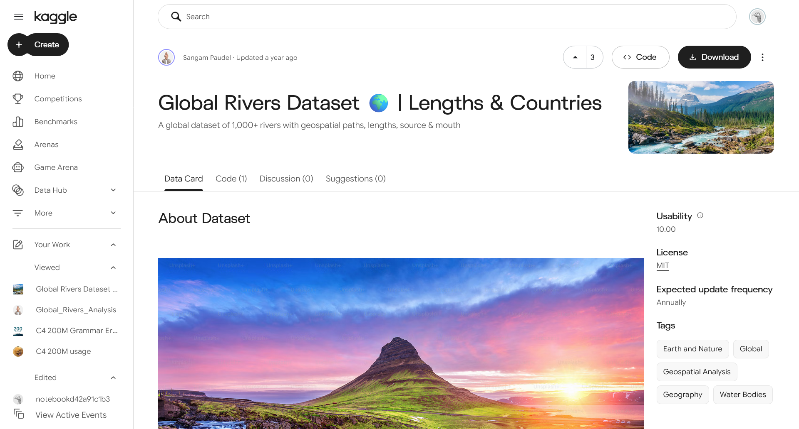
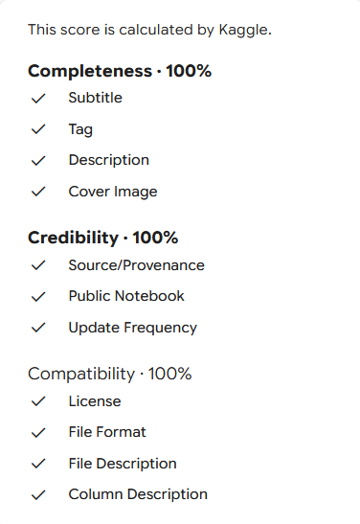

Global Rivers Dataset
[1] Global Rivers Dataset 🌍 | Length and Countries: https://www.kaggle.com/datasets/sangampaudel530/global-rivers-dataset-lengths-and-countries
Notes:
1082 unique river entries
MIT license
Information about geographical location, countries passed, continent

Slide 4
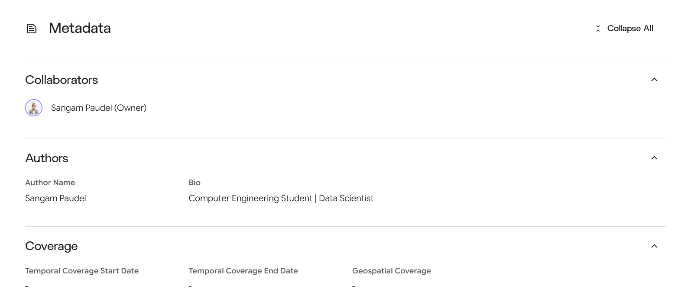
Global Rivers Dataset
[1] Global Rivers Dataset 🌍 | Length and Countries: https://www.kaggle.com/datasets/sangampaudel530/global-rivers-dataset-lengths-and-countries

Slide 5
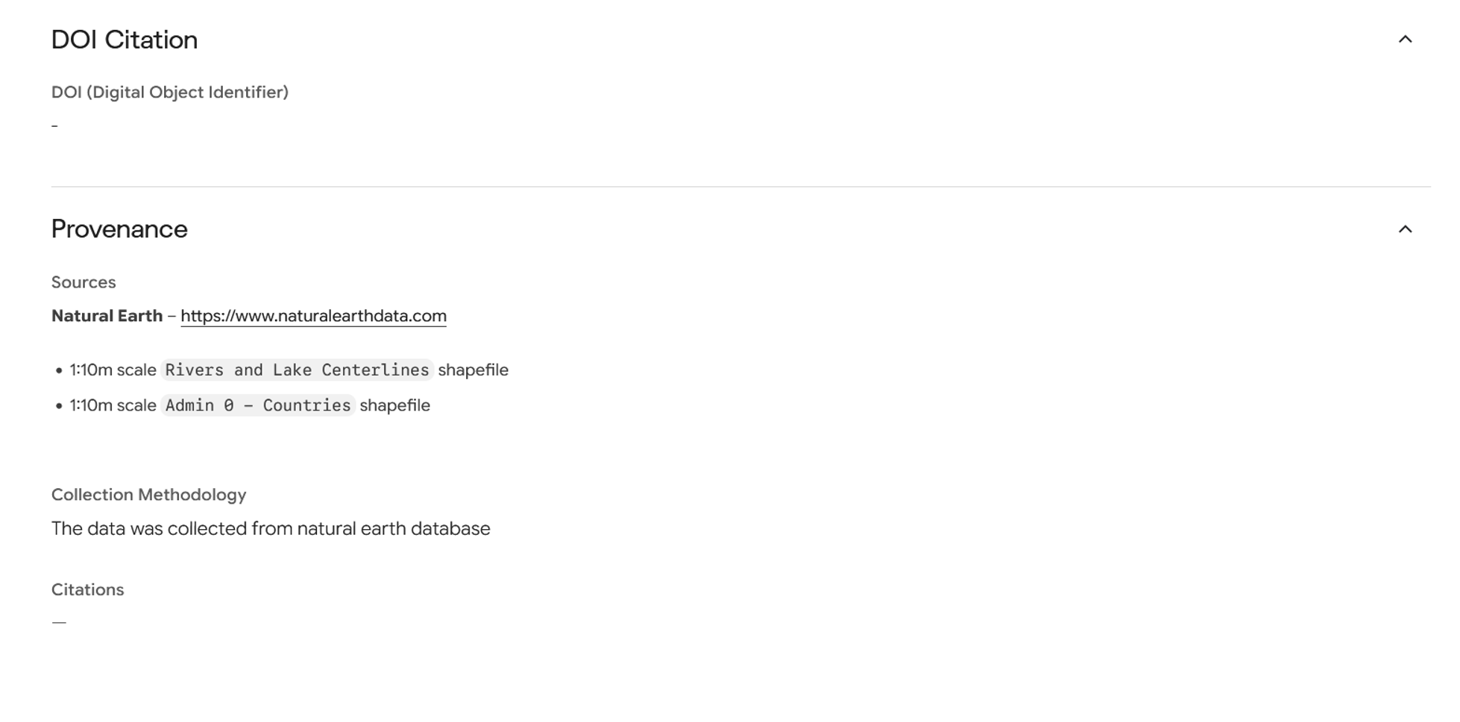
Global Rivers Dataset
[1] Global Rivers Dataset 🌍 | Length and Countries: https://www.kaggle.com/datasets/sangampaudel530/global-rivers-dataset-lengths-and-countries

Slide 6
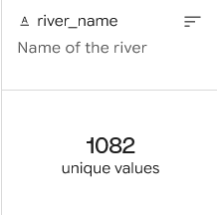
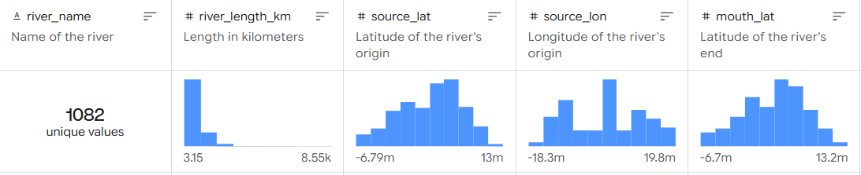
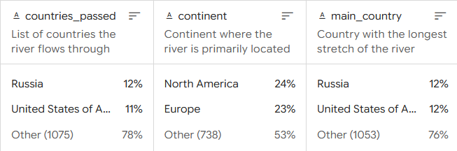
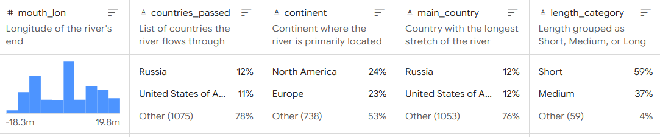
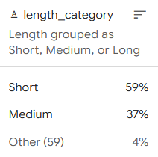
Global Rivers Dataset
[1] Global Rivers Dataset 🌍 | Length and Countries: https://www.kaggle.com/datasets/sangampaudel530/global-rivers-dataset-lengths-and-countries

Slide 7
Initial FAIRness
Accessible:
A1. (Meta)data are retrievable by their identifier using a standardized communications protocol
A1.1 The protocol is open, free, and universally implementable
A1.2. The protocol allows for an authentication and authorization procedure, where necessary
A2. Metadata are accessible, even when the data are no longer available
Findable:
F1. (meta)data are assigned a globally unique and persistent identifier
F2. Data are described with rich metadata
F3. Metadata clearly and explicitly include the identifier of the data it describes
F4. (Meta)data are registered or indexed in a searchable resource
Accessible:
A1. (Meta)data are retrievable by their identifier using a standardized communications protocol
A1.1 The protocol is open, free, and universally implementable
A1.2. The protocol allows for an authentication and authorization procedure, where necessary
A2. Metadata are accessible, even when the data are no longer available
Findable:
F1. (meta)data are assigned a globally unique and persistent identifier
F2. Data are described with rich metadata
F3. Metadata clearly and explicitly include the identifier of the data it describes
F4. (Meta)data are registered or indexed in a searchable resource

Slide 8
Initial FAIRness
Interoperable:
I1. (Meta)data use a formal, accessible, shared, and broadly applicable language for knowledge representation
I2. (Meta)data use vocabularies that follow FAIR principles
I3. (Meta)data include qualified references to other (meta)data
Reusable:
R1. (Meta)data are richly described with a plurality of accurate and relevant attributes
R1.1. (Meta)data are released with a clear and accessible data usage license
R1.2. (Meta)data are associated with detailed provenance
R1.3. (Meta)data meet domain- relevant community standards
Interoperable:
I1. (Meta)data use a formal, accessible, shared, and broadly applicable language for knowledge representation
I2. (Meta)data use vocabularies that follow FAIR principles
I3. (Meta)data include qualified references to other (meta)data
Reusable:
R1. (Meta)data are richly described with a plurality of accurate and relevant attributes
R1.1. (Meta)data are released with a clear and accessible data usage license
R1.2. (Meta)data are associated with detailed provenance
R1.3. (Meta)data meet domain- relevant community standards

Slide 9
FAIRification Goals
Understand & Evaluate
Identify & Connect
Share & Reuse
Notes:
Understand and evaluate: improve interpretability, improve transparency and provenance
Identify and connect: improve identification of individual rivers, connect to external resources
Share and reuse: improve discoverability and access, support independent reuse, preserve traceability of enrichment

Slide 10
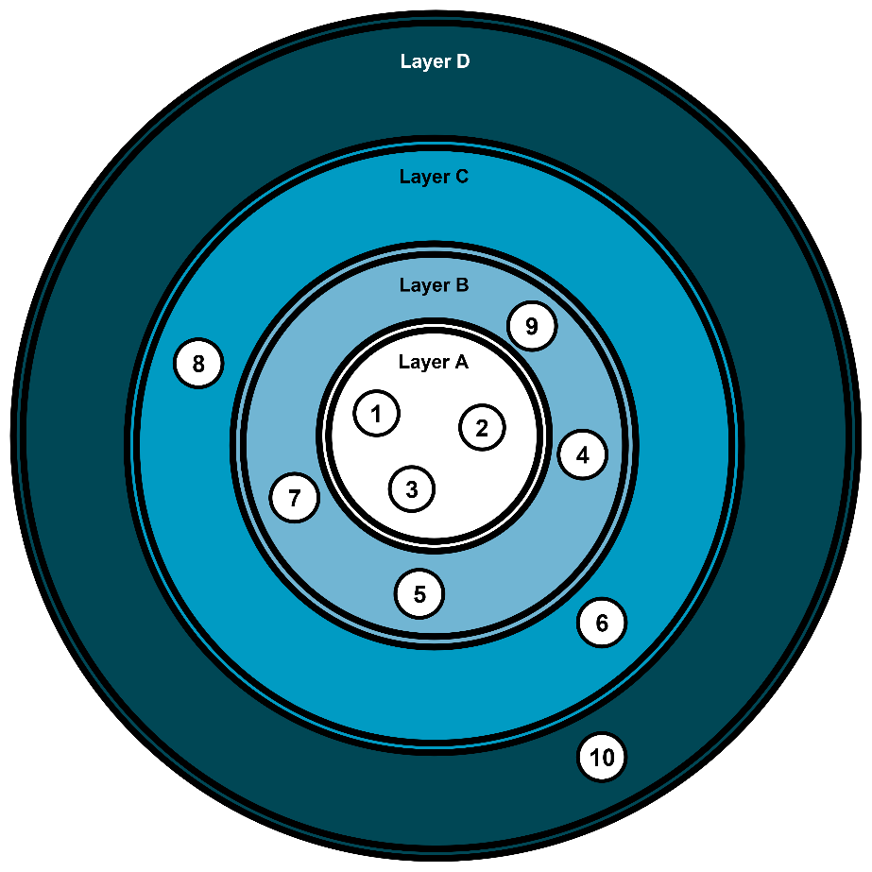
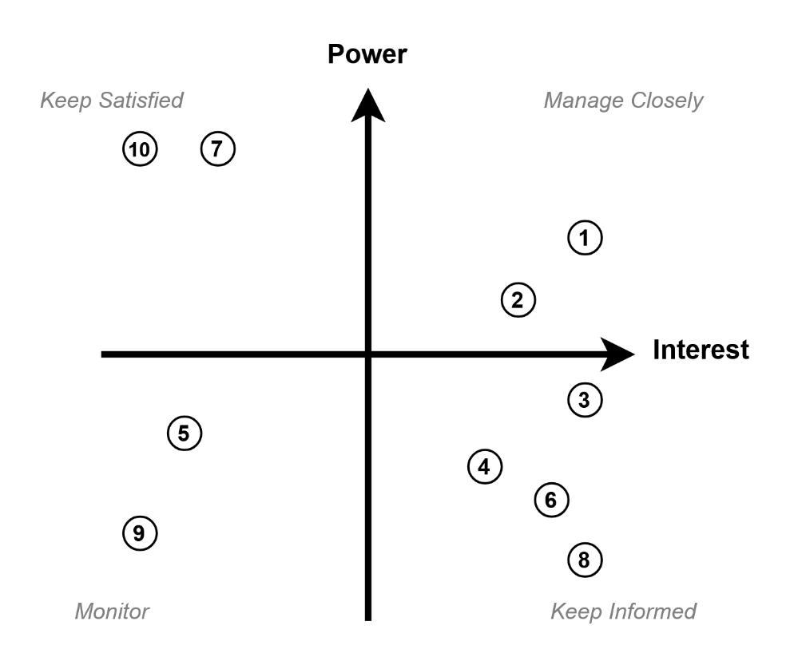
FAIRification Stakeholders
Notes:
Internal: project team, data
Reuse stakeholders: gis, hydrology researchesrs, data scientiest

Slide 11
FAIRification Requirements
ID | Requirement | Type | Related Goal(s) | Priority | Feasibility
1 | The meaning, type unit, and origin of attributes shall be explicitly documented. | Non-functional | G1, G6 | Must have | Hight
2 | Derived classifications should have explicit and reproducible criteria. | Non-functional | G1, G2, G6 | Must have | High
3 | Relevant geographic entities should be linked with external persistent identifiers. | Functional | G3, G4 | Must have | Medium
4 | Ambiguous or unmatched entities should remain uniquely identifiable rather than being treated as uncertain. | Functional | G3, G4 | Should have | Medium
5 | FAIRified river entities should contain unique persistent identifiers. | Functional | G3, G5, G6 | Must have | High
6 | Target resources should have machine-operable semantic representation. | Functional | G3, G4, G6 | Must have | Medium
7 | Data and resources which have been enriched or modified should remain distinct from untransformed ones. | Non-functional | G2, G7 | Must have | Medium
8 | Dataset-level metadata should contain information regarding the dataset’s title, creators, maintainers, source, version, license, publication methodology, FAIRification methodology, and relation to the original dataset. | Functional | G2, G5, G6, G7 | Must have | Medium
9 | The final FAIRified data should be made available in standardized format, e.g., CSV, TSV, JSON, RDF. | Non-functional | G5, G6 | Should have | High
10 | Real-time automatic monitoring and updates should be applied to all entries based on the baseline Natural Earth data. | Functional | G1, G3, G4 | Could have | Medium
11 | Incorrect, incomplete, or misleading data entries should be automatically detected and mitigated. | Functional | G3, G4, G7 | Will not have | Low
12 | Entities which cannot be automatically matched with 100% certainty to a relevant external object should be manually examined and connected. | Non-functional | G1, G3, G4, G5 | Will not have | Low
13 | Data, metadata, vocabularies, identifiers, and external resources should comply with existing licensing or regulatory restrictions. | Constraint | G2, G4, G5, G6, G7 | Must have | High
14 | The FAIRified resource should be published in a publicly available repository allowing for independent and easy download of the data, metadata, or other related resources. | Functional | G1, G5, G6 | Should have | High
15 | The FAIRification project should be finished before October 30 2026 | Constraint | - | Must have | High
ID | Requirement | Type | Related Goal(s) | Priority | Feasibility
1 | The meaning, type unit, and origin of attributes shall be explicitly documented. | Non-functional | G1, G6 | Must have | Hight
2 | Derived classifications should have explicit and reproducible criteria. | Non-functional | G1, G2, G6 | Must have | High
3 | Relevant geographic entities should be linked with external persistent identifiers. | Functional | G3, G4 | Must have | Medium
4 | Ambiguous or unmatched entities should remain uniquely identifiable rather than being treated as uncertain. | Functional | G3, G4 | Should have | Medium
5 | FAIRified river entities should contain unique persistent identifiers. | Functional | G3, G5, G6 | Must have | High
6 | Target resources should have machine-operable semantic representation. | Functional | G3, G4, G6 | Must have | Medium
7 | Data and resources which have been enriched or modified should remain distinct from untransformed ones. | Non-functional | G2, G7 | Must have | Medium
8 | Dataset-level metadata should contain information regarding the dataset’s title, creators, maintainers, source, version, license, publication methodology, FAIRification methodology, and relation to the original dataset. | Functional | G2, G5, G6, G7 | Must have | Medium
9 | The final FAIRified data should be made available in standardized format, e.g., CSV, TSV, JSON, RDF. | Non-functional | G5, G6 | Should have | High
10 | Real-time automatic monitoring and updates should be applied to all entries based on the baseline Natural Earth data. | Functional | G1, G3, G4 | Could have | Medium
11 | Incorrect, incomplete, or misleading data entries should be automatically detected and mitigated. | Functional | G3, G4, G7 | Will not have | Low
12 | Entities which cannot be automatically matched with 100% certainty to a relevant external object should be manually examined and connected. | Non-functional | G1, G3, G4, G5 | Will not have | Low
13 | Data, metadata, vocabularies, identifiers, and external resources should comply with existing licensing or regulatory restrictions. | Constraint | G2, G4, G5, G6, G7 | Must have | High
14 | The FAIRified resource should be published in a publicly available repository allowing for independent and easy download of the data, metadata, or other related resources. | Functional | G1, G5, G6 | Should have | High
15 | The FAIRification project should be finished before October 30 2026 | Constraint | - | Must have | High
ID | Requirement | Type | Related Goal(s) | Priority | Feasibility
1 | The meaning, type unit, and origin of attributes shall be explicitly documented. | Non-functional | G1, G6 | Must have | Hight
2 | Derived classifications should have explicit and reproducible criteria. | Non-functional | G1, G2, G6 | Must have | High
3 | Relevant geographic entities should be linked with external persistent identifiers. | Functional | G3, G4 | Must have | Medium
4 | Ambiguous or unmatched entities should remain uniquely identifiable rather than being treated as uncertain. | Functional | G3, G4 | Should have | Medium
5 | FAIRified river entities should contain unique persistent identifiers. | Functional | G3, G5, G6 | Must have | High
6 | Target resources should have machine-operable semantic representation. | Functional | G3, G4, G6 | Must have | Medium

Slide 12
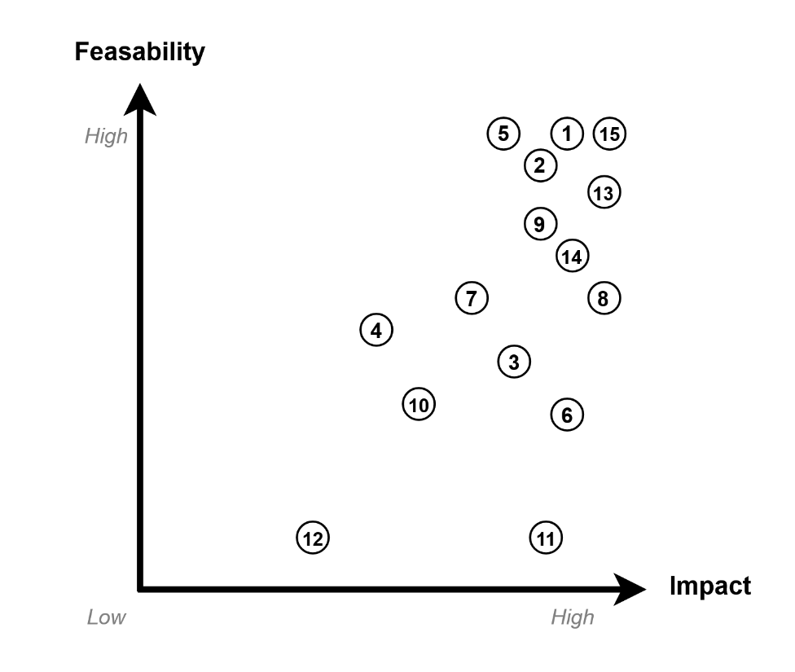
FAIRification Requirements

Slide 13
Semantic Types
ID | Semantic Types
S1 | River
S2 | Geographical Location
S3 | Administrative Location
S4 | River Characteristics
S5 | River Classification
S6 | Geographical Relationship
S7 | Identification and Linking

Slide 14
Competency Questions
ID | Competency Question
Q1 | Which rivers pass through multiple countries?
Q2 | Which countries are passed by the largest number of rivers?
Q3 | How does the distribution of short, medium, and long rivers differ between the different countries and continents?
Q4 | Which continent contains the biggest number of long rivers?
Q5 | How many unique river bodies share the same name?
Q6 | How does the average river length vary between countries?
Q7 | Which countries are the main country for the largest number of rivers?
Q8 | Are rivers which only pass within one country less likely to be classified as long compared to those that flow through multiple?
Q9 | Do different river entities that share the same name flow through the same country?
Q10 | What is the shortest river that passes through multiple countries?
Q11 | What is the longest river presented in the dataset?
Q12 | How many transcontinental rivers are presented?
ID | Competency Question
Q1 | Which rivers pass through multiple countries?
Q2 | Which countries are passed by the largest number of rivers?
Q3 | How does the distribution of short, medium, and long rivers differ between the different countries and continents?
Q4 | Which continent contains the biggest number of long rivers?
Q5 | How many unique river bodies share the same name?
Q6 | How does the average river length vary between countries?
Q7 | Which countries are the main country for the largest number of rivers?
Q8 | Are rivers which only pass within one country less likely to be classified as long compared to those that flow through multiple?
Q9 | Do different river entities that share the same name flow through the same country?
Q10 | What is the shortest river that passes through multiple countries?
Q11 | What is the longest river presented in the dataset?
Q12 | How many transcontinental rivers are presented?

Slide 15
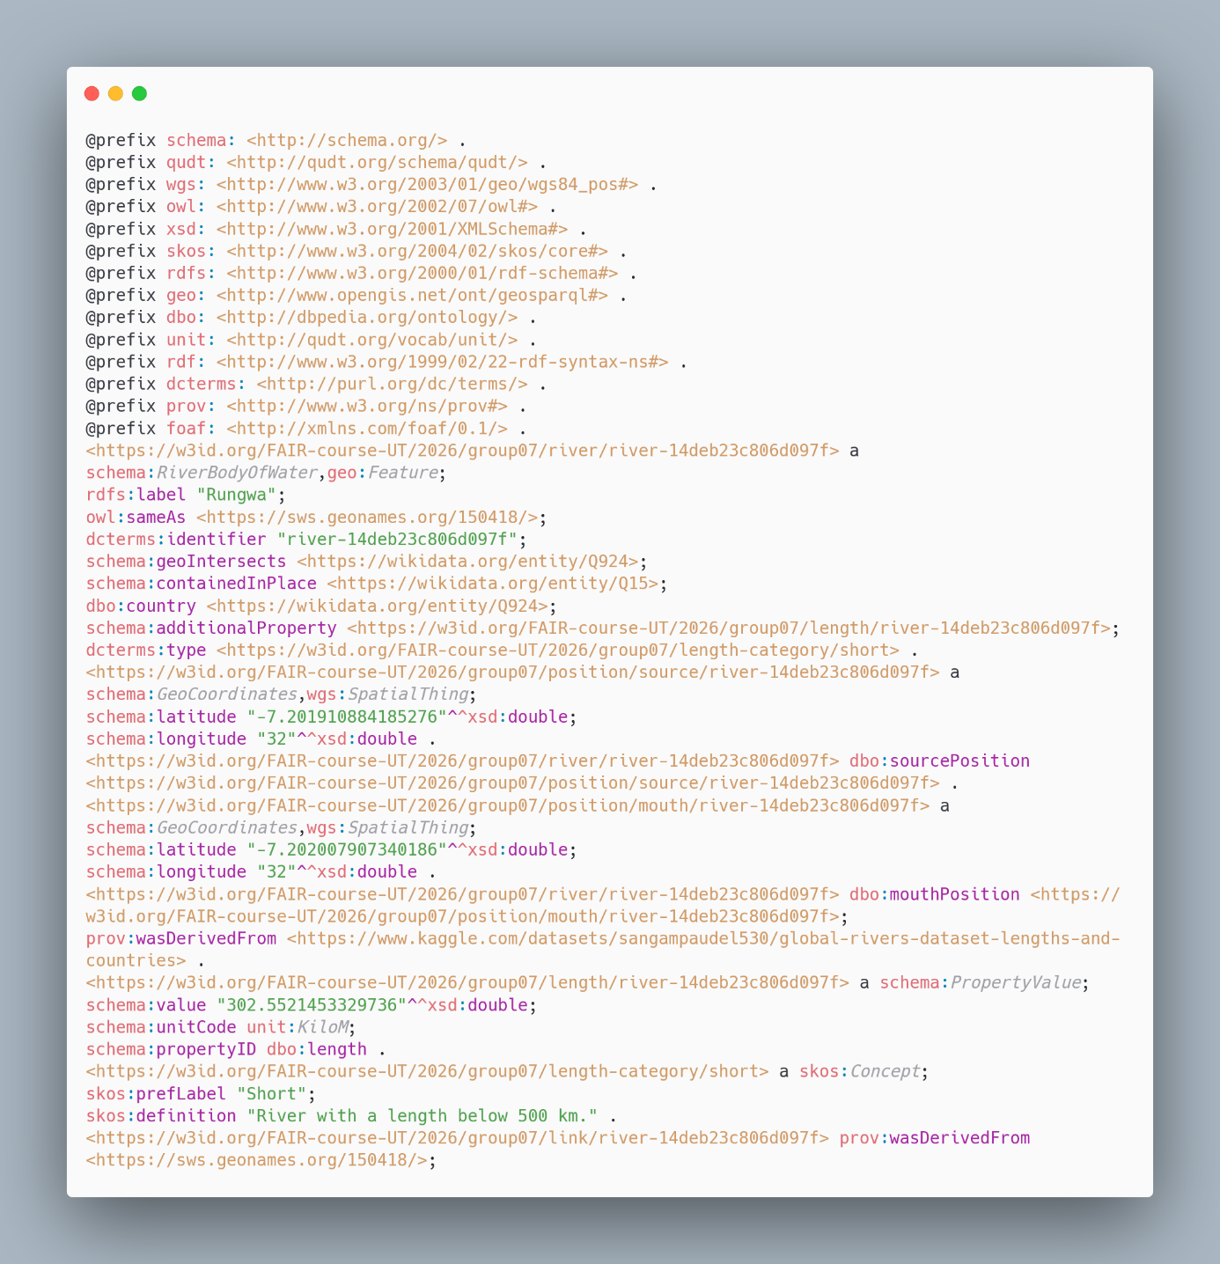
Data Triplification

Slide 16
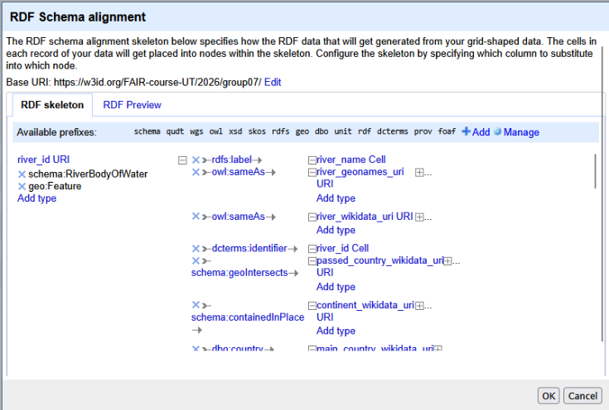
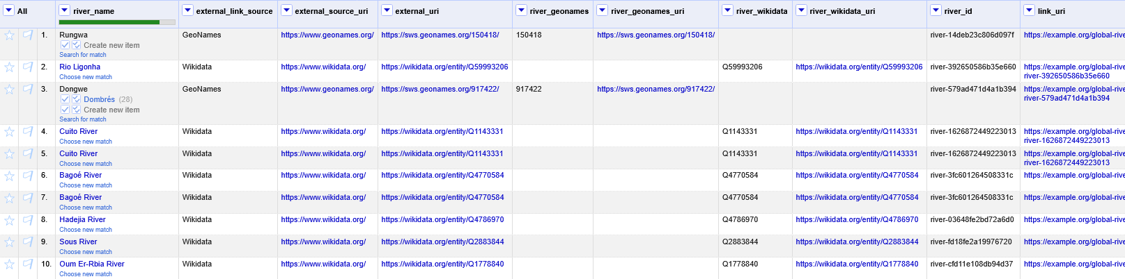
Semantic Model

Slide 17
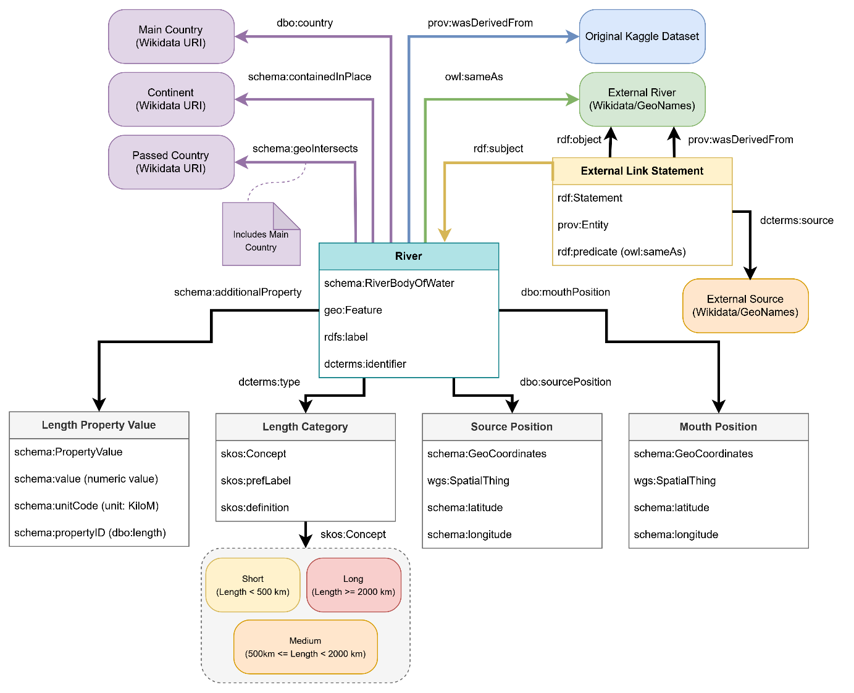
Semantic Model

Slide 18
Project-specific URIs
Resource | URI Suffix
Base Namespace: https://w3id.org/FAIR-course-UT/2026/group07/
River | river/{river_id}
Length Value | length/{river_id}
Source Position | position/source/{river_id}
Mouth Position | position/mouth/{river_id}
External Link Statement | link/{river_id}
Short Category | length-category/short
Medium Category | length-category/medium
Long Category | length-category/long

Slide 19
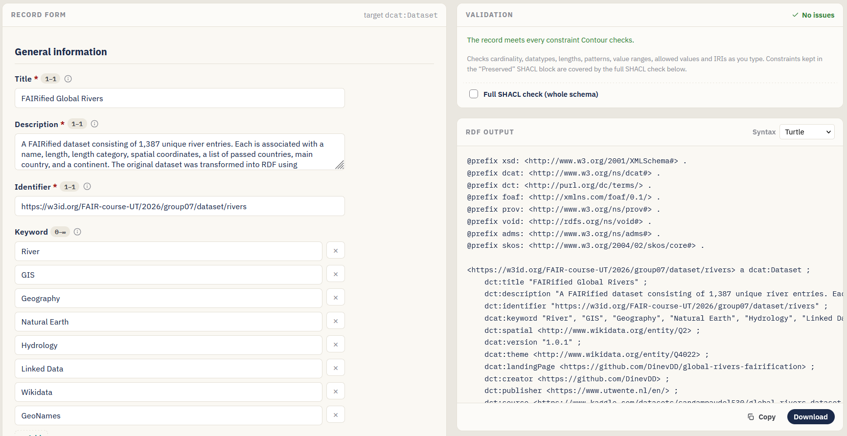
Metadata Model

Slide 20
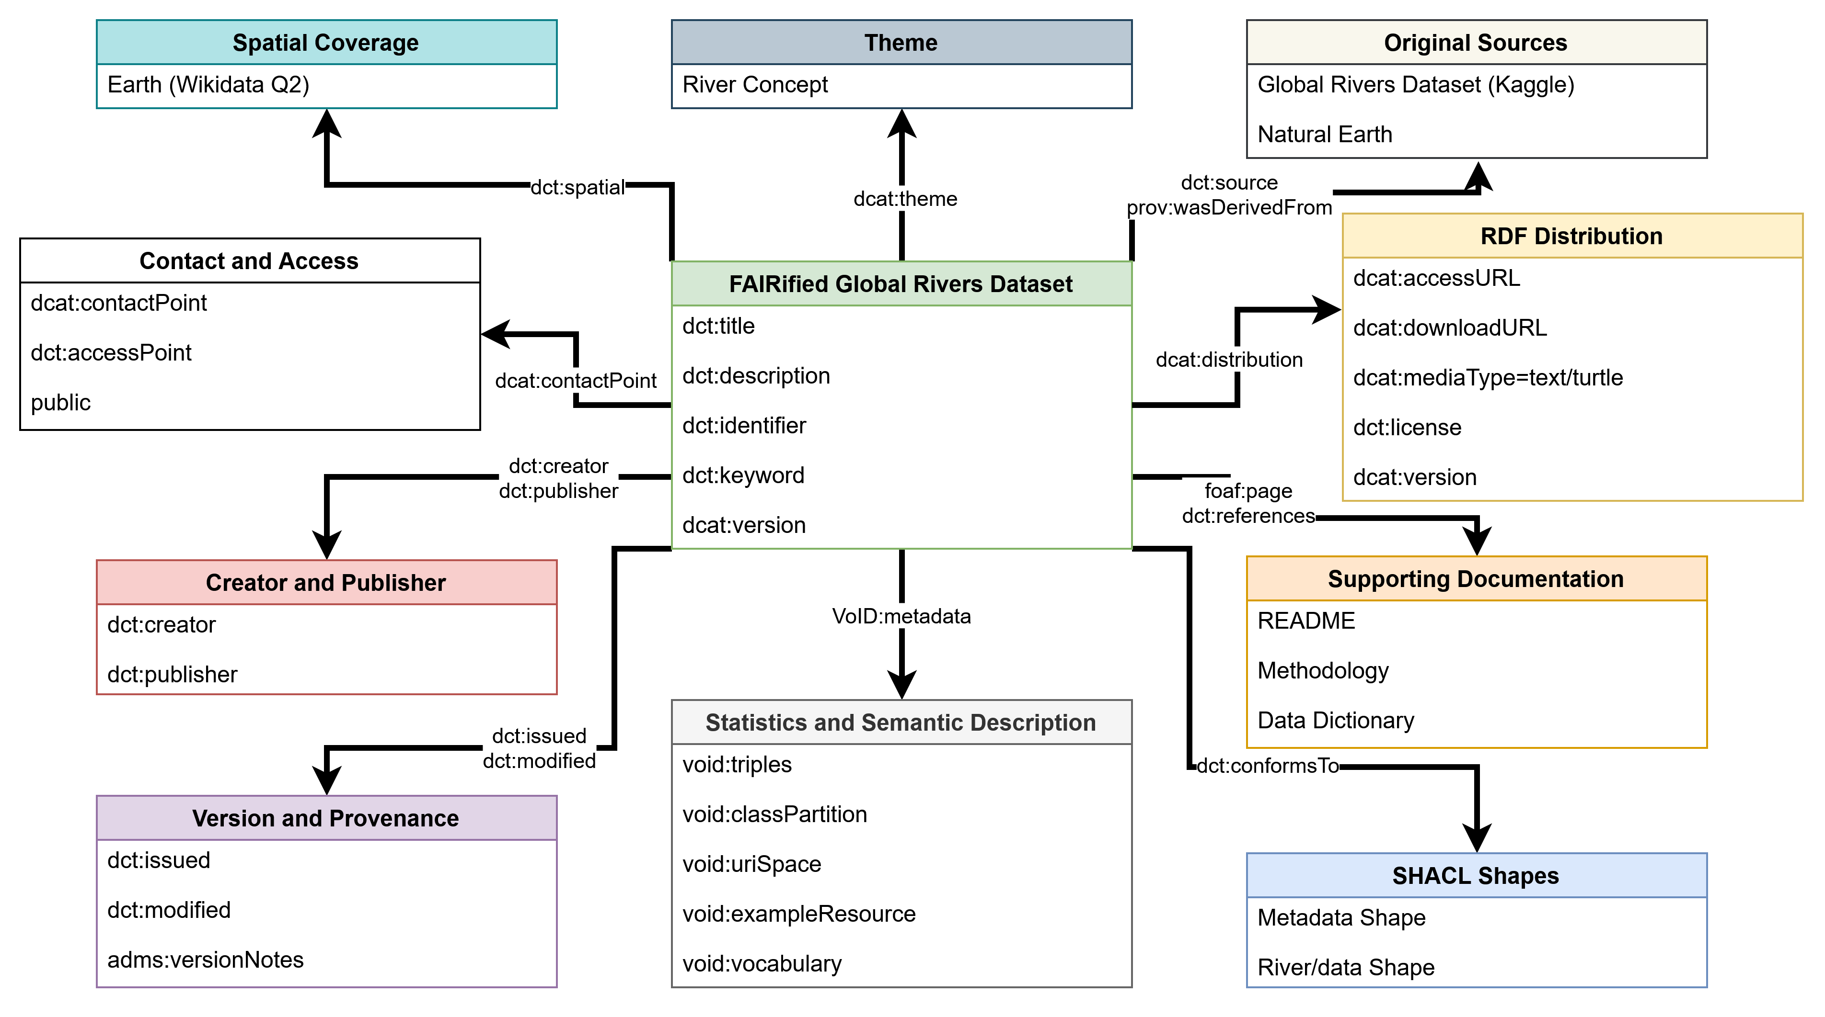
Metadata Model

Slide 21
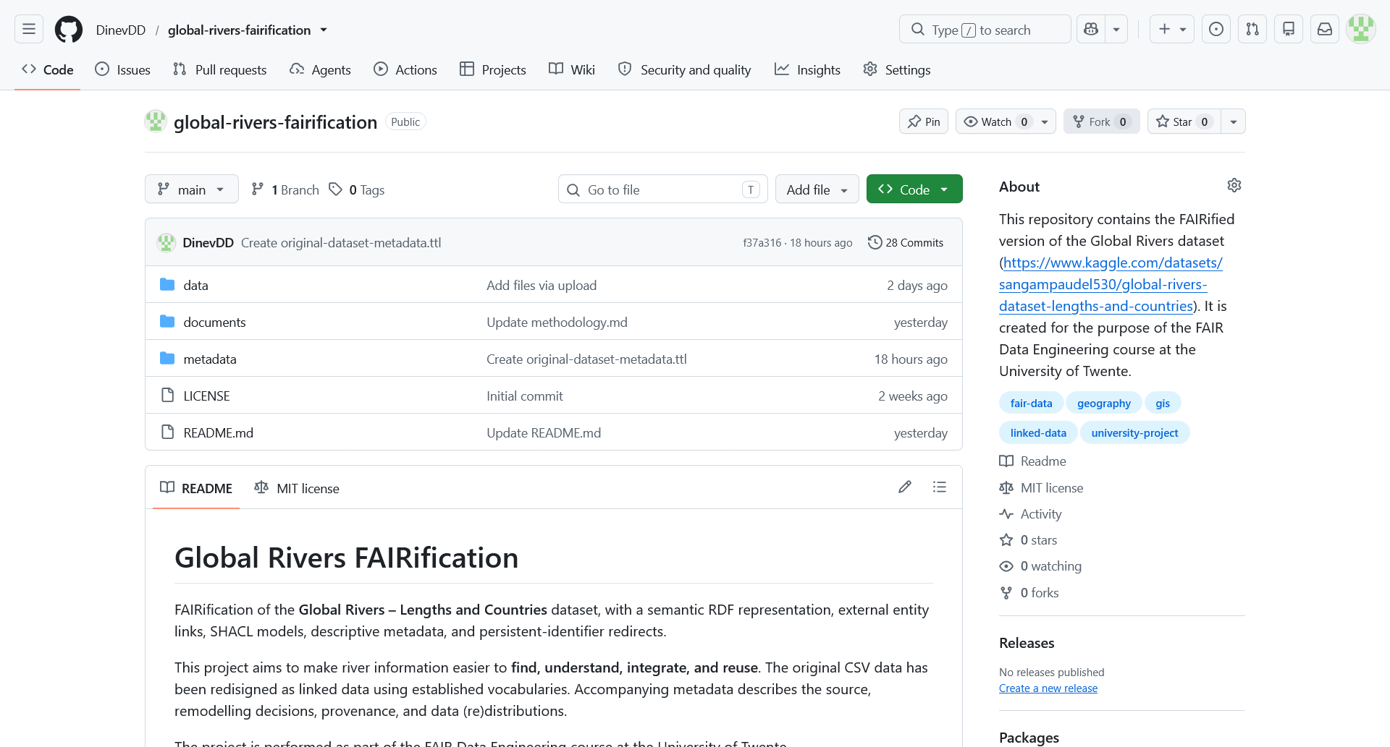
Availability
[2] Global Rivers FAIRification: https://github.com/DinevDD/global-rivers-fairification

Slide 22
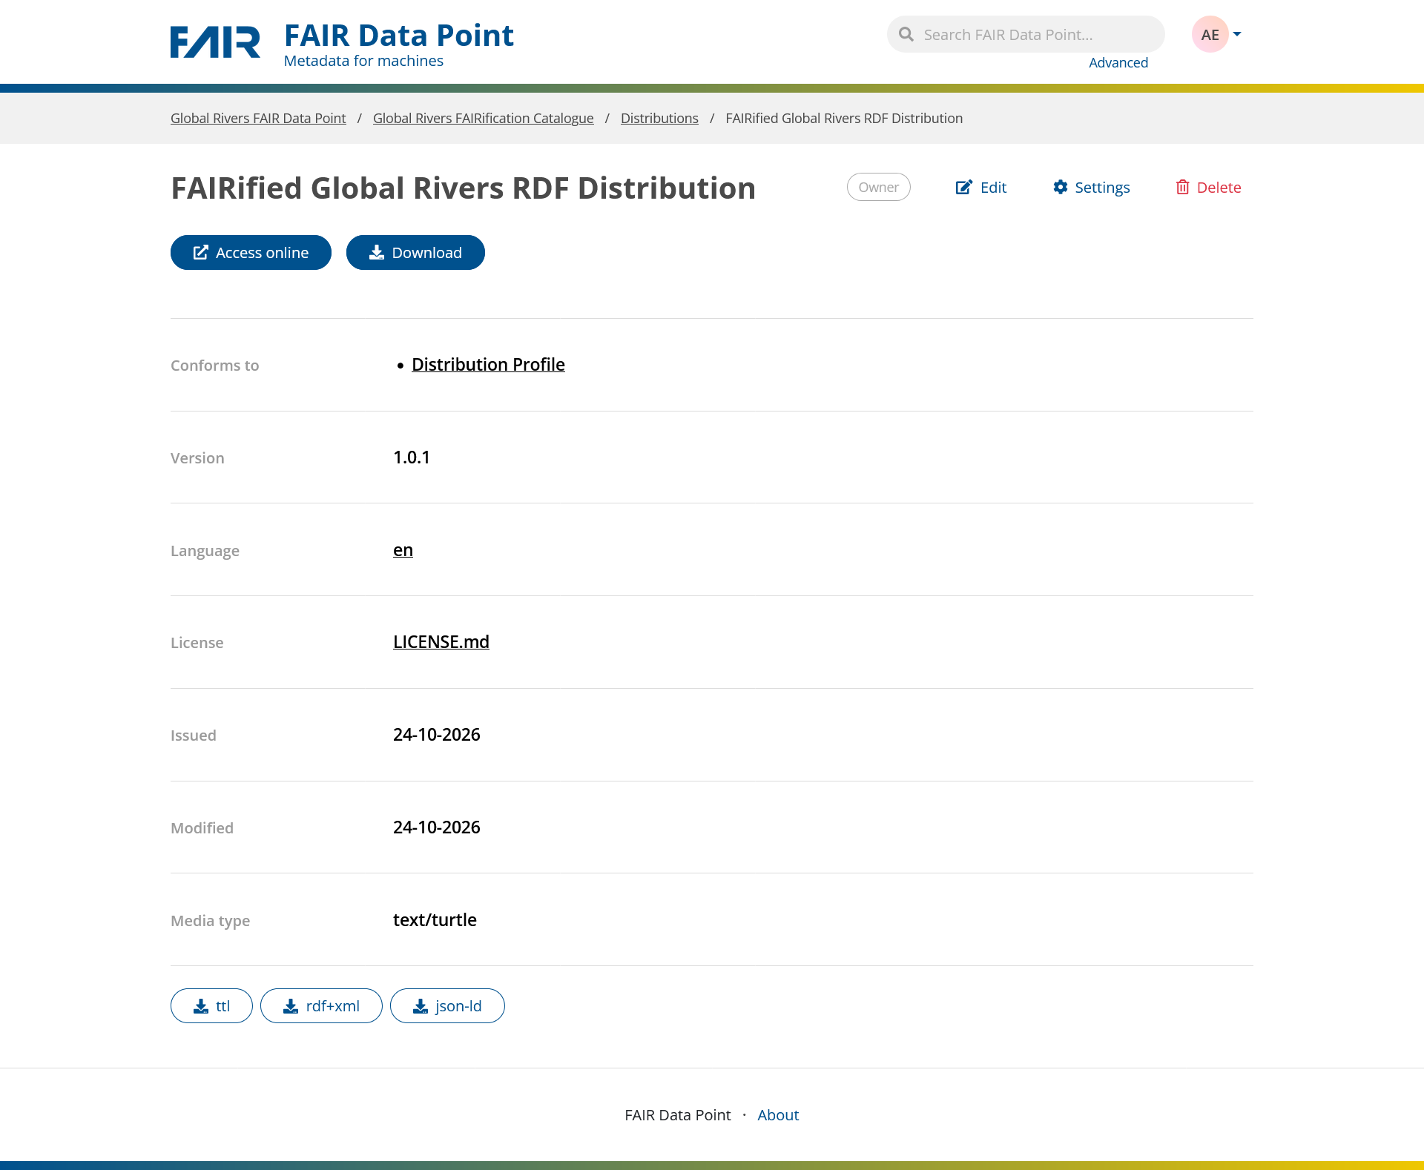
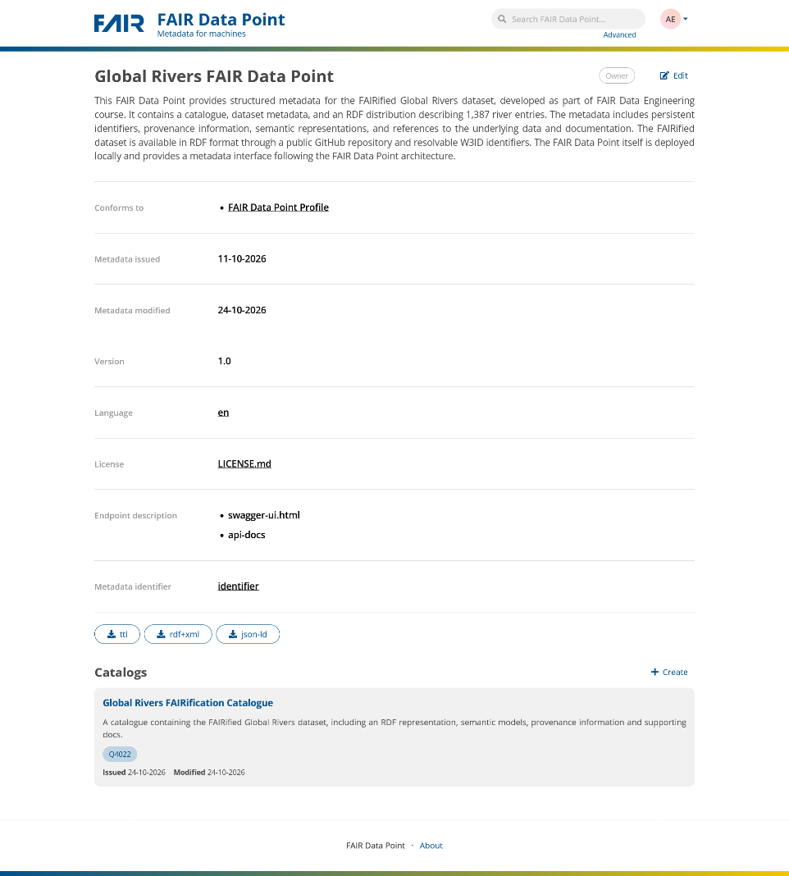
Availability

Slide 23
Final FAIRness
Accessible:
A1. (Meta)data are retrievable by their identifier using a standardized communications protocol
A1.1 The protocol is open, free, and universally implementable
A1.2. The protocol allows for an authentication and authorization procedure, where necessary
A2. Metadata are accessible, even when the data are no longer available
Findable:
F1. (meta)data are assigned a globally unique and persistent identifier
F2. Data are described with rich metadata
F3. Metadata clearly and explicitly include the identifier of the data it describes
F4. (Meta)data are registered or indexed in a searchable resource
Accessible:
A1. (Meta)data are retrievable by their identifier using a standardized communications protocol
A1.1 The protocol is open, free, and universally implementable
A1.2. The protocol allows for an authentication and authorization procedure, where necessary
A2. Metadata are accessible, even when the data are no longer available*
Findable:
F1. (meta)data are assigned a globally unique and persistent identifier
F2. Data are described with rich metadata
F3. Metadata clearly and explicitly include the identifier of the data it describes
F4. (Meta)data are registered or indexed in a searchable resource

Slide 24
Final FAIRness
Interoperable:
I1. (Meta)data use a formal, accessible, shared, and broadly applicable language for knowledge representation
I2. (Meta)data use vocabularies that follow FAIR principles
I3. (Meta)data include qualified references to other (meta)data*
Reusable:
R1. (Meta)data are richly described with a plurality of accurate and relevant attributes
R1.1. (Meta)data are released with a clear and accessible data usage license
R1.2. (Meta)data are associated with detailed provenance
R1.3. (Meta)data meet domain- relevant community standards*
Interoperable:
I1. (Meta)data use a formal, accessible, shared, and broadly applicable language for knowledge representation
I2. (Meta)data use vocabularies that follow FAIR principles
I3. (Meta)data include qualified references to other (meta)data
Reusable:
R1. (Meta)data are richly described with a plurality of accurate and relevant attributes
R1.1. (Meta)data are released with a clear and accessible data usage license
R1.2. (Meta)data are associated with detailed provenance
R1.3. (Meta)data meet domain- relevant community standards

Slide 25
Expert Evaluation
Dataset Expansion
Public Deployment
Future Work

Slide 26
Questions?

Slide 27
Thank You for Your Attention!

