Slide 1
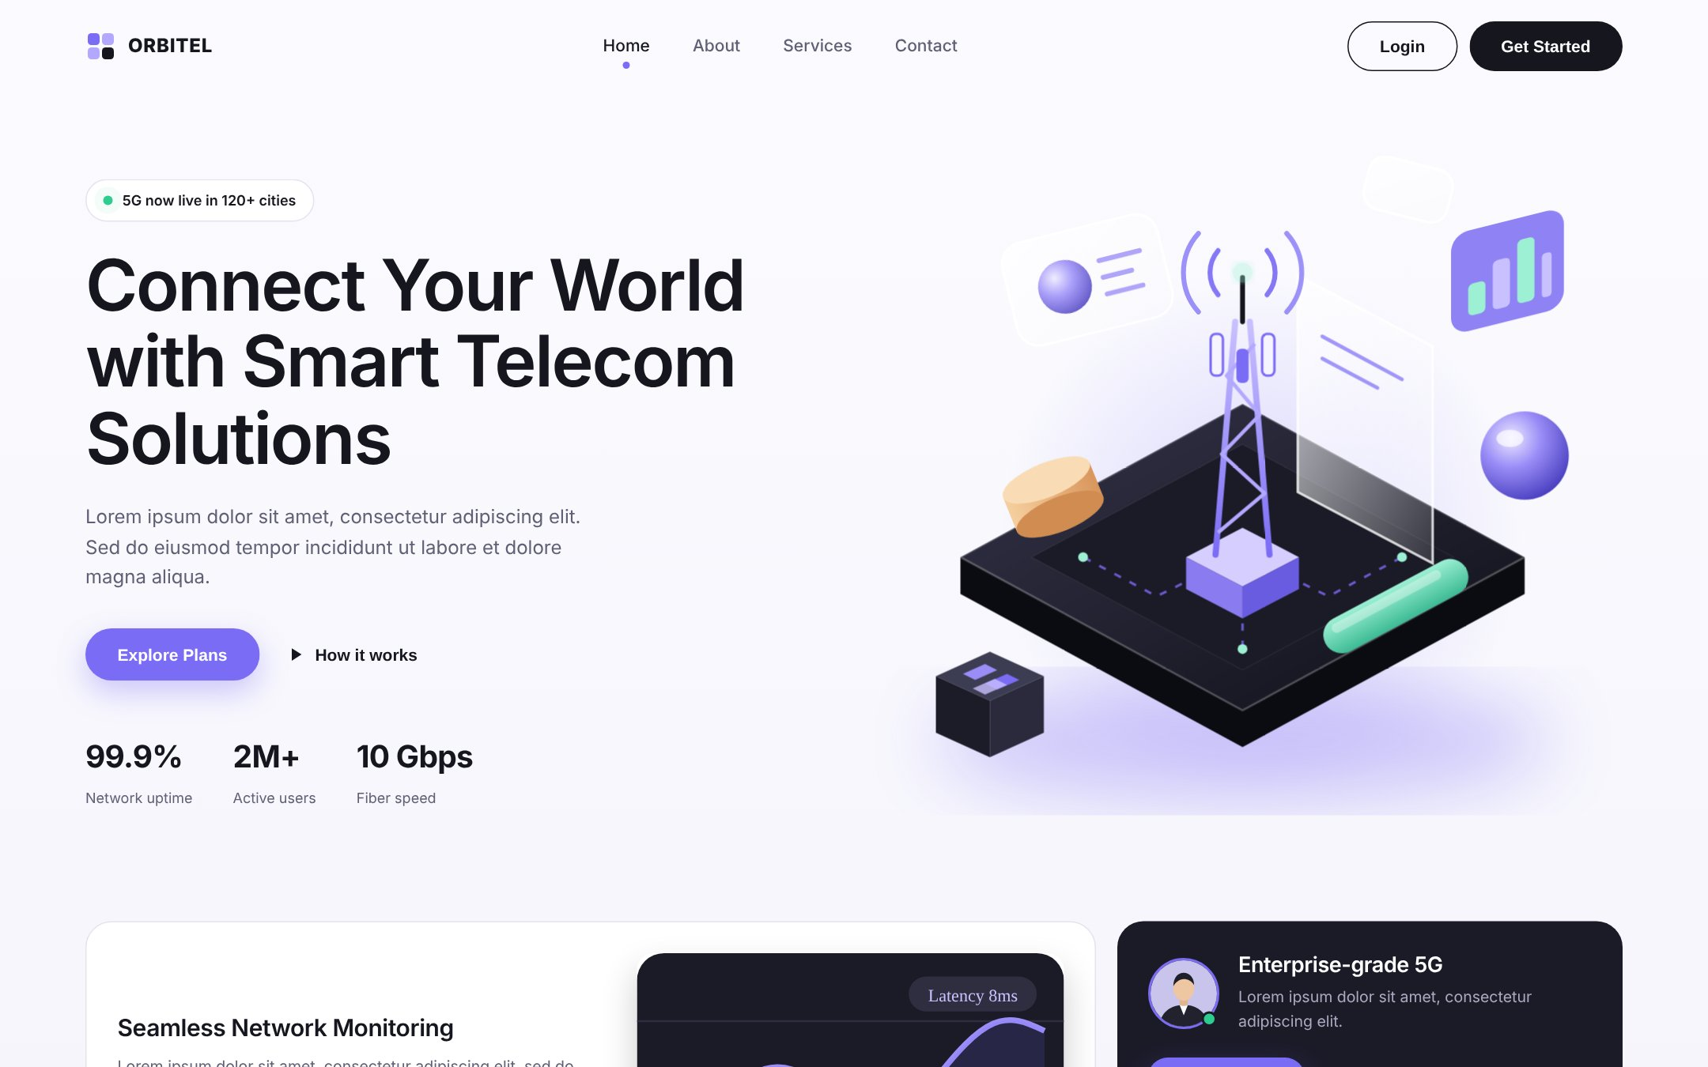
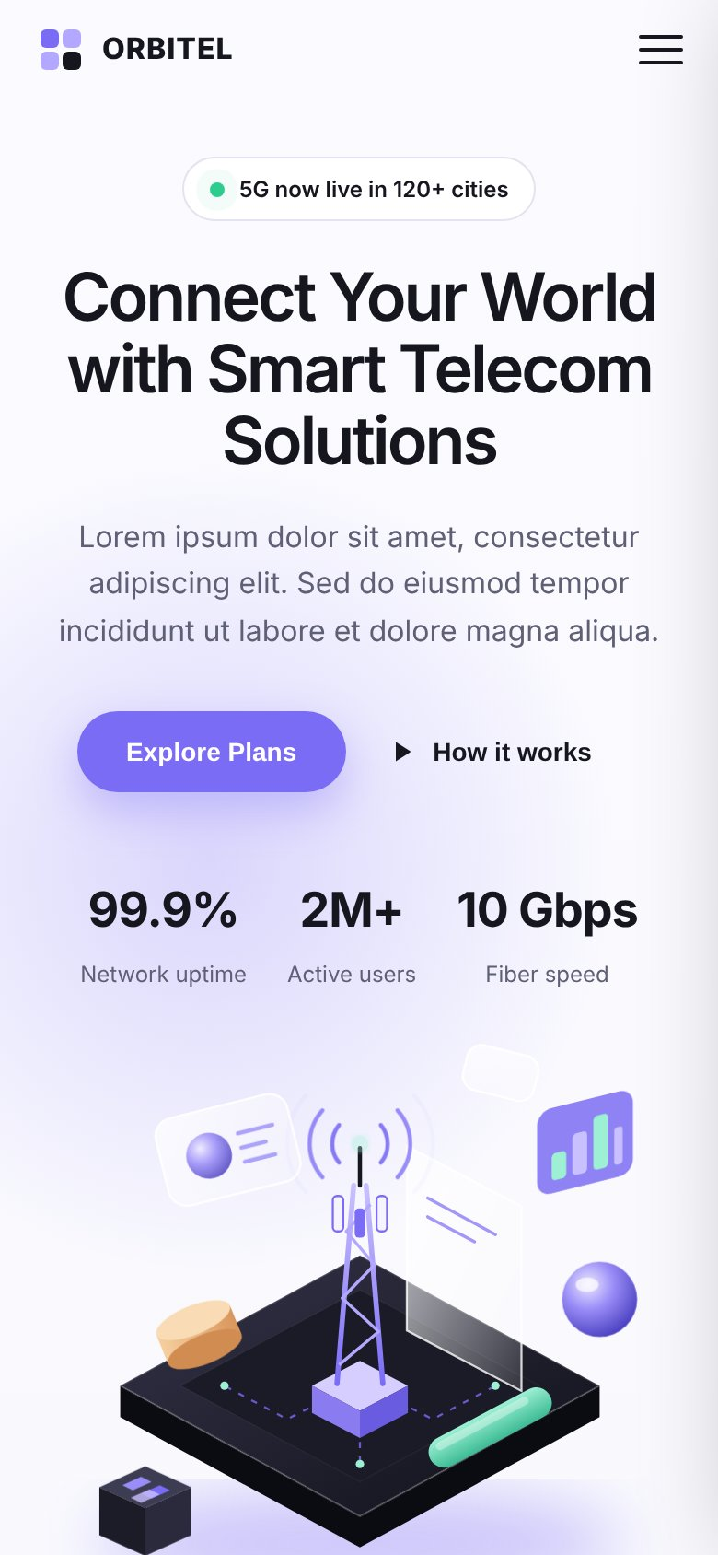
Omaginfo LLC Corporate Website
WEBSITE DESIGN PROPOSAL
Global Connectivity. Trusted Partnerships.
Page-by-page design and content plan · October 2026
Design reference: supplied sample website (placeholder content)

Slide 2
What this proposal covers
OVERVIEW
01
Foundations
Sample site analysis, what we keep and change, sitemap, visual direction
How to read the page slides
02
Global elements
Aa
Plain text in mockups
Navigation bar, footer and the reusable call-to-action band
Taken from the client's Website Content document
03
Home page
Hero, featured solutions, about preview, services overview
✱
✱ Marked text
04
About Us page
Proposed microcopy (button labels, short UI lines) — not in the document; needs approval
Company introduction, story, mission & vision, leadership team
05
Services pages
TBC
TBC chip
Services overview, VoIP & Voice Termination, SMS Connectivity
Information or asset missing — must be supplied or confirmed by the client
06
Contact Us page
Dashed boxes
Enquiry form, contact details and form behaviour
Image, illustration or photo to be produced or supplied
07
Delivery
Responsive design, SEO, missing items for approval, next steps
No sample placeholder content (names, figures, prices, addresses) is carried into the proposed site.

Slide 3




Goal: a credible B2B home for Omaginfo LLC
PROJECT OVERVIEW
Omaginfo LLC provides voice and messaging connectivity to operators, carriers and business partners across international markets. The new site should present its VoIP, A–Z voice termination and SMS routing services clearly and turn visitors into partnership enquiries.
Inputs analysed
Objectives
Proposed scope
Audience (from document)
Sample website: index.html, style.css, script.js (rendered and screenshotted at desktop, tablet and mobile widths)
Client document: Website_Content.docx (12 content items)
Communicate the services clearly to telecom buyers
Build trust: company, founders, mission
Drive enquiries to info@omaginfo.com
6 pages: Home, About Us, Services, VoIP, SMS, Contact Us
Plus Privacy Policy and Terms (content TBC)
Responsive desktop, tablet and mobile
Telecom operators and mobile network operators
Carriers, service providers, SMS aggregators
A2P / CPaaS platforms and businesses

Slide 4
Foundations
01
What the sample website does well, what changes for Omaginfo LLC, the sitemap and the visual direction.

Slide 5
Layout and navigation of the sample site
SAMPLE WEBSITE ANALYSIS
1
1
Logo mark + wordmark, top left
2
3
2
Centered links: Home, About, Services, Contact
4
3
Right: Login (outline) + Get Started (dark) pills
5
4
Status pill with live dot above headline
8
5
Large headline, left column (≈ 60px, semibold)
6
6
Primary purple CTA + secondary text link
7
7
Animated stat counters (3 figures)
9
8
Isometric 3D SVG illustration with mouse parallax
9
Bento highlight cards below the fold
Single long page with anchor navigation. Sticky header turns frosted-white on scroll; active link marked by a purple dot.

Slide 6
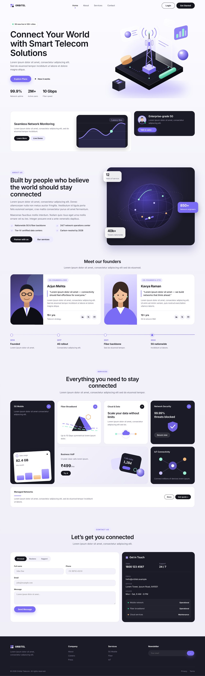
Section structure, top to bottom
SAMPLE WEBSITE ANALYSIS
Navbar
Sticky; logo left, links centre, two pill buttons right; hamburger below 900px
Hero
2-column grid: text left (pill tag, H1, paragraph, 2 CTAs, 3 counters), isometric illustration right
Highlight strip
Bento 2:1 — light card with chart visual + dark compact card with avatar and CTA
About
Text + tick list + 2 buttons left; dark globe card with 3 floating stat chips right
Founders
Two horizontal cards: illustrated portrait, role pill, name, quote, bio, years, social icons
Timeline
4 milestones on a horizontal line (stacks vertically on mobile)
Services
Centered heading + 4-column bento grid of 7 cards (tall, wide, full-width banner)
Contact
Form card (enquiry-type toggle, 4 fields) + dark info card with phone, email, hours, status
Footer
Dark: logo + text, two link columns, newsletter field, copyright and legal links

Slide 7
Colours, typography and components
SAMPLE WEBSITE ANALYSIS
Colour tokens (from style.css)
Components & motion
Primary
Dark
Outline
Soft
Ink
Dark card
Purple
Lavender
EYEBROW LABEL
#16161F · Text, dark buttons
#1B1B28 · Cards, footer
#7B6CF6 · Primary accent
#B3A8FF · Secondary accent
Light card
Dark card
22px radius, 1px border, lift on hover
Contrast block for key items
Purple soft
Mint
Peach
Page
#ECEBFF · Pills, tints
#9DF0D4 · Highlights
#F2B77A · Warm accent
#F3F2FA · Background
Scroll-reveal fade-up on every block
Animated number counters
Floating / parallax SVG layers in hero
Dashed 'data flow' line animations
Respects reduced-motion settings
Typography
Plus Jakarta Sans
Google Font · weights 400–800 · headings 600 with tight letter-spacing · body 16px / 1.6 line height in muted grey #5F6075

Slide 8
What we keep, adapt and remove
FROM SAMPLE TO OMAGINFO LLC
Keep
Adapt
Remove
Overall layout grid, spacing and rounded-card style
Sticky navbar with mobile slide-in menu
Bento card grids for services
Founder card format
Two-column contact section and form validation
Scroll-reveal motion and reduced-motion support
Single page → 6-page site with a Services dropdown
5G tower art → globe / voice & SMS route illustrations
Timeline → 'Our Story' text (no dates supplied)
Stat chips → company values from the document
Enquiry toggle → Voice / SMS / Partnership / General ✱
Network status panel → LinkedIn + office details
Orbitel name, logo and all lorem-ipsum text
Sample services: 5G, fibre, cloud, security, IoT
Sample figures: 99.9%, 2M+, 10 Gbps, 12 yrs, 40k+, 850+
Sample price ₹499/mo and sample founders
Sample phone, email, address and hours
Login button and newsletter (unless confirmed)

Slide 9
Proposed sitemap
INFORMATION ARCHITECTURE
The client document provides separate content for VoIP and SMS, so each gets its own page; the remaining three services sit on the Services overview.
Home
omaginfo.com /
About Us
Services
Contact Us
Story · Mission & Vision · Leadership
Overview of all five services
Enquiry form · Contact details
VoIP & Voice
SMS Connectivity
International voice termination page
A2P messaging page
Footer / utility pages: Privacy Policy · Terms of Use (content TBC). Main menu: Home · About Us · Services ▾ (VoIP & Voice, SMS) · Contact Us + Partner with Us ✱

Slide 10






Same modern look, re-themed for global voice & messaging
VISUAL DIRECTION
Colour
Typography
Illustration
Keep the sample's ink + purple palette with mint and peach accents. If Omaginfo LLC has brand colours, the purple accent is swapped for the brand colour across the whole site (one token).
Plus Jakarta Sans (free Google Font): semibold headings, regular body. Clear, technical and easy to read for an international B2B audience.
Custom isometric SVG illustrations in the sample style: globe with route arcs (Home), phone handset + voice waves (VoIP), message bubbles crossing regions (SMS). No 5G/fibre imagery.
Photography
Icons
Data & claims
Professional headshots of both founders (to be supplied). Avoid generic stock people; illustrations carry the rest of the site.
One line-icon set (e.g. Lucide or Phosphor) in purple on soft-purple circles: voice, route, message, handshake, sliders, headset.
No metrics, coverage counts or quality claims are shown unless the client supplies and approves them.

Slide 11
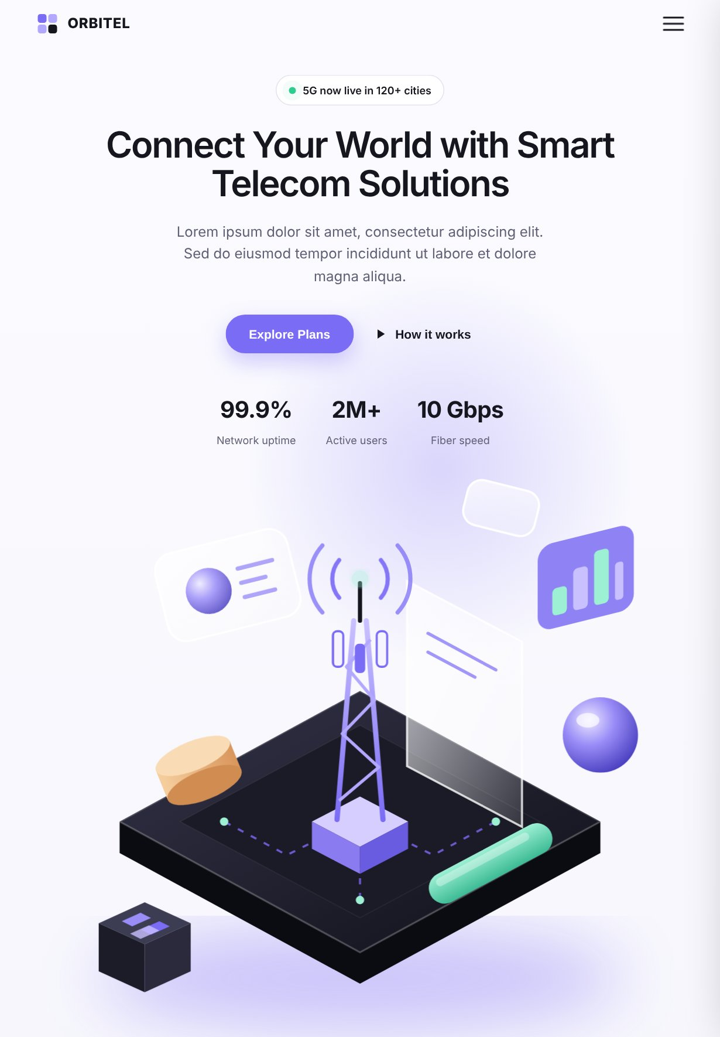
Global elements
02
Components shared by every page: navigation bar, footer and the call-to-action band.

Slide 12

Navigation bar
GLOBAL · NAVIGATION BAR
omaginfo.com
SAMPLE REFERENCE
Omaginfo LLC logo
TBC
Home
About Us
Services ▾
Contact Us
Partner with Us
✱
VoIP & Voice Termination
SMS Connectivity
Layout
All services →
Logo left, 4 links centred, one CTA pill right
Sticky; frosted white background + shadow after 20px scroll
Below 900px: hamburger opens a 280px slide-in panel
✕
Desktop (≥ 900px) shown above
Content
Links: Home · About Us · Services ▾ · Contact Us
Services dropdown: VoIP & Voice Termination, SMS Connectivity
CTA: 'Partner with Us' ✱ (sample's Login removed)
Home
About Us
Visuals
Services +
Omaginfo LLC logo (SVG) — not supplied, TBC
Purple dot under the active page link
Contact Us
Partner with Us
Functionality
Links go to their pages; CTA → Contact Us
Dropdown opens on hover/focus (desktop), expands inline on mobile
Keyboard accessible; menu closes after a tap
Mobile · closed
Mobile · menu open

Slide 13
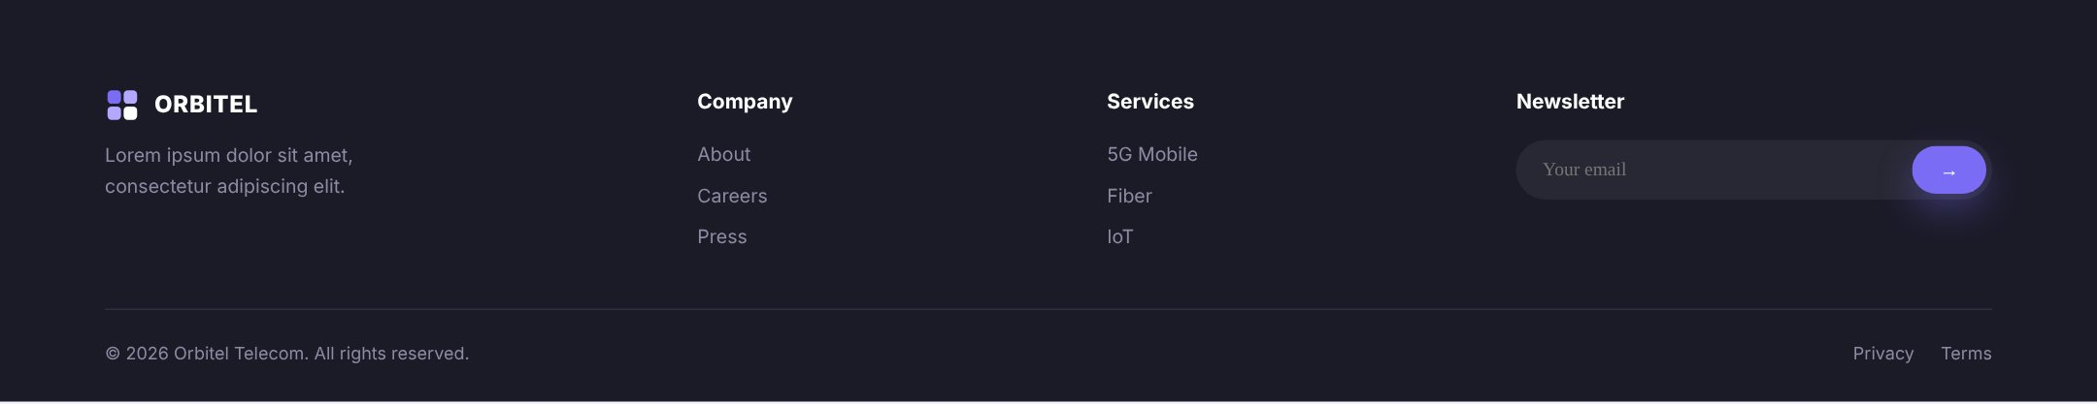
Footer
GLOBAL · FOOTER
omaginfo.com
SAMPLE REFERENCE
Logo (light version)
Company
Services
Contact
Global Connectivity. Trusted Partnerships.
About Us
VoIP & Voice Termination
info@omaginfo.com
Leadership
SMS Connectivity
+1 (725) 465-8316
Contact Us
Direct Route Solutions
1309 Coffeen Avenue, STE 1200,
Layout
in
All Services
Sheridan, Wyoming, USA 8280
Full-width dark band; 4 columns (brand, Company, Services, Contact)
Bottom bar: copyright left, legal links right
ZIP TBC
Content
© 2026 Omaginfo LLC. All rights reserved.
Privacy Policy Terms of Use
Tagline: Global Connectivity. Trusted Partnerships.
Email, phone and address exactly as supplied
LinkedIn: linkedin.com/company/omaginfo-llc
Year updates automatically. Newsletter column from the sample is replaced by the Contact column (no newsletter in the brief).
Visuals
Light/white version of logo (TBC)
LinkedIn icon in a dark circle, hover turns white
Mobile: columns stack to 2 (tablet) and 1 (phone); contact items become tap-to-email / tap-to-call links.
Functionality
mailto: and tel: links; LinkedIn opens in new tab
Privacy / Terms pages need client-approved text

Slide 14

Closing call-to-action band, reused on each page
GLOBAL · CALL-TO-ACTION BAND
omaginfo.com
Layout
Full-width light card (sample's 'Managed Networks' banner)
Heading + short purple line + text left; button right
Stacks with button below text on mobile
Building connections. Enabling growth.
Contact Our Team
✱
Visuals
Connect with Omaginfo LLC to discuss your routing requirements and explore opportunities for collaboration.
White card, 1px border, 22px radius on the page tint
Optional faint globe line-art in the right corner
Functionality
Button opens Contact Us with the enquiry type pre-selected (Voice on VoIP page, SMS on SMS page)
Implemented via a URL parameter, e.g. /contact?type=sms
Copy per page (headings and text from the client document)
Page | Heading | Button ✱ → Contact Us
Home / About / Services | Building connections. Enabling growth. | Contact Our Team
VoIP | Partner with Omaginfo LLC | Discuss Voice Routes
SMS | Build Your Global Messaging Network with Omaginfo LLC | Discuss SMS Routes
Notes
Button labels are proposed (✱); doc says 'Connect with Omaginfo LLC' / 'Contact our team'

Slide 15
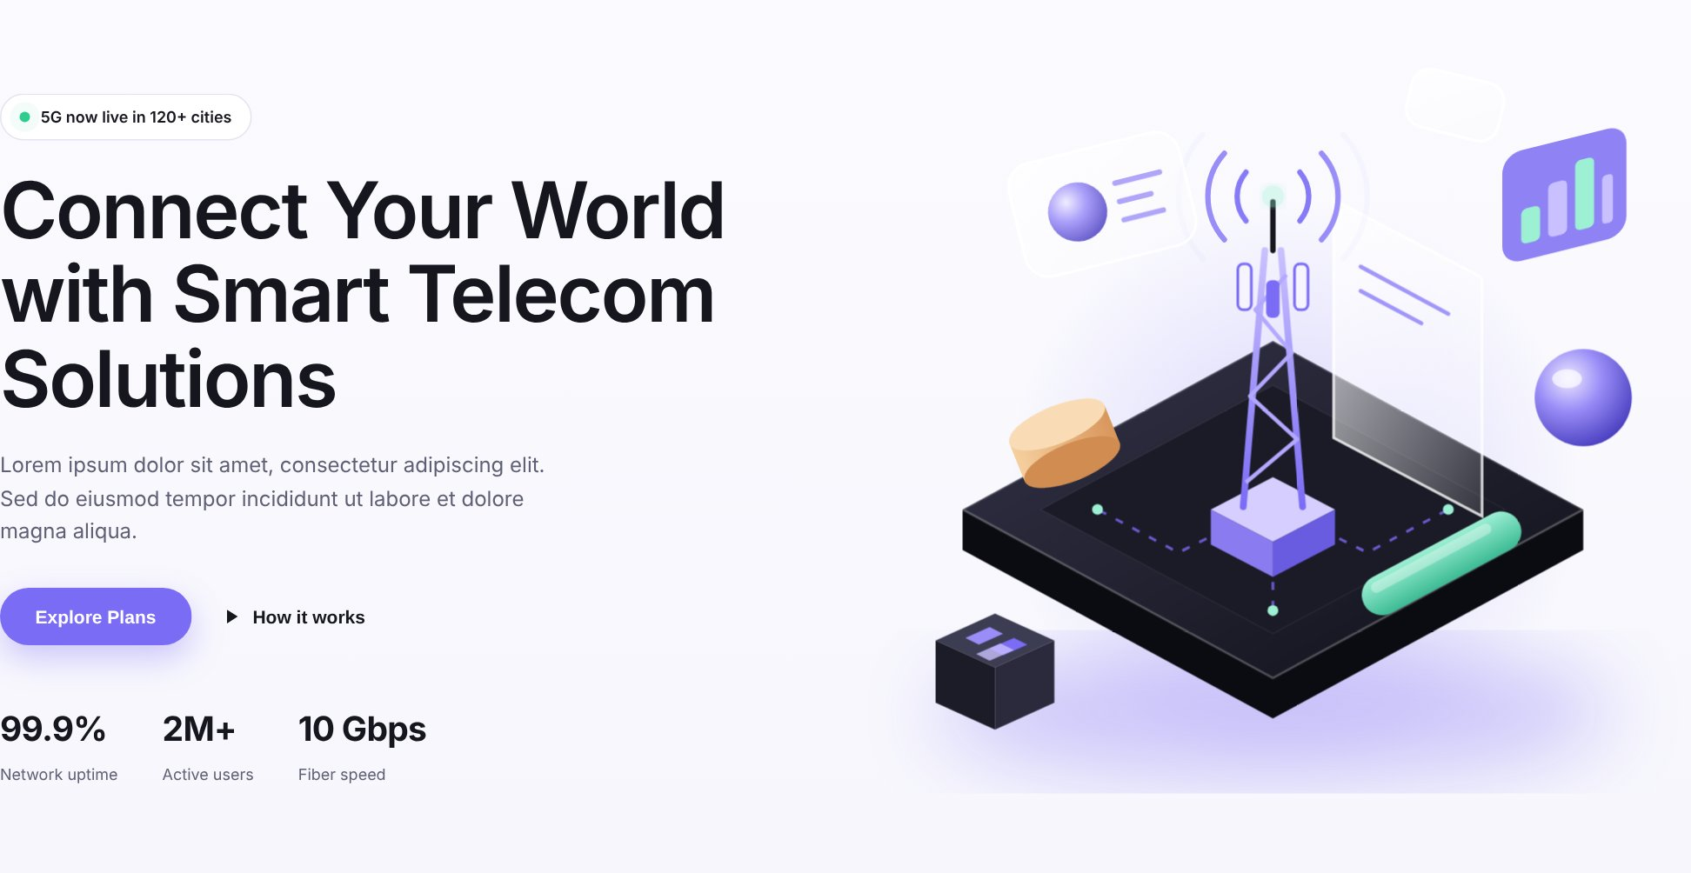
Home page
03
Introduces Omaginfo LLC, its five services and routes visitors to the VoIP, SMS and Contact pages.

Slide 16

Home page at a glance
HOME · PAGE STRUCTURE
SAMPLE SECTION
PROPOSED HOME SECTION
Navbar
Navigation bar Global component
Hero
Hero Connecting Businesses Through Global Voice & Messaging
Highlight strip
Featured solutions Two cards → VoIP page and SMS page
About + founders + timeline
About preview About Omaginfo LLC + company values (founders move to About page)
Services bento
Our Services Five service cards from the document
Contact section
CTA band Building connections. Enabling growth. (form lives on Contact page)
Footer
Footer Global component
Sample

Slide 17

Hero section
HOME · SECTION 1 OF 4
omaginfo.com
SAMPLE REFERENCE
Logo
Home
About Us
Services ▾
Contact Us
Partner with Us
✱
Global Connectivity. Trusted Partnerships.
Connecting Businesses Through Global Voice & Messaging
Layout
2-column grid (text 1 : art 1.1), vertically centred
Text left; illustration right with soft purple glow
Mobile: single column, centred text, art below
Content
Omaginfo LLC delivers international voice termination, VoIP, and SMS connectivity solutions designed to help telecom operators and business partners expand their reach through reliable connections and competitive commercial offerings.
Tag: Global Connectivity. Trusted Partnerships.
H1, paragraph and closing line verbatim from document item 3
Buttons ✱: 'Explore Our Services', 'Partner with Us'
Custom isometric illustration: globe on platform with voice & SMS route arcs, floating message and call cards
Visuals
Building connections. Enabling growth.
New isometric SVG in sample style (globe instead of 5G tower)
Pill tag with pulsing green dot
Explore Our Services
✱
Partner with Us
✱
Functionality
Optional stats row (e.g. destinations, partners) — only with client-verified figures
Explore Our Services → Services page; Partner with Us → Contact Us
Mouse parallax on illustration layers (desktop only)
Sample counters hidden unless real figures are supplied
TBC

Slide 18
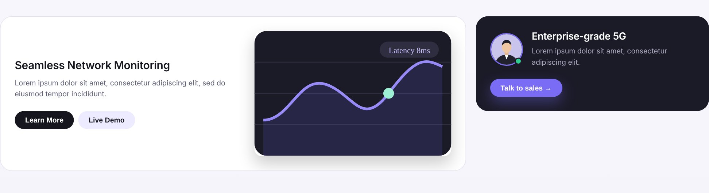


Featured solutions strip
HOME · SECTION 2 OF 4
omaginfo.com
SAMPLE REFERENCE
Global Voice Connectivity
Our VoIP and voice termination services help partners connect across international destinations through flexible routing options and commercially competitive solutions.
SMS Connectivity Solutions
Layout
We support SMS traffic across destinations in Asia, Africa, the Middle East, Europe, and the Americas.
Bento 2:1 — wide light card + compact dark card
Wide card splits text left / visual right
Stacks to one column below 900px
Dark screen: route map with voice arcs (no metrics)
Visuals
Learn More
✱
Discuss Routes
✱
Explore SMS →
✱
Dark 'screen' illustration of voice routes (replaces latency chart)
SMS icon in a soft circle (replaces avatar)
Functionality
Text: first sentences of the document's VoIP page (item 6) and SMS page (item 7).
Learn More → VoIP page; Discuss Routes → Contact (Voice pre-selected)
Explore SMS → SMS page
Card lifts 5px on hover; scroll-reveal fade-in
Why this section: the client has two in-depth service pages. Surfacing them directly under the hero gives operators and aggregators a one-click path to the page relevant to them.
Notes
Sample 'Latency 8ms', '5G' and avatar removed — no figures supplied

Slide 19
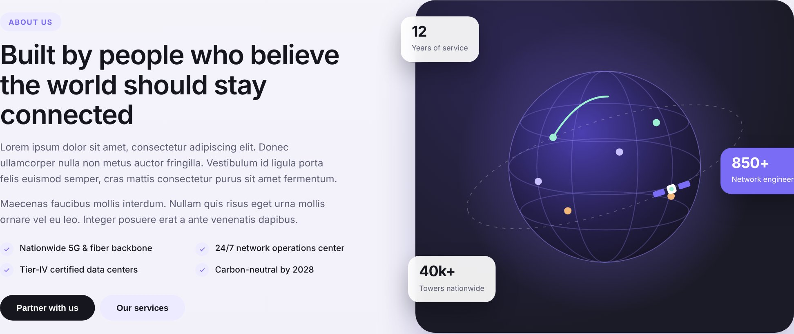


About preview
HOME · SECTION 3 OF 4
omaginfo.com
SAMPLE REFERENCE
ABOUT US
About Omaginfo LLC
Reliability
Omaginfo LLC is a telecommunications company focused on providing voice and messaging connectivity solutions to operators, carriers, and business partners across international markets. We specialize in VoIP services, A–Z voice termination, SMS routing, and global connectivity solutions tailored to meet the evolving needs of the telecom industry.
Layout
2 columns: text left, dark globe card right
Tick list in 2 columns; two buttons below
Mobile: text first, visual below
Globe with connection arcs and orbiting satellite (sample visual, recoloured)
Content
Heading + paragraph: document item 1, first paragraph
Ticks: the four services named in that paragraph
Chips: values named in paragraph 2 (reliability, competitive commercial offerings, mutual trust)
VoIP services
A–Z voice termination
SMS routing
Global connectivity solutions
Competitive commercial offerings
Visuals
Learn More About Us
✱
Our Services
Sample globe & satellite SVG kept, arcs recoloured
Floating chips carry words, not invented numbers
Mutual trust
Functionality
Learn More About Us ✱ → About Us; Our Services → Services
Founders and timeline move to the About page

Slide 20
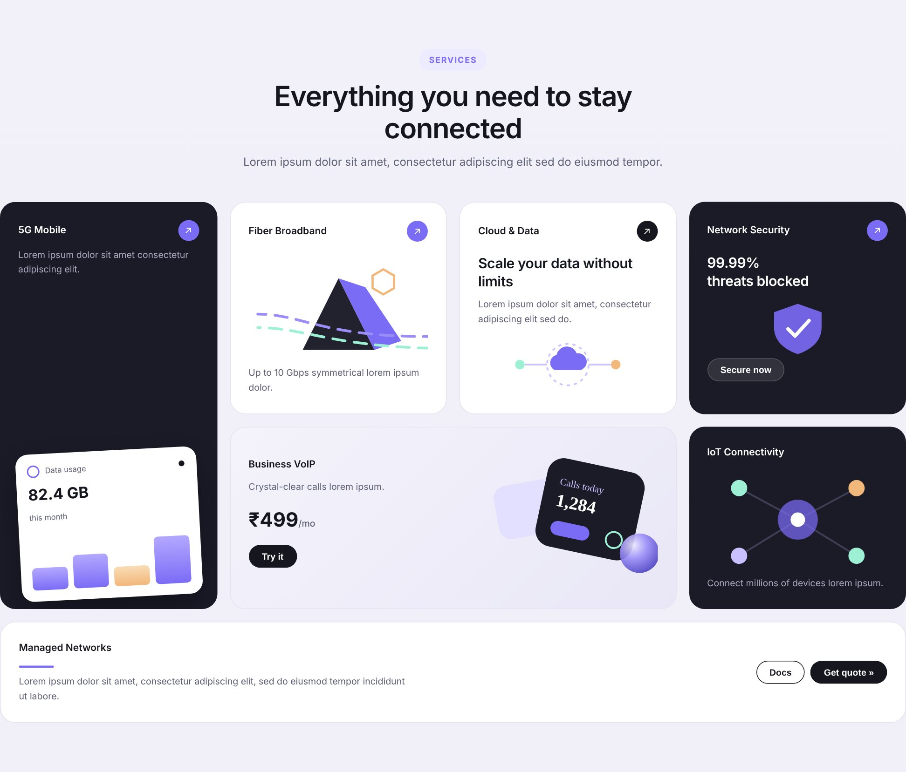






Our Services (bento grid)
HOME · SECTION 4 OF 4
omaginfo.com
SAMPLE REFERENCE
SERVICES
Our Services
VoIP & International Voice Termination
↗
SMS Routing & Connectivity
↗
Direct Route Solutions
↗
Global Telecom Partnerships
↗
Layout
Centred heading, 4-column bento: 1 tall, 4 standard, 1 wide card
Tablet: 2 columns; phone: 1 column
Voice connectivity and A–Z termination solutions for international telecom operators, carriers, and service providers.
SMS routing and traffic solutions designed to support messaging requirements across available international destinations.
Access to available direct fixed and mobile routes to support routing efficiency and connectivity requirements.
Flexible commercial arrangements and collaboration opportunities for operators and carriers seeking to expand their international reach.
Content
Five titles + descriptions verbatim from document item 4
6th card ✱ 'Who we work with' uses audiences named in item 1
Sample prices (₹499/mo) and figures not used
Tailored Connectivity Solutions
↗
Who we work with
✱
↗
Visuals
Line icons per service; dark/light cards alternate
Tall card keeps the tilted floating panel, now a voice-route visual
Business-focused voice and messaging options developed around partner requirements, traffic needs, and commercial objectives.
Operators · Carriers · Service providers · Business partners
Floating card: voice route illustration
✱
Functionality
Discuss Requirements
VoIP card → VoIP page; SMS card → SMS page
Direct Routes → Services page; Partnerships & Tailored → Contact
Whole card clickable; ↗ icon signals link

Slide 21
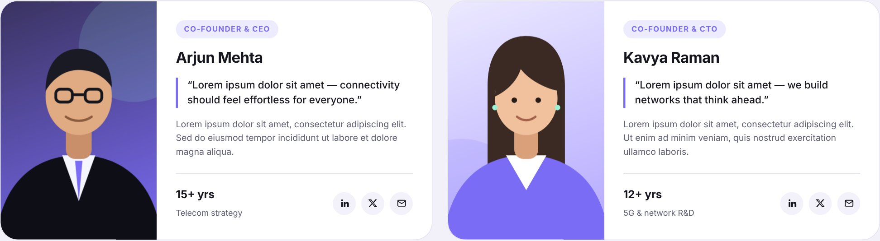
About Us page
04
Company introduction, story, mission & vision, and the leadership team — all from the client document.

Slide 22
Page header and company introduction
ABOUT US · SECTION 1 OF 3
omaginfo.com/about
Layout
Home / About Us
Page header band: breadcrumb, eyebrow, H1, tagline
Below: 2 columns — text + value ticks left, visual card right
Mobile: single column, visual after text
ABOUT US
About Omaginfo LLC
Content
Global Connectivity. Trusted Partnerships.
H1 'About Omaginfo LLC' and both paragraphs verbatim (document item 1)
Ticks condensed from paragraph 2 wording
Tagline from document item 2
Omaginfo LLC is a telecommunications company focused on providing voice and messaging connectivity solutions to operators, carriers, and business partners across international markets. We specialize in VoIP services, A–Z voice termination, SMS routing, and global connectivity solutions tailored to meet the evolving needs of the telecom industry.
Visuals
Soft page-tint header band (no photo needed)
Dark globe card reused from Home for consistency
Stat chips omitted — no years, coverage or staff figures supplied (TBC)
We believe successful telecommunications partnerships are built on reliability, competitive commercial offerings, and mutual trust. Our approach combines flexible connectivity options with a commitment to professional service and long-term collaboration. At Omaginfo LLC, we strive to help our partners expand their reach, optimize their connectivity, and explore new business opportunities in an increasingly connected world.
Globe & satellite visual; optional office or team photo
Functionality
Breadcrumb 'Home' links back
Scroll-reveal on blocks; no forms on this section
Reliability
Competitive offerings
Mutual trust
Long-term collaboration

Slide 23


Our Story, Mission and Vision
ABOUT US · SECTION 2 OF 3
omaginfo.com/about
SAMPLE REFERENCE
Our Story
Optional milestone timeline
Omaginfo LLC was established with the aim of creating valuable connections within the global telecommunications industry. We recognized the importance of dependable routing, competitive pricing, and strong business relationships in helping telecom operators grow. With this focus, we work to develop partnerships and provide voice and messaging solutions that address the practical needs of our customers.
Shown only if founding year and milestones are supplied
Layout
Story: text left, optional timeline card right
Mission & Vision: two equal cards side by side
Mobile: everything stacks; cards full width
As we continue to grow, our focus remains on expanding our connectivity opportunities, strengthening partner relationships, and creating sustainable value across the telecommunications ecosystem.
Dates TBC
Content
'Our Story' 2 paragraphs, Mission and Vision verbatim from item 1
Sample timeline (2014–2024, 4G/5G) removed
Our Mission
Our Vision
Visuals
To deliver dependable and cost-effective voice and messaging connectivity while building transparent, mutually beneficial relationships with telecom operators and business partners worldwide.
To become a trusted international telecommunications partner recognized for connectivity, commercial flexibility, service reliability, and lasting business relationships.
Mission: dark card, mint target icon
Vision: purple card, white eye icon
Notes
Founding year and any milestones needed to show a timeline (TBC); otherwise the story stands alone

Slide 24


Leadership team
ABOUT US · SECTION 3 OF 3
omaginfo.com/about#leadership
SAMPLE REFERENCE
Leadership team
FOUNDER & MANAGING DIRECTOR
CO-FOUNDER & DIRECTOR
Gaurav Goyal
Aastha Gupta
Layout
Two founder cards side by side (sample format)
Photo, role pill, name, bio, footer row with experience + social
Below 1080px: cards stack; below 600px photo moves on top
Headshot
Headshot
Content
Photo TBC
Photo TBC
Names, titles and full 3-paragraph bios verbatim (item 5)
First paragraph visible; 'Read full bio' ✱ expands the rest
Sample quotes removed — add only if founders supply one
Gaurav Goyal brings a technical foundation and industry experience to the leadership of Omaginfo LLC. With an academic background in electronics engineering and a professional association with the telecommunications sector, he brings an understanding of network technologies and the operational requirements of the telecom industry.
Aastha Gupta brings professional experience in account management and telecommunications business relationships to Omaginfo LLC. Her background in managing customer accounts and coordinating with business partners supports the company's focus on service, collaboration, and long-term commercial relationships.
Visuals
Professional headshots on purple gradient backgrounds (TBC)
Functionality
✱
✱
Read full bio ▾
Read full bio ▾
Expand/collapse bio; LinkedIn icon opens profile in new tab
Personal LinkedIn URLs / emails and years of experience TBC
Experience
in
@
Experience
in
@
Years TBC
Years TBC

Slide 25
Services pages
05
A services overview plus dedicated pages for VoIP & Voice Termination and SMS Connectivity.

Slide 26


Services overview page
SERVICES · OVERVIEW PAGE
omaginfo.com/services
Layout
Home / Services
Header band (breadcrumb, H1 'Our Services', tagline)
Row 1: two large cards for the services with their own pages
Row 2: three cards for the remaining services
Global CTA band, then footer
Our Services
Global Connectivity. Trusted Partnerships.
Content
All five titles and descriptions verbatim (item 4)
Link labels: 'VoIP page →', 'SMS page →', 'Enquire →' ✱
VoIP & International Voice Termination
SMS Routing & Connectivity
Visuals
Voice connectivity and A–Z termination solutions for international telecom operators, carriers, and service providers.
SMS routing and traffic solutions designed to support messaging requirements across available international destinations.
Icons in soft circles; VoIP card dark for emphasis
Functionality
VoIP page →
SMS page →
VoIP / SMS cards open their pages
Other three open Contact Us with 'General / Partnership' pre-selected
Notes
Direct Route Solutions
Global Telecom Partnerships
Tailored Connectivity Solutions
Client to confirm: should Direct Routes, Partnerships or Tailored Solutions get their own pages later?
Access to available direct fixed and mobile routes to support routing efficiency and connectivity requirements.
Flexible commercial arrangements and collaboration opportunities for operators and carriers seeking to expand their international reach.
Business-focused voice and messaging options developed around partner requirements, traffic needs, and commercial objectives.
✱
✱
✱
Enquire →
Enquire →
Enquire →
Closing CTA band: 'Building connections. Enabling growth.'

Slide 27
VoIP hero and introduction
VOIP PAGE · SECTION 1 OF 3
omaginfo.com/services/voip
SAMPLE REFERENCE
Home / Services / VoIP
VOIP SERVICES
✱
Global Voice Connectivity with Omaginfo LLC
Layout
Breadcrumb + hero in the Home hero format (text left, art right)
Intro card below: two text columns
Mobile: single column, art after buttons
At Omaginfo LLC, we provide international voice connectivity solutions designed to meet the needs of telecom operators, carriers, and service providers. Our VoIP and voice termination services help partners connect across international destinations through flexible routing options and commercially competitive solutions.
Isometric phone handset with voice waves travelling along routes across a globe
Content
H1 and three intro paragraphs verbatim (item 6)
Eyebrow 'VoIP Services' ✱
Buttons ✱: 'Discuss Voice Routes', 'Our VoIP Services ↓'
Discuss Voice Routes
✱
Our VoIP Services ↓
Visuals
New isometric SVG: handset, voice waves, route arcs
Same purple glow background as Home hero
We understand that successful voice traffic management depends on route availability, call quality, efficient routing, and responsive technical coordination. Our focus is to help partners meet their connectivity requirements while supporting their commercial objectives in an evolving telecommunications market.
Whether you are expanding your international voice coverage or looking for new routing partnerships, Omaginfo LLC offers a business-focused approach to global voice connectivity.
Functionality
Discuss Voice Routes → Contact (Voice pre-selected)
Our VoIP Services ↓ smooth-scrolls to the services grid

Slide 28


Our VoIP Services
VOIP PAGE · SECTION 2 OF 3
omaginfo.com/services/voip
SAMPLE REFERENCE
SERVICES
✱
Our VoIP Services
International Voice Termination
Quality-Focused Routing
Layout
Centred section heading
2 × 2 card grid, alternating dark and light (checkerboard)
Tablet: 2 columns; phone: 1 column
Access voice termination solutions across A–Z destinations, with routing options based on destination availability, traffic requirements, and commercial agreements.
We prioritize route selection based on available quality information, agreed technical parameters, and partner requirements to support consistent voice connectivity.
Content
Heading and four service titles + descriptions verbatim (item 6)
Visuals
Flexible Connectivity Options
Partner Support
One line icon per card in a circle (globe, route, network, headset)
Cards lift on hover; no stock photos needed
Our solutions are designed to accommodate different traffic profiles and interconnection needs, helping operators establish suitable routing arrangements for their businesses.
Our team works with partners to coordinate service requirements, address technical queries, and facilitate communication regarding routing and connectivity matters.
Functionality
Informational cards (no links), anchor target for the hero's scroll button
Scroll-reveal with staggered delay

Slide 29
Approach, partner support and closing CTA
VOIP PAGE · SECTION 3 OF 3
omaginfo.com/services/voip
Layout
Voice Connectivity Built Around Your Business
01
Approach: intro text left, 5 numbered rows right
Support: full-width dark band, heading left, text right
CTA band (global component) closes the page
Mobile: all blocks stack; numbered rows stay full width
International Reach – Voice termination opportunities across available global destinations.
International voice traffic involves complex routing requirements, varying destination costs, and changing network conditions. Omaginfo LLC works with its partners to identify suitable routing opportunities and develop connectivity arrangements aligned with their business needs.
02
Route Selection – Routing options aligned with destination, quality, and commercial requirements.
Content
03
Operational Coordination – Support for technical discussions, interconnection, and service-related queries.
All headings, paragraphs and five approach points verbatim (item 6)
Closing line 'Global Connectivity. Trusted Partnerships.' sits in the footer
Our approach focuses on:
04
Commercial Flexibility – Business arrangements based on mutually agreed rates and traffic requirements.
Visuals
05
Long-Term Collaboration – Partnerships built around professional communication, transparency, and shared growth objectives.
Numbered rows instead of plain bullets
Headset icon in mint on the dark support band
Functionality
Dedicated Support for Our Partners
We believe effective communication between partners is essential to maintaining reliable telecom services. Omaginfo LLC aims to provide responsive assistance for routing queries, technical coordination, and commercial discussions. Our team works with partners to understand their requirements and help resolve issues through clear communication and coordinated follow-up.
Discuss Voice Routes ✱ → Contact Us with 'Voice' pre-selected
Partner with Omaginfo LLC
✱
Looking to expand your international voice coverage or establish new voice termination partnerships? Connect with Omaginfo LLC to discuss your routing requirements and explore opportunities for collaboration.
Discuss Voice Routes

Slide 30
SMS hero and coverage
SMS PAGE · SECTION 1 OF 4
omaginfo.com/services/sms
Layout
Home / Services / SMS
Hero (text left, art right) as on the VoIP page
Dark coverage band with five region chips + paragraphs
Mobile: chips wrap to 2–3 per row
GLOBAL MESSAGING SOLUTIONS BY OMAGINFO LLC
SMS Connectivity Solutions
Content
H1, sub-heading (as eyebrow) and 3 paragraphs verbatim (item 7)
Region chips list only the regions named in the document
Buttons ✱: 'Discuss SMS Routes', 'Our SMS Capabilities ↓'
At Omaginfo LLC, we provide international SMS connectivity solutions that help businesses, telecom operators, and messaging providers reach mobile subscribers across multiple markets. Our services are designed to support application-to-person (A2P) messaging requirements, enabling businesses to deliver transactional notifications, verification codes, alerts, and other business communications to mobile devices.
Visuals
Isometric phone with message bubbles flying along arcs between regions
Isometric SVG: phone + message bubbles
Optional dotted world map behind the chips, regions highlighted
Functionality
✱
Discuss SMS Routes → Contact (SMS pre-selected)
Scroll button jumps to capabilities
Discuss SMS Routes
Our SMS Capabilities ↓
Asia
Africa
Middle East
Europe
Americas
Through our network of messaging partners and available direct connectivity options, we support SMS traffic across destinations in Asia, Africa, the Middle East, Europe, and the Americas. Our focus is on efficient message routing, competitive pricing, and dependable connectivity to meet the varying needs of our partners. We work closely with customers to understand their traffic profiles and destination requirements, helping them identify suitable messaging routes and commercial arrangements.

Slide 31


Our SMS Capabilities
SMS PAGE · SECTION 2 OF 4
omaginfo.com/services/sms
SAMPLE REFERENCE
Our SMS Capabilities
Layout
International A2P Messaging
Direct SMS Connectivity
Multi-Region Coverage
Flexible Routing Solutions
Centred heading; 4 equal cards in a row
Use-case chip row under the cards
Tablet: 2 × 2; phone: 1 column
We support application-to-person messaging for business communications, including one-time passwords (OTPs), transaction notifications, service alerts, and customer updates, subject to route and destination availability.
Where available, our direct connectivity options help partners access mobile network operators and reduce unnecessary intermediary routing, supporting efficient message delivery.
Our SMS solutions support international messaging requirements across a broad range of destinations, helping aggregators, messaging platforms, and telecom operators extend their reach into new markets.
We work with partners to identify suitable routes based on destination, traffic type, delivery requirements, and agreed commercial terms.
Content
Four capability titles + text verbatim (item 7)
Chips repeat the A2P examples named in the document
Visuals
Icons: key (OTP), exchange, globe, route
First card dark to lead the row
Functionality
A2P use cases:
OTPs
Transaction notifications
Service alerts
Customer updates
Informational; anchor target for hero scroll button
Staggered scroll-reveal

Slide 32


Key benefits and flexible commercial models
SMS PAGE · SECTION 3 OF 4
omaginfo.com/services/sms
Layout
Key Benefits of Our SMS Services
Benefits: 3 × 2 grid of tick cards
Commercial models: text left, two option cards right
Mobile: 1 column; the two option cards sit side by side
International Reach
Direct Route Opportunities
Business-Specific Routing
Content
Messaging connectivity across available destinations in multiple regions.
Access to available direct operator connections and optimized routing options.
Routing arrangements tailored to partner requirements, traffic profiles, and destination needs.
Six benefits and the commercial-models text verbatim (item 7)
Option card captions ✱ summarise the document's two pricing bases
No rates or prices shown (agreed per route)
Flexible Pricing Models
Delivery-Focused Approach
Scalable Messaging Support
Commercial options based on submitted or successfully delivered messages, as agreed for each route.
Emphasis on route performance, delivery reporting, and efficient message handling.
Solutions designed to accommodate different business messaging volumes and evolving connectivity requirements.
Visuals
Tick icons; paper-plane vs clipboard-check icons for the two models
Flexible Commercial Models
Functionality
Static content; optional 'Ask about pricing' link → Contact (SMS)
We recognize that messaging businesses have different commercial and operational needs. Omaginfo LLC can explore pricing arrangements based on message submission or confirmed delivery, depending on destination capabilities, reporting availability, and mutually agreed terms. Our objective is to help partners select suitable routes and commercial models that align with their messaging requirements.
Submission-based
Delivery-based
✱
✱
Pricing on messages submitted
Pricing on confirmed delivery

Slide 33



Who can benefit and closing CTA
SMS PAGE · SECTION 4 OF 4
omaginfo.com/services/sms
Layout
Who Can Benefit from Our SMS Solutions?
Centred heading + intro line
Five audience cards in one row
Dark CTA band (dark variant of the global band)
Tablet: 3 + 2 cards; phone: 1 per row
Our services are designed for:
Content
Heading, intro and five audiences verbatim (item 7)
CTA heading and paragraph verbatim; button ✱
Telecom operators and mobile network operators
International SMS aggregators
A2P messaging providers and CPaaS platforms
Businesses requiring international messaging connectivity
Service providers seeking additional SMS routing opportunities
Visuals
Icons: tower, exchange, server, building, network
Dark band with optional faint message-bubble pattern
Functionality
Discuss SMS Routes → Contact Us with 'SMS' pre-selected
Build Your Global Messaging Network with Omaginfo LLC
Whether you are expanding into new destinations, looking for additional SMS routes, or seeking a messaging connectivity partner, Omaginfo LLC welcomes the opportunity to discuss your requirements. Contact our team to explore available destinations, routing options, and commercial opportunities for your SMS traffic.
Discuss SMS Routes
✱

Slide 34
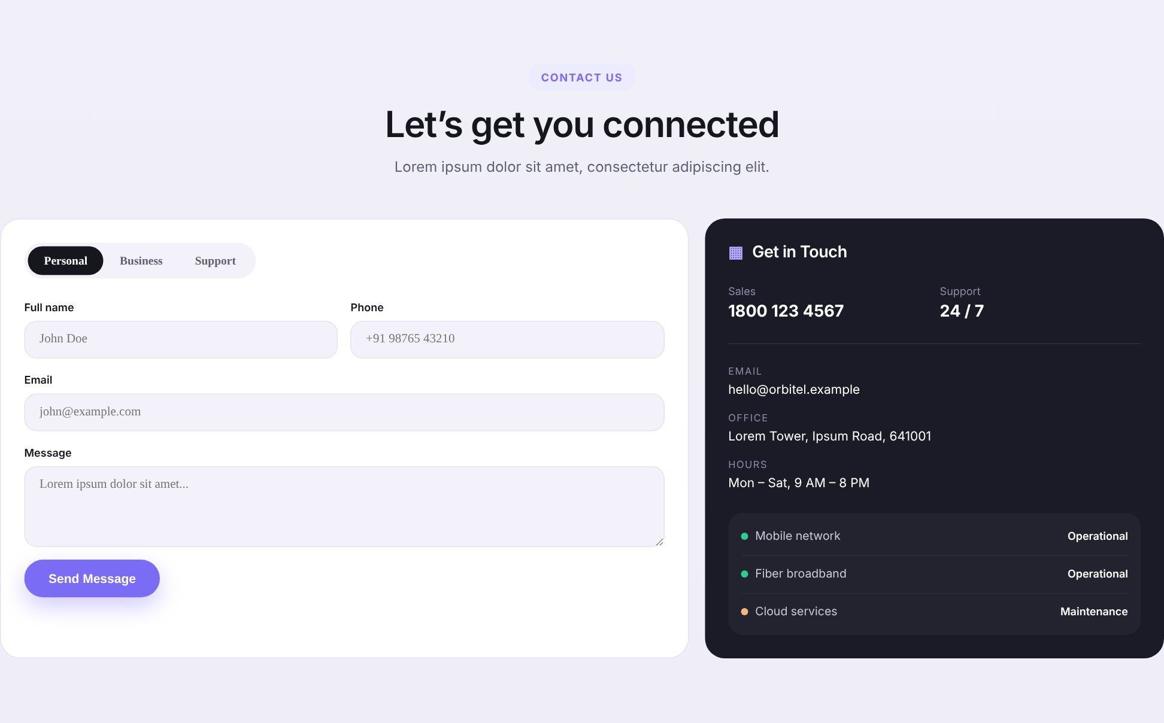
Contact Us page
06
One clear place to start a partnership conversation, with all enquiries sent to info@omaginfo.com.

Slide 35




Enquiry form and contact details
CONTACT US · SECTION 1 OF 2
omaginfo.com/contact
SAMPLE REFERENCE
CONTACT US
Connect with Omaginfo LLC
Discuss your routing requirements and explore opportunities for collaboration.
Layout
✱
✱
Centred heading; form card (1.5) + dark info card (1)
Mobile: form first, info card below; fields one per row
Voice / VoIP
SMS
Partnership
General
Get in Touch
Full name *
Company *
EMAIL
Content
Your name
Company name
info@omaginfo.com
Heading adapted from document text ('Connect with Omaginfo LLC…')
Email, phone, address and LinkedIn exactly as supplied (items 8–11)
Sample status panel, hours and 1800 number removed
Business email *
Phone
PHONE
name@company.com
+ country code
+1 (725) 465-8316
Message *
ZIP TBC
Tell us about your destinations and traffic requirements
OFFICE
1309 Coffeen Avenue, STE 1200, Sheridan, Wyoming, USA 8280
Visuals
LINKEDIN
Line icons for each contact item
Optional map embed of the office address (client to approve)
I agree to the Privacy Policy
Omaginfo LLC
Send Enquiry
✱
Business hours / time zone
Functionality
✱ Field labels, placeholders and toggle are proposed
TBC
Email → mailto:, phone → tel:, LinkedIn → company page
Form behaviour detailed on the next slide

Slide 36



How the enquiry form works
CONTACT US · SECTION 2 OF 2
1
2
3
4
5
Visitor opens form
Validation
Spam protection
Delivery
Confirmation
Directly, or from a page CTA with the enquiry type pre-selected (?type=voice / sms)
Required fields checked in the browser; invalid fields turn red with a short message
Hidden honeypot field + reCAPTCHA / Turnstile (client to choose)
Enquiry emailed to info@omaginfo.com with the type in the subject line
On-page success message ✱; optional auto-reply to the visitor
Field | Type | Required | Rule
Enquiry type | Toggle | Yes | Voice / VoIP · SMS · Partnership · General ✱
Full name | Text | Yes | At least 2 characters
Company | Text | Yes | Added for B2B context ✱
Business email | Email | Yes | Valid email format
Phone | Tel | No | Digits, spaces, + and - (international)
Message | Textarea | Yes | At least 5 characters
Privacy consent | Checkbox | Yes | Links to Privacy Policy (text TBC)
To confirm
Form handler: hosting SMTP, a form service or CMS plugin
Auto-reply wanted? If so, approve wording
Which spam protection to use
Store submissions anywhere besides email?

Slide 37
Delivery
07
Responsive design: how the site adapts to every screen, SEO groundwork, the items we need from you, and next steps.

Slide 38
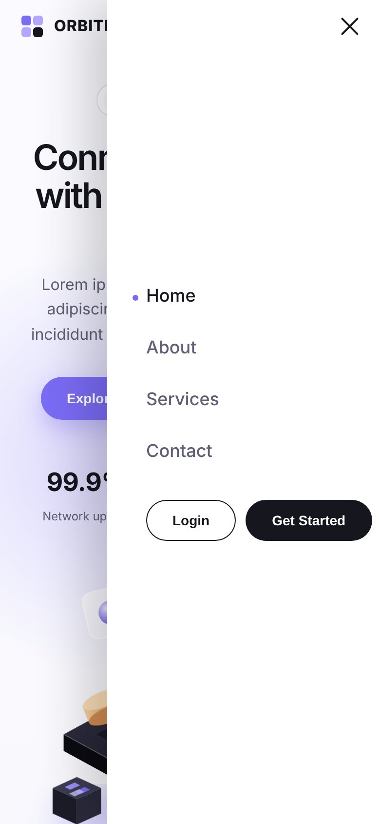
Breakpoints carried over from the sample
RESPONSIVE DESIGN
Screenshots of the sample site at each size (placeholder content shown).
Desktop 1440px
Tablet 820px
Mobile 390px
Mobile menu open
Width | Device | What changes
≥ 1080px | Desktop | Full layouts: 4-column bento, side-by-side founder cards, 2-column hero
900–1080px | Small laptop | Bento drops to 2 columns; founder cards stack
600–900px | Tablet | Hamburger menu; hero, about and contact become single column; footer 2 columns
< 600px | Phone | Everything single column; form fields one per row; timeline vertical; footer 1 column

Slide 39
Mobile layouts and recommendations
RESPONSIVE DESIGN
Recommendations
Hero text + 2 buttons
Breadcrumb · H1 · intro
Heading
Mobile-first build; test at 360, 390, 768, 1024 and 1440px
Touch targets ≥ 44px; primary CTA reachable without zooming
Services dropdown becomes an expandable item in the mobile menu
Contact details use tap-to-call and tap-to-email
Illustrations as lightweight SVG; photos as WebP with lazy loading
Heavy parallax/animation off on touch devices and for reduced-motion users
Hero headline scales fluidly (clamp) so it never wraps awkwardly
WCAG 2.1 AA contrast; visible focus states for keyboard users
Type toggle (scrolls)
Illustration
Illustration
Fields, one per row
Voice card
Capability card
SMS card
Capability card
Send Enquiry (full width)
Numbered / tick rows
Tap-to-call / email info card
Service cards (1 per row)
Footer
CTA band
Home
VoIP / SMS
Contact Us

Slide 40
SEO groundwork
SEO & TECHNICAL
Page | Proposed title tag ✱ | Primary terms (from the document)
Home | Omaginfo LLC | Global Voice & Messaging Connectivity | international voice termination, VoIP, SMS connectivity
About Us | About Omaginfo LLC | Global Connectivity. Trusted Partnerships. | telecommunications company, telecom partnerships
Services | Our Services | VoIP, SMS Routing & Direct Routes | Omaginfo LLC | SMS routing, direct route solutions, global telecom partnerships
VoIP | VoIP & International Voice Termination | Omaginfo LLC | A–Z voice termination, international voice connectivity
SMS | SMS Connectivity & A2P Messaging | Omaginfo LLC | A2P SMS, international SMS aggregators, direct SMS connectivity
Contact Us | Contact Omaginfo LLC | Partner with Us | Omaginfo LLC contact
Technical basics
Target region: Global (as supplied)
Unique meta description per page
One H1 per page; clean URLs (/services/voip)
Organization schema with address, phone, LinkedIn
XML sitemap, robots.txt, HTTPS
Google Search Console + analytics (access TBC)
Fast loading: SVG art, compressed images
Only 'Global' was supplied for keywords/regions; the terms above come from the client's own service wording. Additional keywords or priority countries to be confirmed.

Slide 41
Assets we need from you
FOR CLIENT APPROVAL
# | Asset | Used on | Status
1 | Logo — vector (SVG/AI/EPS), full-colour and white versions; favicon | Navbar, footer, browser tab | Required
2 | Brand colours and fonts (if any exist) | Whole site (else sample palette is used) | Confirm
3 | Professional headshots of Gaurav Goyal and Aastha Gupta | About Us – Leadership | Required
4 | Founders' LinkedIn profile URLs and (optional) public emails | Founder cards | Required
5 | Optional founder quotes and years of experience | Founder cards | Optional
6 | Verified figures, if you want a stats row (e.g. destinations, partners) | Home hero, About | Optional
7 | Founding year and milestones for a timeline | About Us – Our Story | Optional
8 | Privacy Policy and Terms of Use text | Footer links, form consent | Required
9 | Any certifications or partner logos — only with written permission | Home / About (if supplied) | Optional
10 | Approval of illustration style (isometric SVG, sample-based) | Hero and page headers | Approve

Slide 42





Information to confirm before design starts
FOR CLIENT APPROVAL
Address ZIP code
Business hours & time zone
Supplied as 'Sheridan, Wyoming, USA 8280'. US ZIP codes have five digits, so this looks incomplete — please confirm the exact code. Also confirm you want it shown publicly and on a map.
Not supplied. Shown on Contact Us only if provided; otherwise the line is removed.
Domain & hosting
Login / client portal
We assume omaginfo.com (from the email address). Confirm domain, hosting and who manages DNS.
Sample had a 'Login' button. Remove unless you have a portal URL to link to.
Newsletter
Proposed microcopy (✱)
Sample had a newsletter sign-up. Removed — not mentioned in the brief. Confirm if wanted.
Button labels, form labels, eyebrows and short captions were written by us. Please approve or edit.
Page structure
Other social channels
Approve the 6-page sitemap, or tell us if Direct Routes / Partnerships need their own pages.
Only LinkedIn was supplied. Add any others you want linked.

Slide 43
From proposal to launch
NEXT STEPS
1
2
3
4
5
Approve
Supply
Design
Build
Review & launch
Sitemap, visual direction and proposed copy (✱)
Logo, photos, legal text and items marked TBC
High-fidelity designs for all 6 pages, desktop + mobile
Responsive development, form setup, SEO basics
Content check, cross-device testing, go-live
Timeline and pricing to be agreed separately once the scope above is approved.

