Slide 1
SUPPLIER DECISION SUPPORT
Causora
The algorithm behind
an inspectable AI decision
Simulation computes the tradeoffs.
AI challenges the reasoning. Humans make the final call.
CAUSORA
01

Slide 2
ALGORITHM AND RUNTIME
The renewal decision
26,000 units
Locked forecast
60% minimum share
15,600 units committed to Supplier A
Demand falls to 22,100 units
The commitment stays fixed as demand falls
CAUSORA
02

Slide 3
ALGORITHM AND RUNTIME
Monte Carlo sampling
1,000 trials × 104 weeks
Demand
Supplier A
Supplier B
Bootstrap historical
weekly observations
Bootstrap observed
lead times
Triangular lead times
with explicit assumptions
PCG64 seed 1042026 reuses the same world draws across options
CAUSORA
03

Slide 4
ALGORITHM AND RUNTIME
Inventory and cost calculation
Available = opening stock + arrivals
Filled demand = min(demand, available)
Shortage = demand − filled demand
Inventory position triggers replenishment
Expected TCO
Mean purchase + holding + shortage loss + renewal premium + exit fee
CAUSORA
04

Slide 5
ALGORITHM AND RUNTIME
Constraint screening before cost ranking
Contract feasibility, stockout ≤ 12%, cash P90 ≤ $480,000
Baseline option | Expected TCO | Stockout | Eligibility
D0 Keep A | $365,811 | 91.9% | Fails risk
D1 Minimum A + B | $348,040 | 0.8% | Eligible
D2 Exit A | $356,665 | 89.5% | Fails risk
Among eligible options, code selects the lowest expected TCO
CAUSORA
05

Slide 6
ALGORITHM AND RUNTIME
Real AI review through OpenRouter
CFO, COO and Risk review in parallel
Critic examines cross-view issues and evidence coverage
Synthesizer produces a structured decision brief
Validators check numbers, evidence and matching run identity
Normal path: 5 provider calls. Bounded correction or fallback may add 1.
CAUSORA
06

Slide 7
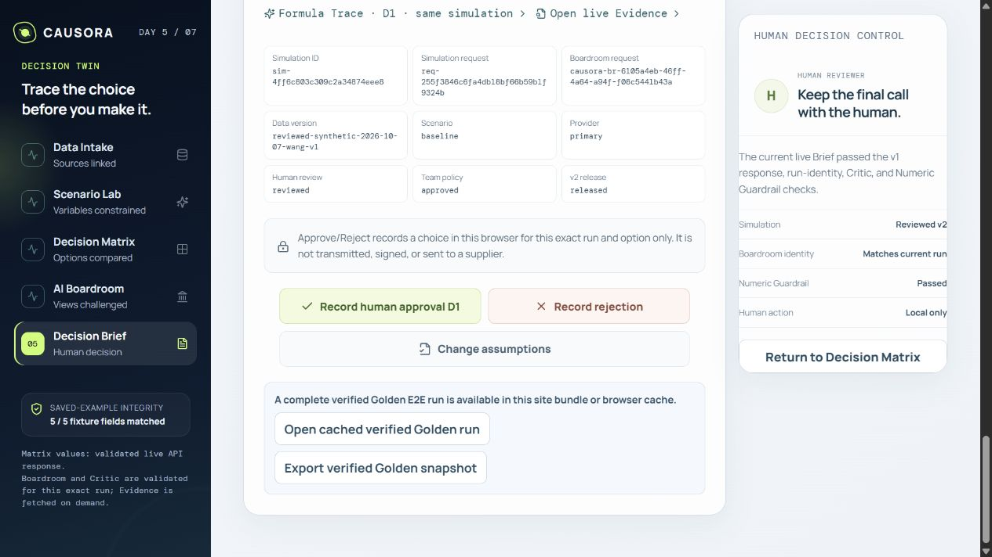
ALGORITHM AND RUNTIME
Runtime and human decision control
Vercel frontend calls the Render API
PostgreSQL stores the shared AI budget
Matching validated runs enable the human controls
AI failure preserves the Matrix and Formula Trace
CAUSORA
07

Slide 8
ALGORITHM AND RUNTIME
Differentiation through inspectable decisions
Design choice | What a reviewer can inspect
Shared simulation draws | Fair option comparisons under the same sampled worlds
Formula and evidence links | How a number and contract constraint support a claim
Constrained AI roles + Critic | Where perspectives disagree and compound risks appear
Validation + run identity | Whether the brief matches the calculation on screen
Target user: procurement teams reviewing a constrained supplier renewal
CAUSORA
08

Slide 9
ALGORITHM AND RUNTIME
Evidence and remaining limits
Verified
A complete real review with 5 returned stages
Recorded provider cost of $0.02016645
Repeatable seeded simulation
Still to establish
Real company data and wider user testing
Independent review-quality benchmarks
Reliability across repeated public runs
CAUSORA
09

