Slide 1
Bloom Filter for Big Data FileSystems
A Project by Hongchao Wang, Ding LI, Raghav Sairam

Slide 2
Motivation
The exponentially growth of data requires us to rethink the traditional file system.
From experiences of managing a large number of files for analytic workloads, we observed that when the number of files in one directory exceeds some thousands, the performance of traditional operating system degrades dramatically. The intuition is that existing file systems did not take into consideration the exponentially growth of data due to advances of technologies such as cloud computing, Internet of Things, machine generated data, etc;.
Most importantly, the need to analyse all the data efficiently. This pushes us to implement a cache conscious metadata scheme for big data filesystems which is achieved by using the bloom filter.

Slide 3
Introduction
This project aims at implementing a file system metadata scheme that uses bloom filter to avoid unnecessary SSD/disk accesses.
This mechanism is especially useful for big data file systems (i.e. HDFS, ClusterFS) where at least hundreds of thousands of files exist in each directory and analytical queries over those files are required.
The experiment shows that our method dramatically improved file query performance compared to the existing scheme. In addition, the implementation overhead of the proposed scheme is small.

Slide 4
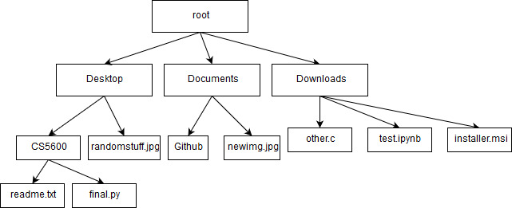
Filesystem Tree
We use a file-system tree to represent directories, subdirectories, and files.
The data structure we use is an n-ary tree, so-called because a node of the tree could have any number of children.

Slide 5
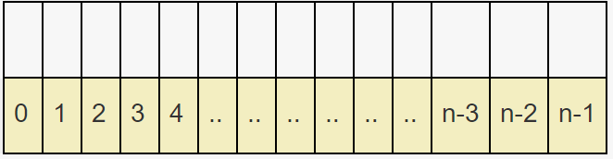
Why Bloom Filter?
The bloom filter is a probabilistic data structure that is used to maintain/test the membership of an element in a set.
In other words, it tells us if an element is definitely not in the set or maybe in the set.
The underlying data structure is a bit vector which is used to maintain the candidacy of an element.
Consider the following n bit vector:
To add an element to the filter, the element is simply hashed a few times and the index given by these hash functions are set to 1 in the bit vector.

Slide 6
Why Bloom Filter?
Consider the following input: “The quick brown fox jumps over the lazy dog.”
murmur(“The quick brown fox jumps over the lazy dog.”) = 8
fnv (“The quick brown fox jumps over the lazy dog.”) = 2
Results in the bit at index 2 and 8 being set to 1.
Consequently, it is sufficient to hash an element and check if the corresponding bits are set in the filter to check the membership of an element.

Slide 7
Choosing A HASH (CRC32)
The CRC32 (32 Bit Cyclic Redundancy Check) is an error detection code used to check the integrity of the data (a checksum) which is commonly used for error detection in networks and storage devices.
Since speed is of the essence in querying operations, the hash function used must be computationally inexpensive.
To elaborate on this, consider the SHA-256 vs CRC32. Although SHA-256 is stronger (lesser collisions and harder to reverse), the bloom filter does not benefit from these advantages.
Truncating the SHA-256 to a desired length leads to many collisions (for inputs that differ by 1 or 2 bytes).
The CRC is designed towards reliably detecting such errors and is well protected against such cases.

Slide 8
Proposed Mechanism
For every directory with a large number of files (>10,000), we maintain a bloom filter as the metadata for this path.
When a file is requested, the file system traverses the tree from the root to the leaf to obtain this metadata, and determine the status of this file (exists or not). If there is a match, the filesystem continues to access that file; otherwise the filesystem goes to other locations or abort this request.

Slide 9
Demo

Slide 10

Fine Tuning Parameters
Consider a bloom filter with k hash functions, m bits in the filter and n elements already inserted.
An obvious effect of using more hash functions is the accuracy. The trade-off being the speed of the bloom filter.
For an error rate e, the ideal number of hashes and filter bits are given by,
Although choosing these values appears ideal on first sight, the size of the filter does not scale reliably the size of disk space.
The parameters were tested across multiple values of n to avoid overfitting.

Slide 11
A randomized tuning approach
The efficiency of the bloom filter can be measured by the lookup times for these (n, k, m) triples. For best tuning these values a common implementation is,
Choose a disk size.
A value for the length of the filter is chosen.
An optimal value for the number of hashes is calculated.
If this falls within acceptable error rates, the process is complete. If it is not, the process is repeated with different filter lengths until an acceptable performance is obtained.

Slide 12
Benchmark Performance
The experiment is run on MacBook Pro 2016 with 2.9 GHz Intel Core i5 processor and 8GB 2133 MHz LPDDR3 RAM.
We generated 10,000 small files in a test directory whose names were collected from an English dictionary. We compared two ways to access the same random file: (1) using system call “access” to request it; (2) checking the metadata first and then request it depending on the feedback.

Slide 13
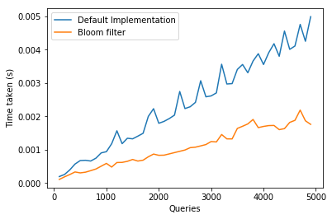
Benchmark Performance
The experiment shows that the effectiveness of file manipulation increases apparently even for not so many (10,000) files.
Besides from query time being shorter, it is also more stable without sudden spikes. We argue this is a useful attribute for big data filesystems.

Slide 14
Problems Faced and future work
It is not a comprehensive benchmark.
Only suitable for certain workloads.
Implement a dynamic bloom filter.
Explore performance of more data structures for further optimization.
Using machine learning algorithms to predict file access pattern.

Slide 15
Fin

