Slide 1
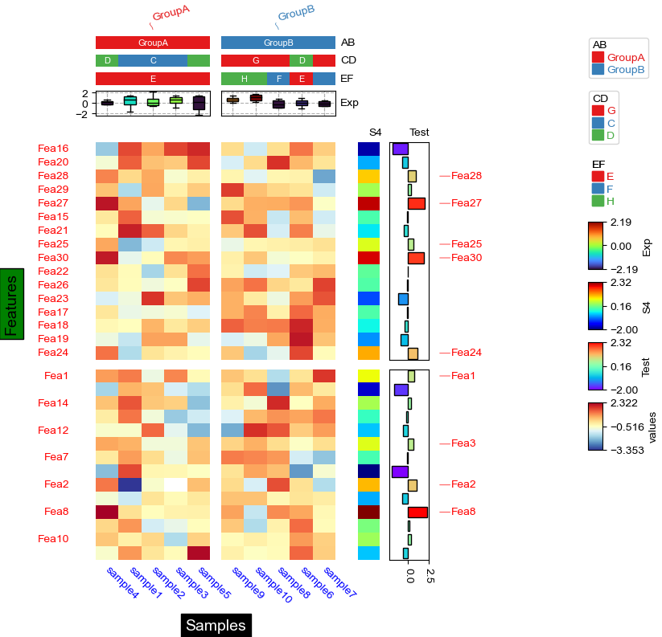
col_split_gap
legend_vpad
hgap
legend_gap
subplot_gap
legend_hpad
row_split_gap
xlabel_kws: labelpad
ylabel_kws: labelpad
wgap
yticklabels_kws: pad

