Slide 1
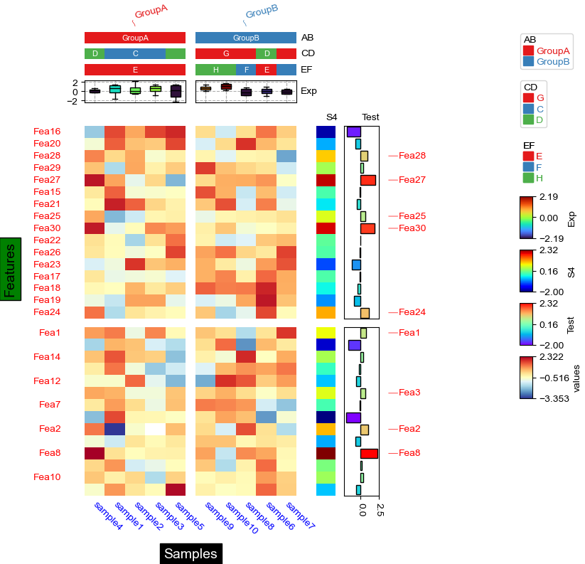
col_split_gap
legend_width
legend_vpad
hgap
legend_vgap
subplot_gap
legend_order
legend_hpad
legend_kws
[‘cbar_height’]
row_split_gap
1st column of legend
2nd column of legend
legend_hgap
xlabel_kws: labelpad
ylabel_kws: labelpad
wgap
yticklabels_kws: pad

