Slide 1


Engineering the
quantum circuit
From Josephson quantisation to
error-corrected logical memory
How did quantum behaviour become protected quantum information?
1985
2007
2025
Can a circuit have
quantized energy levels?
Can design reduce
charge-noise sensitivity?
Can a larger code
reduce logical errors?
Martinis et al. (1985) · Koch et al. (2007) · Google Quantum AI and Collaborators (2025)
01

Slide 2

Contents
Introduction
03
Phase 1 · Quantized circuit levels
05
Phase 2 · Charge-stable qubits
10
Phase 3 · Logical protection
15
Conclusion
21
References
23
Backup slides
25
02

Slide 3
Introduction
03

Slide 4
Introduction
Quantum information in a circuit
Why superconductivity?
Superconducting quantum computing uses
engineered circuit states to carry information.
Cooper pairs share a
collective quantum state.
Electrical dissipation is
reduced; loss still remains.
The challenge: resolve, control and preserve
those states in a noisy physical device.
THREE GUIDING QUESTIONS IN EVERY PHASE
1 Key question
2 Methodology
3 Noise and errors
Martinis et al. (1985); Koch et al. (2007); Google Quantum AI and Collaborators (2025).
04

Slide 5
PHASE 1 · 1985
Quantized
circuit levels
05

Slide 6
PHASE 1 · 1 KEY QUESTION
Unequal energy gaps enable selective control
Can a fabricated circuit exhibit discrete quantum energy levels?
LC oscillator
Josephson junction
Capacitor + linear inductor
Weak link → nonlinear inductance
|2⟩
|2⟩
Equal gaps
Unequal gaps
|1⟩
The same frequency
can excite both steps.
|1⟩
Suitable pulses can
distinguish the steps.
|0⟩
|0⟩
Leakage outside the chosen |0⟩, |1⟩ space
Selective control; leakage is still possible
Schematic energy levels; |0⟩ and |1⟩ are selected circuit states.
Lecture 7, “Implementation”, pp. 25–27; Koch et al. (2007), Sec. II.
06

Slide 7
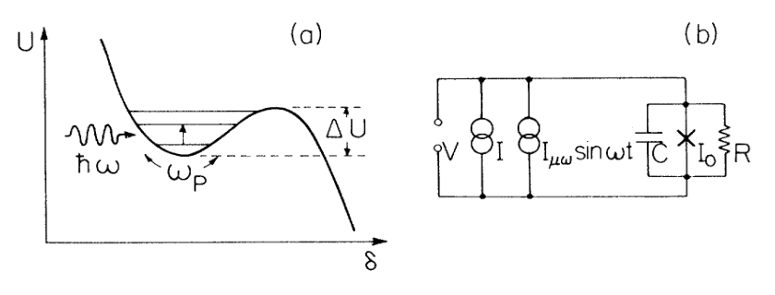
PHASE 1 · 2 METHODOLOGY
A collective circuit variable becomes measurable
What is moving?
The collective phase
difference across
the junction.
hf = E₁ − E₀
The “particle” is not an electron
moving in real space.
Original Fig. 1(a–b): potential and current-biased circuit
1 Trapped
2 Excited
3 Escaped
Zero-voltage state
Microwaves raise the energy
Measurable voltage
Martinis, Devoret & Clarke (1985), Fig. 1(a–b), p. 1543.
07

Slide 8
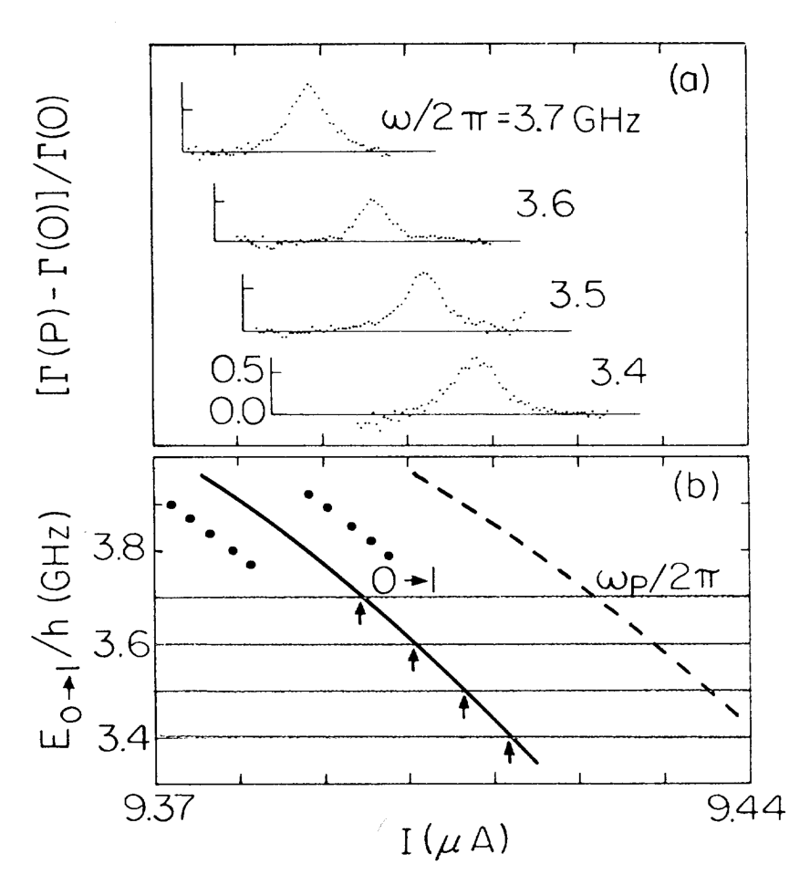
PHASE 1 · 2 METHODOLOGY
Microwave escape resonances
support quantized levels
1 Hold frequency. Sweep current.
Panel (a): relative escape-rate enhancement.
Each trace uses one fixed microwave frequency.
2 Compare the resonance positions.
Panel (b): quantum level spacing fits the shifts.
The dashed classical prediction differs.
Agreement with quantum predictions
Independent junction parameters; 18 mK.
A peak alone is not uniquely quantum.
I: bias current (μA) · E₀₁/h: frequency (GHz)
Martinis, Devoret & Clarke (1985), Fig. 3, pp. 1544–1545.
08

Slide 9
PHASE 1 · 3 NOISE AND ERRORS
Noise control made the measurement reliable
1 COOL
2 FILTER
3 RECOVER
18 mK
Quiet inputs
Allow cooling
Reduce unwanted
excitation from heat.
Filter electrical lines
to reduce unwanted
external signals.
Remove the bias after
switching; let heating
become negligible.
Temperature for Fig. 3 data
These precautions revealed discrete energy levels.
Controlled manipulation and preservation of a qubit remained to be demonstrated.
Martinis, Devoret & Clarke (1985), pp. 1543–1545; Fig. 3.
09

Slide 10
PHASE 2 · 2007
Charge-stable
qubits
10

Slide 11
PHASE 2 · 1 KEY QUESTION
Can a qubit be less sensitive to charge?
In a Cooper-pair box, environmental charge shifts the transition frequency.
Repeated experiments then accumulate different relative phases.
Charge fluctuates
→
Frequency shifts
→
Phase is uncertain
The environment
changes.
The “clock rate” drifts.
This is dephasing.
Reduce charge sensitivity while keeping unequal energy gaps.
The transmon develops from the Cooper-pair box, rather than directly modifying the 1985 device.
Koch et al. (2007), Sec. I and Sec. II A–D.
11

Slide 12
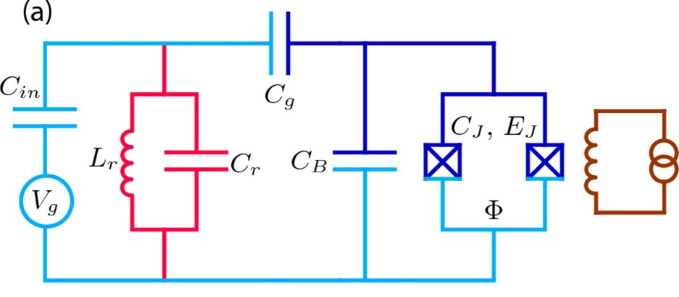
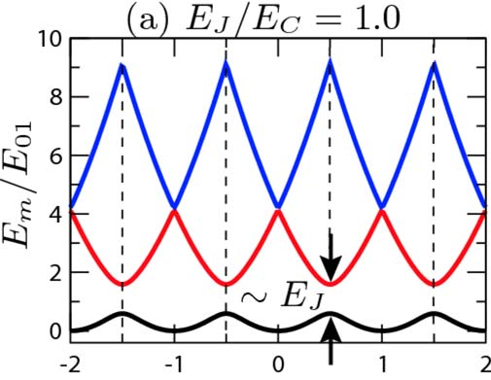
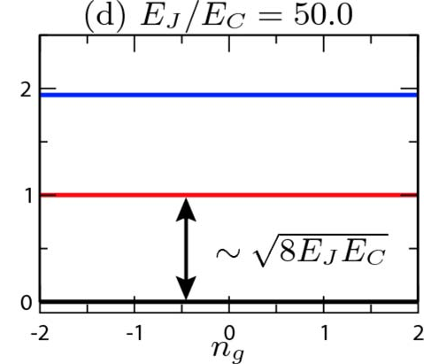
PHASE 2 · 2 METHODOLOGY
Larger capacitance reduces charge sensitivity
1 Change the circuit
2 Calculate the charge dependence
Larger CΣ → lower E꜀
→ larger Eⱼ/E꜀
E꜀: charging energy
Eⱼ: Josephson coupling energy
nɡ is offset charge; each panel uses its own E₀₁ scale.
Read (a) → (d): flatter curves mean less sensitivity.
Theoretical design and numerical results: charge dispersion is strongly suppressed.
Koch et al. (2007), Fig. 1(a), Fig. 2(a,d), Sec. II A–D.
12

Slide 13
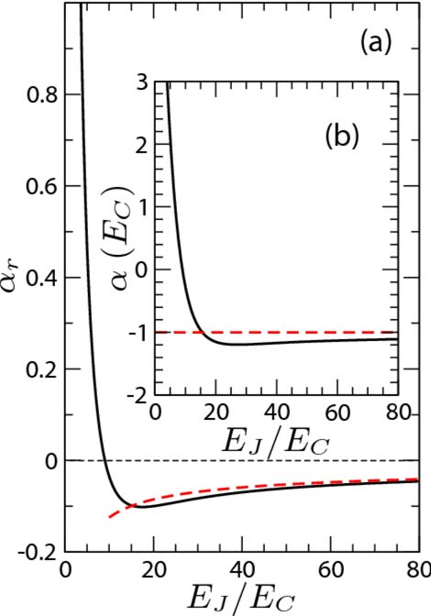
PHASE 2 · 3 NOISE AND ERRORS
Charge stability comes with a control trade-off
Less charge sensitivity
The fluctuations remain; their effect is smaller.
Closer transition frequencies
|2⟩
More leakage risk
|1⟩
Selective driving
becomes harder.
|0⟩
Energy-level schematic
Useful anharmonicity remains.
Fig. 5(a,b): theoretical calculation
In (a), relative spacing differences decrease; (b) approaches −E꜀.
Koch et al. (2007), Fig. 5(a–b), Sec. II B–C.
13

Slide 14
PHASE 2 · 3 NOISE AND ERRORS
Better physical qubits still need
logical protection
One physical qubit
One logical qubit
|ψ⟩
…
Residual errors remain.
Encoded jointly across physical qubits.
Hardware quality still matters.
Not copies of an unknown state. Schematic.
Relaxation · dephasing · gate and measurement errors · leakage
The 2025 experiment uses a transmon array.
Better hardware + repeated error correction
Google Quantum AI and Collaborators (2025), pp. 920–921.
14

Slide 15
PHASE 3 · 2025
Logical protection
15

Slide 16
PHASE 3 · 1 KEY QUESTION
Can a larger code make a better memory?
A logical qubit distributes information across physical qubits.
Test whether logical errors decrease as code distance grows.
3
5
7
Code distance d: increasing protection against combinations of physical errors
Larger codes help when physical errors are sufficiently low: below threshold.
Google Quantum AI and Collaborators (2025), pp. 920–921, Eq. (1).
16

Slide 17
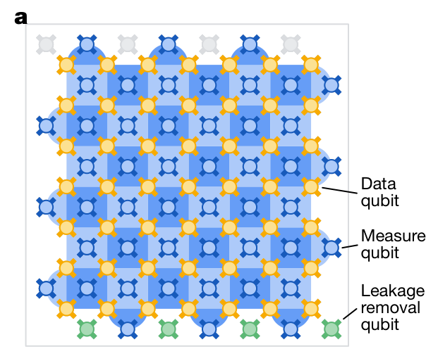
PHASE 3 · 2 METHODOLOGY
Repeated checks reveal errors without reading the data
101 physical qubits
Distance-7 code on a 105-qubit processor
49 data + 48 measurement
+ 4 additional leakage-removal qubits
Read the pattern of checks
Parity checks compare collective
properties.
Changes supply clues about errors.
A decoder infers the likely error pattern.
Google Quantum AI and Collaborators (2025), Fig. 1(a), p. 921.
17

Slide 18
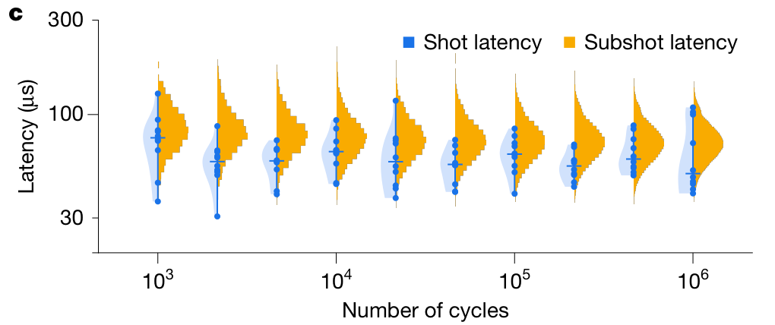
PHASE 3 · 2 METHODOLOGY
Real-time decoding must keep pace with the circuit
Separate distance-5 experiment · 72-qubit processor · sparse-blossom decoder
1.1 μs
Quantum correction cycle
63 ± 17 μs
Mean decoding latency
Throughput keeps pace.
Latency is the output delay,
not the time between cycles.
Read left → right: latency stays roughly constant as runs grow.
Google Quantum AI and Collaborators (2025), Fig. 4(c), “Real-time decoding”, p. 924.
18

Slide 19
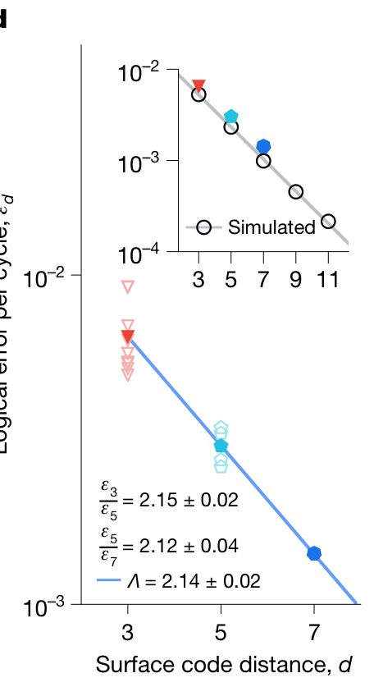
PHASE 3 · 3 NOISE AND ERRORS
Larger codes suppress logical errors below threshold
Λ = 2.14 ± 0.02
Each +2 in code distance more than halves logical error.
Fig. 1(d), main panel: neural-network decoder; distances 3, 5, 7.
Active data-qubit leakage removal
Remove leaked population to keep leakage short-lived.
291 ± 6 μs
Distance-7 logical memory lifetime
More than twice the lifetime of its best constituent physical qubit.
Google Quantum AI and Collaborators (2025), Fig. 1(d), pp. 921–922.
19

Slide 20
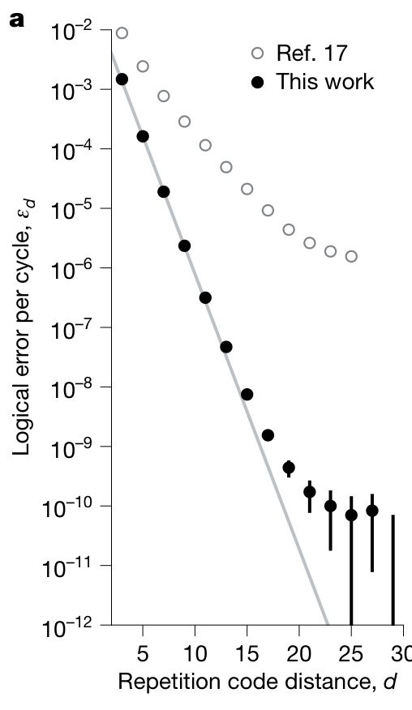
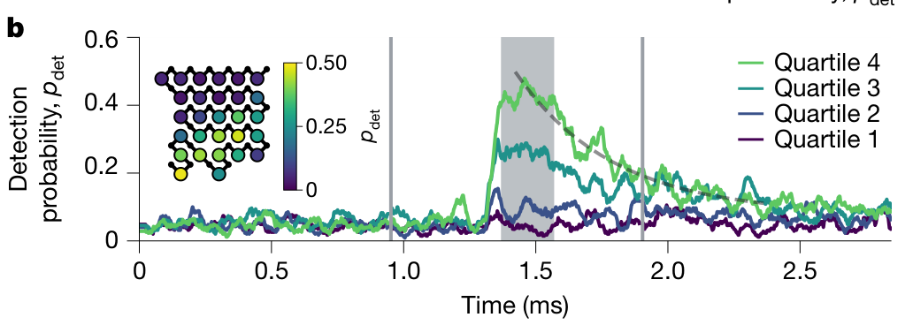
PHASE 3 · 3 NOISE AND ERRORS
Rare correlated bursts expose another challenge
2 Many qubits are disturbed together.
Repetition codes: apparent error floor
around 10⁻¹⁰ per cycle.
Roughly hourly bursts across ~30 qubits; origin unknown.
1 Scaling departs from the trend.
A separate repetition-code study, not a universal surface-code limit.
Google Quantum AI and Collaborators (2025), Fig. 3(a–b), “A repetition code memory…”, p. 923.
20

Slide 21
Conclusion
21

Slide 22
CONCLUSION
Protection now depends on the whole system
1985
2007
2025
Resolve the levels
Improve the device
Protect the memory
Spectroscopy revealed
quantization of a
collective circuit variable.
The transmon reduced
charge sensitivity while
retaining unequal gaps.
Encoding, repeated checks
and decoding extended
logical memory lifetime.
Make the measurement reliable.
Reduce sensitivity to disturbance.
Manage errors across the system.
Logical memory can outlive its constituent physical qubits.
Next: scale hardware and control, and understand correlated noise.
Martinis et al. (1985); Koch et al. (2007); Google Quantum AI and Collaborators (2025).
22

Slide 23
References
23

Slide 24
References
1 Observation — Martinis, Devoret & Clarke (1985)
“Energy-Level Quantization in the Zero-Voltage State of a Current-Biased Josephson Junction.”
Physical Review Letters 55, 1543–1546. DOI: 10.1103/PhysRevLett.55.1543
2 Design — Koch et al. (2007)
“Charge-insensitive qubit design derived from the Cooper pair box.”
Physical Review A 76, 042319. DOI: 10.1103/PhysRevA.76.042319
3 Protection — Google Quantum AI and Collaborators (2025)
“Quantum error correction below the surface code threshold.”
Nature 638, 920–926. DOI: 10.1038/s41586-024-08449-y
Background: Lecture 7, “Implementation”, pp. 25–27 (course slides supplied by the presenter).
24

Slide 25
Backup slides
25

Slide 26
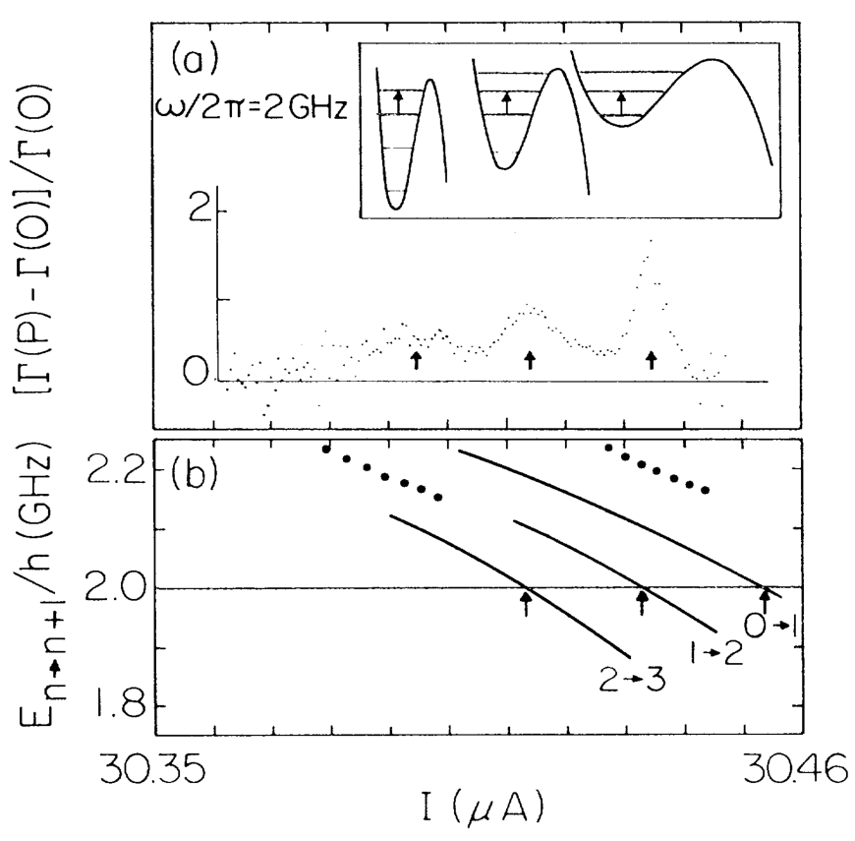
BACKUP SLIDES
What the 1985 evidence establishes
1 Fig. 2: several transitions
Fixed 2 GHz; sweep bias current.
Predicted 0→1, 1→2 and 2→3 resonances.
2 Fig. 3: test resonance positions
Independent junction parameters constrain theory.
Quantum and classical predictions differ.
3 Linewidth is an inference
Authors inferred coherence times up to 40 ns.
This was not a Ramsey T₂ measurement.
No controlled Rabi/Ramsey operation shown.
Martinis, Devoret & Clarke (1985), Figs. 2–4, pp. 1544–1545.
26

Slide 27
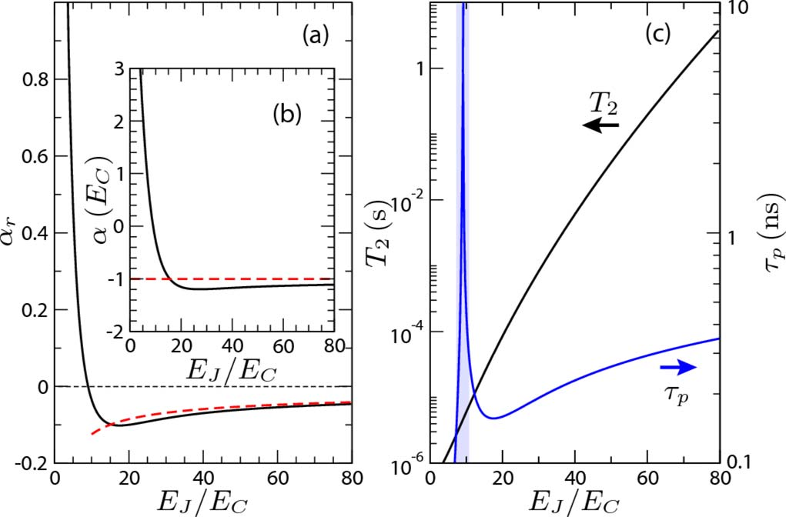
BACKUP SLIDES
Why the transmon trade-off works
$$H=4E_{C}{\left(n−n_{g}\right)}^{2}−E_{J}\cos{ϕ}$$
n: Cooper-pair number; nɡ: offset charge
φ: phase difference; Eⱼ and E꜀: energies
Charge dispersion
$\exp\left[−\sqrt{8E_{J}/E_{C}}\right]$
Leading exponential; algebraic prefactors omitted.
Anharmonicity at large Eⱼ/E꜀
$α_{E}=E_{12}−E_{01}≈−E_{C}$
$α_{r}=α_{E}/E_{01}≈−{\left(8E_{J}/E_{C}\right)}^{−1/2}$
αE has energy units; αE/h is in Hz.
Fig. 5: calculation, not measured coherence.
Koch et al. (2007), Eqs. (2.1), (2.5), (2.12), Fig. 5.
27

Slide 28
BACKUP SLIDES
Keep the 2025 experiments distinct
1 Distance-7 surface-code memory
101 qubits used · neural-network decoder · Λ = 2.14 ± 0.02
Lifetime 291 ± 6 μs; best physical qubit 119 ± 13 μs; advantage 2.4 ± 0.3. [Fig. 1; pp. 921–922]
2 Distance-5 real-time decoding
72-qubit processor · sparse-blossom decoder · 63 ± 17 μs mean latency
1.1 μs correction cycle; streaming throughput keeps pace despite longer output latency. [Fig. 4; p. 924]
3 Repetition-code study up to distance 29
Apparent error floor ~10⁻¹⁰ per cycle · rare correlated bursts · unknown origin
A device- and experiment-specific limitation, not a universal thermodynamic bound. [Fig. 3; p. 923]
Google Quantum AI and Collaborators (2025), Nature 638, 920–926.
28

