Slide 1
Our idea
1
One free app for deciding where to eat, with ratings you can trust.
For
students and young professionals in Boston, starting at Northeastern
Who
want great places to eat but can't trust the ratings
Our app is
a free restaurant guide
That
puts reviews, posts, hours and booking for each place on one page
Unlike
checking Google Maps, Yelp, Instagram, TikTok and Beli one by one
Ours
only counts reviews from people who proved they ate there
Our value proposition. The app doesn't have a name yet.
Notes:
We’re building a free app that tells you where to eat in Boston. We’re starting at Northeastern.
It’s for students and young professionals who want a great meal but can’t trust the ratings. Right now you check Google Maps, then Yelp, then Instagram, then TikTok, then Beli, and you still end up guessing.
Our app puts the reviews, the posts, the hours and booking for a place on one page. And our score only counts people who proved they ate there.
We don’t have a name yet. Here’s why we think it’s worth building.

Slide 2
What we heard
2
Finding one good place to eat takes multiple apps, and people still get it wrong.
1
2
3
4
Google Maps
Instagram or TikTok
A friend
Then they go
to see what's nearby
to see the food
to check it's good
and it's still a miss
Nobody had one place to save where they want to go.
They want one app they can trust.
From 35 interviews with students and young professionals, Sep to Oct 2026.
Notes:
We talked to 35 students and young professionals this fall. Almost all of them described the same routine.
They open Google Maps to see what’s nearby. Then Instagram or TikTok to see the food. Then they ask a friend if it’s good. Then they go, and it’s still a miss.
Two things came up again and again. Nobody has one place to save where they want to go. And they want one app they can trust.
There’s plenty of information out there. Knowing which of it to trust is the hard part.

Slide 3
What we’re building
3
One page for every restaurant, and a score that only counts people who ate there.
Find
Compare
Keep
What's open near you
Filter by diet, price and distance
New places people are talking about
Every rating and post on one page
Our score only counts diners who scanned a receipt
Nobody pays to rank higher
Your history and lists
Scan a receipt, get a verified badge
Book a table
Dietary filters stay free: a halal or nut-free search is what sends a restaurant the diner it pays for. Nobody pays for placement.
The core app is free. If another app won't share its ratings, we link out to it.
Notes:
The app does three things: find, compare and keep.
Find: what’s open near you, filtered by diet, price and distance, plus new places people are talking about.
Compare: every rating and post for a place on one page, next to our own score. Our score only counts diners who scanned a receipt, and nobody can pay to rank higher.
Keep: your history, your lists, and booking a table.
All of it is free. You asked whether people would pay for a dietary filter. We think they shouldn’t. A halal or nut-free search is what sends a restaurant the diner it pays for, so it stays free.

Slide 4
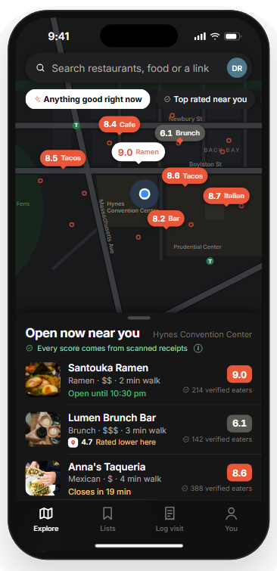
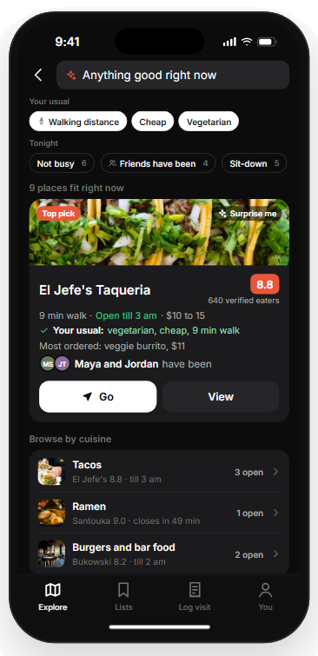
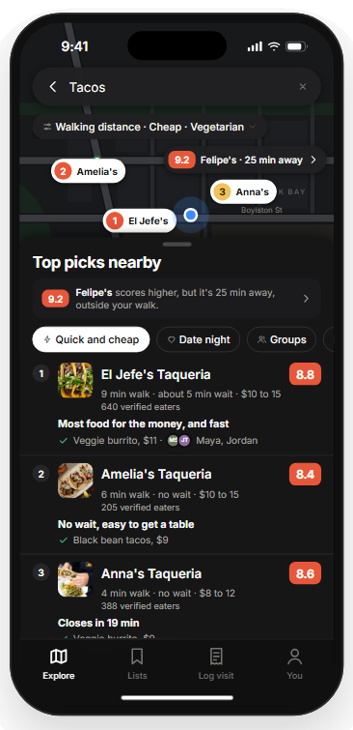
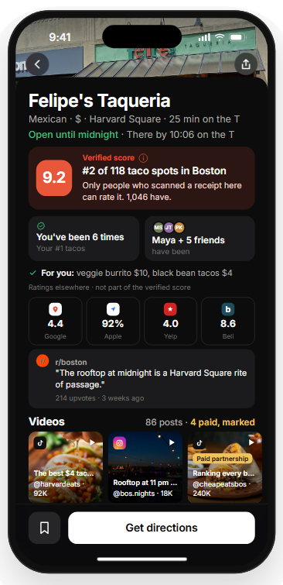
4
1 Start nearby
2 Let it pick
3 See why
4 Check every rating
What's open around you.
One best bet for your budget and diet.
Three picks, each with a reason.
Our verified score next to everyone else's, with creators' paid posts flagged.
Concept screens. Every score and person is made up. Photos: Unsplash; Daderot, Wikimedia Commons (CC0).
Notes:
These are four screens from our concept. Every score and person on them is made up.
One, start nearby. You open the app and see what’s open around you.
Two, let it pick. You get one best bet that’s open, close, in your budget and fits your diet, and you see which friends have been.
Three, see why. Three picks for the occasion, each with a reason.
Four, check every rating. Our verified score sits next to Google, Yelp, Beli, Reddit and TikTok, and creators’ paid posts are flagged.
Next we put this in front of students on campus.

Slide 5
Why it matters
5
We start with Boston's 162,000 students. About 19 million US students could use it.
Where we start
Our users by Year 5
Restaurants we can sign
162K
540K
3,350
Boston college students. Year 1 is 12K of them.
2.8% of US college students
Licensed places to eat in Boston
The market
77.8M people aged 18 to 34 (TAM), 19M US college students we can reach (SAM), 540K we plan to win (SOM).
Growth
Boston first. Other cities from Year 3.
Why not Beli
Beli ranks where you've been. We tell you where to go now, with scores people proved.
US Census Bureau, 2024 estimates. NCES Digest of Education Statistics 2024, fall 2023 enrollment. City of Boston Student Housing Report 2025 and license data, Oct 2026.
Notes:
Start with the smallest number. Boston has 162,000 college students, and we want 12,000 of them in Year 1.
Zoom out and there are about 19 million college students in the US. That’s who we can reach, one campus at a time. The bigger pool is 77.8 million people between 18 and 34.
By Year 5 we want 540,000 active users. That’s 2.8% of US college students, inside the 2 to 5% range we talked about in class.
On the other side, Boston has 3,350 licensed places to eat. Those are the businesses that will pay us.
People ask why not Beli. Beli ranks where you’ve been. We tell you where to go right now, with scores people proved.

Slide 6
How we win users
6
Our first 1,000 users come from Boston campuses, starting with ours, one friend inviting the next.
Who they are and where we find them
What we tell them
First 10
People we interviewed and our friends test the prototype.
Help us build it.
First 100
Northeastern students they invite, plus clubs and group chats.
Every rating for a place, in one app.
First 1,000
Other Boston campuses, through student ambassadors and food posts.
One app instead of five tabs.
Friends inviting friends gets us to 12K by the end of Year 1; about 80% of Beli's users arrived that way. Users never have to pay.
Beli referrals: Wall Street Journal, May 2025. User targets are from our Gate 2 model.
Notes:
How do we get our first users? One friend at a time.
The first ten are people we interviewed, plus our friends. They test the prototype this semester, and what we tell them is: help us build it.
The first hundred are Northeastern students they invite, plus clubs and group chats. Now the pitch is every rating for a place, in one app.
The first thousand come from other Boston campuses, through student ambassadors and food posts. One app instead of five tabs.
It’s the same loop every time. A friend tells you, you download, you save a place, you invite someone. About 80% of Beli’s users arrived that way, and it’s how we get to 12,000 by the end of Year 1.
Users never pay. Restaurants do, and that’s next.

Slide 7
How we make money
7
Restaurants pay for the diners we send, not for ads.
Their problem
What we charge
Year 5
Restaurants, booking sites, chains
Pay for ads up front and can't tell what worked. Chains guess what a neighborhood eats before signing a lease.
About $0.90 per new diner we send, once a receipt proves it. Booking sites pay per table. Chains: $6,000 a year per neighborhood.
$288K
Users
The app is free. About 3 in 1,000 pay for extras. What the $5 buys is our first Year 1 test.
An optional $5 a month membership.
$67K
Two sides pay, $356K in Year 5. Paying never changes a score or a ranking.
Next: five owner calls, each offered a free 30-day pilot and a report of the diners we sent.
OpenTable pricing via Eat App, 2026. TechCrunch, Aug 2024 (Placer.ai). Together these come to $356K of revenue in Year 5.
Notes:
Here’s how we make money. Restaurants pay for the diners we send them, not for ads.
Today a restaurant pays for ads and boosted posts before it knows if anyone will walk in. We flip that. It pays about 90 cents, and only after a receipt shows the diner came. OpenTable charges $1 to $1.50 a diner.
Booking sites pay per table. And from Year 3, chains pay $6,000 a year per neighborhood to see what people there eat. All of that adds up to $288,000 in Year 5.
On the user side the app is free. About 3 in 1,000 pay $5 a month for extras, and that’s another $67,000.
So $356,000 in Year 5. Nothing anyone pays changes a score or a ranking.
We haven’t talked to restaurant owners yet. Five owner calls are next, each with a free 30-day pilot and a report on the diners we sent.

Slide 8
What we learned
8
None of the apps before us made money early, so we kept ours lean.
What happened to them
What we did about it
OpenTable
Nine years to a profit, $57M lost getting there.
No salaries. Co-op students before hires.
Resy
Ran on $45M of investor money, then sold.
Costs low enough to need $240K, starting with grants.
Beli
1.1M monthly users, mostly through friends, five people, almost no revenue.
A quarter of its size, almost no ads, restaurants paying from Year 2.
The trade-off: a smaller team, and it only works if restaurants sign up.
OpenTable Form S-1, 2009. TechCrunch, May 2019 (Resy). Sensor Tower in the Boston Globe, Nov 2025, and Wall Street Journal, May 2025 (Beli). Resy never reported a profit.
Notes:
Before we built our numbers, we looked at the apps closest to us. None of them made money early.
OpenTable took nine years to turn a profit and lost $57 million getting there. Resy ran on $45 million of investor money and then sold. Beli has 1.1 million monthly users, mostly through friends, with five people and almost no revenue.
So we made three choices. No salaries, and co-op students before hires. Costs low enough that we only need about $240,000, starting with grants. And Beli as our yardstick: a quarter of its size, almost no ads, and restaurants paying from Year 2.
The trade-off is a smaller team, and it only works if restaurants sign up. Here’s what that means for us.

Slide 9
9
What it means
Restaurants start paying us in Year 2, and Year 5 is our first profit.
Notes:
So what does that add up to?
Restaurants start paying us in Year 2, and Year 5 is our first profitable year.
Here’s how the numbers get there.

Slide 10
The numbers
10
We spend about $11K a quarter for two years. Our lowest point is $192K, in Year 4.
$K | Q1 | Q2 | Q3 | Q4 | Q5 | Q6 | Q7 | Q8 | Yr 3 | Yr 4 | Yr 5
Active users (K) | 0 | 1.8 | 5.4 | 12.0 | 15.2 | 19.3 | 24.5 | 31.1 | 80 | 208 | 540
Revenue | 0 | 0 | 0 | 0 | 2.0 | 2.6 | 3.3 | 4.2 | 50 | 140 | 356
Spending | 10.6 | 10.6 | 10.6 | 10.7 | 10.9 | 10.9 | 11.0 | 11.1 | 117 | 191 | 283
Profit or loss | (10.6) | (10.6) | (10.6) | (10.7) | (8.8) | (8.3) | (7.7) | (7.0) | (67) | (51) | 72
Cumulative | (11) | (21) | (32) | (43) | (51) | (60) | (67) | (74) | (141) | (192) | (120)
What happens
Build the app
Launch in Boston
Grow by referral
12K users
First revenue
More restaurants
Pitch chains
Hire co-op for yr 3
Co-op students: 1, 2 and 3 in Years 3 to 5.
Highlighted: first revenue, the $192K low, and first profit. That low plus a 25% cushion sets the $240K total. Each quarter of Years 1 and 2: $7,500 developer, $1,500 marketing, $1,500 legal and insurance, plus hosting. Nobody else is paid until the angel round funds Year 3.
$K. Years 1 and 2 by quarter, years 3 to 5 by year. From our Gate 2 model; assumptions and sources are in the workbook.
Notes:
Here’s the detail. Look at the three highlighted numbers.
Years 1 and 2 are flat on purpose, about $11,000 a quarter. That’s a contract developer at $7,500, $1,500 for marketing, $1,500 for legal and insurance, and a little hosting. Nobody else gets paid until restaurants do.
The first highlight is Year 2, when the first revenue comes in. From Year 3, co-op students join as our users grow.
The second is the low point, about $192,000 down in Year 4. That’s why we’re raising $240,000: the low point plus a 25% cushion.
The third is Year 5, our first profitable year, at about $72,000.

Slide 11
How we’d fund it
11
We'd start on grants, as Beli did. One angel round of about $166K takes us to profit.
When
What we'd show to get it
Grants and competitions, about $74K
Years 1 and 2
IDEA Gap Fund and Boston pitch competitions. If we fall short, or the round slips, we cover the gap ourselves.
One angel round, about $166K
End of Year 2
31K Boston users, restaurants paying for four quarters, and receipt-proven visits.
$74K in grants plus $166K from angels: $240K in all. At $356K of Year 5 revenue we're too small for venture funds, so the angels' way out is a sale to a bigger platform or a card company, as Resy sold to American Express.
Beli: Wikipedia (Harvard grants); CB Insights ($5.3M, Nov 2023); Boston Globe, Nov 2025 (users). IDEA Gap Fund: Northeastern Global News. Amounts are from our Gate 2 model.
Notes:
Last piece: how we pay for it.
We start with grants, the way Beli did. Northeastern’s IDEA Gap Fund and pitch competitions around Boston, about $74,000, cover Years 1 and 2. If we fall short, we cover the gap ourselves.
At the end of Year 2 we raise one angel round, about $166,000. What we’ll show them is about 31,000 Boston users, a year of restaurants paying for diners we sent, and visits proven by receipts. We’d look for angels through IDEA, competition judges and our own networks.
Together that’s the $240,000. At $356,000 of revenue in Year 5 we’re too small for venture funds, so the angels’ way out is a sale to a bigger platform or a card company, the way Resy sold to American Express.
That’s the plan. Let me sum it up.

Slide 12
In summary
12
Boston students can’t trust the ratings. We’re building the one app they can.
Trust
Money
Path
Only diners who proved they ate there count toward our score.
Restaurants pay for the diners we send. Users never pay.
Grants first, then one angel round. Profit in Year 5.
Notes:
To sum up.
Boston students don’t trust the ratings they see, and checking five apps doesn’t fix it.
Trust: we’re building one free app that only counts people who proved they ate there.
Money: restaurants pay for the diners we send, so users never pay.
Path: we start on grants, raise one angel round, and reach a profit in Year 5.
Thank you. We’re happy to take questions.

Slide 13
Appendix
Two sides pay, and every price starts from a real company’s number. How many we sell is our guess.
Stream
Year 5
What they pay for and why
Businesses
$288K
Diners we send ($156K), tables booked ($54K) and area insights for chains ($78K). They pay for customers, not for ads. About $0.90 a diner sits under OpenTable’s $1.00 to $1.50, bookings are a quarter of Tabelog’s rate, and chains pay a quarter of Placer.ai’s.
Users
$67K
The optional $5 a month membership: extras on top of a free app, such as taste match with friends. About 0.3% pay, the same share as Tabelog’s users.
OpenTable pricing via Eat App, 2026. TechCrunch, Aug 2024 (Placer.ai). Kakaku.com results, Nov 2025 (Tabelog).
Notes:
This one is for questions. It shows where each price comes from.
Businesses pay $288,000 in Year 5: $156,000 for diners we send, $54,000 for tables booked and $78,000 for area insights for chains. About 90 cents a diner sits under OpenTable’s $1 to $1.50. Bookings are a quarter of Tabelog’s rate, and chains pay a quarter of what Placer.ai charges.
Users pay $67,000 for the optional $5 a month membership. About 0.3% sign up, the same share as Tabelog’s users.
Every price starts from a real company’s number. How many we sell is our guess.

