Slide 1
Our idea
1
A free app for deciding where to eat in Boston, with a score based on real visits.
For
students and young professionals in Boston, starting at Northeastern
Who
want a good place to eat without checking three apps first
Our app is
a free restaurant guide
That
puts reviews, posts, hours and booking for each place on one page
Unlike
checking Google Maps, Instagram or TikTok, and a friend one by one
Ours
only counts reviews from people who proved they ate there
Our value proposition. The app doesn't have a name yet.
Notes:
We’re working on a free app that helps you decide where to eat in Boston, starting at Northeastern.
Today most people check Google Maps, then Instagram or TikTok, then ask a friend. We’d put the reviews, posts, hours and booking for a place on one page, plus our own score that only counts people who scanned a receipt.
It doesn’t have a name yet, and we haven’t built it. This is the concept and the research behind it.

Slide 2
The challenge
2
Most people we talked to check three apps to pick one place to eat, and for many, it still misses.
1
2
3
Google Maps
Instagram or TikTok
A friend
to see what's nearby
to see the food
to check it's good
Most are okay with what they use now, but would try something better.
From 35 interviews with students and young professionals, Sep to Oct 2026.
Notes:
We interviewed 35 students and young professionals in September and October.
Most of them check three apps to pick one place. Google Maps to see what’s nearby, Instagram or TikTok to see the food, and a friend to check it’s good. Many said it still misses after all that.
Most people were okay with what they use now. But they told us they’d try something better.
It’s not a huge problem, it’s just annoying, and we think it can be easier.

Slide 3
The opportunity
3
One page per restaurant, and a score that only counts diners with a receipt.
Find
Compare
Keep
What's open near you
Filter by diet, price and distance
New places people are talking about
Other apps’ ratings, where allowed
Our score only counts diners who scanned a receipt
Nobody pays to rank higher
Your history and lists
Scan a receipt, get a verified badge
Book a table
Why not Beli? Beli is for ranking places you’ve been. We help you decide where to go next, with a score based on receipts.
The core app is free. If another app won't share its ratings, we link out to it.
Notes:
Here’s the idea: one page for each restaurant.
You can find what’s open near you, filtered by diet, price and distance. You can compare other apps’ ratings, where they let us show them, next to our score, which only counts diners with a receipt. If an app won’t share, we link out. And you can keep your lists and history, and book a table.
Dietary filters stay free. A halal or nut-free search is what sends a restaurant a diner, so it shouldn’t cost anything.
People ask about Beli a lot. Beli is for ranking places you’ve been. We’re about deciding where to go next.

Slide 4
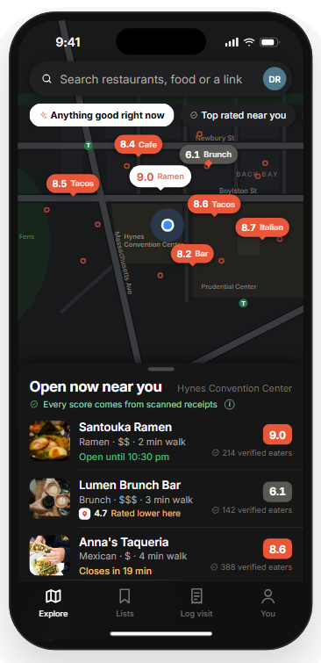
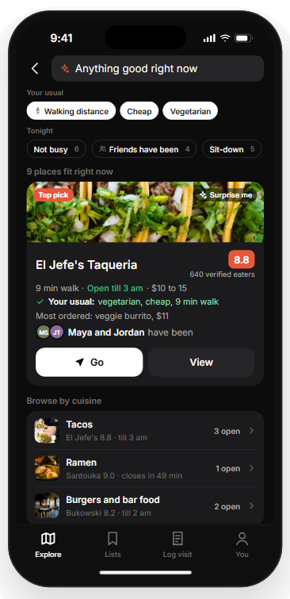
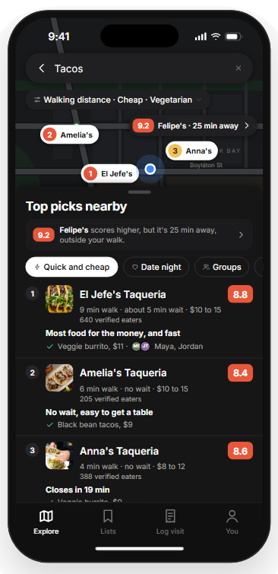
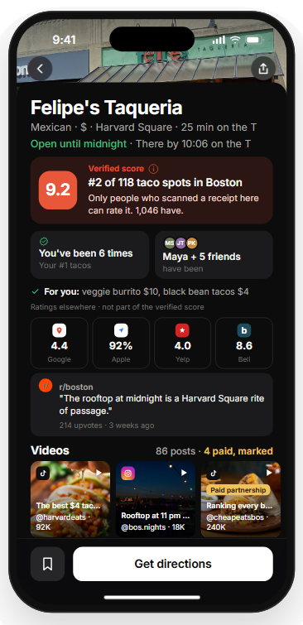
A first look
4
In our concept, it picks one place and shows you why.
1 Start nearby
2 Let it pick
3 See why
4 Check every rating
What's open around you.
One best bet for your budget and diet.
Three picks, each with a reason.
Our verified score next to everyone else's, with creators' paid posts flagged.
Concept screens. Every score and person is made up. Other apps’ ratings shown only where we’re allowed. Photos: Unsplash; Daderot, Wikimedia Commons (CC0).
Notes:
These are concept screens, and every score and person on them is made up.
You see what’s open nearby. The app suggests one place that fits your budget and diet, then gives three picks with a reason for each. The last screen puts our receipt score next to other apps’ ratings and flags paid posts.
We want to test these with students before we build anything.

Slide 5
How big it is
5
We start with Boston’s 162,000 students and aim for 540,000 US users by Year 5.
Where we start
Our users by Year 5
Restaurants in Boston
162K
540K
3,350
Boston college students. Year 1 is 12K of them.
2.8% of US college students
Licensed places to eat in Boston
The market
77.8M people aged 18 to 34 (TAM), 19M US college students we can reach (SAM), 540K we plan to win (SOM).
Growth
Boston first. Other cities from Year 3.
US Census Bureau, 2024 estimates. NCES Digest of Education Statistics 2024, fall 2023 enrollment. City of Boston Student Housing Report 2025 and license data, Oct 2026.
Notes:
If students like it, here’s how far it can go. Boston has about 162,000 college students, and we’re aiming for 12,000 of them in Year 1.
Across the US there are about 19 million college students. By Year 5 we’re aiming for 540,000 users. That’s about 2.8% of them, inside the 2 to 5% range we covered in class.
And Boston has 3,350 licensed places to eat.

Slide 6
How we’d get users
6
We plan to find our first 1,000 users on Boston campuses, starting with ours, one friend at a time.
Who they are and where we find them
What we tell them
First 10
People we interviewed and our friends test the prototype.
Help us build it.
First 100
Northeastern students they invite, plus clubs and group chats.
Every rating for a place, in one app.
First 1,000
Other Boston campuses, through student ambassadors and food posts.
One app instead of three.
If friends invite friends, our model reaches 12K users by the end of Year 1; about 80% of Beli’s users arrived that way.
Beli referrals: Wall Street Journal, May 2025. User targets are from our Gate 2 model.
Notes:
We’d grow mostly through friends, the way Beli did. About 80% of Beli’s users came that way.
The first ten users are people we interviewed and our friends. The next hundred are Northeastern students they invite, plus clubs and group chats. The first thousand come from other Boston campuses, through student ambassadors and food posts.
If that works, we get to 12,000 users by the end of Year 1.

Slide 7
How we’d make money
7
We’d charge restaurants per diner sent, not for ads.
Their problem
What we charge
Year 5
Restaurants, booking sites, chains
Pay for ads up front and can’t tell what worked.
About $0.90 per new diner whose visit started in our app, confirmed by receipt. Booking sites pay per table. Chains pay $6,000 a year per area from Year 3, counted from the month each signs.
$288K
Users
Want extras on top of a free app.
An optional $5 a month membership.
$67K
In our model, two sides pay: $356K in Year 5. Paying never changes a score or a ranking.
Not yet tested with owners. Next: five owner calls, each with a free 30-day pilot and a diner report.
OpenTable pricing via Eat App, 2026. TechCrunch, Aug 2024 (Placer.ai).
Notes:
Users never have to pay. We’d charge restaurants for the diners we send, not for ads.
A restaurant pays about 90 cents for a new diner whose visit started in our app, once a receipt confirms it. OpenTable charges $1 to $1.50. Booking sites pay per table, and from Year 3 chains pay $6,000 a year per area.
We’re also thinking about an optional $5 a month membership for extras. We expect about 3 in 1,000 users to sign up.
That’s $356,000 in Year 5, and nobody can pay to change a score.
We haven’t tested this with restaurant owners yet. Next we’re calling five owners and offering a free 30-day pilot.

Slide 8
What we learned from rivals
8
The apps closest to us took years to make money, so we kept our costs low.
What happened to them
What we did about it
OpenTable
Nine years to a profit, $57M lost getting there.
No founder salaries. Co-op students before full-time hires.
Resy
Ran on $45M of investor money, then sold.
Costs low enough to need $240K, starting with grants.
Beli
1.1M monthly users, mostly through friends, five people, almost no revenue.
A quarter of Beli’s size, almost no ad spending, restaurants paying from Year 2.
The trade-off: a smaller team, and it only works if restaurants sign up.
OpenTable Form S-1, 2009. TechCrunch, May 2019 (Resy). Sensor Tower in the Boston Globe, Nov 2025, and Wall Street Journal, May 2025 (Beli). Resy never reported a profit.
Notes:
Before we built our numbers, we looked at the apps closest to us.
OpenTable took nine years to make a profit and lost $57 million getting there. Resy ran on $45 million of investor money and then sold. Beli has 1.1 million monthly users, five people, and almost no revenue.
So we planned for slow money: no founder salaries, co-op students before full-time hires, and about $240,000 in total. We’re planning for a quarter of Beli’s size.
The trade-off is a small team, and it only works if restaurants sign up.

Slide 9
The numbers
9
We plan to spend about $11K a quarter for two years. Our model shows a first profit in Year 5.
$K | Q1 | Q2 | Q3 | Q4 | Q5 | Q6 | Q7 | Q8 | Yr 3 | Yr 4 | Yr 5
Active users (K) | 0 | 1.8 | 5.4 | 12.0 | 15.2 | 19.3 | 24.5 | 31.1 | 80 | 208 | 540
Revenue | 0 | 0 | 0 | 0 | 2.0 | 2.6 | 3.3 | 4.2 | 50 | 140 | 356
Spending | 10.6 | 10.6 | 10.6 | 10.7 | 10.8 | 10.9 | 11.0 | 11.1 | 117 | 191 | 283
Profit or loss | (10.6) | (10.6) | (10.6) | (10.7) | (8.8) | (8.3) | (7.7) | (7.0) | (67) | (51) | 72
Cumulative | (11) | (21) | (32) | (43) | (51) | (60) | (67) | (74) | (141) | (192) | (120)
What happens
Build the app
Launch in Boston
Grow by referral
12K users
First revenue
More restaurants
Pitch chains
Hire co-op
Co-op students: 1, 2 and 3 in Years 3 to 5.
Highlighted: first revenue, the $192K low, and first profit. That low plus a 25% cushion sets the $240K total. Each quarter of Years 1 and 2: $7,500 developer, $1,500 marketing, $1,500 legal and insurance, plus hosting. Nobody else is paid until the angel round funds Year 3.
$K. Years 1 and 2 by quarter, years 3 to 5 by year. From our Gate 2 model; assumptions and sources are in the workbook.
Notes:
We highlighted the three numbers to look at.
Years 1 and 2 cost about $11,000 a quarter: a contract developer at $7,500, $1,500 for marketing, $1,500 for legal and insurance, and hosting. No one else gets paid until the angel round funds Year 3.
First revenue comes in Year 2. Our low point is about $192,000 down in Year 4, so we’d raise $240,000, that low plus a 25% cushion. Year 5 is our first profitable year, at about $72,000.

Slide 10
How we’d fund it
10
We’d start on grants, as Beli did. One angel round of about $166K gets us to a first profitable year.
When
What we'd show to get it
Grants and competitions, about $74K
Years 1 and 2
IDEA Gap Fund and Boston pitch competitions. If we fall short, or the round slips, we cover the gap ourselves.
One angel round, about $166K
End of Year 2
31K Boston users, restaurants paying for four quarters, and receipt-proven visits.
$74K in grants plus $166K from angels: $240K in all. At $356K of Year 5 revenue we're too small for venture funds, so the angels' way out is a sale to a bigger platform or a card company, as Resy sold to American Express.
Beli: Wikipedia (Harvard grants); CB Insights ($5.3M, Nov 2023); Boston Globe, Nov 2025 (users). IDEA Gap Fund: Northeastern Global News. Amounts are from our Gate 2 model.
Notes:
We’d start with grants, the way Beli did. Northeastern’s IDEA Gap Fund and Boston pitch competitions, about $74,000, cover Years 1 and 2. If we come up short, we cover the gap ourselves.
At the end of Year 2, after four quarters of restaurants paying, we’d raise one angel round of about $166,000. By then we want around 31,000 Boston users and receipt-proven visits to show.
At $356,000 in Year 5 revenue we’re too small for venture funds. An angel’s exit would be a sale to a bigger platform or a card company, like Resy’s sale to American Express.

Slide 11
In summary
11
Right now, picking a place to eat takes three apps. We think it could take one.
Trust
Money
Path
Only diners who proved they ate there count toward our score.
Restaurants would pay for the diners we send. Users never have to pay.
Grants first, then one angel round. Our model shows profit in Year 5.
What we still need to prove
Whether restaurants will pay, and whether people will scan receipts. Next: five owner calls with a free 30-day pilot, and a receipt-scan test with about 10 users.
Notes:
Right now, picking a place to eat takes three apps. We think it could take one.
Our score only counts people who proved they ate there. Restaurants would pay for the diners we send, and users never have to pay. We’d start on grants, and Year 5 is our first profitable year.
What we still need to prove is whether restaurants will pay and whether people will scan receipts. So next, we’re calling five owners with a free pilot and testing receipt scanning with about ten users.
That’s our idea and our research so far. What would you like to ask?

