Slide 1

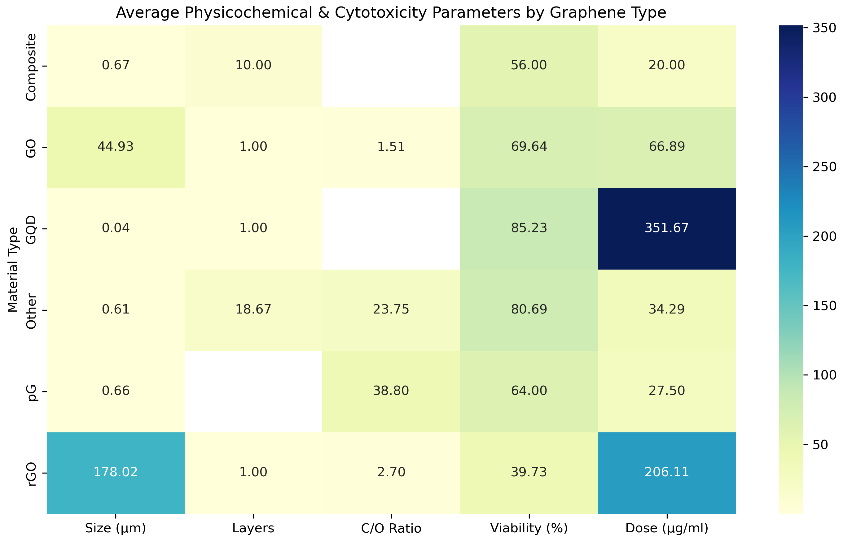
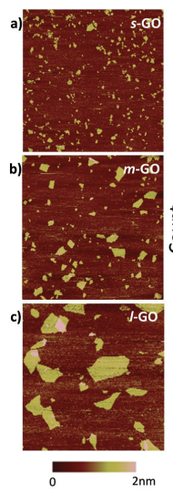
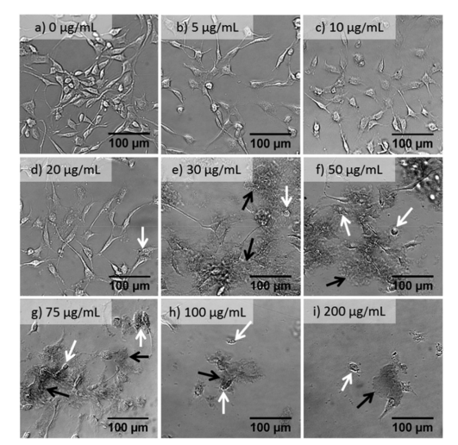
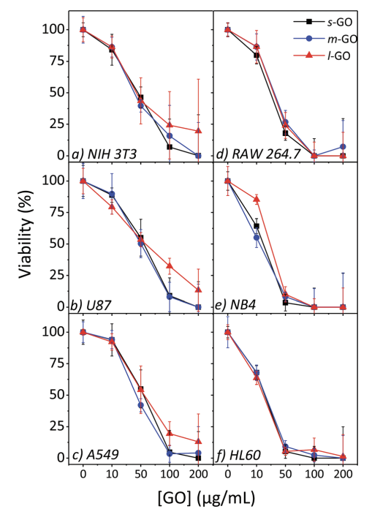
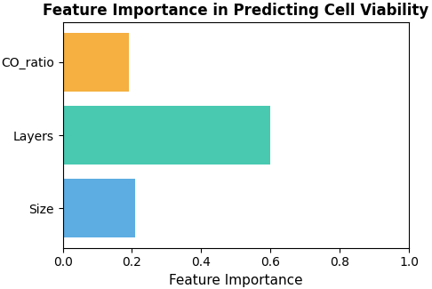
Department of Chemical and Environmental Engineering (CEE)
Data-Driven Analysis of Graphene Biocompatibility Factors
Graphene Types & Preparation Methods
Literature Data Summary
Pristine Graphene (pG)
• High conductivity, low oxygen
• Made by exfoliation or CVD
• Poor dispersibility → variable toxicity
Graphene Oxide (GO)
• Hydrophilic, tunable
• Hummers or electrochemical exfoliation
• Widely used in biomedicine
Reduced Graphene Oxide(rGO)
• Obtained by reducing GO (chemical/thermal)
• Balances conductivity and oxygen groups
Alternative Synthesis
•Physical exfoliation → broad size range
• Green/biomass synthesis → eco-friendly but less scalable
• Method: 40 studies grouped into 6 categories (GO, rGO, pG, GQD, Composites, Other)
• Averaged parameters: size, layers, C/O ratio, viability, dose
• Shown as heatmap (blue = low, yellow = high)
Representative Images Layout
Key Findings:
• GO: widest size range, moderate viability (50–95%)
• rGO: more toxic at low doses; reduction method crucial
• pG: Variable toxicity due to poor dispersibility
• GQDs: highest cell viability (>90%)
• Composites: lower toxicity than GO/rGO
• Overall: size and oxygen groups are key factors
Machine Learning Analysis
(Gies & Zou, 2018)
• ML models such as RF, SVM, GBM, and NN have been applied to predict and optimize graphene performance in biological, mechanical, and energy systems
• Key inputs: size, layers, surface chemistry, synthesis route • Typical outputs: cell viability, conductivity, strength, adsorption energy
Panel: s-GO, m-GO, l-GO
1. Size Distribution
• s-GO: 0.15 µm, 1–5 layers
• m-GO: 0.24 µm, 1–5 layers
• l-GO: 1 µm, 1–5 layers
2. Cell Imaging
• NB4 cell morphology under increasing GO concentrations (0–200 µg/mL)
• Higher doses lead to stronger aggregation and reduced cell density
3. Cell Viability
• s-GO: 70% (10 µg/mL)
• m-GO: 75% (20 µg/mL)
• l-GO: 78% (30 µg/mL)
Acknowledgements We thank Prof. Chengheng Pang and Dr. Yuqin Xiao for guidance, and the Department of CEE, University of Nottingham Ningbo China for support.
• Example RF model on collected graphene data: Layers (0.5997) > Size (0.2085) > C/O ratio (0.1919); Model R² = 0.82
Dingyao Guo(20617079); Wenyi Han(20514272)
Supervisor: Chengheng Pang & Yuqin Xiao

