Slide 1
Map Visualization Library
2019.8.19

Slide 2
Data
Map (Map.json)
id
name
chinese_name
cp
coordinates
Statistics (Statistics.json)
id
has_data
main_data (data_num)
stage

Slide 3
Data
Link (Path.json)
source
name, id, cp
Target
name, id, cp
stage
main_data
Web components（web_info.json）
title & chinese_title
data source & map source
data url & map url
data_range
axis_range
data_point

Slide 4
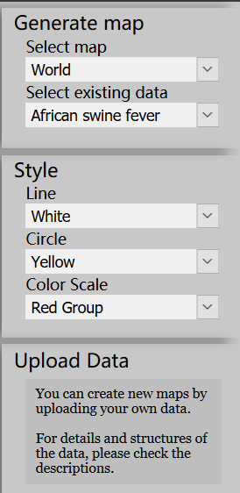
Main functions
Select existing map
Select basic map
Select existing statistic
Change component style
Line
Circle
Color range
Upload data
Upload new data to generate map for users
Change language

Slide 5
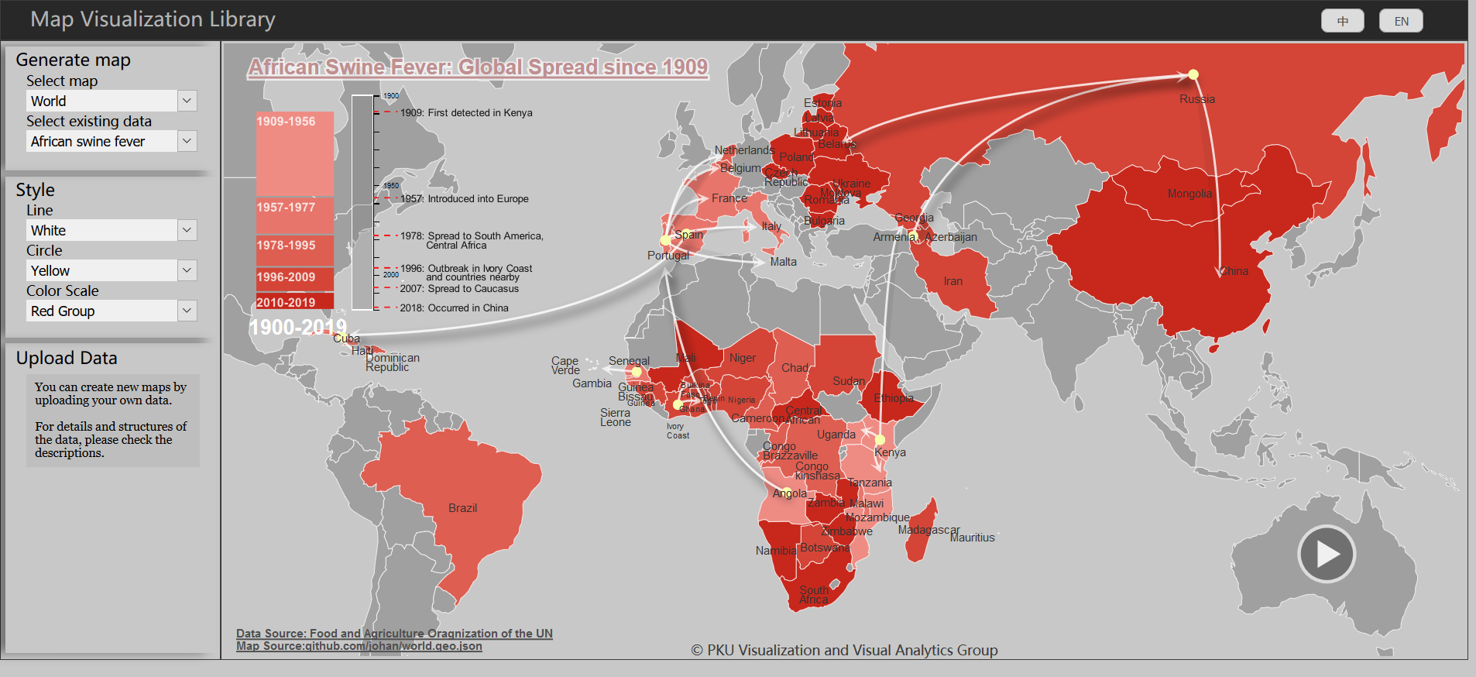
Web Page(have completed)

Slide 6
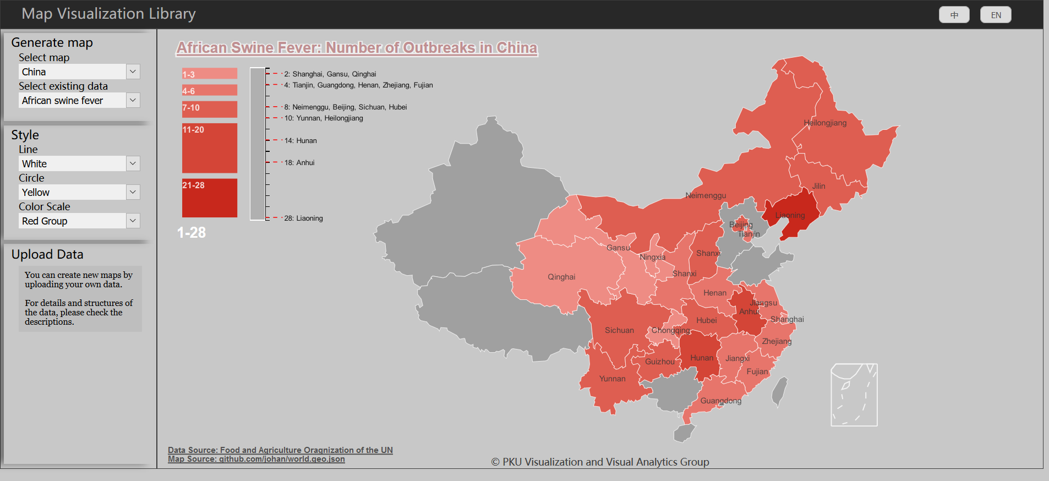
Web Page(have completed)

Slide 7
Next Steps
Add more existing data
Add zooming function
Add the function of uploading data
Think about the hierarchical map
Think about the deformation of the map
Check the details

