Slide 1
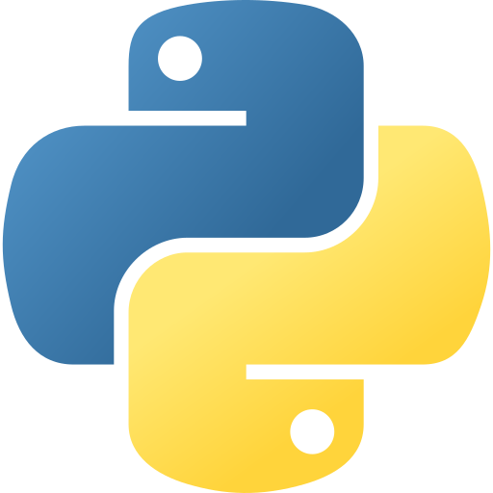










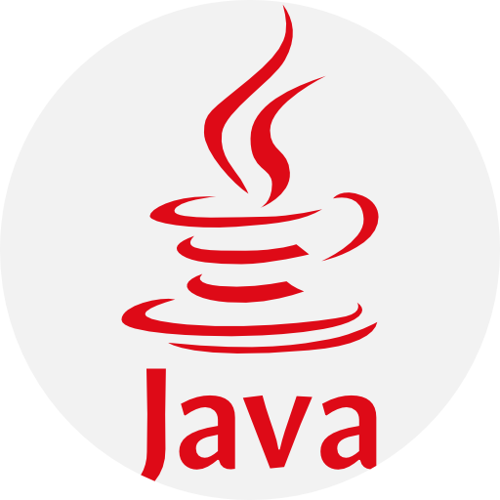



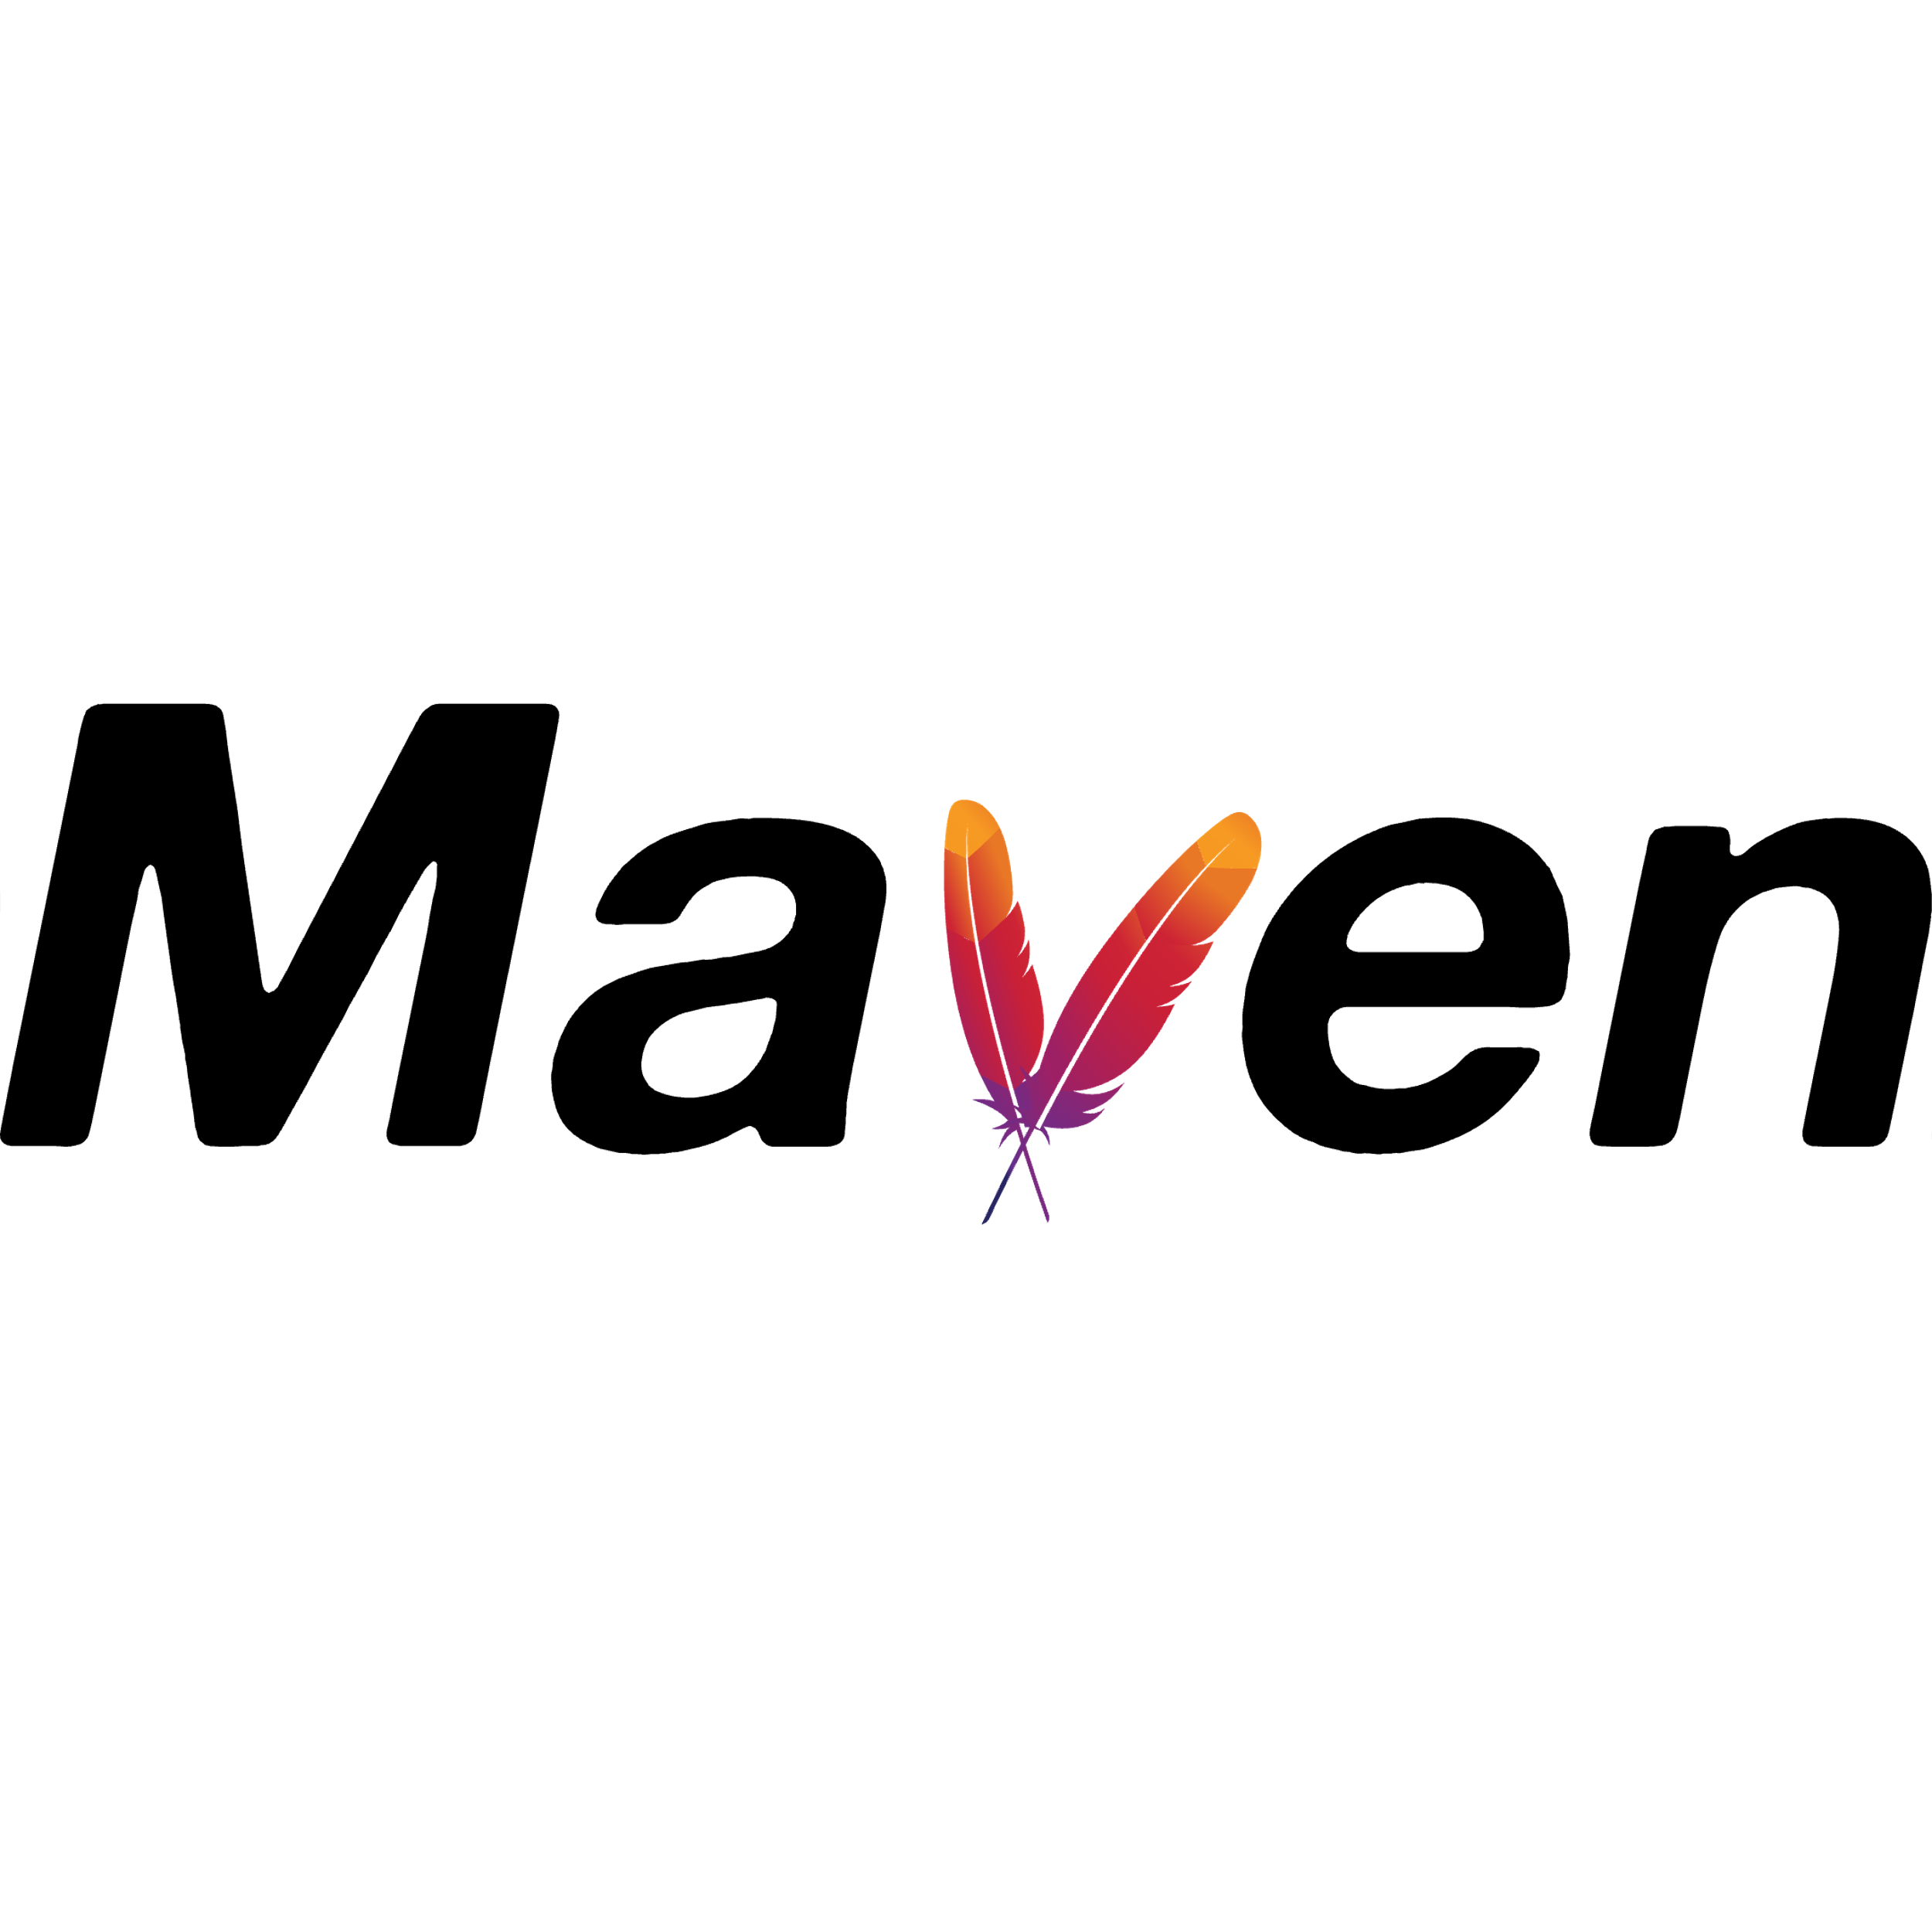




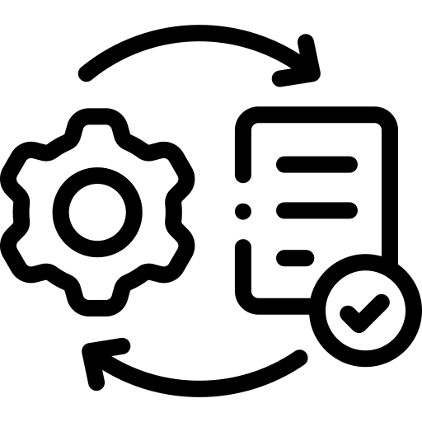


(a) Languages and Repositories Selection
(b) Pull Requests Data Collection
Languages
Selection
Candidate
Repos List
Target Repos List
Raw PRs
data
Filtered
PRs data
Top 4 used
Top 200
15 Repos
Pull Requests
Pull Requests
Collecting
Filtering
Collecting
Attribute Filtering
Different
Domains
GitHub API
Request
With Related Issues
With Changed Tests
(c) Task Instances Construction
(d) Execution-based verification
Filtered
PR data
Building
Instances
Environment Construction
Final Task
Instances
Pull Requests
Task instances
Executable
Environment
Task instances
Extracting
Constructing
Execution-based verification
Key Issue information
Read Repository Documents
Existing tests from fail to pass
Notes:
v1

Slide 2
(a) Language and Repository Selection
(b) Pull Requests Data Collection
Language
Selection
Candidate
Repos List
Target Repos List
Raw PRs
Data
Filtered
PRs data
Top 4 used
Top 200
15 Repos
Pull Requests
Pull Requests
Collecting
Filtering
Collecting
Attribute Filtering
Different
Domains
GitHub API
Request
With Related Issues
With Changed Tests
(c) Task Instances Construction
(d) Execution-based verification
Filtered
PRs Data
Building
Instances
Environment Construction
Final Task
Instances
Pull Requests
Task Instances
Execution
Environment
Task Instances
Extracting
Constructing
Execution-based verification
Key Issue Information
Reading Repo Documents
Existing tests from fail to pass
Notes:
v2

Slide 3
(a) Language and Repository Selection
(b) Pull Request Data Collection
Selected Languages
Candidate Repos
Target Repos
Raw PRs
Filtered PRs
Top 4 used
Top 200
15 Repos
Pull Requests
Pull Requests
Collecting
Filtering
Collecting
Attribute Filtering
Different
Domains
GitHub API
Request
With Related Issues
With Changed Tests
(c) Task Instance Construction
(d) Execution-Based Verification
Filtered PRs
Built Instances
Constructed Environment
Result
Pull Requests
Task instances
Execution
Environment
Task Instances
Extracting
Constructing
Execution-based Verification
Key Issue Information
Reading Repos' Documents
Existing Tests from Fail to Pass
Notes:
v3

Slide 4
(a) Language and Repository Selection
(b) Pull Request Data Collection
Selected Languages
Candidate Repos
Target Repos
Raw PRs
Filtered PRs
Top 4 used
Top 200
15 Repos
Pull Requests
Pull Requests
Collecting
Filtering
Collecting
Attribute Filtering
Different
Domains
GitHub API
Request
With Related Issues
With Changed Tests
(c) Task Instance Construction
(d) Execution-Based Verification
Filtered PRs
Built Instances
Constructed Environment
Result
Pull Requests
Task instances
Execution
Environment
Task Instances
Extracting
Constructing
Execution-based Verification
Key Issue Information
Reading Repos' Documents
Existing Tests from Fail to Pass
Notes:
[Yanlin] v4

Slide 5


(a) Language and Repository Selection
(b) Pull Request Data Collection
Selected Languages
Candidate Repos
Target Repos
Raw PRs
Filtered PRs
Top 4 used
Top 200
15 Repos
Pull Requests
Pull Requests
Collecting
Filtering
Collecting
Attribute Filtering
Different
Domains
GitHub API
Request
With Related Issues
With Changed Tests
(c) Task Instance Construction
(d) Execution-Based Verification
(d) Unnecessary Image Filtering
Filtered PRs
Built Instances
Constructed Environment
Result
Final Results
Pull Requests
Task instances
Execution
Environment
Execution-based
Verification
Task Instances
Final Task Instances
Extracting
Constructing
Filtering
Key Issue Information
Reading Repos' Documents
Existing Tests from Fail to Pass
Unnecessary Images
Notes:
v5

Slide 6
(a) Language and Repository Selection
(b) Pull Request Data Collection
Selected Languages
Candidate Repos
Target Repos
Raw PRs
Filtered PRs
Top 4 used
Top 200
15 Repos
Pull Requests
Pull Requests
Collecting
Filtering
Collecting
Attribute Filtering
Different
Domains
GitHub API
Request
With Related Issues
With Changed Tests
(c) Task Instance Construction
(d) Execution-Based Verification
(d) Unnecessary Image Filtering
Filtered PRs
Built Instances
Constructed Environment
Result
Final Results
Pull Requests
Task instances
Execution
Environment
Execution-based
Verification
Task Instances
Final Task Instances
Extracting
Constructing
Filtering
Key Issue Information
Reading Repos' Documents
Existing Tests from Fail to Pass
Unnecessary Images
Notes:
v6

Slide 7
(a) Language and Repository Selection
(b) Pull Request Data Collection
Selected Languages
Candidate Repos
Target Repos
Raw PRs
Filtered PRs
Top 4 used
Top 200
15 Repos
Pull Requests
Pull Requests
Collecting
Filtering
Collecting
Attribute Filtering
Different
Domains
GitHub API
Request
With Related Issues
With Changed Tests
(c) Task Instance Construction
(d) Execution-Based Verification
(d) Unnecessary Image Filtering
Filtered PRs
Built Instances
Constructed Environment
Result
Final Results
Pull Requests
Task instances
Execution
Environment
Execution-based
Verification
Task Instances
Final Task Instances
Extracting
Constructing
Filtering
Key Issue Information
Reading Repos' Documents
Existing Tests from Fail to Pass
Unnecessary Images
Notes:
v7

