Slide 1
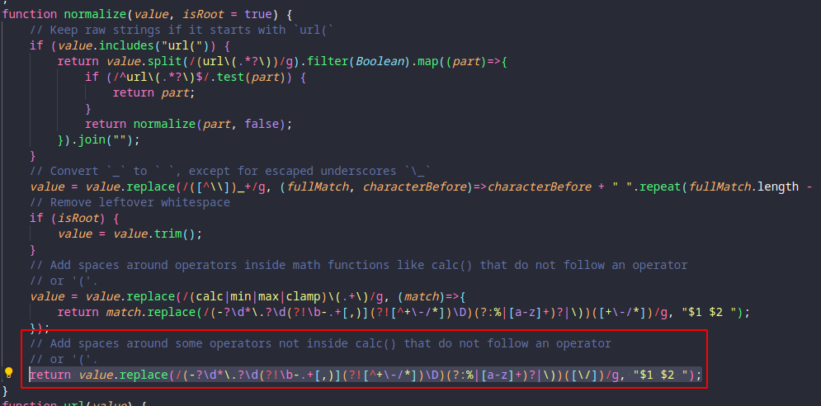
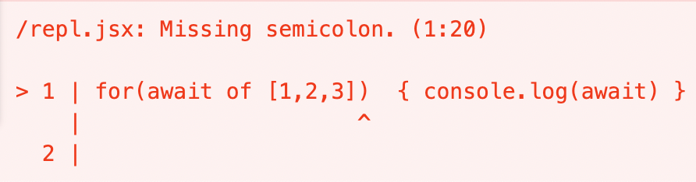


Screenshots of reproduced code
Error messages or logs
Unexpected code results
Issue: The function "normalize" with dataTypes.js leads to errors when using with some plugins like plaiceholder within 11ty for example ...
Issue: [Bug]: Babel crashes when using await as an identifier in ForInOfHead. Input code for( await of [1, 2, 3] ) { console.log(await) } ... However, Babel fails to transpile the input code:
Issue: In v3.3.2, some behaviors of pseudo elements are not as expected, for example, the marker color cannot be changed correctly, while this works correctly in v3.3.1..
V3.3.1
V3.3.2

Slide 2
Screenshots of reproduced code
Error messages or logs
Unexpected code results
Issue: The function "normalize" with dataTypes.js leads to errors when using with some plugins like plaiceholder within 11ty for example ...
Issue: [Bug]: Babel crashes when using await as an identifier in ForInOfHead. Input code for( await of [1, 2, 3] ) { console.log(await) } ... However, Babel fails to transpile the input code:
Issue: In v3.3.2, some behaviors of pseudo elements are not as expected, for example, the marker color cannot be changed correctly, while this works correctly in v3.3.1..
V3.3.1
V3.3.2

Slide 3
（a) Screenshots of reproduced code
(b) Error messages or logs
(c) Unexpected code results
Issue: The function "normalize" with dataTypes.js leads to errors when using with some plugins like plaiceholder within 11ty for example ...
Issue: [Bug]: Babel crashes when using await as an identifier in ForInOfHead. Input code for( await of [1, 2, 3] ) { console.log (await) } ... However, Babel fails to transpile the input code:
Issue: In v3.3.2, some behaviors of pseudo elements are not as expected, for example, the marker color cannot be changed correctly, while this works correctly in v3.3.1..
V3.3.1
V3.3.2
Notes:
v3

