Slide 1
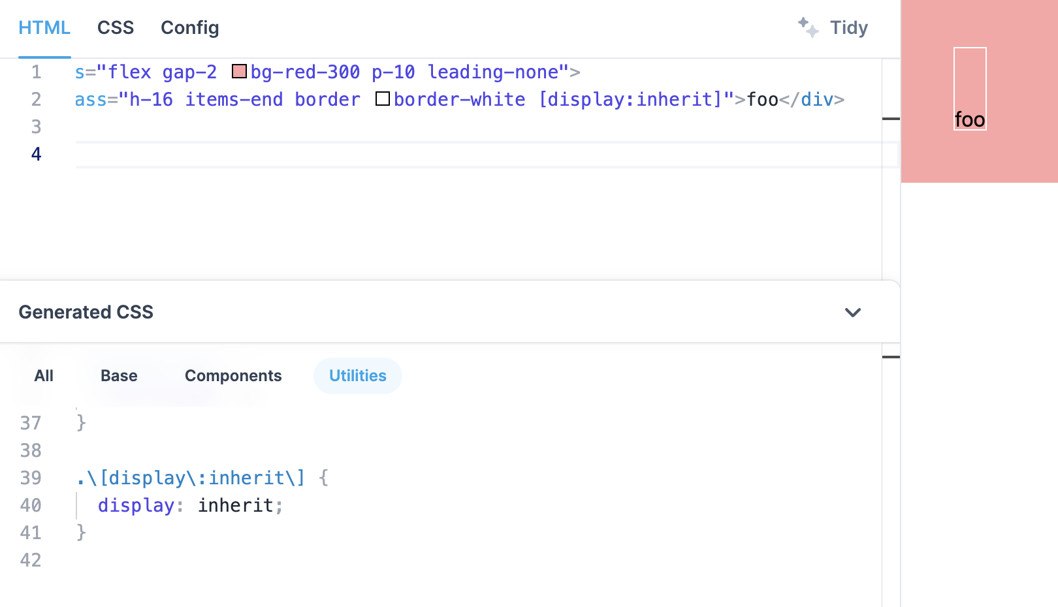
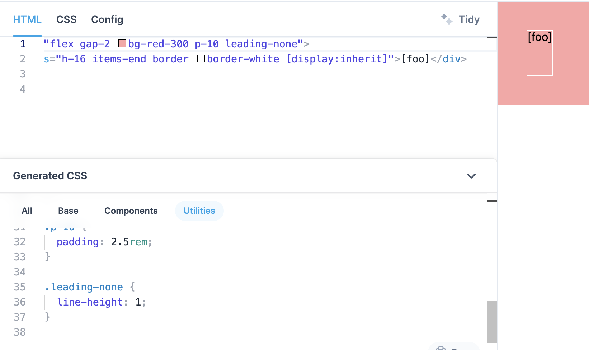
Repo: tailwindlabs/tailwindcss
PR Number: 10212
Instance ID: tailwindlabs__tailwindcss-10212
Version: 3.2
Created At: 2023-04-04
Base Commit: d731049...
Issue Numbers: ["10180"]
Pass2Pass: []
Website Links: ['http...', 'http…']
Issue_Image: [...]
Fail2Pass: ["tests/default-extractor.test.js"]
Issue Descriptions:
tests/default-extractor.test.js
Test Patch
Div content with brackets [] prevents arbitrary class from being generated
488
489 - expect(extractions).toContain(`text-[#bada55]`)
490 - })
491 +
492 + test('arbitrary properties followed by square bracketed stuff', () => {
493 + let extractions = defaultExtractor(
494 + '<div class="h-16 items-end border border-white [display:inherit]">[foo]</div>‘
495 + )
496 +
497 + expect(extractions).toContain(`[display:inherit]`)
498 + })
This works: https://play.tailwindcss.com/0VLICQ8oUW
This does not work: https://play.tailwindcss.com/5KJf7xDKv6
src/lib/defaultExtractor.js
Patch
30 let utility = regex.any([
31 - // Arbitrary properties
32 - /\[[^\s:'"`]+:[^\s]+\]/,
31 + // Arbitrary properties (without square brackets)
+ /\[[^\s:'"`]+:[^\s\[\]]+\]/,
+
34 + // Arbitrary properties with balanced square brackets
+
+ // with square brackets to work in arbitrary properties
+ // while fixing a problem with the regex matching too much
+ /\[[^\s:'"`]+:[^\s]+?\[[^\s]+?\][^\s]+?\]/,
Notes:
v2

Slide 2
Repo: tailwindlabs/tailwindcss
PR Number: 10212
Instance ID: tailwindlabs__tailwindcss-10212
Version: 3.2
Created At: 2023-04-04
Base Commit: d731049...
Issue Numbers: ["10180"]
Pass2Pass: []
Website Links: ['http...', 'http…']
Issue_Image: [...]
Fail2Pass: ["tests/default-extractor.test.js"]
Issue Descriptions:
tests/default-extractor.test.js
Test Patch
Div content with brackets [] prevents arbitrary class from being generated
488
489 - expect(extractions).toContain(`text-[#bada55]`)
490 - })
491 +
492 + test('arbitrary properties followed by square bracketed stuff', () => {
493 + let extractions = defaultExtractor(
494 + '<div class="h-16 items-end border border-white [display:inherit]">[foo]</div>‘
495 + )
496 +
497 + expect(extractions).toContain(`[display:inherit]`)
498 + })
This works: https://play.tailwindcss.com/0VLICQ8oUW
This does not work: https://play.tailwindcss.com/5KJf7xDKv6
src/lib/defaultExtractor.js
Patch
30 let utility = regex.any([
31 - // Arbitrary properties
32 - /\[[^\s:'"`]+:[^\s]+\]/,
31 + // Arbitrary properties (without square brackets)
+ /\[[^\s:'"`]+:[^\s\[\]]+\]/,
+
34 + // Arbitrary properties with balanced square brackets
+
+ // with square brackets to work in arbitrary properties
+ // while fixing a problem with the regex matching too much
+ /\[[^\s:'"`]+:[^\s]+?\[[^\s]+?\][^\s]+?\]/,
Notes:
V3

Slide 3
Repo: tailwindlabs/tailwindcss
PR ID: 10212
Instance ID: tailwindlabs__tailwindcss-10212
Version: 3.2
Created At: 2023-04-04
Base Commit: d731049...
Issue IDs: ["10180"]
Pass2Pass: []
Website Links: ['http...', 'http…']
Issue Images: [...]
Fail2Pass: ["tests/default-extractor.test.js"]
Issue Descriptions:
tests/default-extractor.test.js
Test Patch
Div content with brackets [] prevents arbitrary class from being generated
488
489 - expect(extractions).toContain(`text-[#bada55]`)
490 - })
491 +
492 + test('arbitrary properties followed by square bracketed stuff', () => {
493 + let extractions = defaultExtractor(
494 + '<div class="h-16 items-end border border-white [display:inherit]">[foo]</div>‘
495 + )
496 +
497 + expect(extractions).toContain(`[display:inherit]`)
498 + })
This works: https://play.tailwindcss.com/0VLICQ8oUW
This does not work: https://play.tailwindcss.com/5KJf7xDKv6
src/lib/defaultExtractor.js
Patch
30 let utility = regex.any([
31 - // Arbitrary properties
32 - /\[[^\s:'"`]+:[^\s]+\]/,
31 + // Arbitrary properties (without square brackets)
+ /\[[^\s:'"`]+:[^\s\[\]]+\]/,
+
34 + // Arbitrary properties with balanced square brackets
+
+ // with square brackets to work in arbitrary properties
+ // while fixing a problem with the regex matching too much
+ /\[[^\s:'"`]+:[^\s]+?\[[^\s]+?\][^\s]+?\]/,
Notes:
V3

Slide 4
Repo: tailwindlabs/tailwindcss
PR ID: 10212
Instance ID: tailwindlabs__tailwindcss-10212
Version: 3.2
Created At: 2023-04-04
Base Commit: d731049...
Issue IDs: ["10180"]
Pass2Pass: []
Website Links: ['http...', 'http…']
Issue Images: [...]
Fail2Pass: ["tests/default-extractor.test.js"]
tests/default-extractor.test.js
Issue Descriptions
Test Patch
Div content with brackets [] prevents arbitrary class from being generated
488
489 - expect(extractions).toContain(`text-[#bada55]`)
490 - })
491 +
492 + test('arbitrary properties followed by square bracketed stuff', () => {
493 + let extractions = defaultExtractor(
494 + '<div class="h-16 items-end border border-white [display:inherit]">[foo]</div>‘
495 + )
496 +
497 + expect(extractions).toContain(`[display:inherit]`)
498 + })
This works: https://play.tailwindcss.com/0VLICQ8oUW
src/lib/defaultExtractor.js
This does not work: https://play.tailwindcss.com/5KJf7xDKv6
Patch
30 let utility = regex.any([
31 - // Arbitrary properties
32 - /\[[^\s:'"`]+:[^\s]+\]/,
31 + // Arbitrary properties (without square brackets)
+ /\[[^\s:'"`]+:[^\s\[\]]+\]/,
+
34 + // Arbitrary properties with balanced square brackets
+
+ // with square brackets to work in arbitrary properties
+ // while fixing a problem with the regex matching too much
+ /\[[^\s:'"`]+:[^\s]+?\[[^\s]+?\][^\s]+?\]/,
Notes:
V4

