Slide 1
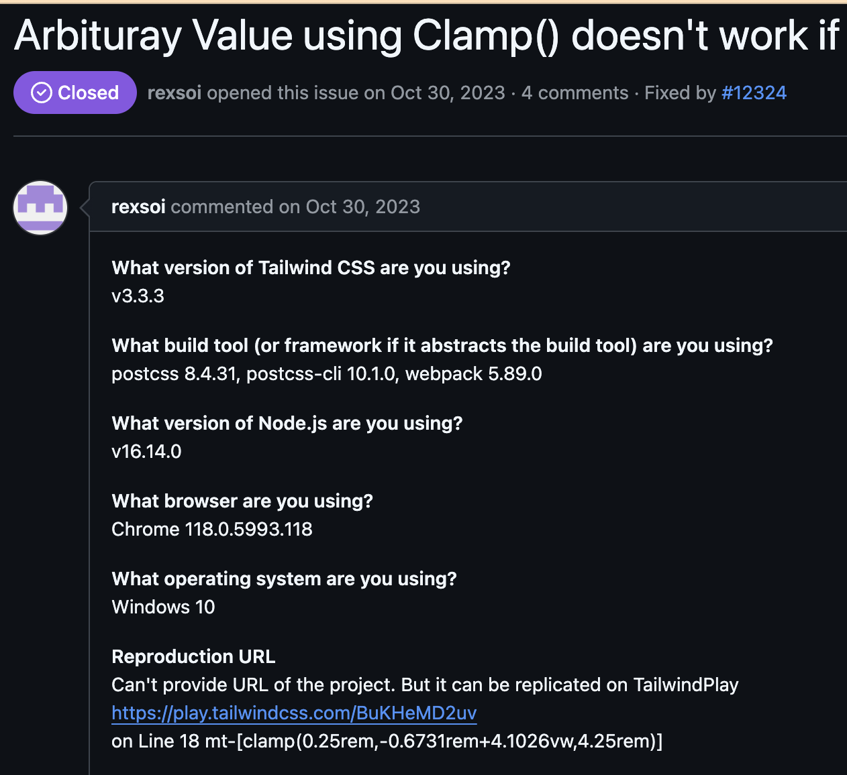
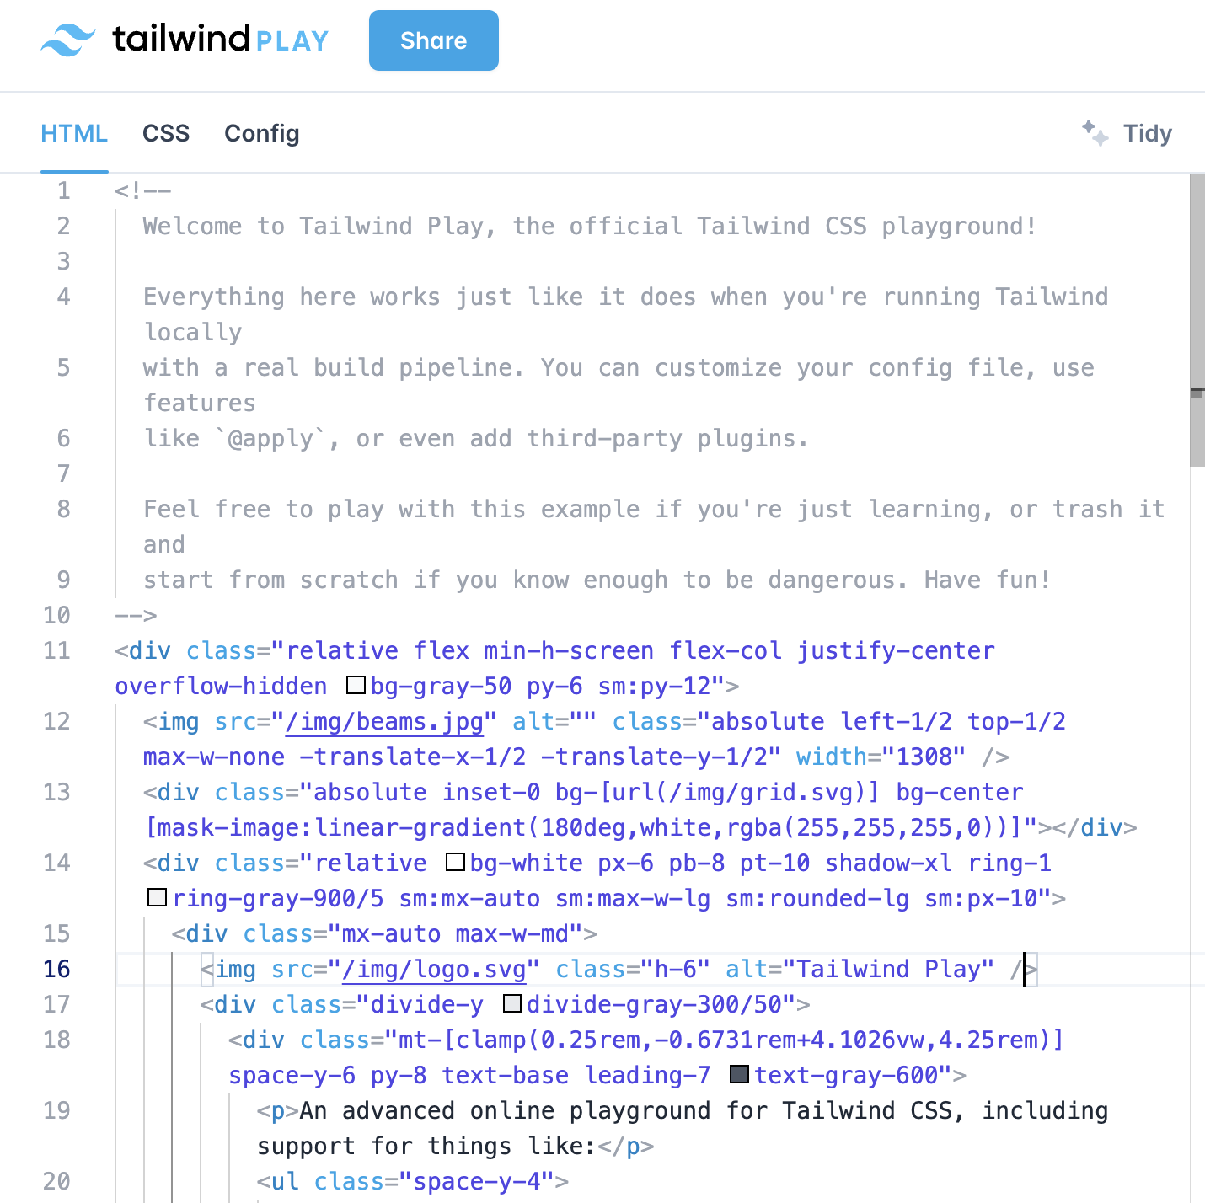
Issue: tailwindlabs/tailwindcss/issues/12318
Web Url: https://play.tailwindcss.com/BuKHeMD2uv

Slide 2
Issue: tailwindlabs/tailwindcss-12318
Web Url: https://play.tailwindcss.com/BuKHeMD2uv

Slide 3
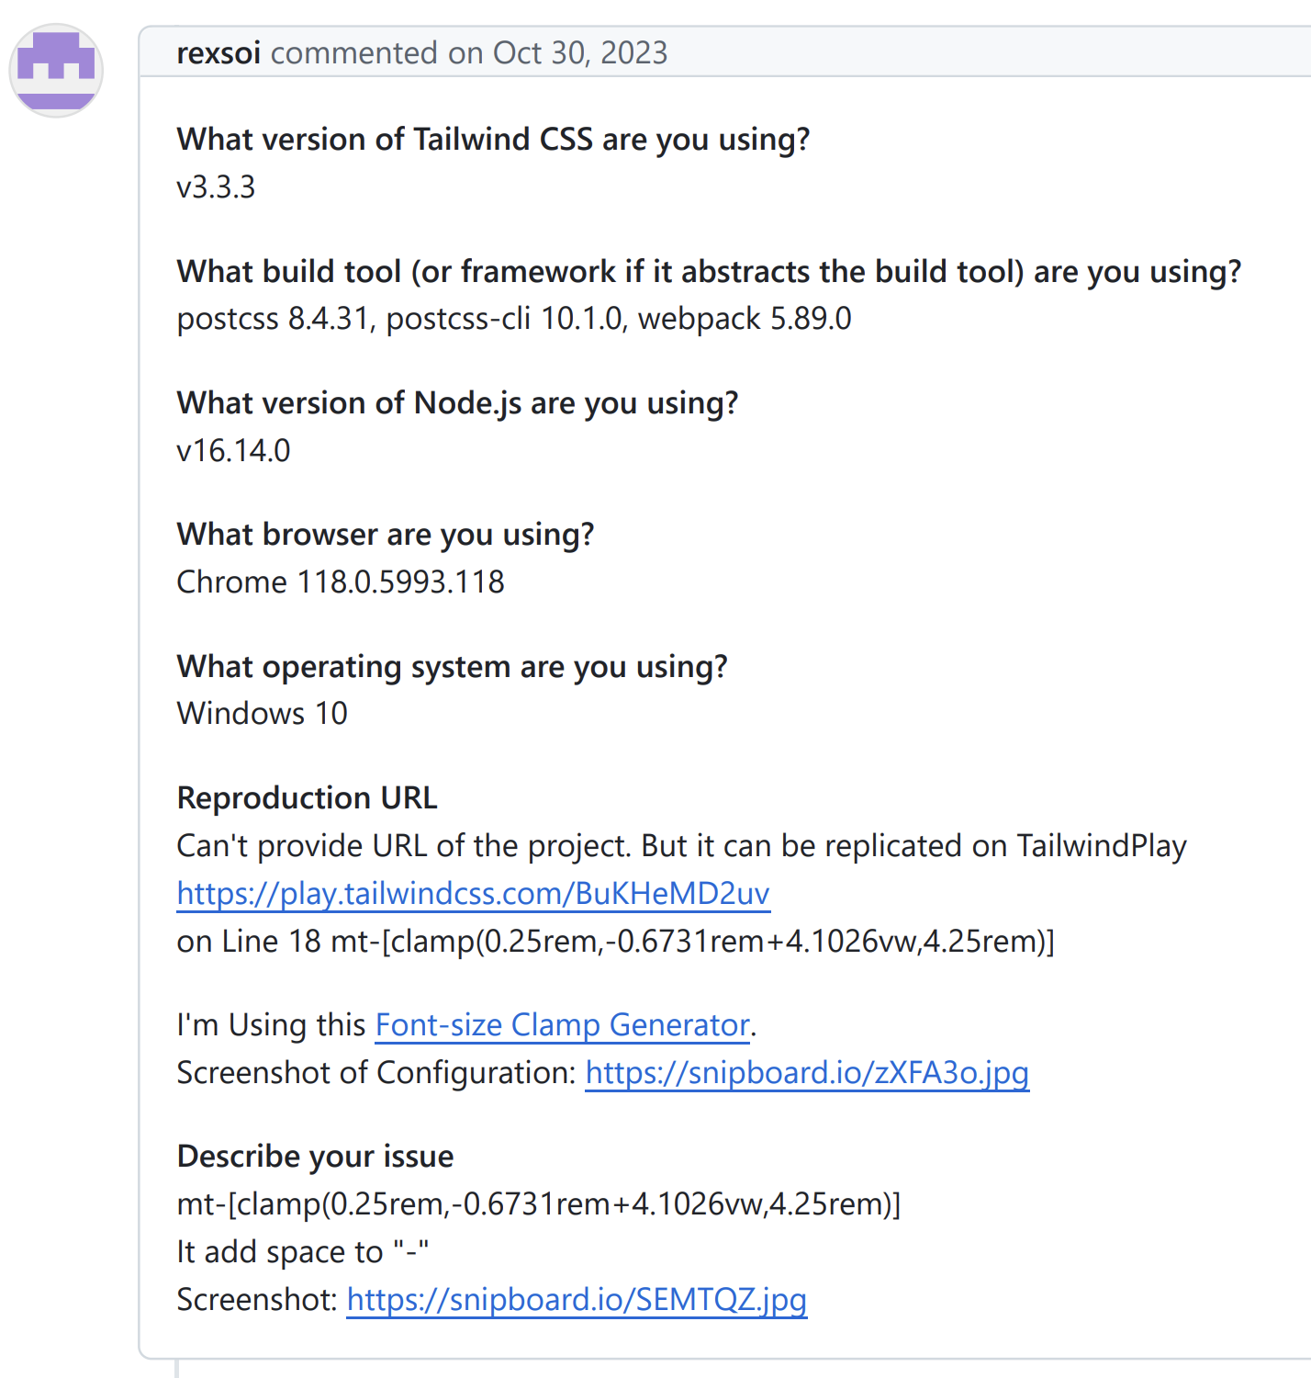
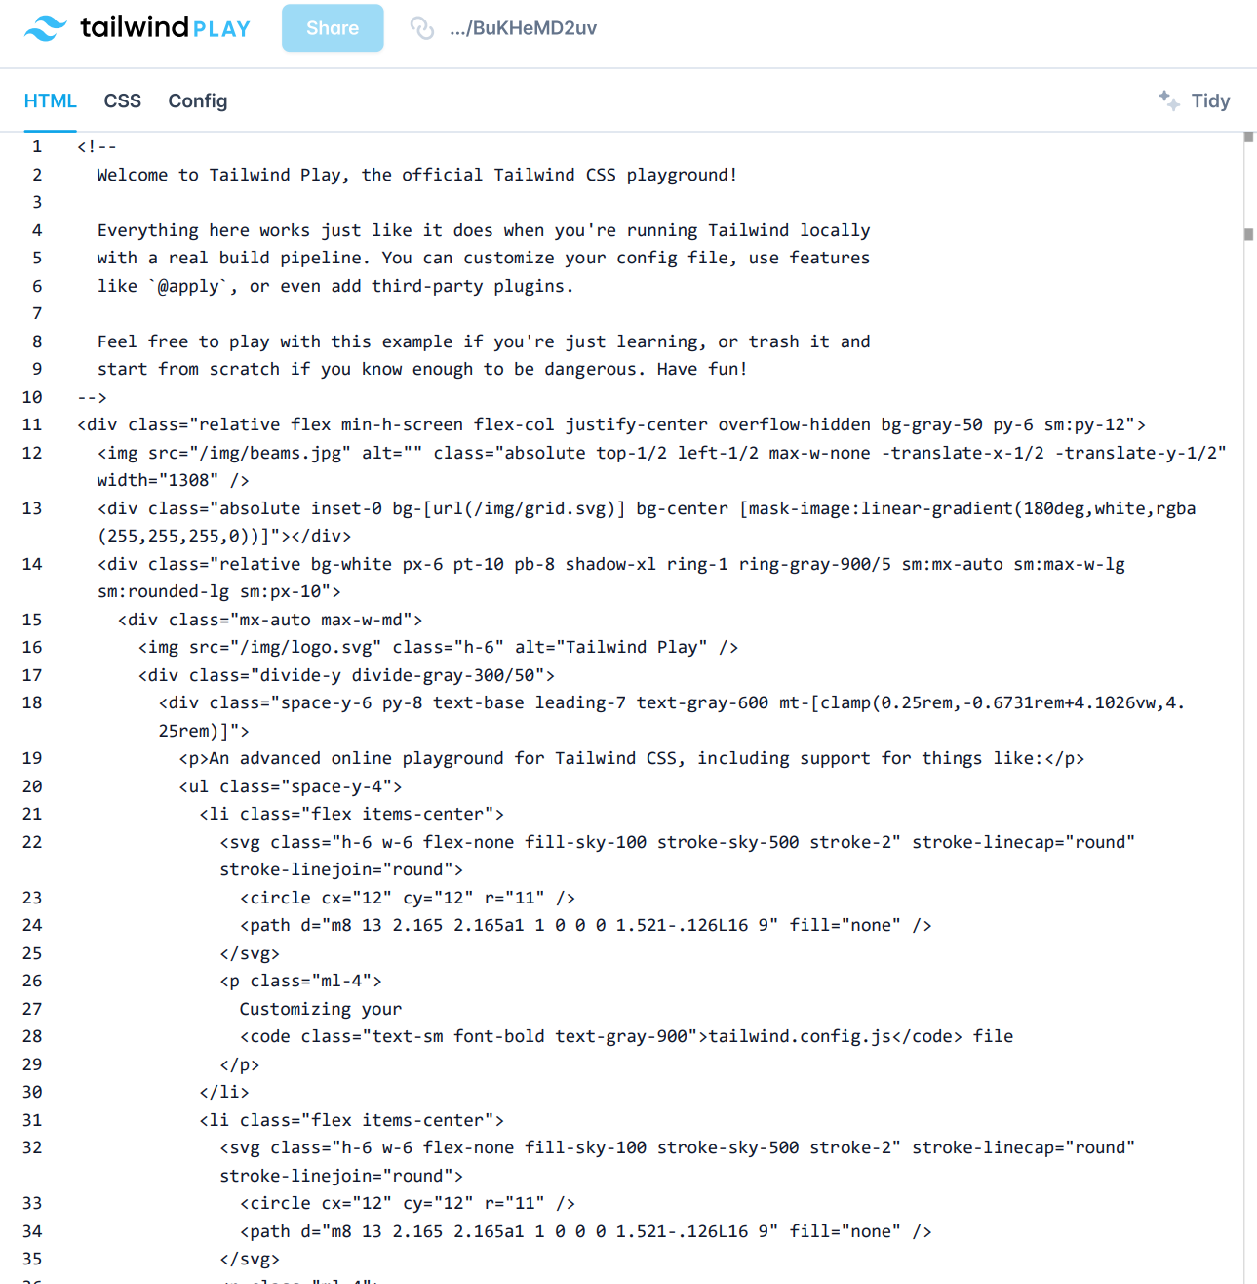
Issue: tailwindlabs/tailwindcss-12318
Website Links: https://play.tailwindcss.com/BuKHeMD2uv
Notes:
v3

Slide 4
Issue: tailwindlabs/tailwindcss/issues/12318
Website Link: https://play.tailwindcss.com/BuKHeMD2uv
Notes:
v4

