Slide 1






(a) Inference
Issue Descriptions
Generated Patch
Issue:
Input
LLM
Patch:
Generate
+12
-20
@apply method is invalid after upgrade to 3.3.1…
Input
(b) Evaluation
Apply
Codebase
Edited Codebase
Test Log
Running Tests
Pass
tests/apply.test.js
Stable
✓ @apply (207 ms)
✓ @apply error with unknown..

Slide 2
Issue Descriptions
(a) Inference
Generated Patch
Issue:
Input
LLM
Patch:
Generate
+12
-20
@apply method is invalid after upgrade to 3.3.1…
Input
(b) Evaluation
Apply
Codebase
Edited Codebase
Test Log
Running Tests
Pass
tests/apply.test.js
Stable
✓ @apply (207 ms)
✓ @apply error with unknown..

Slide 3
Issue Descriptions
Generated Patch
Issue:
Input
LLM
Patch:
+12
-20
Generate
@apply method is invalid after upgrade to 3.3.1…
Input
(a) Inference
Apply
Codebase
Edited Codebase
Test Log
Pass
tests/apply.test.js
Running Tests
Stable
✓ @apply (207 ms)
✓ @apply error with unknown..
(b) Evaluation

Slide 4
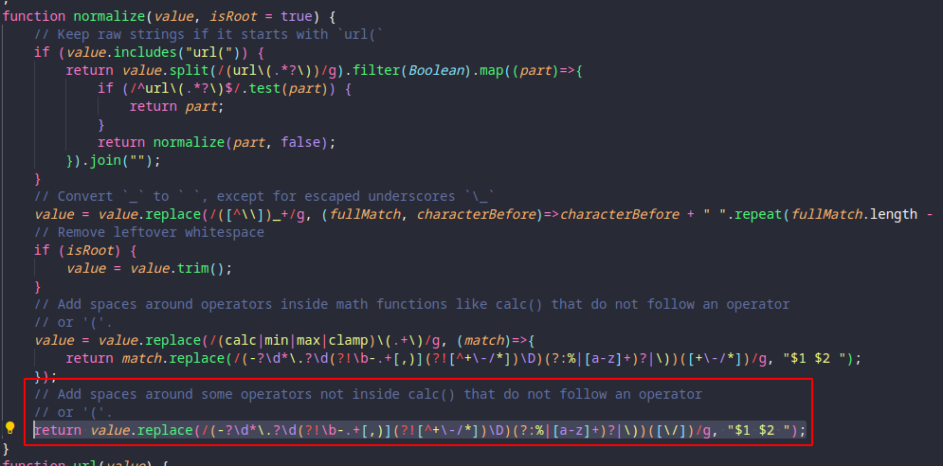
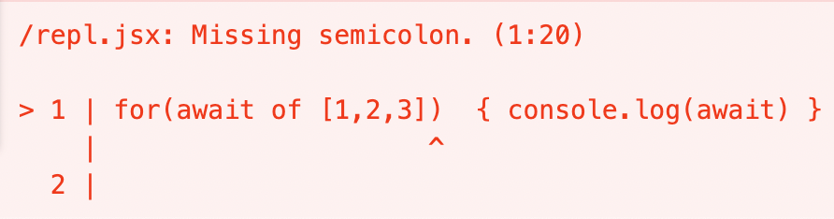
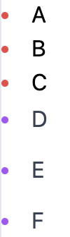
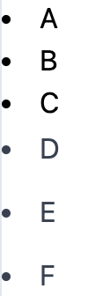
Screenshots of reproduced code
Error messages or logs
Unexpected code results
Issue: The function "normalize" with dataTypes.js leads to errors when using with some plugins like plaiceholder within 11ty for example ...
Issue: [Bug]: Babel crashes when using await as an identifier in ForInOfHead. Input code for( await of [1, 2, 3] ) { console.log(await) } ... However, Babel fails to transpile the input code:
Issue: In v3.3.2, some behaviors of pseudo elements are not as expected, for example, the marker color cannot be changed correctly, while this works correctly in v3.3.1..
V3.3.1
V3.3.2

Slide 5
Screenshots of reproduced code
Error messages or logs
Unexpected code results
Issue: The function "normalize" with dataTypes.js leads to errors when using with some plugins like plaiceholder within 11ty for example ...
Issue: [Bug]: Babel crashes when using await as an identifier in ForInOfHead. Input code for( await of [1, 2, 3] ) { console.log(await) } ... However, Babel fails to transpile the input code:
Issue: In v3.3.2, some behaviors of pseudo elements are not as expected, for example, the marker color cannot be changed correctly, while this works correctly in v3.3.1..
V3.3.1
V3.3.2

Slide 6
(a) Screenshots of reproduced code
(b) Error messages or logs
(c) Unexpected code results
Issue: The function "normalize" with dataTypes.js leads to errors when using with some plugins like plaiceholder within 11ty for example ...
Issue: [Bug]: Babel crashes when using await as an identifier in ForInOfHead. Input code for( await of [1, 2, 3] ) { console.log (await) } ... However, Babel fails to transpile the input code:
Issue: In v3.3.2, some behaviors of pseudo elements are not as expected, for example, the marker color cannot be changed correctly, while this works correctly in v3.3.1..
V3.3.1
V3.3.2
Notes:
主要调整了字体，对齐，图片不压扁

Slide 7
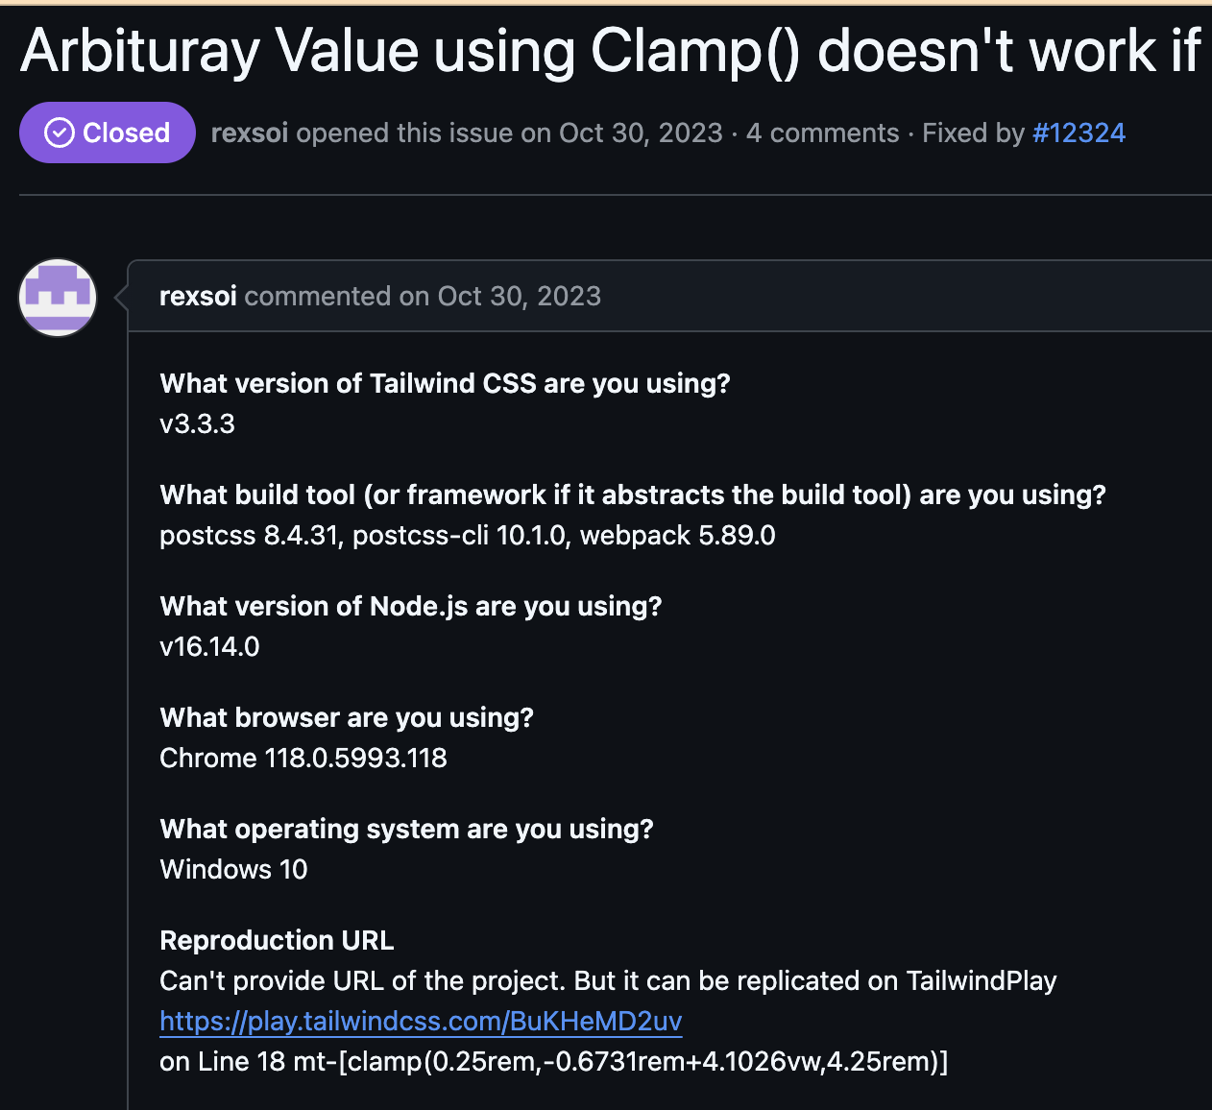
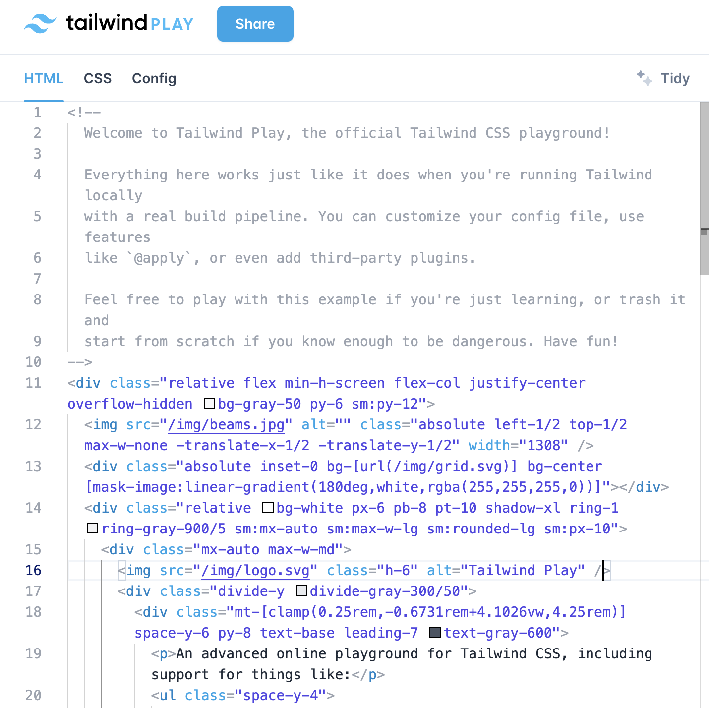
Issue: tailwindlabs/tailwindcss-12318
Web Url: https://play.tailwindcss.com/BuKHeMD2uv

Slide 8
Issue: tailwindlabs/tailwindcss-12318
Web Url: https://play.tailwindcss.com/BuKHeMD2uv

Slide 9
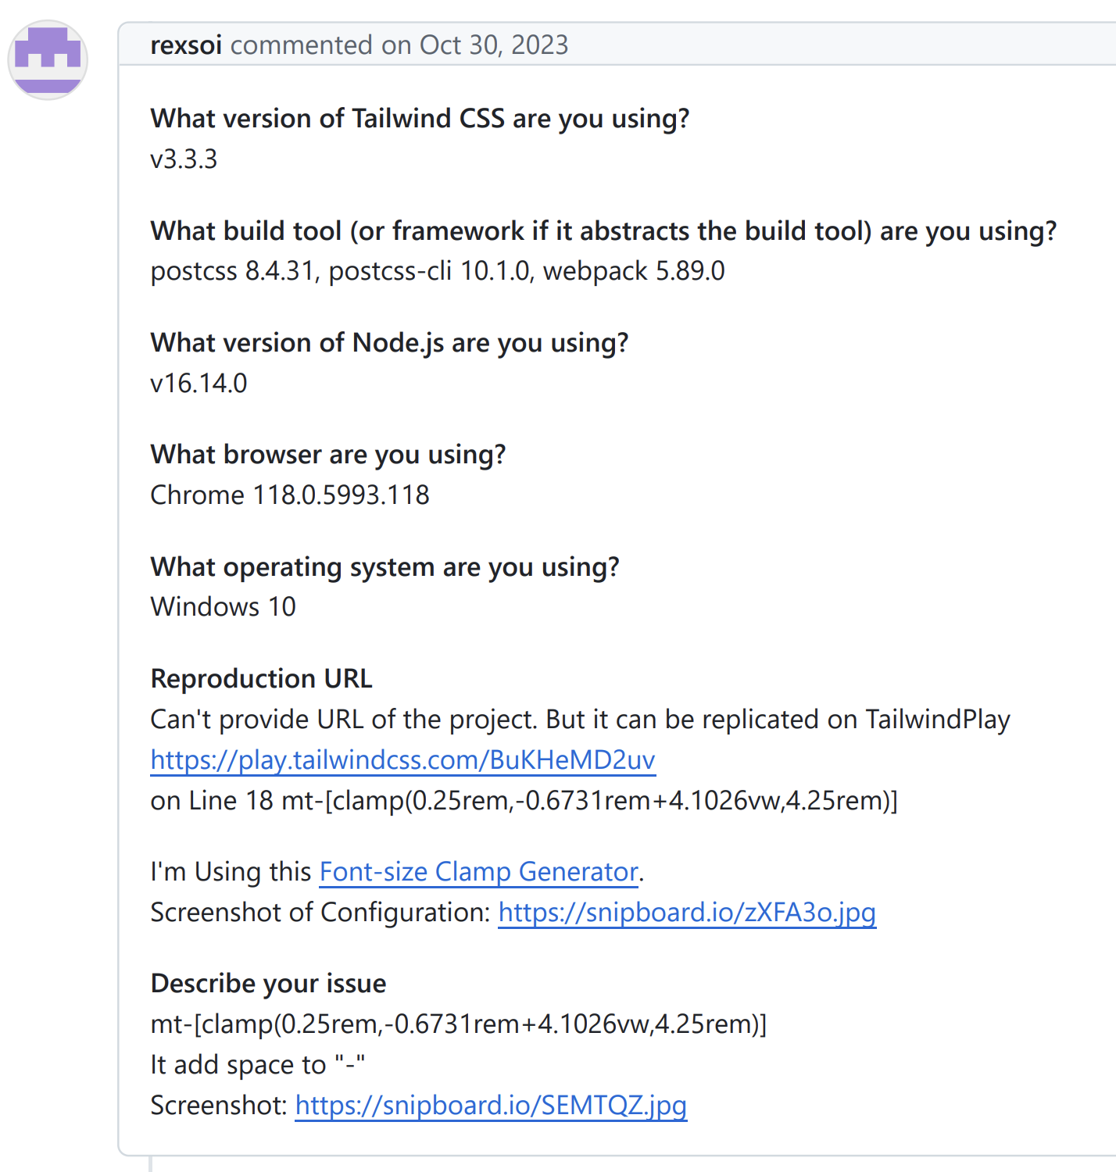
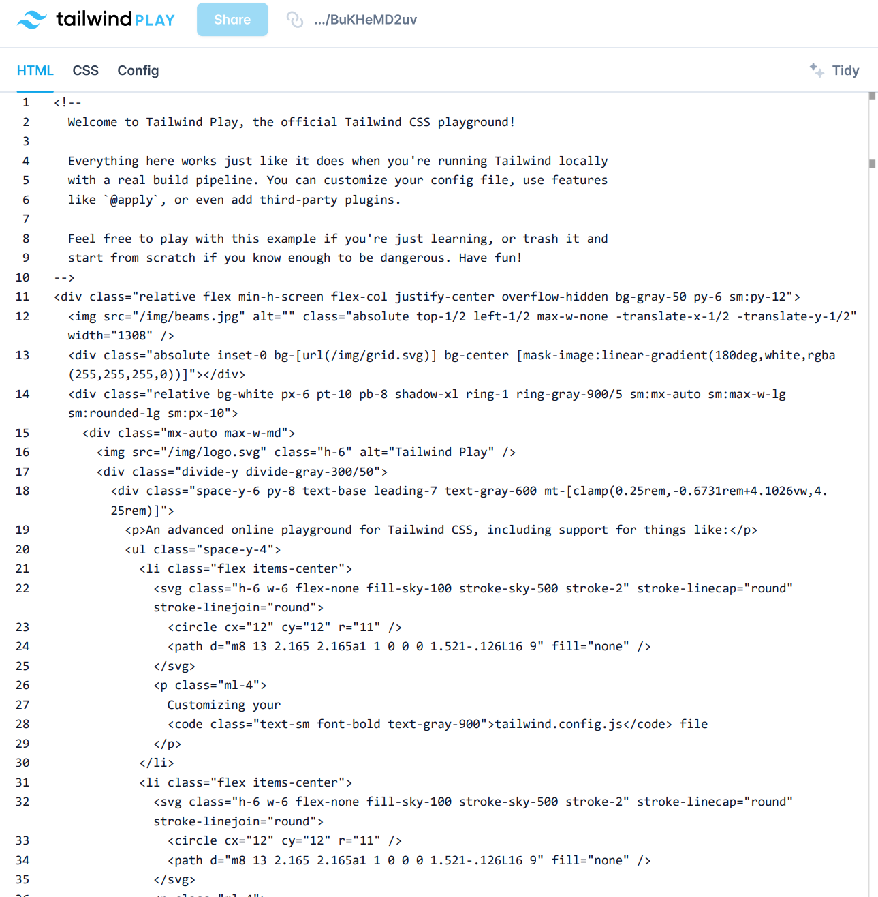
Issue: tailwindlabs/tailwindcss-12318
Website Links: https://play.tailwindcss.com/BuKHeMD2uv

Slide 10






prompt
Response
Please provide the class name, function or method name, or the exact line numbers that need to be edited.
### Examples:
```
full_path1/file1.py
line: 10
class: MyClass1
line: 51
full_path2/file2.py
function: MyClass2.my_method
line: 12
full_path3/file3.py
function: my_function
line: 24
line: 156
```
gpt-4o
Block found!
```
tqdm/_tqdm.py
function: tqdm.format_meter
function: tqdm.__init__
```
Parse Success
Based on the problem description and the provided code skeleton, here are the locations that likely need inspection or editing to fix the ANSI color code issue in the progress bar:
tqdm/_tqdm.py
class: tqdm
function: format_meter
function: __init__
function: __repr__
function: refresh
Claude-3.5
No Block
Parse Failure
Block found!
Deepseek-v2.5
```
tqdm/_tqdm.py
function: tqdm.format_meter
function: tqdm.__init__
function: tqdm.set_description
function: tqdm.set_description_str
....
```
Parse Success

Slide 11
prompt
Response
Please provide the class name, function or method name, or the exact line numbers that need to be edited.
### Examples:
```
full_path1/file1.py
line: 10
class: MyClass1
line: 51
full_path2/file2.py
function: MyClass2.my_method
line: 12
full_path3/file3.py
function: my_function
line: 24
line: 156
```
gpt-4o
Block found!
```
tqdm/_tqdm.py
function: tqdm.format_meter
function: tqdm.__init__
```
Parse Success
Based on the problem description and the provided code skeleton, here are the locations that likely need inspection or editing to fix the ANSI color code issue in the progress bar:
tqdm/_tqdm.py
class: tqdm
function: format_meter
function: __init__
function: __repr__
function: refresh
Claude-3.5
No Block
Parse Failure
Block found!
Deepseek-v2.5
```
tqdm/_tqdm.py
function: tqdm.format_meter
function: tqdm.__init__
function: tqdm.set_description
function: tqdm.set_description_str
....
```
Parse Success

Slide 12
Prompt
Response
Please provide the class name, function or method name, or the exact line numbers that need to be edited.
### Examples:
```
full_path1/file1.py
line: 10
class: MyClass1
line: 51
full_path2/file2.py
function: MyClass2.my_method
line: 12
full_path3/file3.py
function: my_function
line: 24
line: 156
```
Return just the location(s)
GPT-4o
Block Found!
```
tqdm/_tqdm.py
function: tqdm.format_meter
function: tqdm.__init__
```
Parse Success
Based on the problem description and the provided code skeleton, here are the locations that likely need inspection or editing to fix the ANSI color code issue in the progress bar:
tqdm/_tqdm.py
class: tqdm
function: format_meter
function: __init__
function: __repr__
function: refresh
Claude-3.5
-Sonnet
No Block
Parse Failure
Block Found!
```
tqdm/_tqdm.py
function: tqdm.format_meter
function: tqdm.__init__
function: tqdm.set_description
function: tqdm.set_description_str
....
```
DeepSeek-V2.5
Parse Success

Slide 13






















(a) Languages and Repositories Selection
(b) Pull Requests Data Collection
Languages
Selection
Candidate
Repos List
Target Repos List
Raw PRs
data
Filtered
PRs data
Top 4 used
Top 200
15 Repos
Pull Requests
Pull Requests
Collecting
Filtering
Collecting
Attribute Filtering
Different
Domains
GitHub API
Request
With Related Issues
With Changed Tests
(c) Task Instances Construction
(d) Execution-based verification
Filtered
PR data
Building
Instances
Environment Construction
Final Task
Instances
Pull Requests
Task instances
Executable
Environment
Task instances
Extracting
Constructing
Execution-based verification
Key Issue information
Read Repository Documents
Existing tests from fail to pass

Slide 14
(a) Language and Repository Selection
(b) Pull Requests Data Collection
Language
Selection
Candidate
Repos List
Target Repos List
Raw PRs
Data
Filtered
PRs data
Top 4 used
Top 200
15 Repos
Pull Requests
Pull Requests
Collecting
Filtering
Collecting
Attribute Filtering
Different
Domains
GitHub API
Request
With Related Issues
With Changed Tests
(c) Task Instances Construction
(d) Execution-based verification
Filtered
PRs Data
Building
Instances
Environment Construction
Final Task
Instances
Pull Requests
Task Instances
Execution
Environment
Task Instances
Extracting
Constructing
Execution-based verification
Key Issue Information
Reading Repo Documents
Existing tests from fail to pass

Slide 15
(a) Language and Repository Selection
(b) Pull Request Data Collection
Selected Languages
Candidate Repos
Target Repos
Raw PRs
Filtered PRs
Top 4 used
Top 200
15 Repos
Pull Requests
Pull Requests
Collecting
Filtering
Collecting
Attribute Filtering
Different
Domains
GitHub API
Request
With Related Issues
With Changed Tests
(c) Task Instance Construction
(d) Execution-Based Verification
Filtered PRs
Built Instances
Constructed Environment
Result
Pull Requests
Task instances
Execution
Environment
Task Instances
Extracting
Constructing
Execution-based Verification
Key Issue Information
Reading Repos' Documents
Existing Tests from Fail to Pass

Slide 16
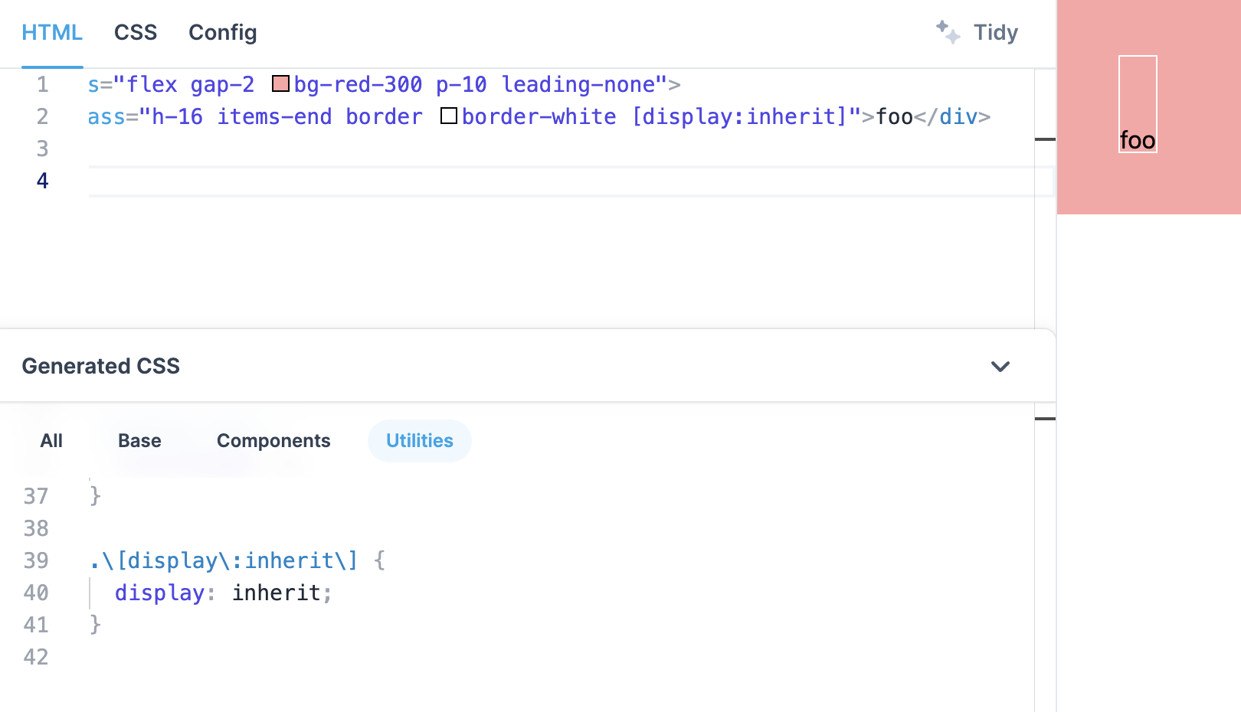
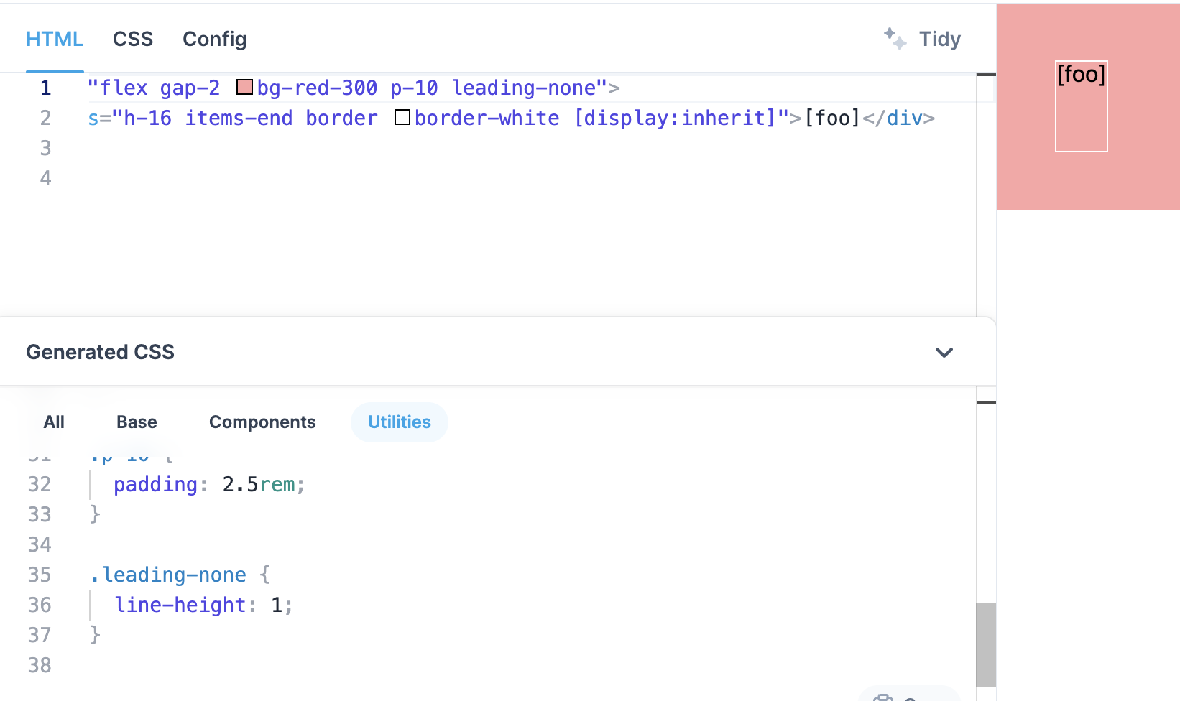
Repo: tailwindlabs/tailwindcss
Pull Number: 10212
Instance ID: tailwindlabs__tailwindcss-10212
Created At: 2023-04-04
Base Commit: d731049...
Issue Numbers: [“10180”]
Version: 3.2
Test patch: [...]
Website: [‘http...’,’http…’]
Issue_Image: [...]
Fail2Pass: ["tests/default-extractor.test.js"]
Pass2Pass: []
Patch: [...]
Problem Statement
tests/default-extractor.test.js
Test Patch
Div content with brackets [] prevents arbitrary class from being generated
488
489 - expect(extractions).toContain(`text-[#bada55]`)
490 - })
491 +
492 + test('arbitrary properties followed by square bracketed stuff', () => {
493 + let extractions = defaultExtractor(
494 + '<div class="h-16 items-end border border-white [display:inherit]">[foo]</div>‘
495 + )
496 +
497 + expect(extractions).toContain(`[display:inherit]`)
498 + })
This works: https://play.tailwindcss.com/0VLICQ8oUW
This does not work: https://play.tailwindcss.com/5KJf7xDKv6
src/lib/defaultExtractor.js
Patch
30 let utility = regex.any([
31 - // Arbitrary properties
32 - /\[[^\s:'"`]+:[^\s]+\]/,
31 + // Arbitrary properties (without square brackets)
+ /\[[^\s:'"`]+:[^\s\[\]]+\]/,
+
34 + // Arbitrary properties with balanced square brackets
+
+ // with square brackets to work in arbitrary properties
+ // while fixing a problem with the regex matching too much
+ /\[[^\s:'"`]+:[^\s]+?\[[^\s]+?\][^\s]+?\]/,

Slide 17
Repo: tailwindlabs/tailwindcss
Pull Number: 10212
Instance ID: tailwindlabs__tailwindcss-10212
Created At: 2023-04-04
Base Commit: d731049...
Issue Numbers: [“10180”]
Version: 3.2
Test Patch: [...]
Website Links: [‘http...’,’http…’]
Issue Images: [...]
Fail2Pass: ["tests/default-extractor.test.js"]
Pass2Pass: []
Patch: [...]
Problem Statement
tests/default-extractor.test.js
Test Patch
Div content with brackets [] prevents arbitrary class from being generated
488
489 - expect(extractions).toContain(`text-[#bada55]`)
490 - })
491 +
492 + test('arbitrary properties followed by square bracketed stuff', () => {
493 + let extractions = defaultExtractor(
494 + '<div class="h-16 items-end border border-white [display:inherit]">[foo]</div>‘
495 + )
496 +
497 + expect(extractions).toContain(`[display:inherit]`)
498 + })
This works: https://play.tailwindcss.com/0VLICQ8oUW
This does not work: https://play.tailwindcss.com/5KJf7xDKv6
src/lib/defaultExtractor.js
Patch
30 let utility = regex.any([
31 - // Arbitrary properties
32 - /\[[^\s:'"`]+:[^\s]+\]/,
31 + // Arbitrary properties (without square brackets)
+ /\[[^\s:'"`]+:[^\s\[\]]+\]/,
+
34 + // Arbitrary properties with balanced square brackets
+
+ // with square brackets to work in arbitrary properties
+ // while fixing a problem with the regex matching too much
+ /\[[^\s:'"`]+:[^\s]+?\[[^\s]+?\][^\s]+?\]/,

Slide 18
Repo: tailwindlabs/tailwindcss
PR Number: 10212
Instance ID: tailwindlabs__tailwindcss-10212
Version: 3.2
Created At: 2023-04-04
Base Commit: d731049...
Issue Numbers: ["10180"]
Pass2Pass: []
Website Links: ['http...', 'http…']
Issue_Image: [...]
Fail2Pass: ["tests/default-extractor.test.js"]
Issue Descriptions:
tests/default-extractor.test.js
Test Patch
Div content with brackets [] prevents arbitrary class from being generated
488
489 - expect(extractions).toContain(`text-[#bada55]`)
490 - })
491 +
492 + test('arbitrary properties followed by square bracketed stuff', () => {
493 + let extractions = defaultExtractor(
494 + '<div class="h-16 items-end border border-white [display:inherit]">[foo]</div>‘
495 + )
496 +
497 + expect(extractions).toContain(`[display:inherit]`)
498 + })
This works: https://play.tailwindcss.com/0VLICQ8oUW
This does not work: https://play.tailwindcss.com/5KJf7xDKv6
src/lib/defaultExtractor.js
Patch
30 let utility = regex.any([
31 - // Arbitrary properties
32 - /\[[^\s:'"`]+:[^\s]+\]/,
31 + // Arbitrary properties (without square brackets)
+ /\[[^\s:'"`]+:[^\s\[\]]+\]/,
+
34 + // Arbitrary properties with balanced square brackets
+
+ // with square brackets to work in arbitrary properties
+ // while fixing a problem with the regex matching too much
+ /\[[^\s:'"`]+:[^\s]+?\[[^\s]+?\][^\s]+?\]/,

