Slide 1
CHAPTER 14 Beyond functionality

Slide 2
Objectives
After finishing this chapter, student could:
detect and specify nonfunctional requirements
Understand the role of quality requirements in software development

Slide 3
Contents
Software quality attributes
Exploring quality attributes
Defining quality requirements
Specifying quality requirements with Planguage
Quality attribute trade-offs
Implementing quality attribute requirements
Constraints
Handling quality attributes on agile projects

Slide 4
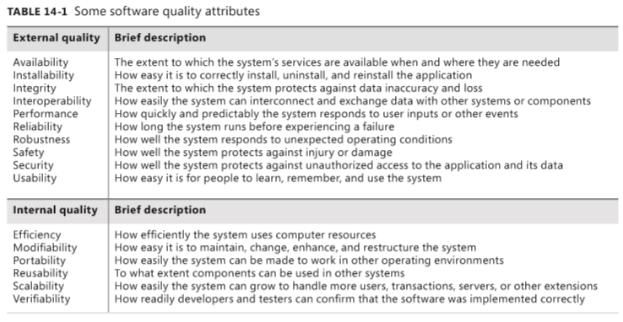
Software quality attributes

Slide 5
Exploring quality attributes
Step 1: Start with a broad taxonomy
Step 2: Reduce the list
Step 3: Prioritize the attributes
Step 4: Elicit specific expectations for each attribute
Step 5: Specify well-structured quality requirements

Slide 6
Defining quality requirements
External quality attributes
Availability, Installability, Integrity, Interoperability, Performance, Reliability, Robustness, Safety, Security, Usability,
Internal quality attributes
Efficiency, Modifiability, Portability, Reusability, Scalability, Verifiability

Slide 7
Specifying quality requirements with Planguage
Definition: Planguage, a language with a rich set of keywords that permits precise statements of quality attributes and other project goals (Simmons 2001).
Purpose: address the problem of ambiguous and incomplete nonfunctional requirements
Example: “At least 95 percent of the time, the system shall take no more than 8 seconds to display any of the predefined accounting reports.”

Slide 8
Specifying quality requirements with Planguage
TAG Performance.Report.ResponseTime
AMBITION Fast response time to generate accounting reports on the base user platform.
SCALE Seconds of elapsed time between pressing the Enter key or clicking OK to request a report and the beginning of the display of the report.
METER Stopwatch testing performed on 30 test reports that represent a defined usage operational profile for a field office accountant.
GOAL No more than 8 seconds for 95 percent of reports. -<-Field Office Manager
STRETCH No more than 2 seconds for predefined reports, 5 seconds for all reports.
WISH No more than 1.5 seconds for all reports.
Base user platform DEFINED Quad-core processor, 8GB RAM, Windows 8, QueryGen 3.3 running, single user, at least 50 percent of system RAM and 70 percent of system CPU capacity free, network connection speed of at least 30 Mbps.

Slide 9
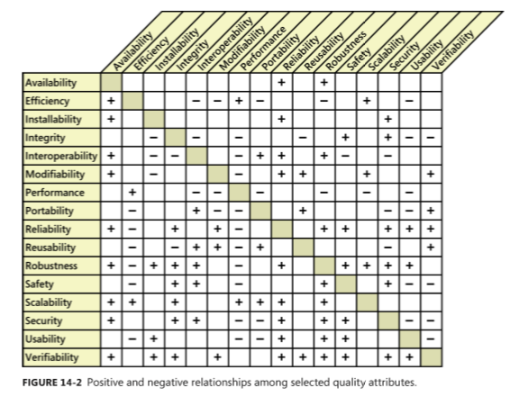
Quality attribute trade-offs

Slide 10
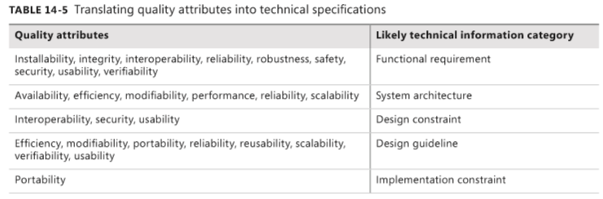
Implementing quality attribute requirements

Slide 11
Constraints
Definition
Purpose
Sources of constraints
Example
CON-1. The user clicks at the top of the project list to change the sort sequence. [specific user interface control imposed as a design constraint on a functional requirement]
CON-2. Only open source software available under the GNU General Public License may be used to implement the product. [implementation constraint]
CON-3. The application must use Microsoft .NET framework 4.5. [architecture constraint]
CON-4. ATMs contain only $20 bills. [physical constraint]
CON-5. Online payments may be made only through PayPal. [design constraint] CON-6. All textual data used by the application shall be stored in the form of XML files. [data constraint]

Slide 12
Handling quality attributes on agile projects
It can be difficult and expensive to retrofit desired quality characteristics into a product late in development or after delivery.
That’s why even agile projects that develop requirements and deliver functionality in small increments need to specify significant quality attributes and constraints early in the project.
This allows developers to make appropriate architectural and design decisions as a foundation for the desired quality characteristics.
Nonfunctional requirements need to have priority alongside user stories; you can’t defer their implementation until a later iteration.
Example

