Slide 1
Real-Time Communication with SignalR

Slide 2
Objectives
Understand Real-Time Communication application
Understand the concepts of creating ASP.NET Core with SignalR
Transports
Hubs
Create a simple chat system using ASP.NET Core with SignalR
Work with Entity Framework combined with SignalR

Slide 3
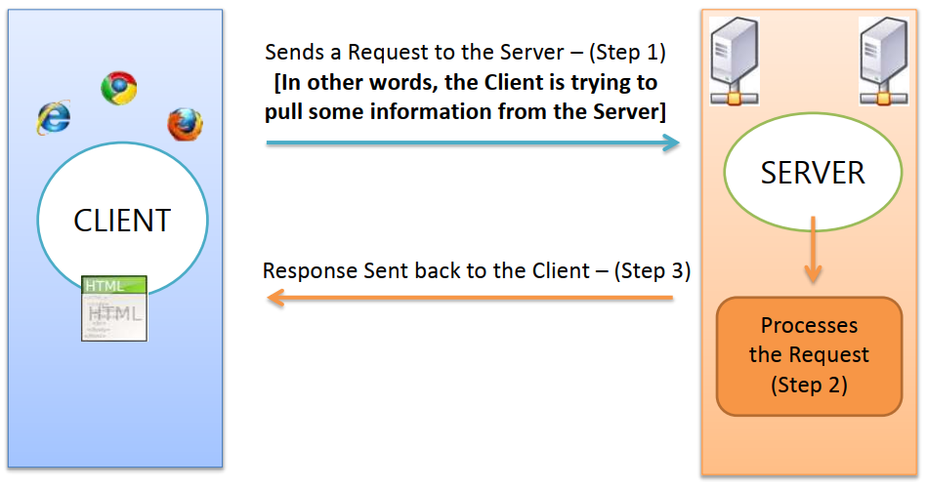
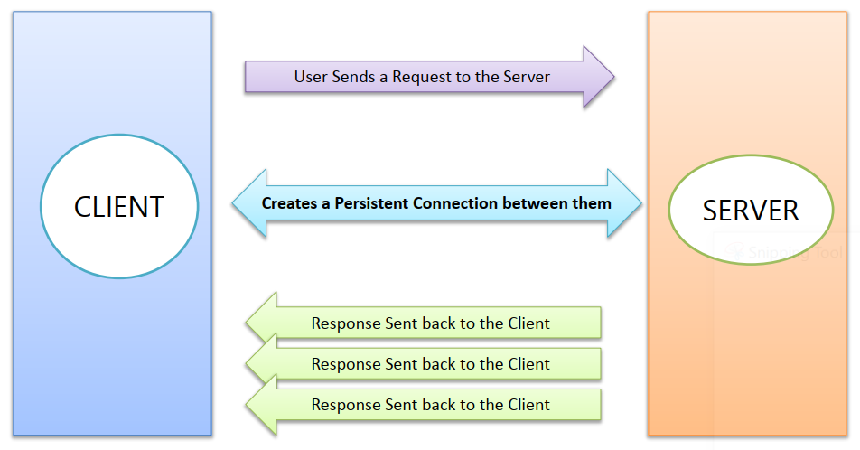
Real Time Web Applications - 1
Real Time Web Applications
Traditional Web Approach

Slide 4
Real Time Web Applications - 2
“Real Time” means an immediate response being sent by the Server to the Client.
Real Time is “Pushing” instead of “Pulling”
Push Technology is completely different from Pull Technology. Its about getting told what’s new, instead of asking for what’s new!

Slide 5
Introducing SignalR
SignalR is a library from Microsoft that offers real-time web development for ASP.NET applications.
SignalR is primarily used by applications that require push notifications from server to client (applications such as chat, stock market, gaming, and dashboards).
SignalR solves the problem by providing a persistent connection between the client and the server. SignalR uses the Hubs API to push notifications from server to client, and it supports multiple channels such as WebSocket, server-sent events, and long polling.
SignalR supports multiple clients ranging from C#/C++ to JavaScript.

Slide 6
History of SignalR
SignalR was created in 2011 by David Fowler and Damian Edwards.
SignalR was brought into the ASP.NET project and released as part of ASP.NET in 2013.
SignalR was set up to solve real-time messaging for the Web problem and provide easy support for real-time capabilities on the ASP.NET stack by creating server- and client-side libraries that abstract away the complications of these technologies.

Slide 7
Features of SignalR for ASP.NET Core
SignalR provides an API for creating server-to-client remote procedure calls (RPC). The RPCs call JavaScript functions on clients from server-side .NET Core code.
Handles connection management automatically.
Sends messages to all connected clients simultaneously. For example, a chat room.
Sends messages to specific clients or groups of clients.
Scales to handle increasing traffic.

Slide 8
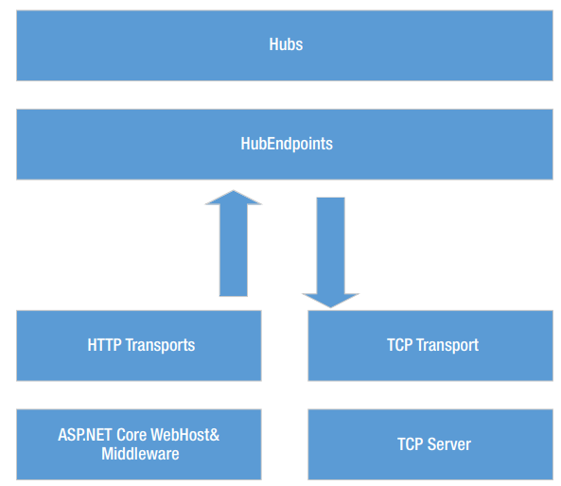
SignalR high-level architecture
The ASP.NET Core SignalR high-level architecture

Slide 9
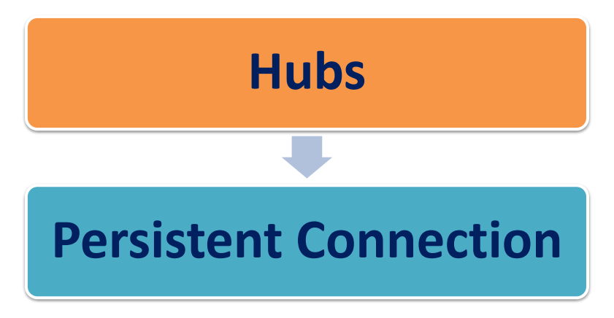
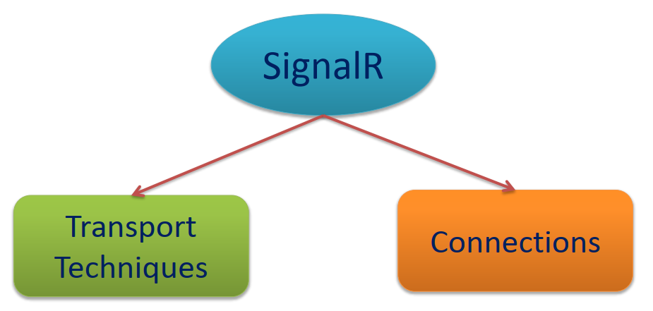
SignalR Connections
“SignalR supports "server push" functionality, in which server code can call out to client code in the browser using Remote Procedure Calls (RPC), rather than the request-response model common on the web today.

Slide 10
Transports
SignalR supports the following techniques for handling real-time communication (in order of graceful fallback):
WebSockets
Server-Sent Events
Long Polling
SignalR automatically chooses the best transport method that is within the capabilities of the server and client.

Slide 11
Hubs - 1
SignalR uses hubs to communicate between clients and servers.
A hub is a high-level pipeline that allows a client and server to call methods on each other.
SignalR handles the dispatching across machine boundaries automatically, allowing clients to call methods on the server and vice versa. You can pass strongly-typed parameters to methods, which enables model binding.
SignalR provides two built-in hub protocols:
a text protocol based on JSON
a binary protocol based on MessagePack

Slide 12
Hubs - 2
MessagePack generally creates smaller messages compared to JSON.
Older browsers must support XHR level 2 to provide MessagePack protocol support.
Hubs call client-side code by sending messages that contain the name and parameters of the client-side method.
Objects sent as method parameters are deserialized using the configured protocol.
The client tries to match the name to a method in the client-side code.
When the client finds a match, it calls the method and passes to it the deserialized parameter data.
Notes:
https://caniuse.com/xhr2

Slide 13
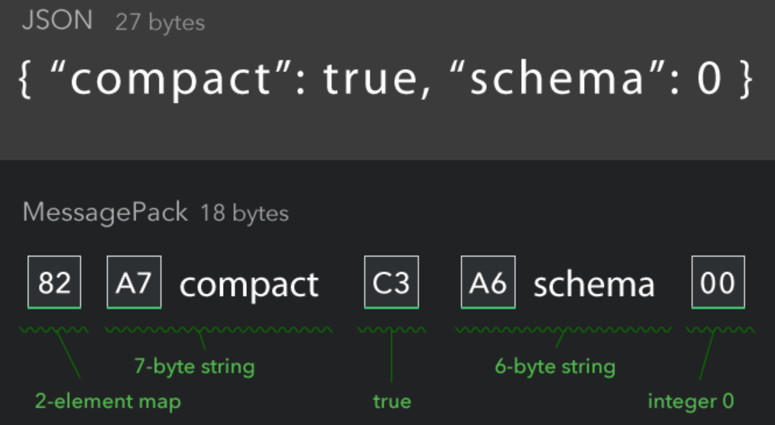
Hubs - 3
MessagePack is an efficient binary serialization format.
It lets you exchange data among multiple languages like JSON. But it's faster and smaller. Small integers are encoded into a single byte, and typical short strings require only one extra byte in addition to the strings themselves.
Notes:
https://msgpack.org/

Slide 14
Use hubs in SignalR for ASP.NET Core
The SignalR Hubs API enables you to call methods on connected clients from the server.
In the server code, you define methods that are called by client.
In the client code, you define methods that are called from the server.
SignalR takes care of everything behind the scenes that makes real-time client-to-server and server-to-client communications possible.

Slide 15
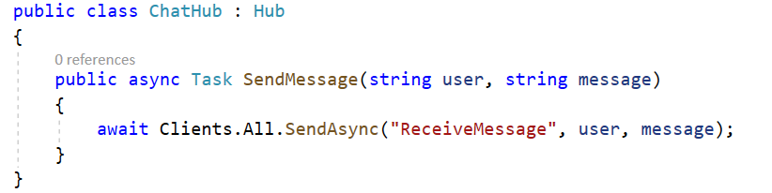
Create and use hubs
Create a hub by declaring a class that inherits from Hub, and add public methods to it.
Clients can call methods that are defined as public.

Slide 16
Configure SignalR hubs
The SignalR middleware requires some services, which are configured by calling services.AddSignalR();
When adding SignalR functionality to an ASP.NET Core app, setup SignalR routes by calling endpoint.MapHub in the Startup.Configure method's app.UseEndpoints callback.
app.UseRouting();
app.UseEndpoints(endpoints =>
{
endpoints.MapHub<ChatHub>("/chathub");
});

Slide 17
The Context object - 1
The Hub class has a Context property that contains the properties with information about the connection
Property | Description
ConnectionId | Gets the unique ID for the connection, assigned by SignalR. There is one connection ID for each connection.
UserIdentifier | Gets the user identifier. By default, SignalR uses the ClaimTypes.NameIdentifier from the ClaimsPrincipal associated with the connection as the user identifier.
User | Gets the ClaimsPrincipal associated with the current user.
Items | Gets a key/value collection that can be used to share data within the scope of this connection. Data can be stored in this collection and it will persist for the connection across different hub method invocations.
Features | Gets the collection of features available on the connection. For now, this collection isn't needed in most scenarios, so it isn't documented in detail yet.
ConnectionAborted | Gets a CancellationToken that notifies when the connection is aborted.

Slide 18
The Context object - 2
Hub.Context also contains the methods
Method | Description
GetHttpContext | Returns the HttpContext for the connection, or null if the connection is not associated with an HTTP request. For HTTP connections, you can use this method to get information such as HTTP headers and query strings.
Abort | Aborts the connection.

Slide 19
The Clients object - 1
The Hub class has a Clients property that contains the following properties for communication between server and client
Property | Description
All | Calls a method on all connected clients
Caller | Calls a method on the client that invoked the hub method
Others | Calls a method on all connected clients except the client that invoked the method

Slide 20
The Clients object - 2
Hub.Clients also contains the following methods
Method | Description
AllExcept | Calls a method on all connected clients except for the specified connections
Client | Calls a method on a specific connected client
Clients | Calls a method on specific connected clients
Group | Calls a method on all connections in the specified group
GroupExcept | Calls a method on all connections in the specified group, except the specified connections
Groups | Calls a method on multiple groups of connections
OthersInGroup | Calls a method on a group of connections, excluding the client that invoked the hub method
User | Calls a method on all connections associated with a specific user
Users | Calls a method on all connections associated with the specified users

Slide 21
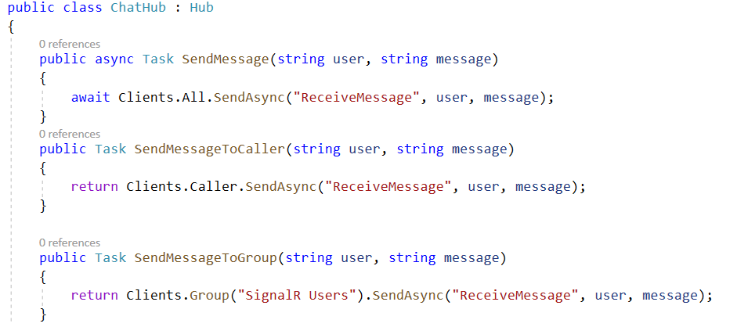
Send messages to clients
SendMessage() sends a message to all connected clients, using Clients.All.
To make calls to specific clients, use the properties of the Clients object.
SendMessageToCaller() sends a message back to the caller, using Clients.Caller.
SendMessageToGroup() sends a message to all clients in the SignalR Users group.

Slide 22
Strongly typed hubs
A drawback of using SendAsync is that it relies on a magic string to specify the client method to be called.
This leaves code open to runtime errors if the method name is misspelled or missing from the client.
An alternative to using SendAsync is to strongly type the Hub with Hub<T>.

Slide 23
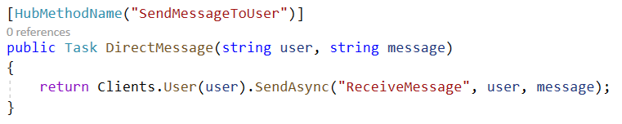
Change the name of a hub method
By default, a server hub method name is the name of the .NET method.
Can use the [HubMethodName] attribute to change this default and manually specify a name for the method.
The client should use this name, instead of the .NET method name, when invoking the method.

Slide 24
Handle events for a connection - 1
The SignalR Hubs API provides the OnConnectedAsync and OnDisconnectedAsync virtual methods to manage and track connections.
Override the OnConnectedAsync virtual method to perform actions when a client connects to the Hub, such as adding it to a group.
Override the OnDisconnectedAsync virtual method to perform actions when a client disconnects. If the client disconnects intentionally (by calling connection.stop(), for example), the exception parameter will be null. However, if the client is disconnected due to an error (such as a network failure), the exception parameter will contain an exception describing the failure.

Slide 25
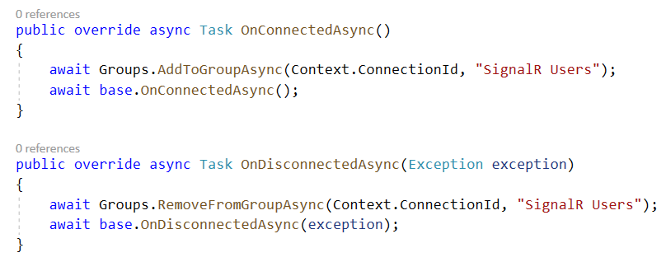
Handle events for a connection - 2

Slide 26
Handle errors
Exceptions thrown in your hub methods are sent to the client that invoked the method.
On the JavaScript client, the invoke method returns a JavaScript Promise.
When the client receives an error with a handler attached to the promise using catch, it's invoked and passed as a JavaScript Error object.

Slide 27
Hub filters - 1
Are available in ASP.NET Core 5.0 or later.
Allow logic to run before and after hub methods are invoked by clients.
Work with Hub filter
Create hub filters
Configure hub filters
Use hub filters
Notes:
https://docs.microsoft.com/en-us/aspnet/core/signalr/hub-filters?view=aspnetcore-5.0

Slide 28
Hub filters - 2
Create hub filters
Create a filter by declaring a class that inherits from IHubFilter, and add the InvokeMethodAsync method.
There is also OnConnectedAsync and OnDisconnectedAsync that can optionally be implemented to wrap the OnConnectedAsync and OnDisconnectedAsync hub methods respectively.

Slide 29
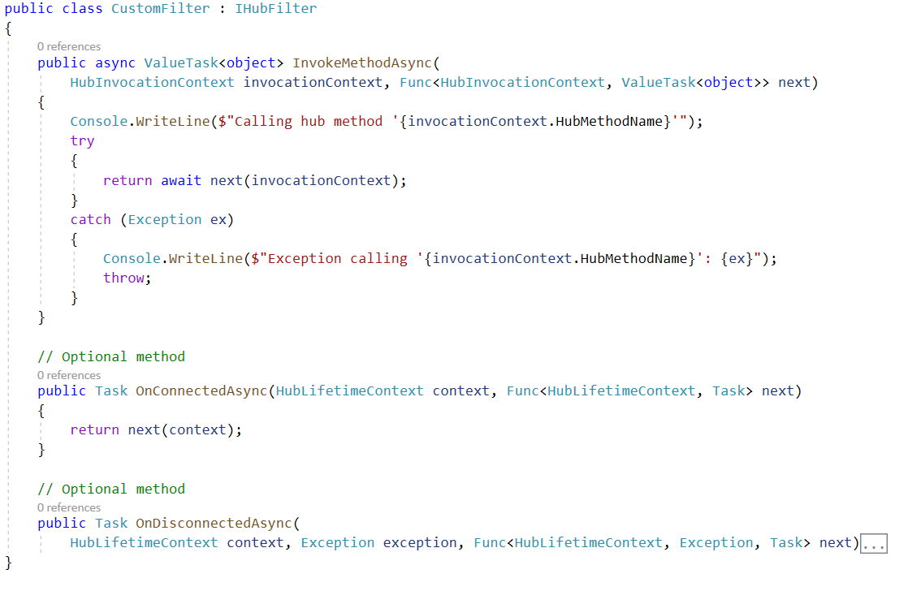
Hub filters - 3

Slide 30
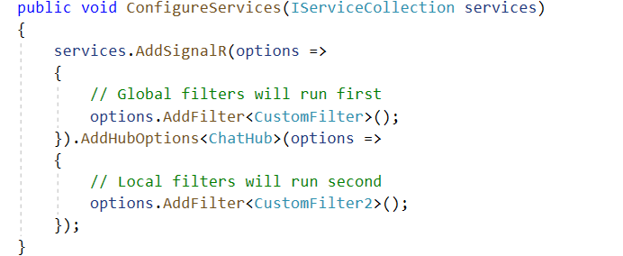
Hub filters - 4
Configure hub filters
Hub filters can be applied globally or per hub type.
The order in which filters are added is the order in which the filters run. Global hub filters run before local hub filters.

Slide 31
Hub filters - 5
When writing the filter logic, try to make it generic by using attributes on hub methods instead of checking for hub method names.
Consider a filter that will check a hub method argument for banned phrases and replace any phrases it finds with ***

Slide 32
Simple Chat with SignalR

Slide 33
Create simple chat with ASP.NET Core SignalR
Step 1. Create a web project.
Step 2. Add the SignalR client library.
Step 3. Create a SignalR hub.
Step 4. Configure the project to use SignalR.
Step 5. Add code that sends messages from any client to all connected clients.

Slide 34
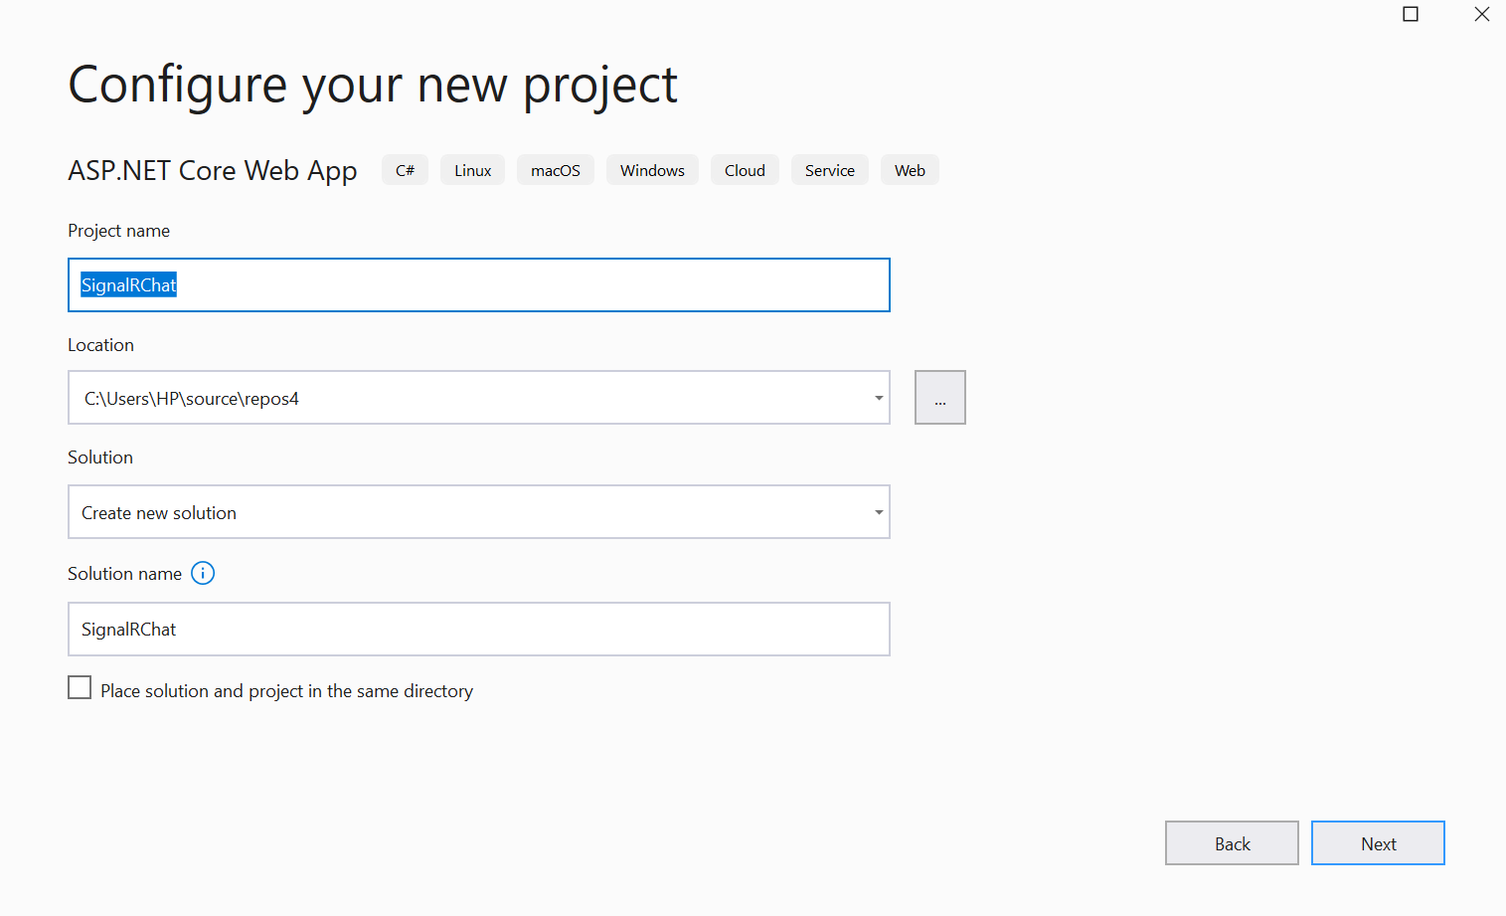
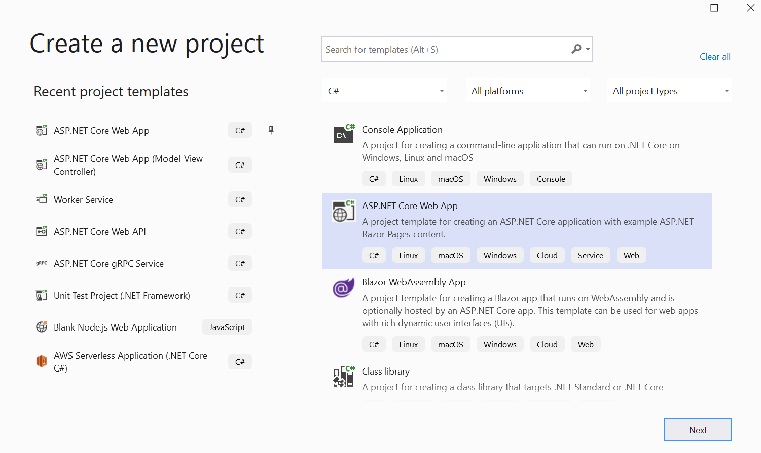
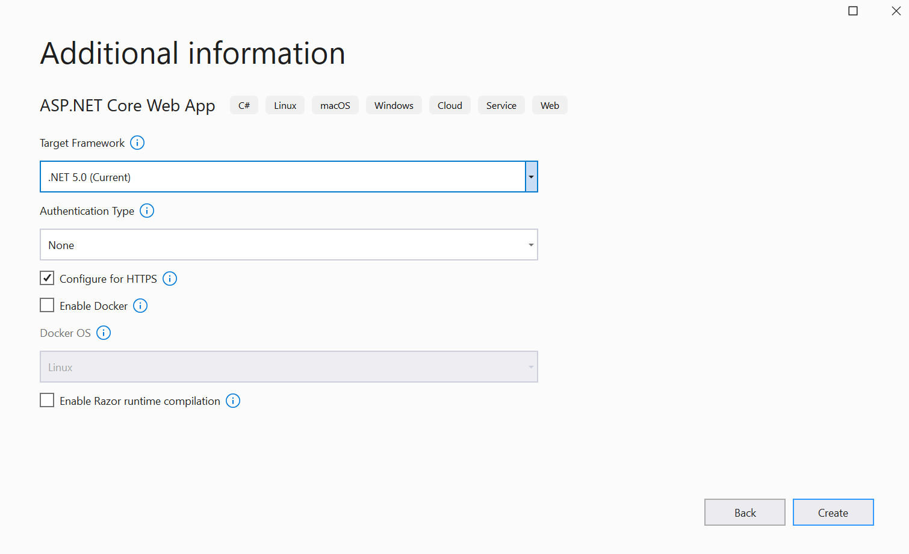
Step 1. Create a web project.

Slide 35
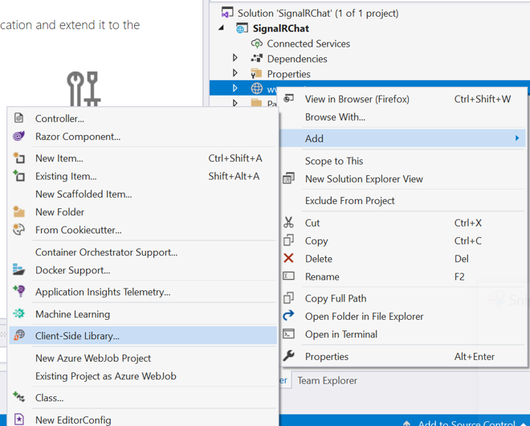
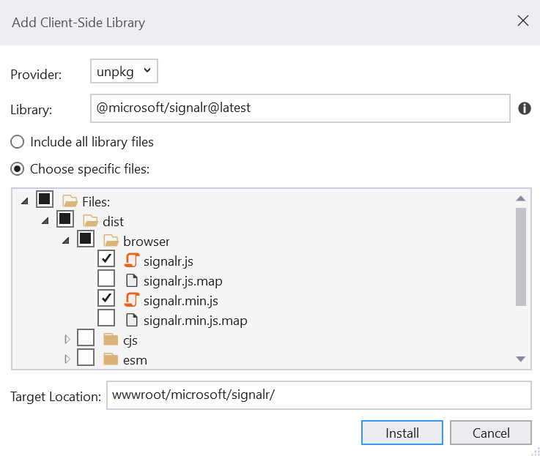
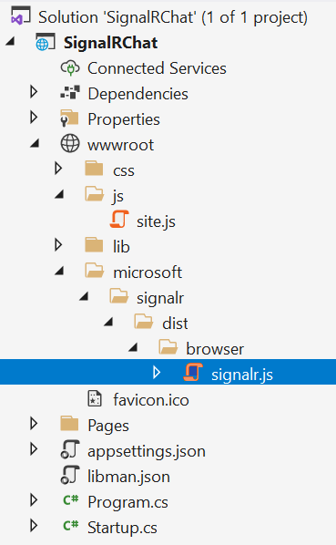
Step 2. Add the SignalR client library.

Slide 36
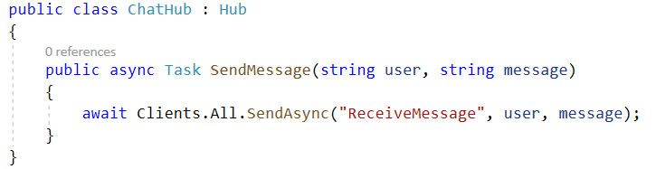
Step 3. Create a SignalR hub.
A hub is a class that serves as a high-level pipeline that handles client-server communication.
Create a ChatHub.cs
The ChatHub class inherits from the SignalR Hub class. The Hub class manages connections, groups, and messaging.
The SendMessage method can be called by a connected client to send a message to all clients.

Slide 37
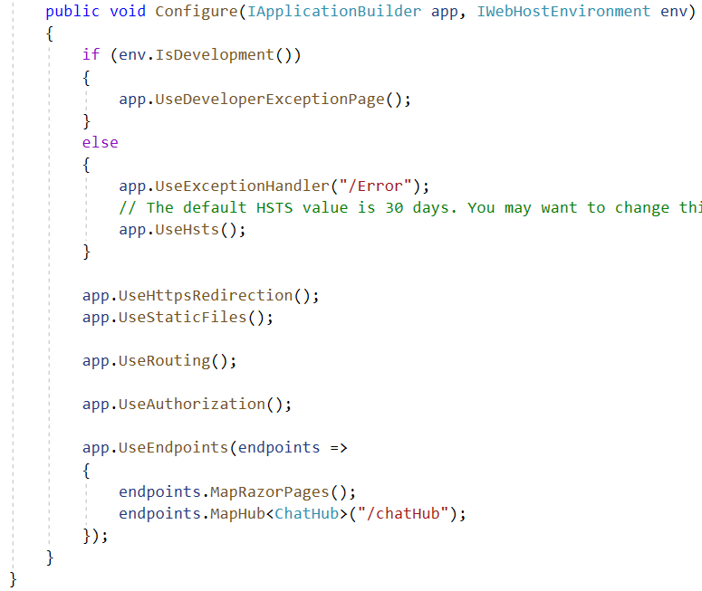
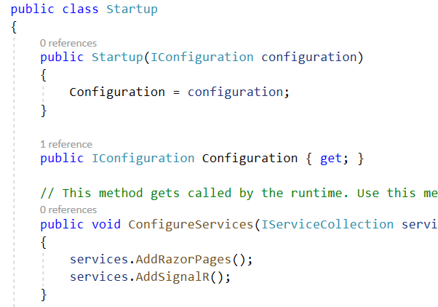
Step 4. Configure the project to use SignalR.
The SignalR server must be configured to pass SignalR requests to SignalR.

Slide 38
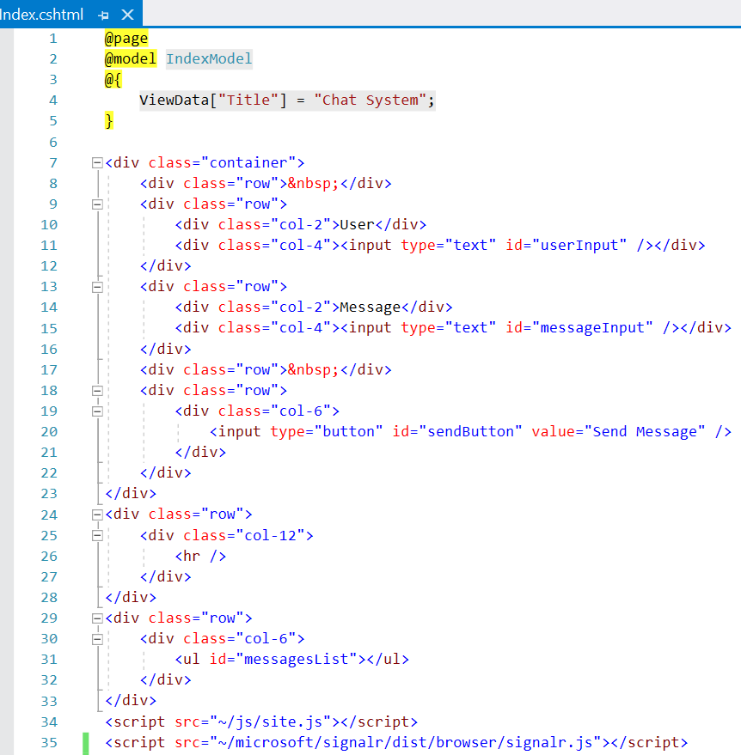
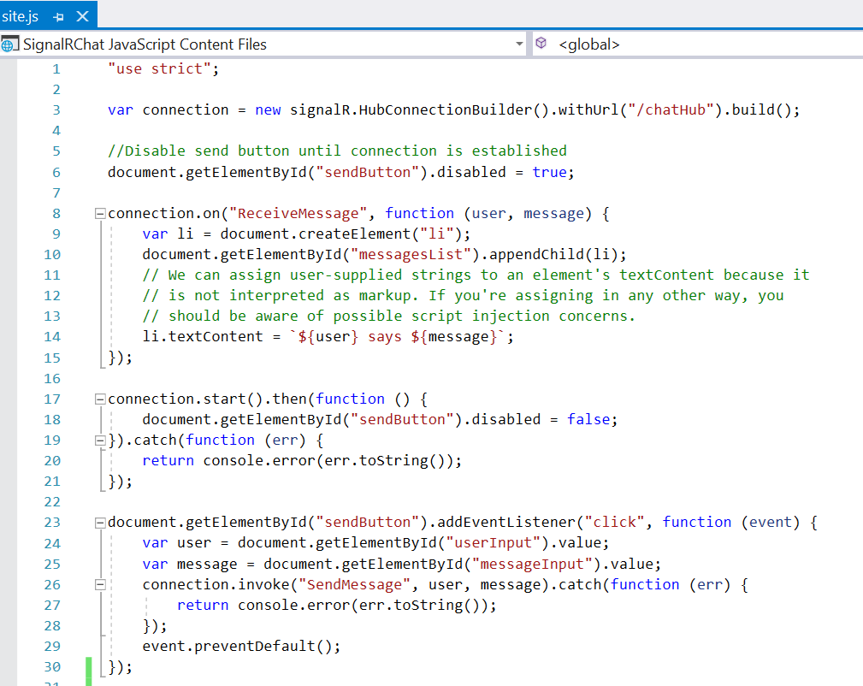
Step 5. Add code that sends messages
Add code that sends messages from any client to all connected clients

Slide 39
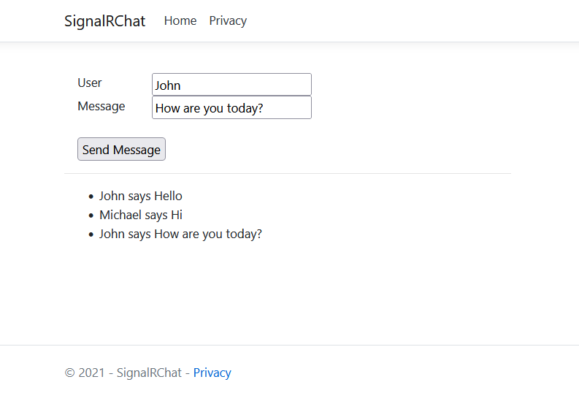
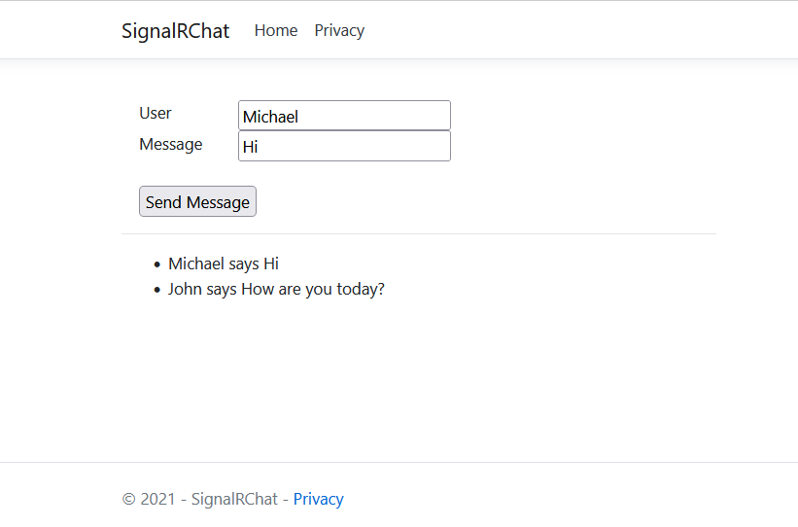
Step 6. Run application

Slide 40
Create an application with Entity Framework and SignalR

Slide 41
Entity Framework combined with SignalR
Step 1. Create Project
Step 2. Work with Entity Framework
Step 3. Create SignalR Hub and configure SignalR
Step 4. Build CRUD functions combined with SignalR
Step 5. Build and run Project. Test all CRUD actions

Slide 42
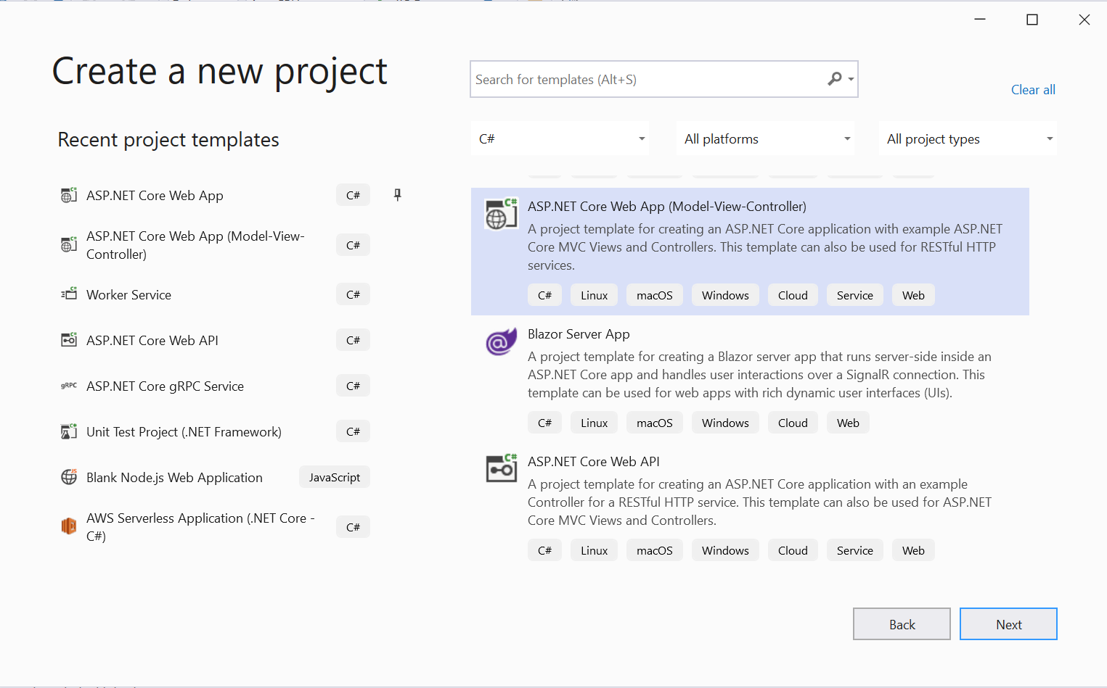
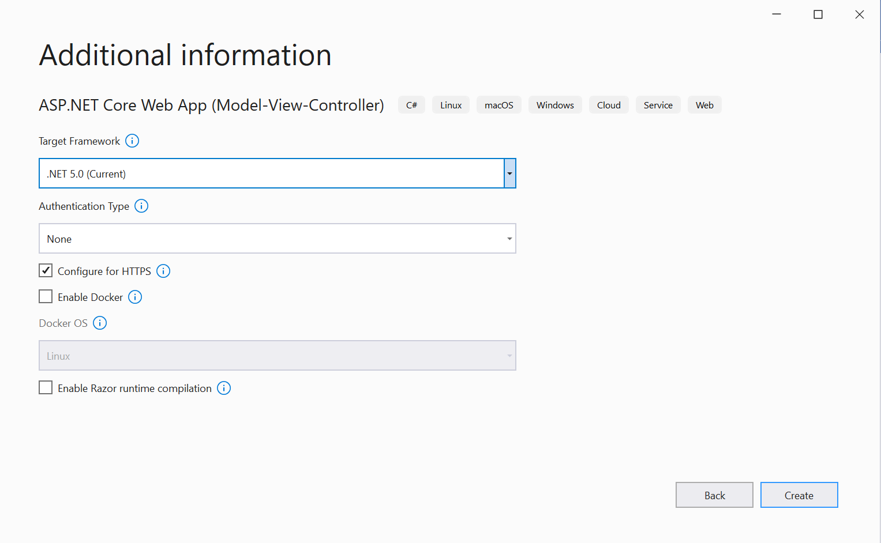
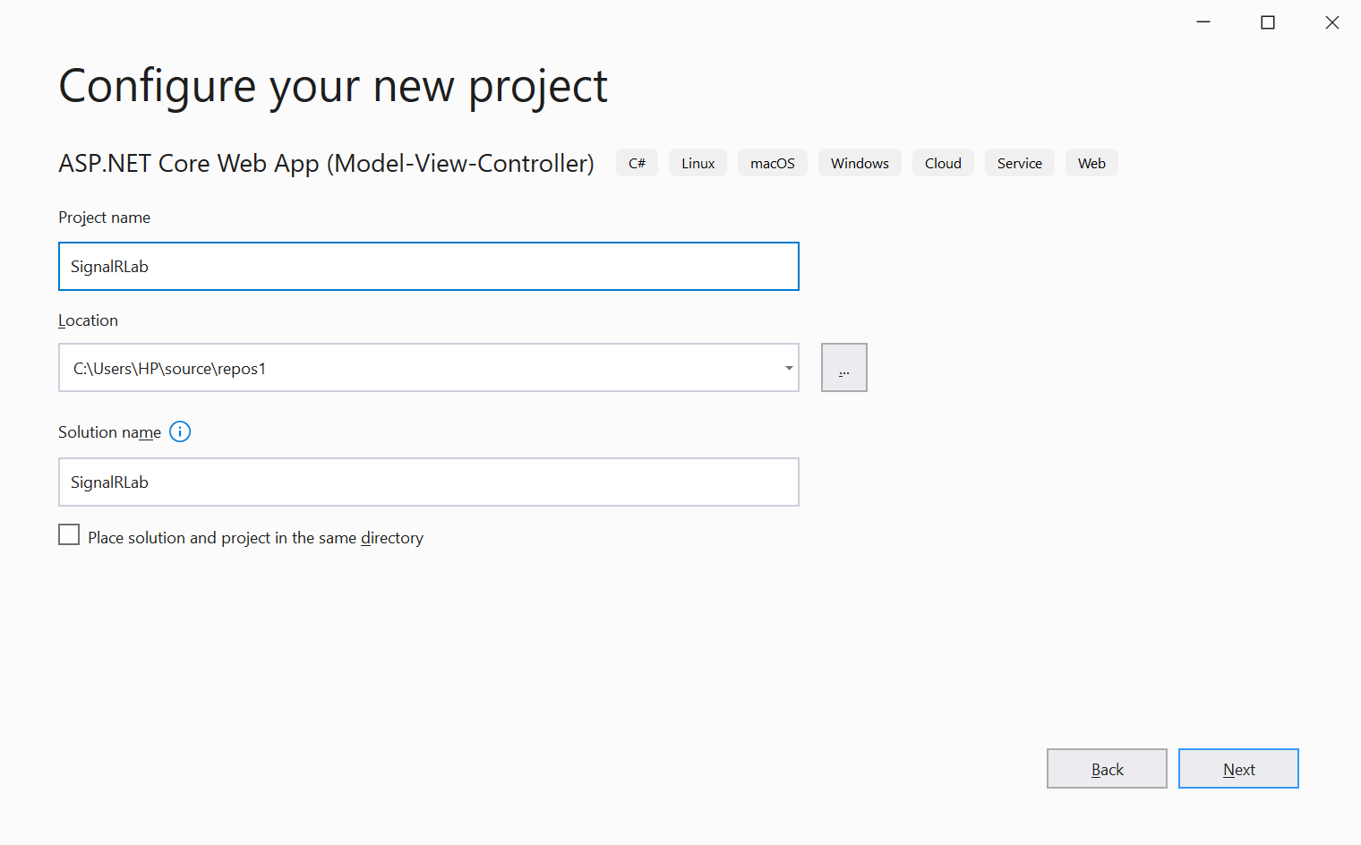
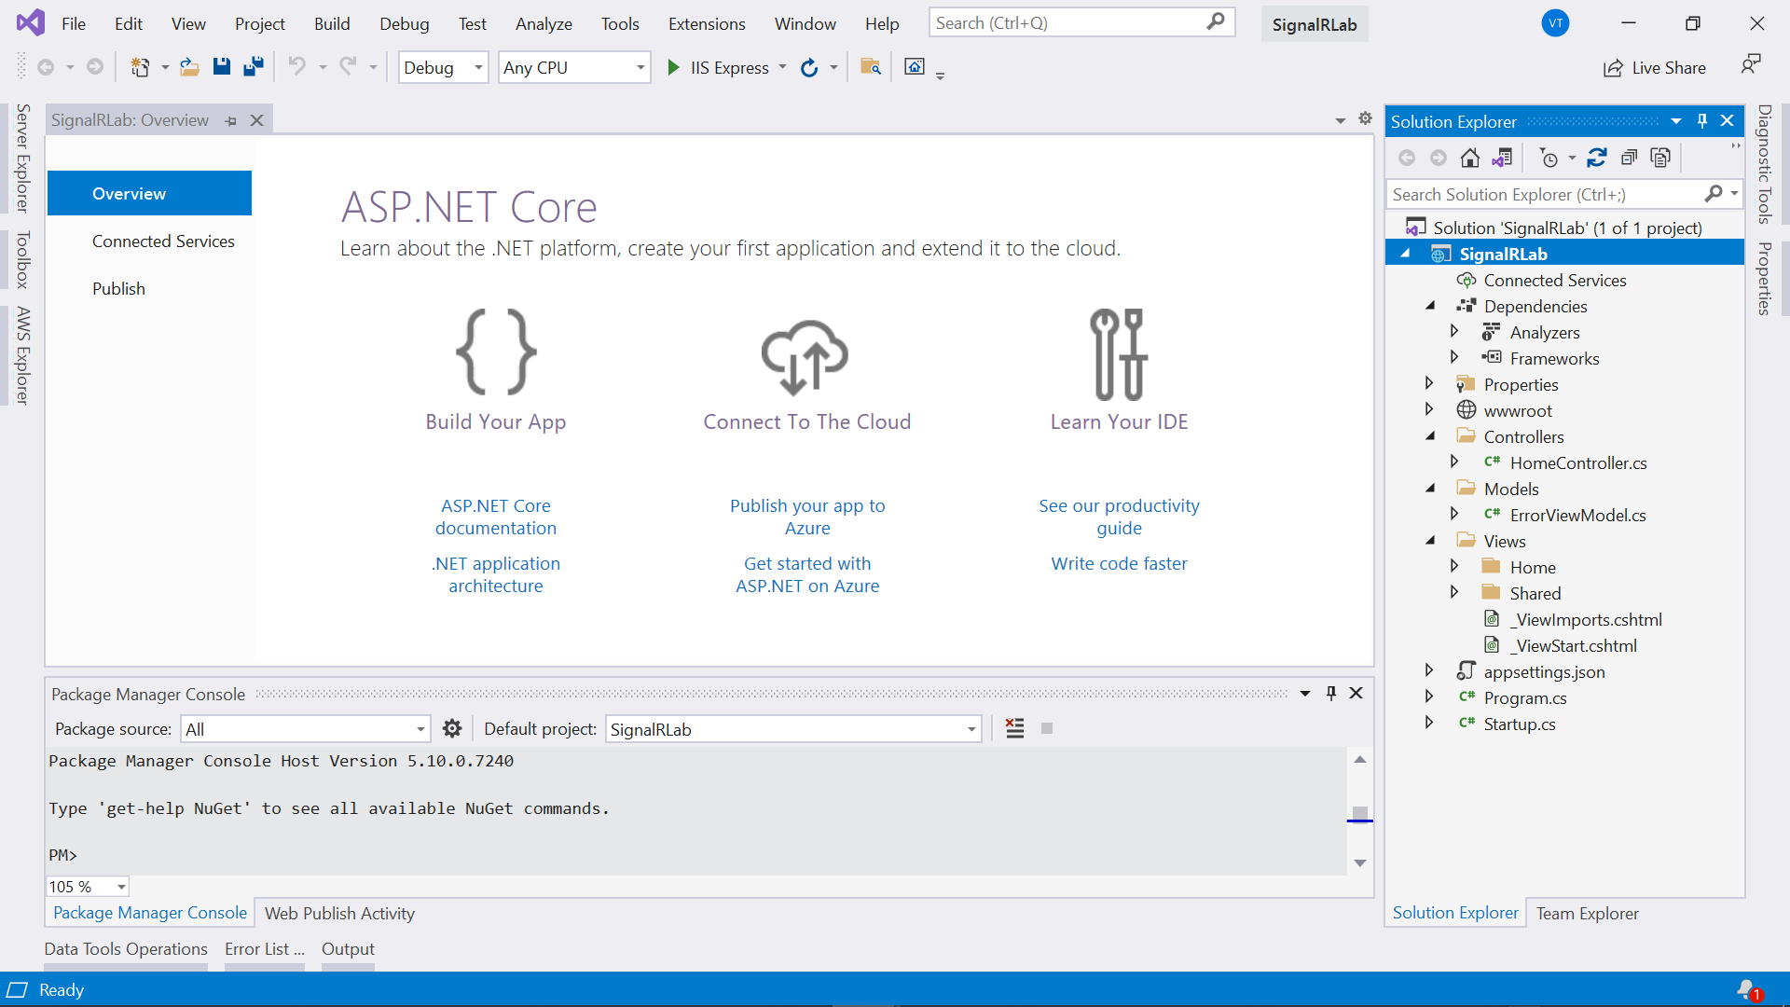
Step 1. Create Project

Slide 43
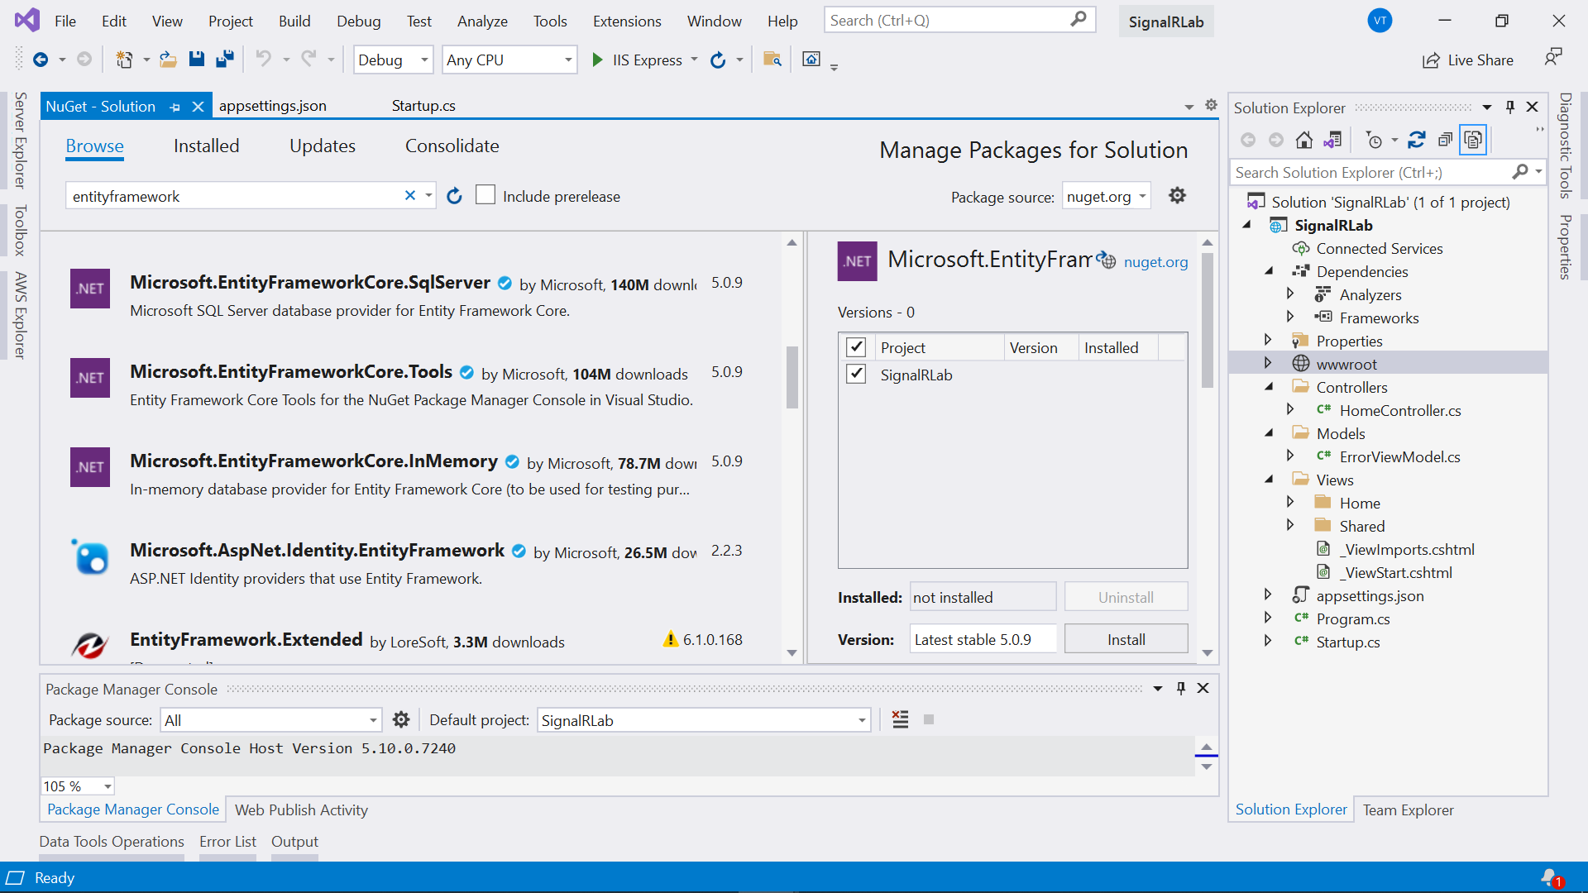
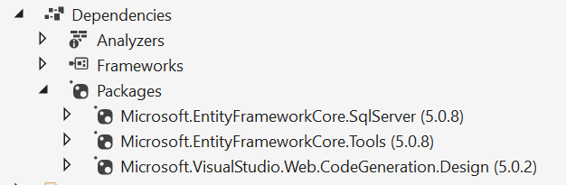
Step 2. Work with Entity Framework
Install the following packages from NuGet:
Add “Products.cs” entity and “ApplicationDBContext.cs” classes
Add-Migration and Update-Database
Add ProductsController with Scraffolding

Slide 44
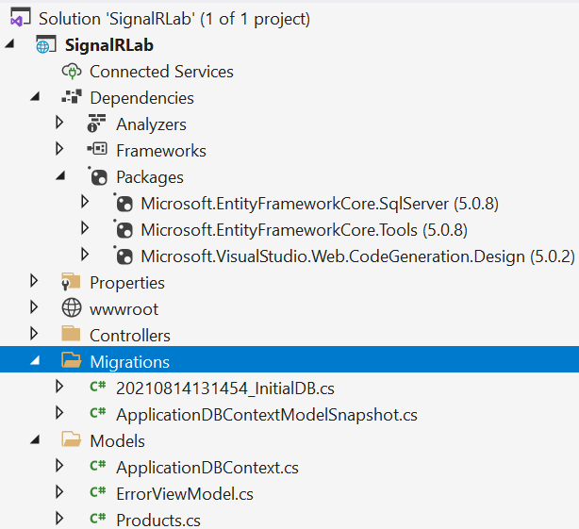
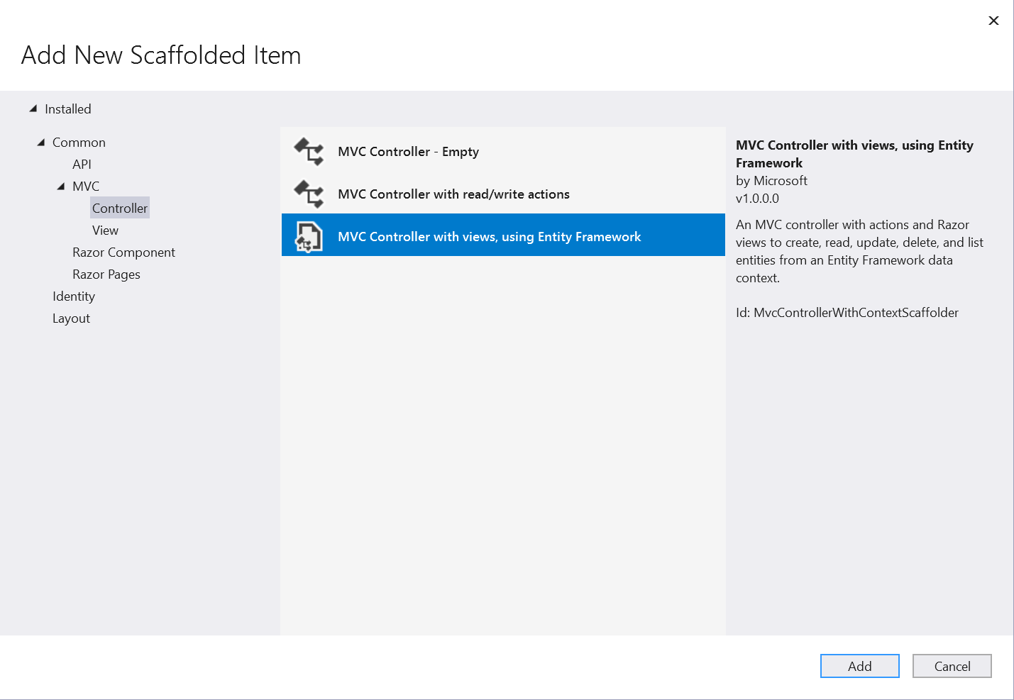
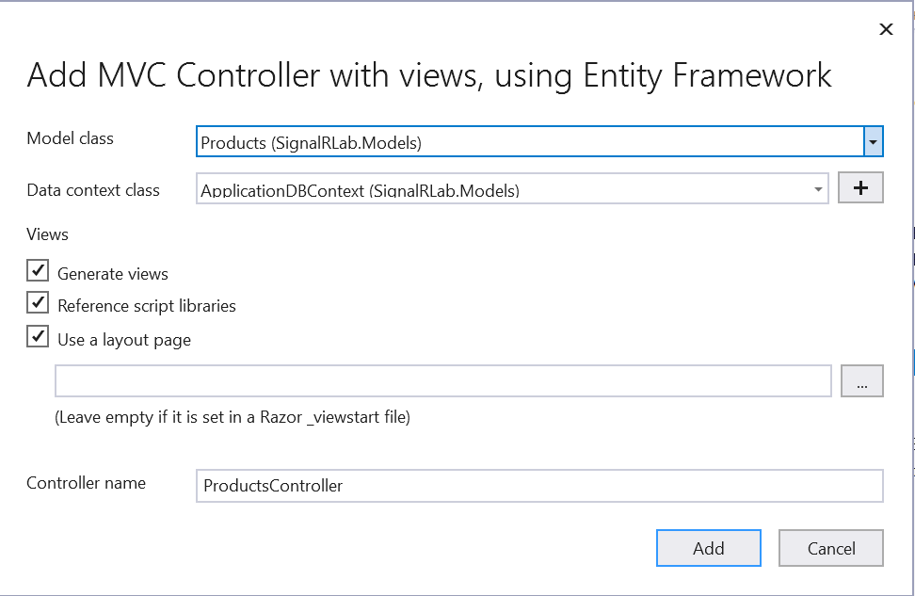
Step 2. Work with Entity Framework - 2

Slide 45
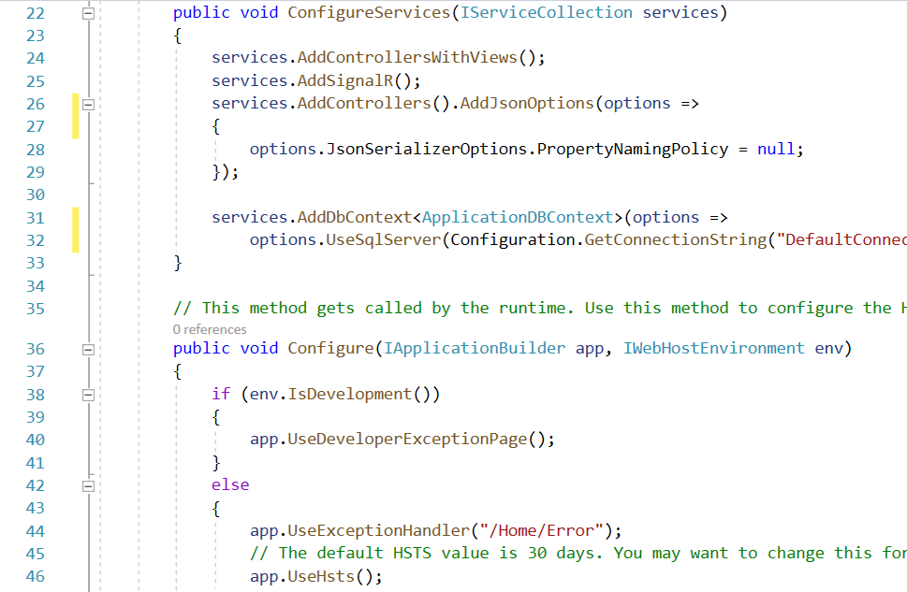
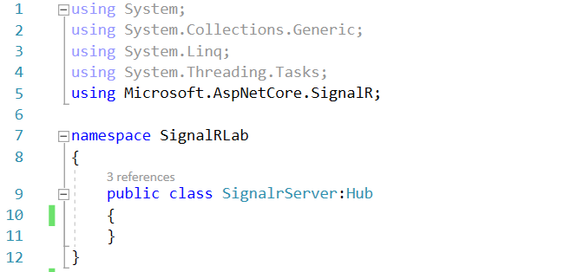
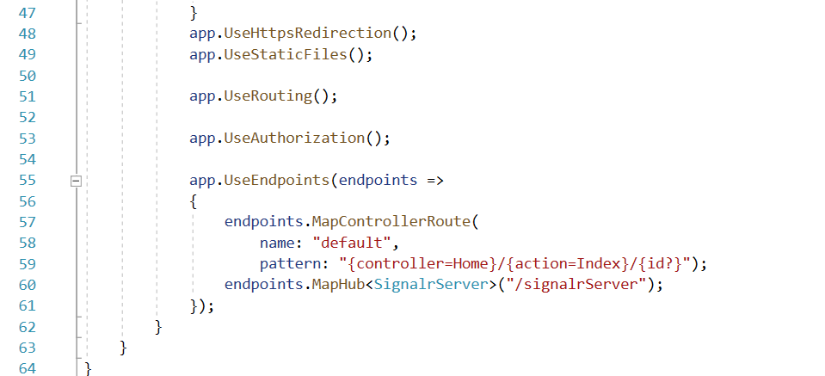
Step 3. Create SignalR Hub and configure
Create SignalR Hubs in the SignalrServer.cs
Add SignalR to Startup.cs

Slide 46
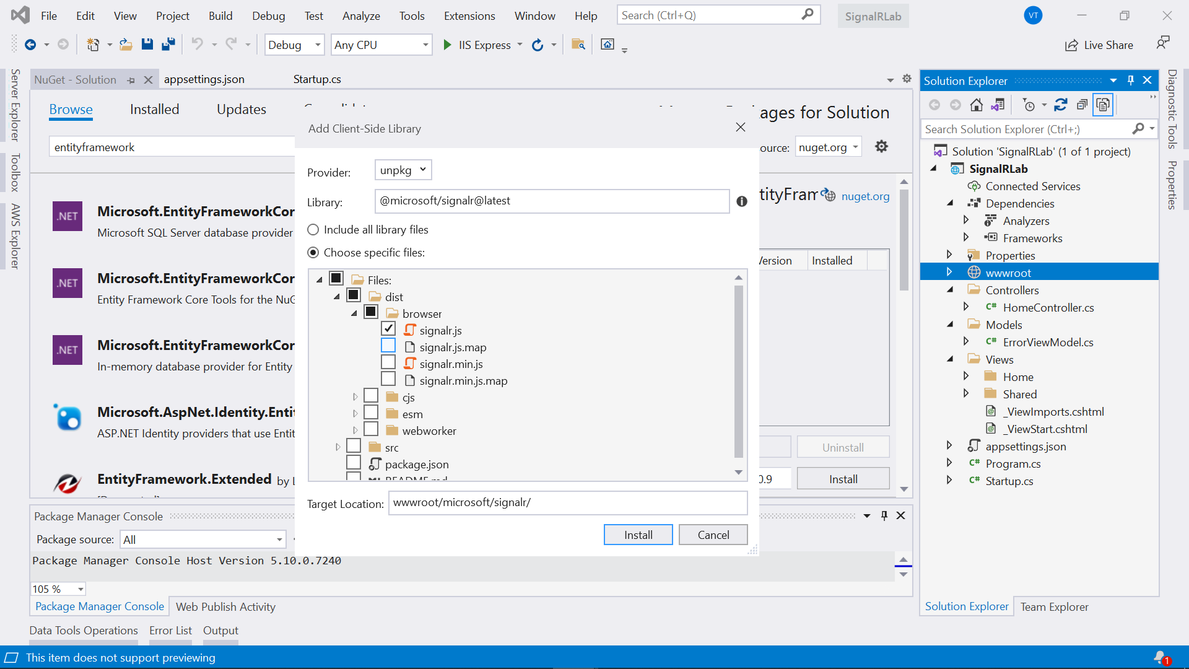
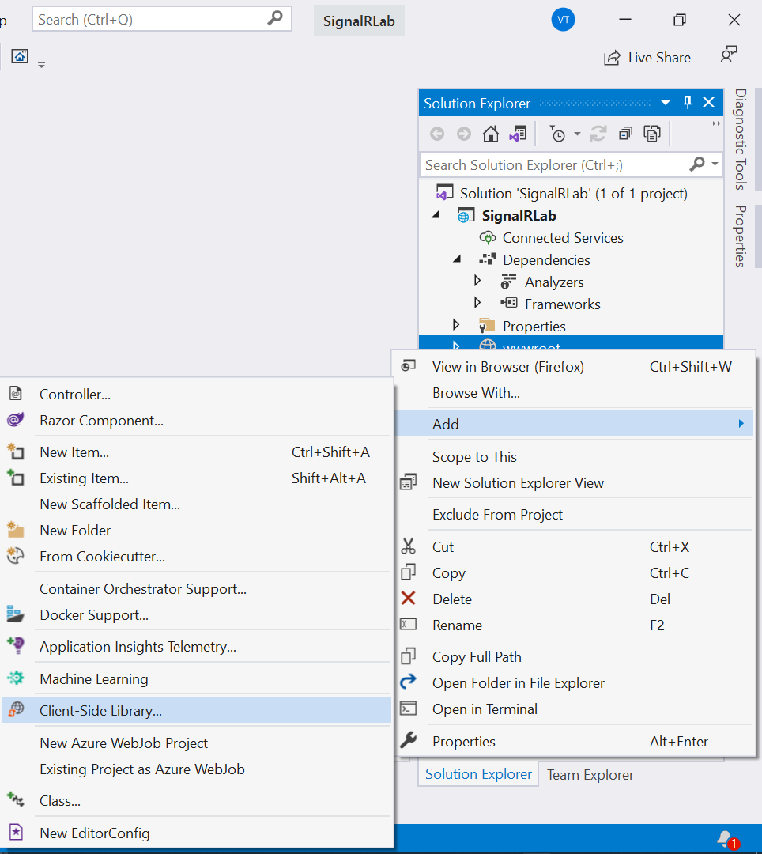
Step 4. CRUD functions with SignalR - 1
Add Client-Side Library to Project
Create a callback function in the script (site.js)
Add the notification to CRUD actions
Add SignalR JavaScript client to View

Slide 47
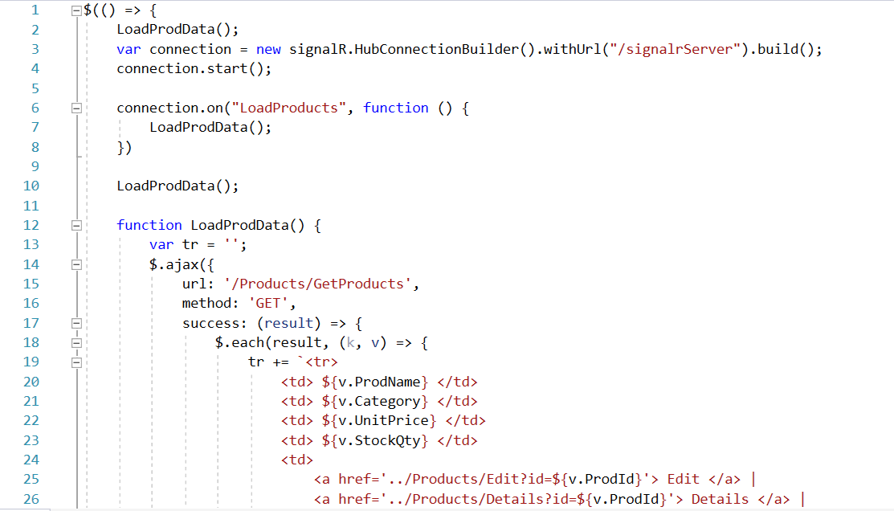
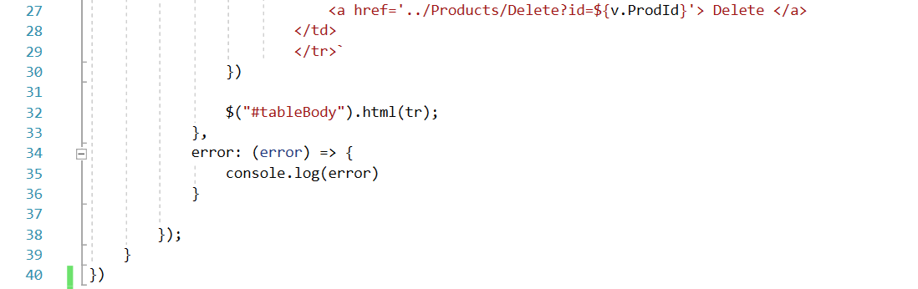
Step 4. CRUD functions with SignalR - 2
Create a callback function in the script (site.js)

Slide 48
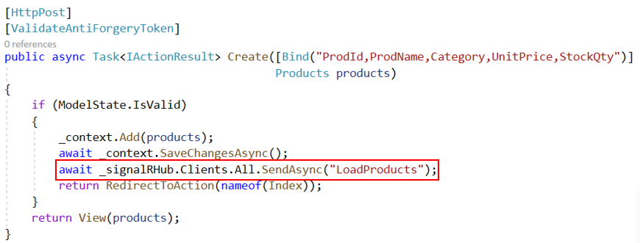
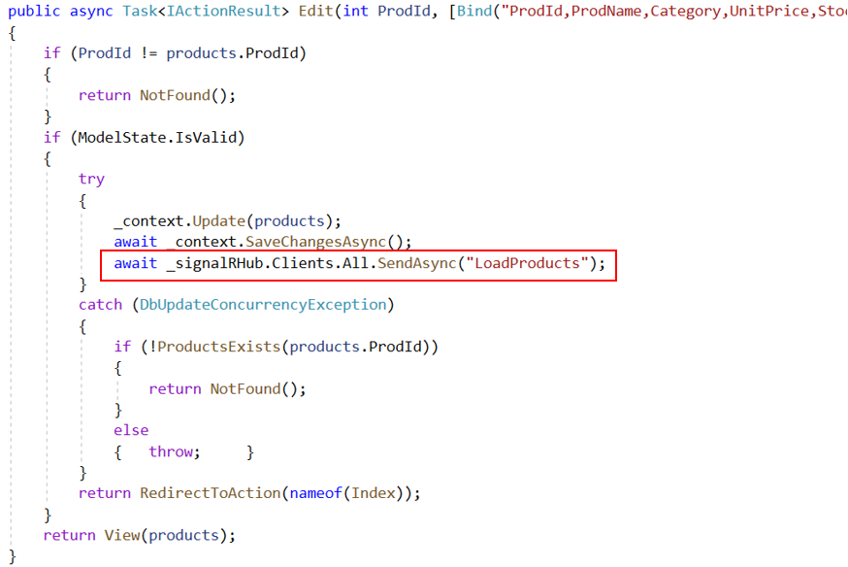
Step 4. CRUD functions with SignalR - 3
Update the list of products in the Create, Edit and Delete functions

Slide 49
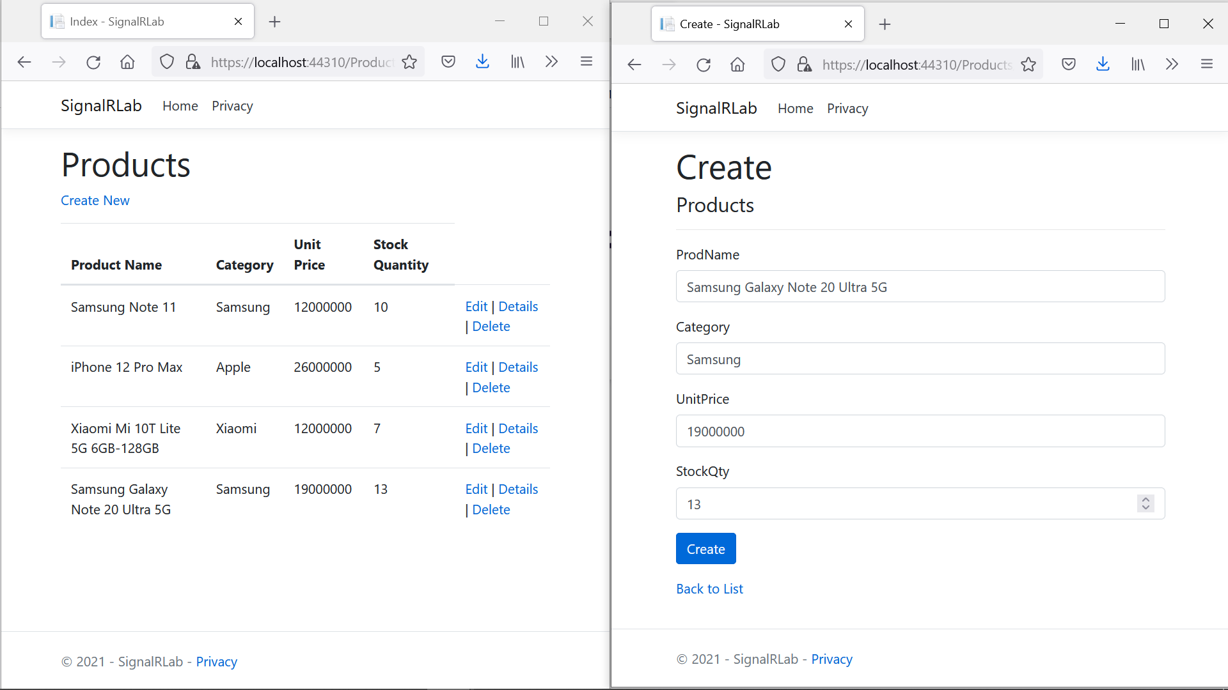
Step 5. Build and run Project. Test all actions
Client 1 Client 2

Slide 50
Summary
Concepts were introduced:
Real-Time Communication application
Creating ASP.NET Core with SignalR
Transports
Hubs
Create a simple chat system using ASP.NET Core with SignalR
Work with Entity Framework combined with SignalR

Slide 51
Discuss
What is SignalR, and how does it enable real-time functionality in web applications?
Can you explain how SignalR differs from traditional HTTP request/response patterns?
What are the main components of a SignalR application in ASP.NET Core?
How do you establish a connection between a client and a server using SignalR?
Can you describe the role of Hubs in SignalR and how they facilitate communication between clients and servers?
How does SignalR handle fallback transport methods when WebSockets are not available?
In what scenarios would you use SignalR over other real-time technologies like WebSockets?

Slide 52
Discuss – cont’d
How do you broadcast a message to all connected clients using SignalR?
How do you ensure that SignalR messages are only sent to specific clients or groups of clients?
Can you demonstrate how to set up a SignalR client in a Razor Pages application?
How does SignalR's automatic reconnection feature work, and how do you configure it?
What security considerations should you be aware of when using SignalR in ASP.NET Core?
How do you scale out SignalR applications to handle a large number of concurrent connections?
Can you provide an example of how SignalR can be used for a live chat application?
How does SignalR integrate with other ASP.NET Core middleware components, like authentication and authorization?

