Slide 1
Smart Questions: Unleashing the Power of Inquiry

Slide 2
Agenda
What is smart question ?
The power of smart questions
Types of questions
Characteristics of a smart question
Ask smart questions in 6 step

Slide 3
What is smart question ?
A question that:
Well-thought-out and insightful inquiry
Provoke thoughtful discussion
Encourage deeper exploration of a subject

Slide 4
The power of smart questions
Harnessing knowledge acquisition, problem-solving and critical thinking
Knowledge acquisition: prompting exploration, research and reflection.
Problem-solving: systematically address and resolve complex problem.
Critical thinking: challenging assumptions, encouraging analysis.

Slide 5
Types of questions
Open-ended questions: invite expansive responses, promote in-depth exploration.
Closed-ended questions: elicit specific, concise reponses.
Probing questions: seeking additional information, clarifications, insights.

Slide 6
Characteristics of a smart question
Time-bound
05
04
Relevant
Action Oriented
03
02
Measurable
Specific
01

Slide 7
Ask smart questions in 6 steps
Think about what you already know
Confirm what you want to learn
Create a draft of your questions
Refine your questions
Ensure simplicity
Ask your questions confidently and politely

Slide 8
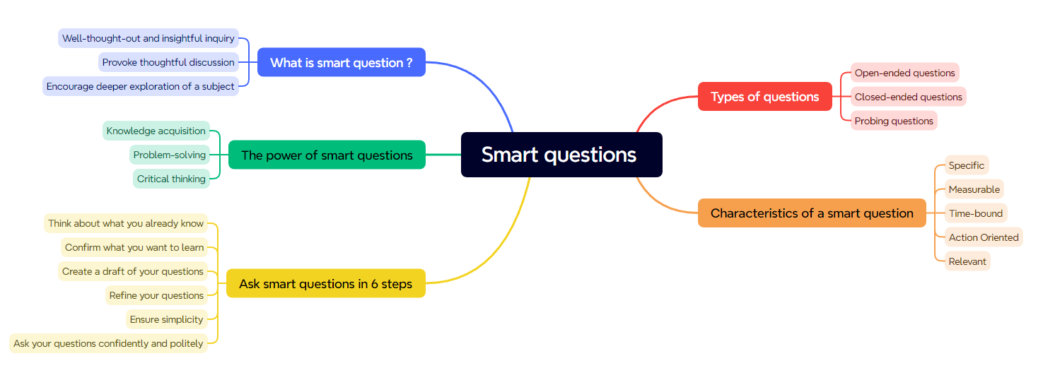
Conclusion

