Slide 1


University of Information Technology VNU-HCM
VLSP 2021 - Vietnamese and English-Vietnamese Textual Entailment
PAPER: UIT@LKT at VLSP2021 Shared Task: A Fine-tuning System based on Pre-trained Language Model with Data Augmentation
Authors:
Ngo Dinh Luan
Ngo Le Hieu Kien
Dang Van Thin
Notes:
<number>

Slide 2
Introduction
Related work
Methodology
Experiment and results
Conclusion and future work
Reference
OUTLINE
Notes:
<number>

Slide 3
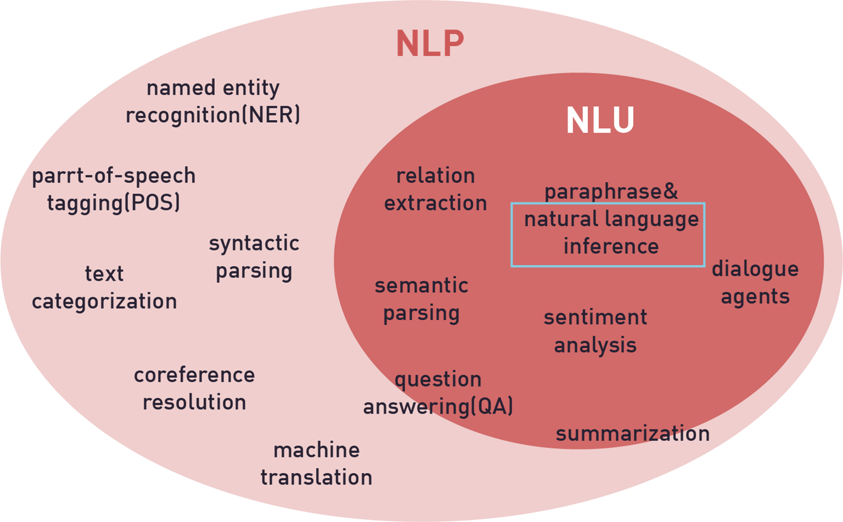
Introduction
Natural Language Inference (NLI)
Figure 1: NLI in Natural language processing
3
Notes:
<number>

Slide 4
Introduction
Natural Language Inference (NLI)
Natural Language Inference is a task of determining whether the given “hypothesis” and “premise” are agree (entailment) or disagree (contradiction) or is neutral (undetermined) to each other.
Premise
Hypothesis
En: A Watertown pastor is on his way to spread the word of the Lord in Tanzania.
Vi: Mục sư ở Watertown đã bị nhiễm COVID-19 sau khi trở về từ Tanzania.
Agree
Entails?
Vi: Sở Y Tế Louisiana báo cáo đang có hơn 116 000 ca lây nhiễm virus corona trong bang.
Vi: Trưa ngày 9 tháng 7, Việt Nam ghi nhận 609 ca mắc COVID-19 mới
Disagree
Entails?
4
Notes:
<number>

Slide 5
Introduction
Objectives
Evaluate the cross-lingual transfer and automated translation on XLM-RoBERTa model.
Evaluate the use of data augmentation technique in solving the NLI problem.
Evaluate Data preprocessing methods can greatly influence the results.
5
Notes:
<number>

Slide 6
2. Related Work
Natural Language Inference dataset
[1] Stanford Natural Language Inference (SNLI-2015) - A large annotated corpus for learning natural language inference.
[2] Multi-Genre Natural Language Inference (MultiNLI-2017) - Offers ten distinct genres.
[3] Cross-lingual Natural Language Inference (XNLI-2018) - Corpus is the extension of the Multi-Genre NLI (MultiNLI) corpus to 15 languages.
[4] VLSP 2021: Vietnamese and English-Vietnamese Textual Entailment - 17,200 labeled sentences, including English and Vietnamese.
6
Notes:
<number>

Slide 7
2. Related Work
Data Augmentation
[5] Sennrich et al., 2016 [6] Sugiyama and Yoshinaga (2019) used the back-translation method to generate more training data.
[7] Fadaee et al., 2017 use contextualized word embeddings to replace target words.
[8] Kafle et al., 2018 approaches do not replace a single or few words but generate the whole sentence.
[9] Rohan at el., 2021 Augmenting data by sentence pair reversal.
7
Notes:
<number>

Slide 8
Data Pre-Processing
System overview
K-Fold Cross Validation
XLM-RoBERTa
Pooling Layer
Global Average Pooling
Global Average Pooling
Concatenate Pooling Layer
Global Max Pooling
Translation Data Augmentation
Replace Words
Data
Fold 1
Data
Fold 2
…
Data
Fold 10
Model 1
Model 2
…
Model 10
Label
Test 1
Label
Test 2
…
Label
Test 10
Voting
Final Predict
8
Notes:
<number>

Slide 9

4. Methodology
Pre-processing
Removed characters that were not alphanumeric and the input was malformed.
01
All viruses, including SARS-CoV-2, the virus that causes COVID-19, change over time.
All viruses, including corona, the virus that causes corona, change over time.
Premise | Hypothesis | Label
bỏ | bỏ | disagree
More than 800 students at the University of Alabama tested positive for Coronavirus in the last week. | bỏ | agree
Remove rows with null or noise content. Usually containing the only character “bỏ”
02
03
Replace words with synonyms without affecting the meaning of the sentence.
04
Remove stopwords
9
Notes:
<number>

Slide 10
4. Methodology
Pre-processing
 | Original | Preprocessed | Vi-Vi | En-Vi
Train | 16200 | 16177 | 8677 | 7500
Test | 4200 | 4177 | 2218 | 2059
Table 1: Summary of the dataset after removing noise samples
10
Notes:
<number>

Slide 11
4. Methodology
Data Augmentation
Translated with sentence pair reversal
P: English – Vietnamese Vietnamese – English
H: Vietnamese – English
Translated all the data into English
P: English – English Vietnamese – English
H: Vietnamese – English
We do that using Google Cloud Translation API^{[1]}
https://cloud.google.com/translate
11
Notes:
<number>

Slide 12
4. Methodology
Data Augmentation
Training Data | Original Data | Data Augmentation | Data Training
VLSP | 16 177 | - | 16 177
VLSP_en | 16 177 | 16 177 | 32 354
VLSP_au | 16 177 | 16 177 | 32 354
VLSP_au+en | 16 177 | 32 354 | 48 531
Table 2: Summary of the dataset after using data augmentation method
12
Notes:
Với bộ dữ liệu đc ban tổ chức cung cấp là VLSP. Sau khi thực hiện dịch toàn bộ dữ liệu sang tiếng anh thì chúng tôi đặt tên là VLSP_en
Và bộ dữ liệu sau khi thực hiện dịch bằng phương pháp sentence pair reversal chúng tôi đặt tên là VLSP_au
Bộ dữ lieeej cuối cùng là bộ dữ liệu khi kết hợp 2 Phương pháp data augmentation ở trên được chúng tôi đặt tên là VLSP au plus en
<number>

Slide 13
4. Methodology
Original pairs | Augmented pairs
P1(en): One of the few silver linings of the novel corona virus is that it mostly sapres kids. H1(vi): Tất cả mọi người đều có khả năng lây nhiễm vi-rút corona như nhau, đặc biệt là trẻ nhỏ. | P1’(vi): Một trong số ít những điều đáng chú ý của corona virus mới là nó hầu như không để lại cho trẻ em. H1’(en): Everyone has the ability to infect Corona viruses equally, especially young children.
P2(vi): Theo sở Y tế Bang Hawaii, Hiện đã có 607 trường hợp đc xác định nghi nhiễm Covid-19 ở đây. H2(vi): Hawaii là bang duy nhất chưa ghi nhận ca nhiệm COVID-19 nào. | P2’(en): According to the Hawaii Departm-ent of Health, there are currently 607 cases of Covid-19 identified cases here. H2’(en): Hawaii is the only state that has not recorded Covid-19.
Table3: Examples with sentence pair reversal with P as a Premise and H as a Hypothesis.
13
Notes:
<number>

Slide 14
4. Methodology
Classifier Model
XLM-RoBERTa^{[10]} (Conneau et al., 2020) - State-of-the-art cross-lingual understanding through self-supervision.
XLM-Roberta model pre-trained on 2.5TB of filtered CommonCrawl data containing 100 languages model.
XLM-R outperforms mBERT on various cross-lingual tasks in low-resource languages like Vietnamese (Van Thin et al., 2021)^{[11]}
14
Notes:
<number>

Slide 15
5. Experiment and result
Experiment setup
Parameter settings :
Model XLM-RoBERTa _{large} (Facebook AI)
learning rate = 1e-5
bath size = 16
num epoch = 3
maximum sentence length = 100
num hidden layer = 24
hidden size = 1024 optimizer = Adam
huggingface.co/xlm-roberta-large
15
Notes:
<number>

Slide 16
5. Experiment and result
Model/Training Data | F1-score
 | Agree | Disagree | Neutral | Average
XLM-R_{large} + VLSP | 87.60 | 84.20 | 85.96 | 85.92
XLM-R_{large} + VLSP_en | 85.08 | 84.52 | 87.05 | 85.55
XLM-R_{large} + VLSP_au | 90.76 | 84.29 | 88.32 | 87.79
XLM-R_{large} + VLSP_au+en | 88.30 | 86.97 | 86.33 | 87.20
Table 4: Model XLM_R on private test datasets and detail accuracy
for each label with average of 10-fold
16
Notes:
<number>

Slide 17
5. Experiment and result
Model/Training Data | F1-score
 | Agree | Disagree | Neutral | Average
XLM-R + VLSP + Replace Words | 88.53 | 86.46 | 87.49 | 87.49
XLM-R + VLSP_en + Replace Words | 87.77 | 89.00 | 86.33 | 87.70
XLM-R + VLSP_au + Replace Words | 90.36 | 84.96 | 88.87 | 88.06
XLM-R + VLSP_au+en +Replace Words | 88.96 | 85.20 | 86.97 | 87.04
Model/Training Data | F1-score
 | Agree | Disagree | Neutral | Average
XLM-R + VLSP + Replace Words | 88.53 | 86.46 | 87.49 | 87.49
XLM-R + VLSP_en + Replace Words | 87.77 | 89.00 | 86.33 | 87.70
XLM-R + VLSP_au + Replace Words | 90.36 | 84.96 | 88.87 | 88.06
XLM-R + VLSP_au+en +Replace Words | 88.96 | 85.20 | 86.97 | 87.04
Table 5: Model XLM-R_{large} with replace words on private test datasets and detail accuracy for each label with average of 10-fold
17
Notes:
<number>

Slide 18
6. Conclusion and Future work
Effectiveness of XLM-R model with Cross-Lingual Transfer.
Effectiveness of data augmentation method in solving the NLI problem.
Importance of data preprocessing for the NLI task.
Improving many other data augmentation methods to improve efficiency, such as EDA techniques.
18
Notes:
<number>

Slide 19
7. Reference
[1] Bowman, Samuel, et al. "A large annotated corpus for learning natural language inference." Proceedings of the 2015 Conference on Empirical Methods in Natural Language Processing. 2015.
[2] Williams, Adina, Nikita Nangia, and Samuel R. Bowman. "A broad-coverage challenge corpus for sentence understanding through inference." arXiv preprint arXiv:1704.05426 (2017).
[3] Conneau, Alexis, et al. "XNLI: Evaluating Cross-lingual Sentence Representations."
[4] VLSP 2021: Vietnamese and English-Vietnamese Textual Entailment –vlsp.org.vn/
19
Notes:
<number>

Slide 20
7. Reference
[5] Sennrich, Rico, Barry Haddow, and Alexandra Birch. "Improving Neural Machine Translation Models with Monolingual Data."
[6] Sugiyama, Amane, and Naoki Yoshinaga. "Data augmentation using back-translation for context-aware neural machine translation." Proceedings of the Fourth Workshop on Discourse in Machine Translation (DiscoMT 2019). 2019.
[7] Kobayashi, Sosuke. "Contextual augmentation: Data augmentation by words with paradigmatic relations." arXiv preprint arXiv:1805.06201 (2018).
[8] Fadaee, Marzieh, Arianna Bisazza, and Christof Monz. "Data Augmentation for Low-Resource Neural Machine Translation." Proceedings of the 55th Annual Meeting of the Association for Computational Linguistics (Volume 2: Short Papers). 2017.
20
Notes:
<number>

Slide 21
7. Reference
[9] Martelli, Federico, et al. "SemEval-2021 Task 2: Multilingual and Cross-lingual Word-in-Context Disambiguation (MCL-WiC)." Proceedings of the Fifteenth Workshop on Semantic Evaluation (SemEval-2021). 2021.
[10] Conneau, Alexis, et al. "Unsupervised Cross-lingual Representation Learning at Scale."
[11] Van Thin, Dang, et al. "Investigating Monolingual and Multilingual BERTModels for Vietnamese Aspect Category Detection." arXiv preprint arXiv:2103.09519 (2021).
21
Notes:
<number>

