Slide 1
Vehicle To Vehicle Communication System
Team:
G.G.E.M. Dinidu Dewmin Ekanayake (SEU/IS/19/EG/014)
R.M. Vimukthi Darshana Priyantha (SEU/IS/19/EG/066)
J.M. Dhyan Lakshita Jayasinghe (SEU/IS/19/EG/105)

Slide 2
“Risk
Road accidents on vehicles during overtaking situations

Slide 3
Our Solution
This system allows vehicles to communicate with each other and providing real-time assistance to drivers in determining the safety of overtaking maneuvers

Slide 4
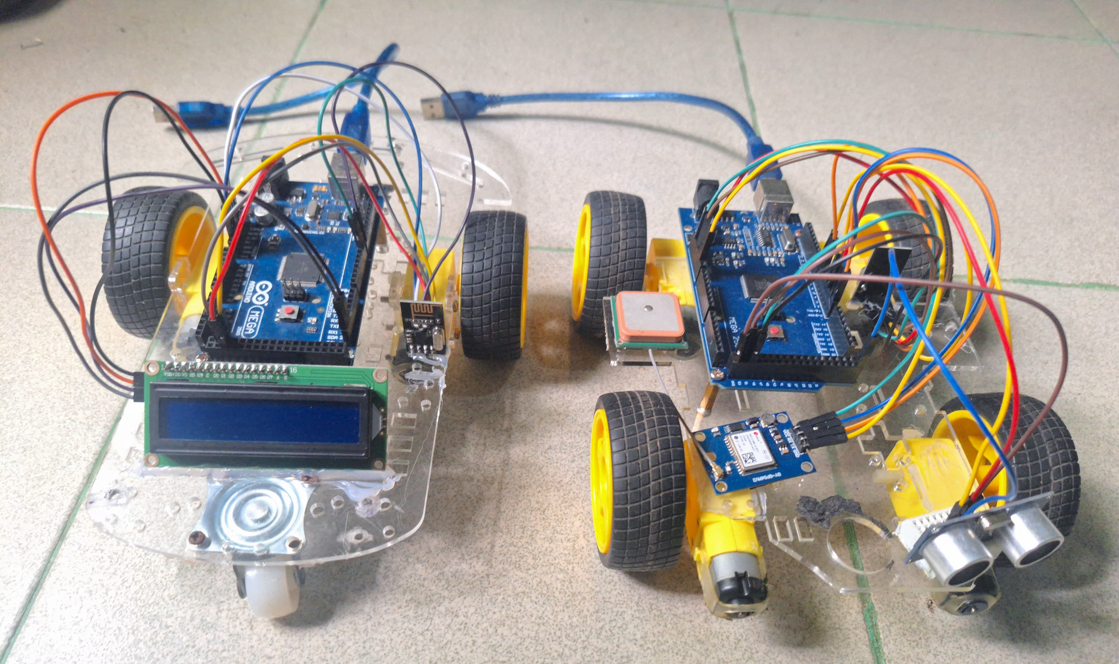
Prototype

Slide 5
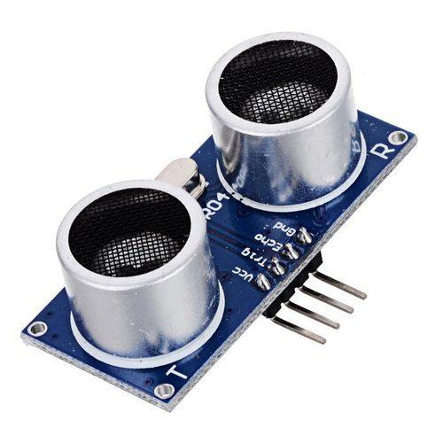
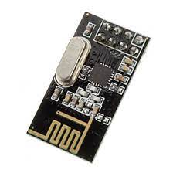
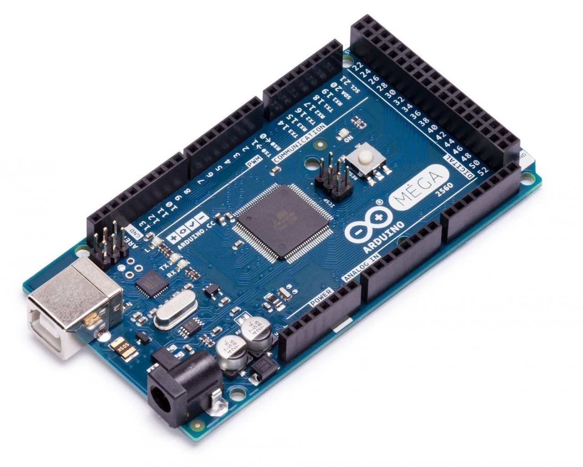
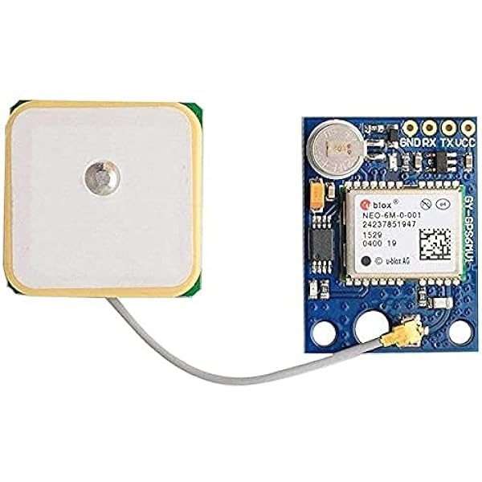
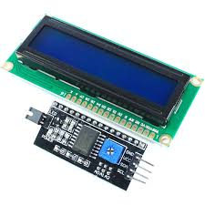
Main Components
Ultrasonic sensor
nRF24L01 Wireless Transceiver
Arduino Mega 2560
Ublox NEO-6M GPS Module
16x2 Blue LCD with I2C

Slide 6
Arduino Mega 2560
Arduino Mega 2560 Rev3 is an exemplary development board that that accommodates the ATmega2560 microcontroller, which operates at a frequency of 16 MHz
Serves as the central control unit
Maintaining effective communication between all the sensors
Reads and processes various sensor data using unique protocols
Running calculation algorithms based on user codes

Slide 7
Ultrasonic Sensor
Utilizes ultrasonic sound waves to measure distance
Typically operates at a frequency of around 40 kHz
Consists of a transmitter and receiver for sending and receiving ultrasonic pulses
Provides a maximum range of several meters, depending on the model
Offers high accuracy and reliability in distance measurements
Using the speed of sound in air, the sensor determines the distance to the object
The calculated distance is then outputted by the sensor for further processing by the Arduino or other microcontroller

Slide 8
Ublox NEO-6M GPS Module
NEO-6M GPS module receives signals from GPS satellites using a built-in antenna
The module calculates various information based on the satellite signals
It outputs this processed data in the form of NMEA (National Marine Electronics Association) sentences
Arduino interfaces with the NEO-6M GPS module via serial communication
The module transmits raw NMEA data to Arduino through a serial port
Arduino reads and parses the incoming NMEA sentences, extracting relevant information

Slide 9
nRF24L01 Wireless Transceiver
Operates in the 2.4 GHz ISM band
Offers multi-channel communication with 125 RF channels
Features Enhanced ShockBurst™ protocol for efficient data transmission between modules
NRF24L module facilitating bidirectional data exchange
Communication occurs via radio frequency (RF) signals
Error detection and correction mechanisms ensure reliable data transmission

Slide 10
16x2 Blue LCD with I2C
16x2 Blue LCD with I2C interface
Features a display size of 16 characters in 2 rows
Utilizes I2C (Inter-Integrated Circuit) communication protocol for interfacing with microcontrollers
The Arduino or microcontroller communicates with the LCD module via the I2C bus
Data to be displayed, such as text or numerical values, is sent to the LCD module in byte format
The LCD module continuously refreshes the display as new data is sent by the microcontroller, providing real-time output

Slide 11
Challenges
The GPS module is not functioning very accurately during indoor conditions
The Ultrasonic sensor is not accurate in outdoor conditions
The focus of drivers is diminished when reading incoming messages
There are some power imbalance issues in the Arduino board

Slide 12
Future Plans
Use more accurate sensors such as LiDAR, RADAR, GPS, and RF Modules
Implement more intelligent algorithms for calculations and risk identification using AI and machine learning technologies
Incorporate data encryption and security features for effective communication
Developing an inter-vehicle voice communication systems

Slide 13
THANK YOU

