Slide 1
TASKFLOW
A focused Todo
management experience
FastAPI • MongoDB • Tailwind CSS • Vanilla JavaScript • Docker
Implementation presentation | Verified repository evidence
Notes:
Introduce TaskFlow as a small, source-verified Todo management application built through the BMAD workflow.

Slide 2
TASKFLOW / ENGINEERING OVERVIEW
The problem: everyday work gets fragmented
• Tasks need a single, low-friction home.
• Private work must remain isolated per user.
• A useful MVP needs authentication, CRUD, and quick status visibility.
• Operational simplicity matters: one Compose topology and a small service surface.
PRODUCT PROMISE
Create, find, edit, complete, and remove personal tasks from a responsive dashboard—without exposing another user’s records.
Scope: focused MVP, not a collaboration suite.
Notes:
The product brief and PRD frame the MVP around personal task ownership, secure access, and a responsive experience.

Slide 3
TASKFLOW / ENGINEERING OVERVIEW
Objectives and requirements
Secure access
Personal tasks
Signup, signin, logout, current-user lookup, Argon2 hashes, JWT cookie.
Create, list, retrieve, update, delete, complete, and mark pending.
Clear feedback
Repeatable delivery
Dashboard totals, loading/error/empty states, responsive UI.
Tailwind CLI build, Dockerfiles, Compose health checks, isolated tests.
Design principle: keep the architecture maintainable and simple for a small application.
Notes:
These objectives are reflected in the implemented routes, UI, container topology, and QA coverage.

Slide 4
TASKFLOW / ENGINEERING OVERVIEW
Technology stack
Frontend
Backend
HTML
Tailwind CSS 4.3.4
Vanilla JavaScript
Fetch API
Python 3.12
FastAPI 0.115.6
Uvicorn 0.34.0
Pydantic Settings
Data & security
Delivery
MongoDB 7.0
PyMongo 4.10.1
Argon2 via pwdlib
PyJWT 2.10.1
Docker Compose
Nginx 1.27-alpine
Pytest 8.3.4
Named Mongo volume
Notes:
All versions and components on this slide are taken from the repository documentation and dependency manifests.

Slide 5
TASKFLOW / ENGINEERING OVERVIEW
System architecture
Browser
Nginx frontend
FastAPI backend
MongoDB
Responsive HTML
Tailwind CSS
Vanilla JS
Static assets
/api reverse proxy
Auth + Todo routes
Validation + services
users + todos
UUID string IDs
External access: frontend on localhost:8080 • backend and MongoDB service-to-service on Compose networks
Notes:
The browser reaches Nginx on port 8080. Nginx serves the frontend and proxies /api to FastAPI. MongoDB is not published to the host.

Slide 6
TASKFLOW / ENGINEERING OVERVIEW
Authentication and Todo functionality
AUTHENTICATION
OWNERSHIP ENFORCEMENT
Signup validates and hashes passwords with Argon2.
JWT is stored in an HttpOnly cookie. A readable CSRF cookie plus X-CSRF-Token and Origin validation protect state-changing requests.
Private routes derive the user ID from the validated JWT.
Every Todo repository operation scopes its query by authenticated user_id.
Implemented endpoints cover CRUD, complete/pending transitions, and dashboard totals.
Password hashes are never returned in API responses.
Representative routes: /api/auth/* • /api/todos/* • /api/dashboard/stats
Notes:
Emphasize that authentication and authorization are separate concerns: the cookie authenticates the request, while user_id scoping enforces ownership.

Slide 7
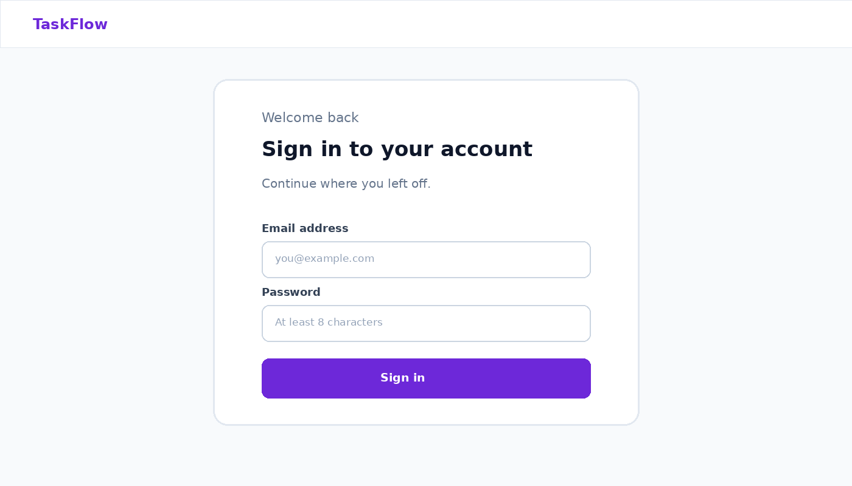
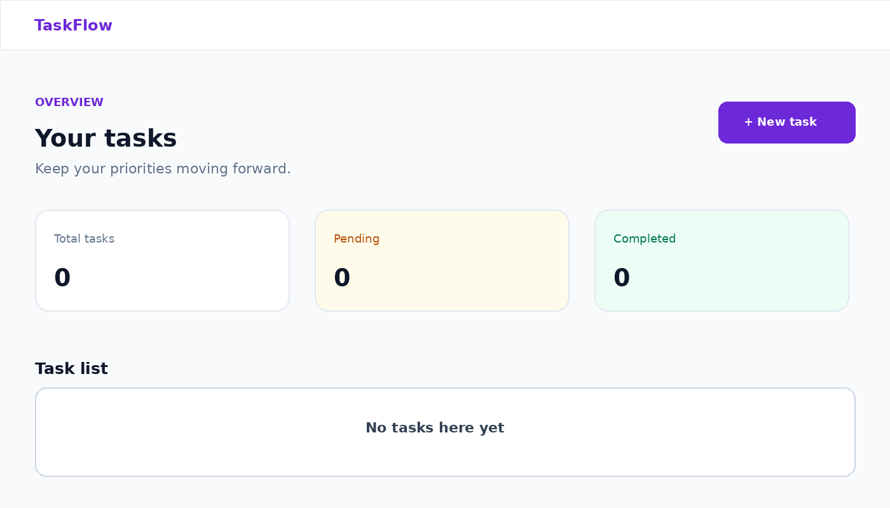
TASKFLOW / ENGINEERING OVERVIEW
Application screenshots
Captured UI states: sign-in page and authenticated dashboard empty state.
Notes:
These visuals reproduce the captured live UI states used during verification: TaskFlow sign-in and the authenticated dashboard with zero tasks.

Slide 8
TASKFLOW / ENGINEERING OVERVIEW
Docker architecture
frontend
backend
mongodb
Nginx runtime
Published localhost:8080
Static assets + /api proxy
Python 3.12-slim
Non-root UID 10001
Health check + Uvicorn
MongoDB 7.0
Named mongo_data volume
Internal network only
Compose services use health checks and dependency conditions. The frontend and backend share the internal network; MongoDB has no host port mapping.
Configuration is environment-driven; .env.example contains placeholders and .env is ignored.
Notes:
Describe the multi-stage frontend build, the non-root backend image, the persistent Mongo volume, and the health-gated startup.

Slide 9
TASKFLOW / ENGINEERING OVERVIEW
BMAD methodology and AI prompt usage
01
02
03
04
05
Discover
Define
Design
Build
Verify
Business analysis
Project brief
PRD
User stories
Architecture
UX specification
Backend, frontend,
Docker, integration
QA, security,
README, presentation
Prompt history is preserved in docs/prompts/; the repository contains planning artifacts, implementation evidence, QA reporting, and source-verified README documentation.
Notes:
The project used BMAD-style role prompts to move from business analysis through product definition, architecture, implementation, QA, documentation, and presentation.

Slide 10
TASKFLOW / ENGINEERING OVERVIEW
Testing, conclusion and future improvements
VERIFIED QA
CONCLUSION
NEXT STEPS
Isolated MongoDB test database
13 Pytest tests passed
Coverage includes auth, invalid input, CRUD, status changes, missing records, dashboard statistics, indexes, and user isolation.
TaskFlow delivers a focused personal Todo MVP with a clear security boundary and repeatable Docker workflow.
Replace development JWT fallback with a required production secret.
Consider MongoDB auth/TLS and stronger production headers (CSP/HSTS).
Thank you • TaskFlow
Notes:
Close with the verified test result from the QA report, then distinguish future hardening ideas from implemented behavior.

