Slide 1
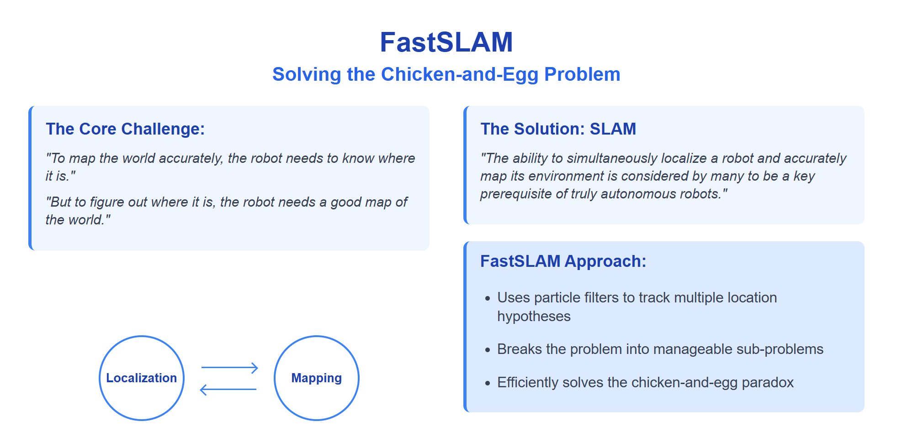

Slide 2
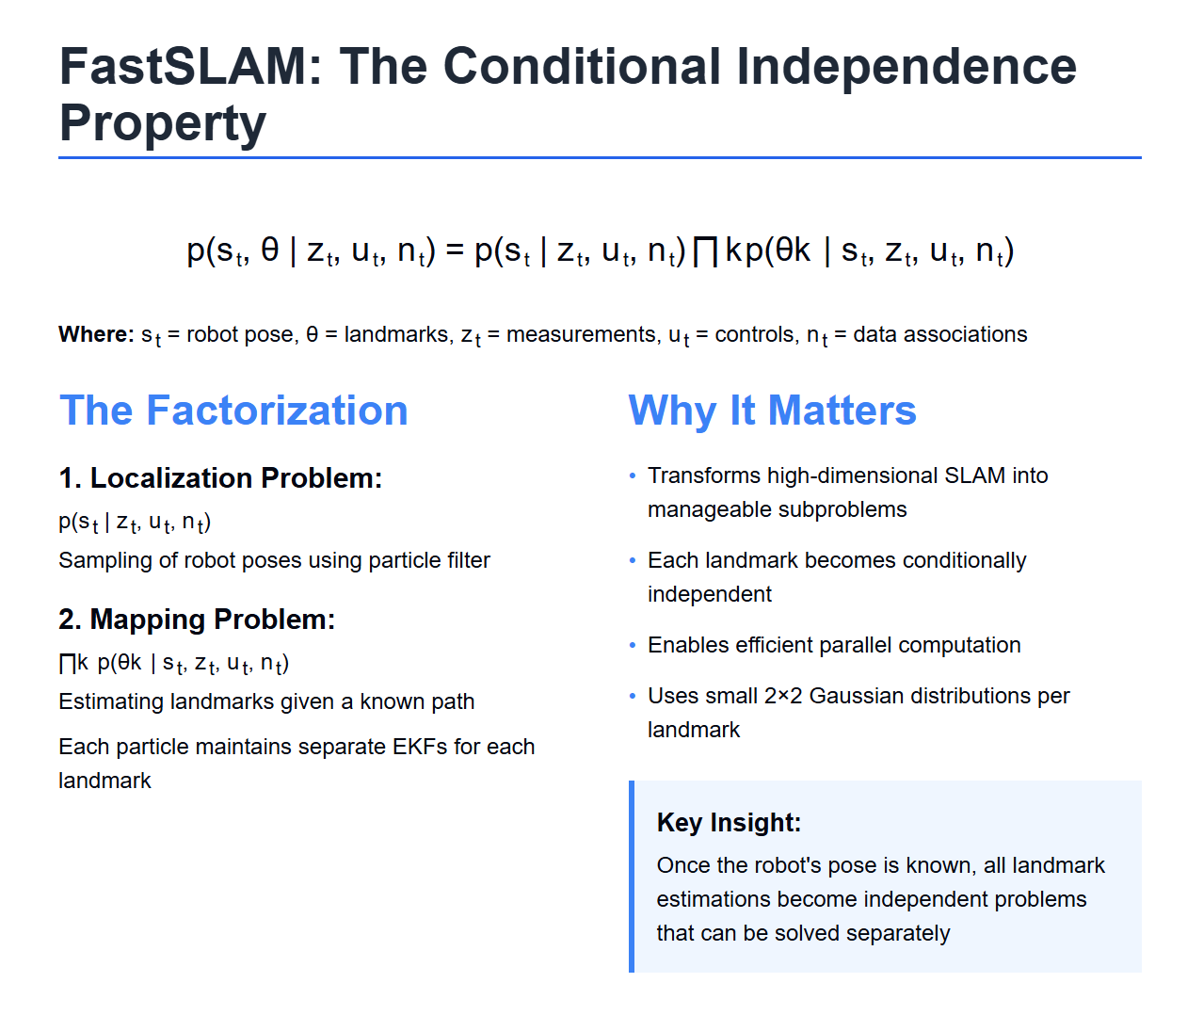

Slide 3
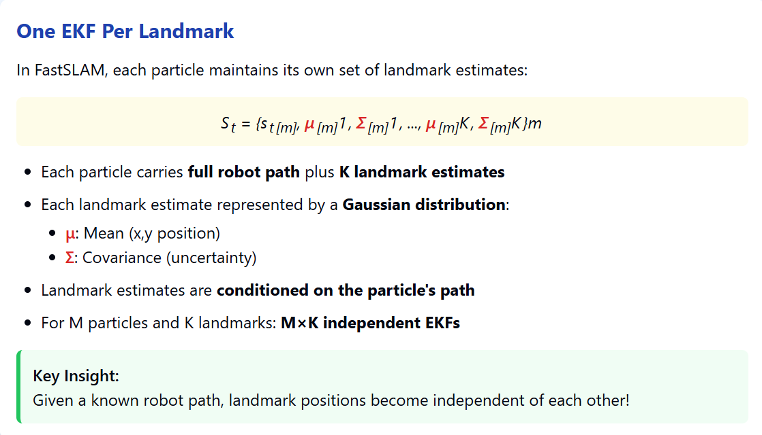

Slide 4
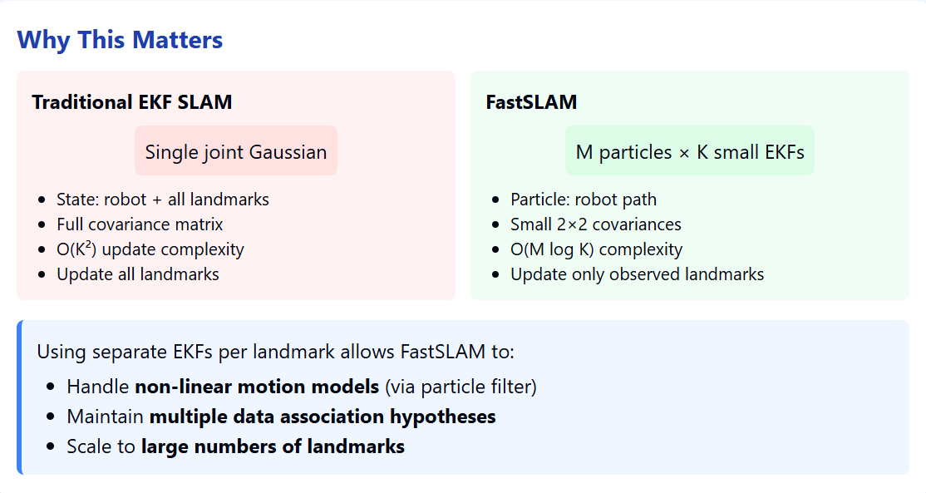

Slide 5
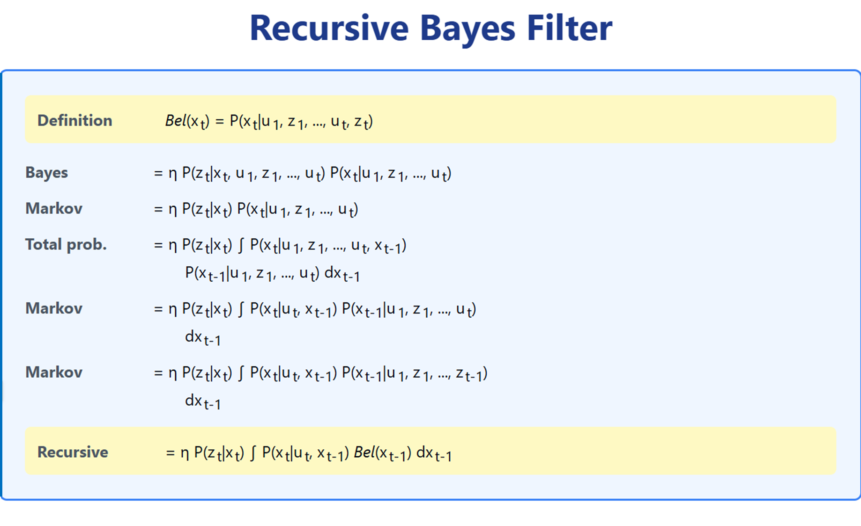
The Bayes Filter is a framework for recursive state estimation:
Linear vs non-linear models
Gaussian vs non gaussian distributions
Parametric vs non parametric filters
Correction Step
Observation Model
Prediction Step
Motion Model

Slide 6
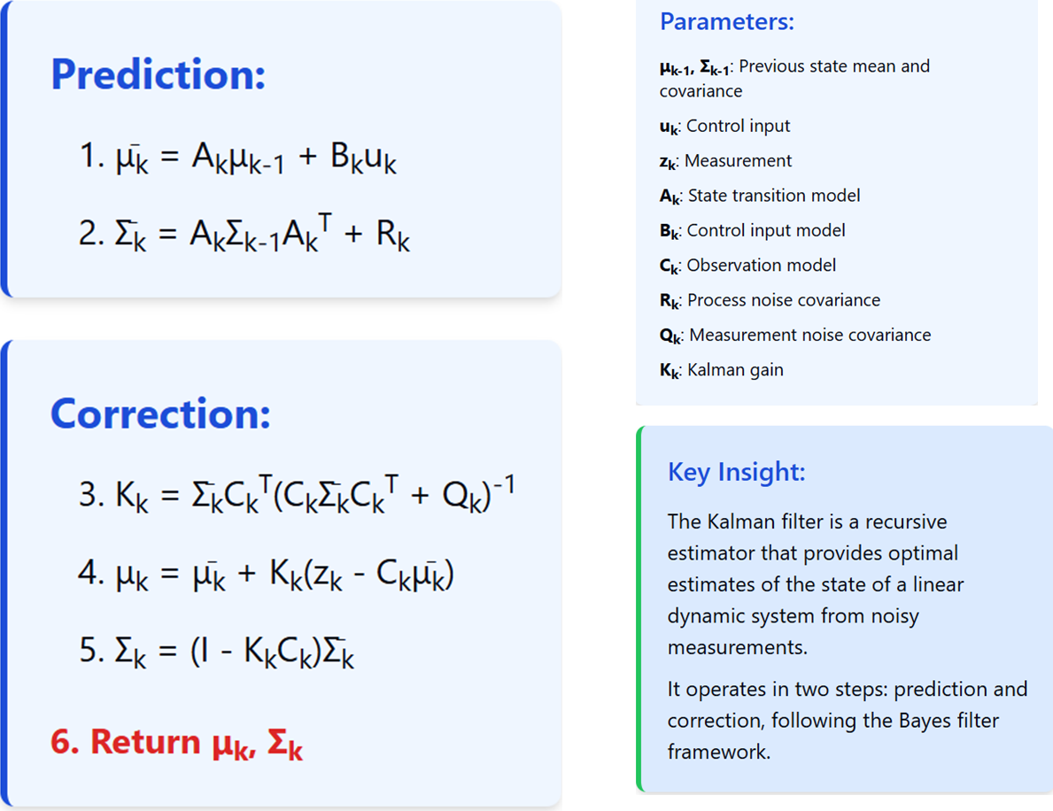
Kalman Filter Algorithm

Slide 7
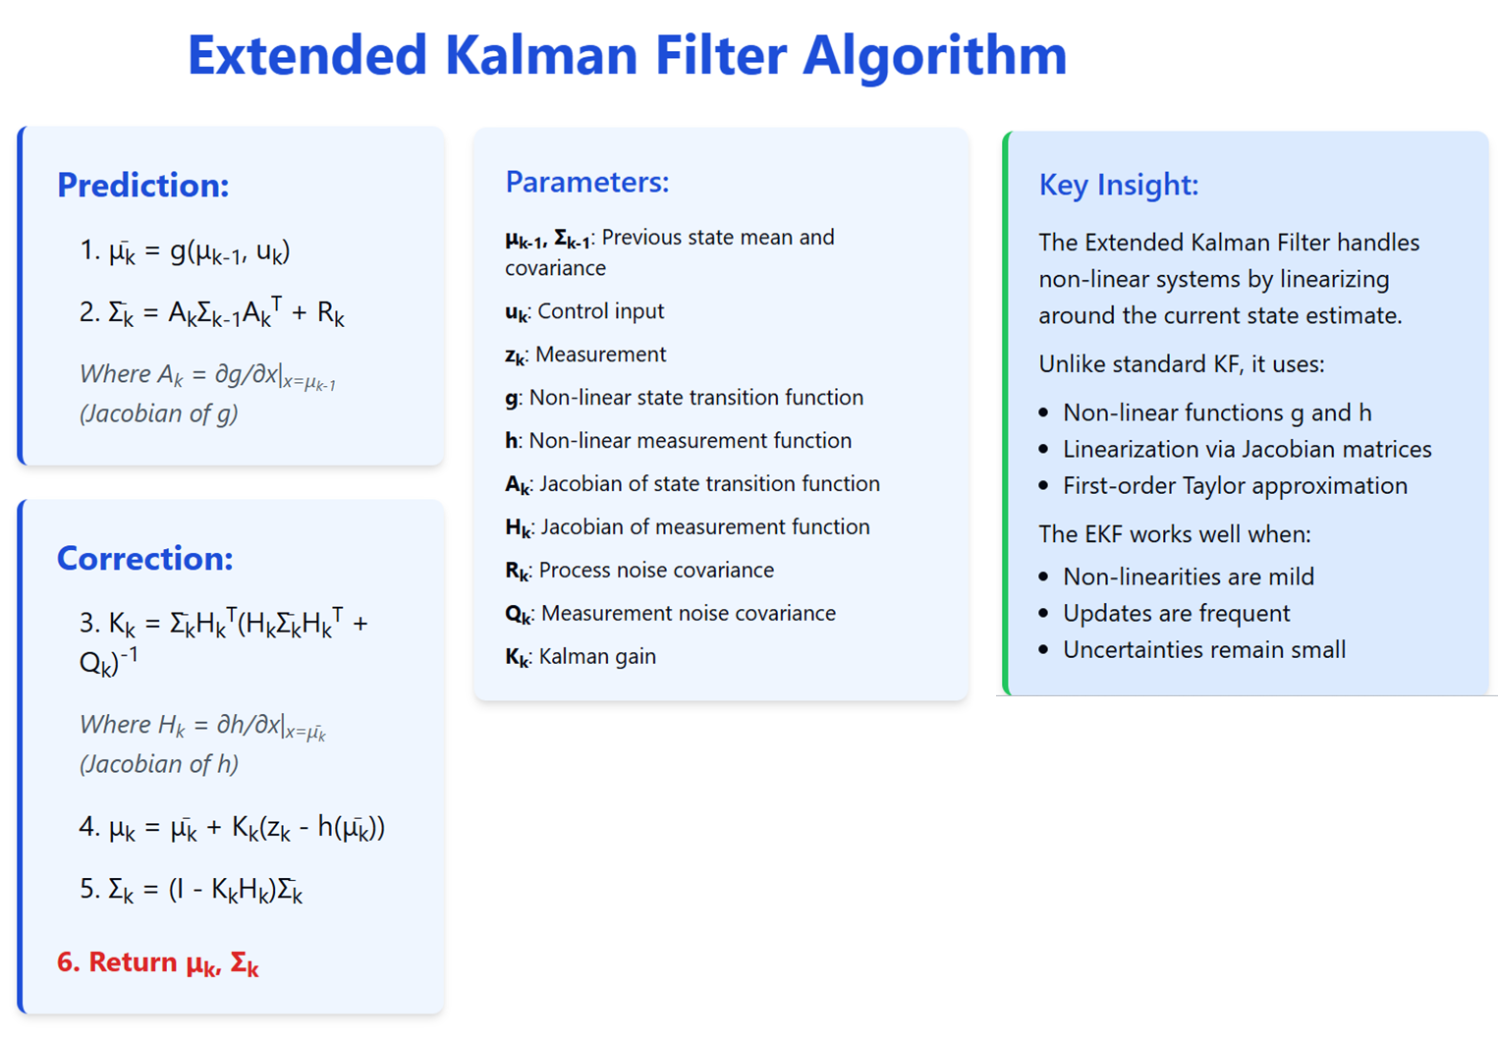

Slide 8
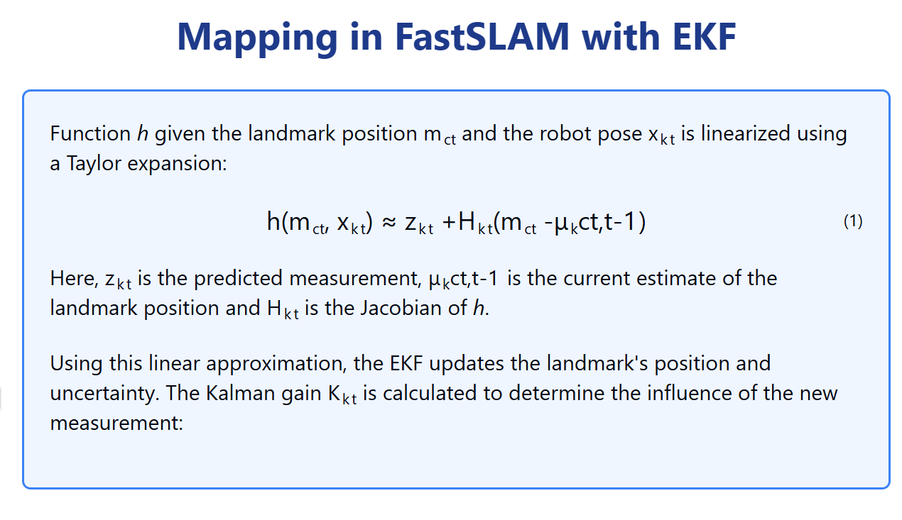

Slide 9
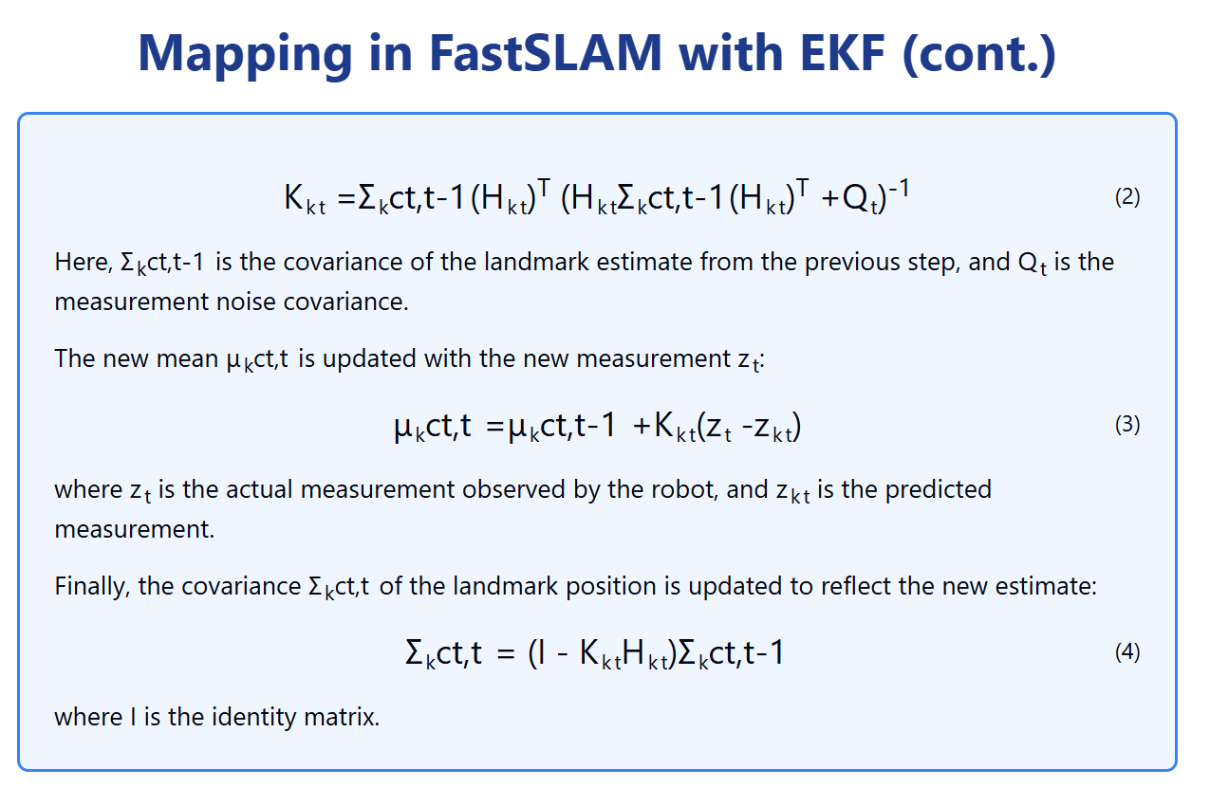
EKF Correction Step

Slide 10
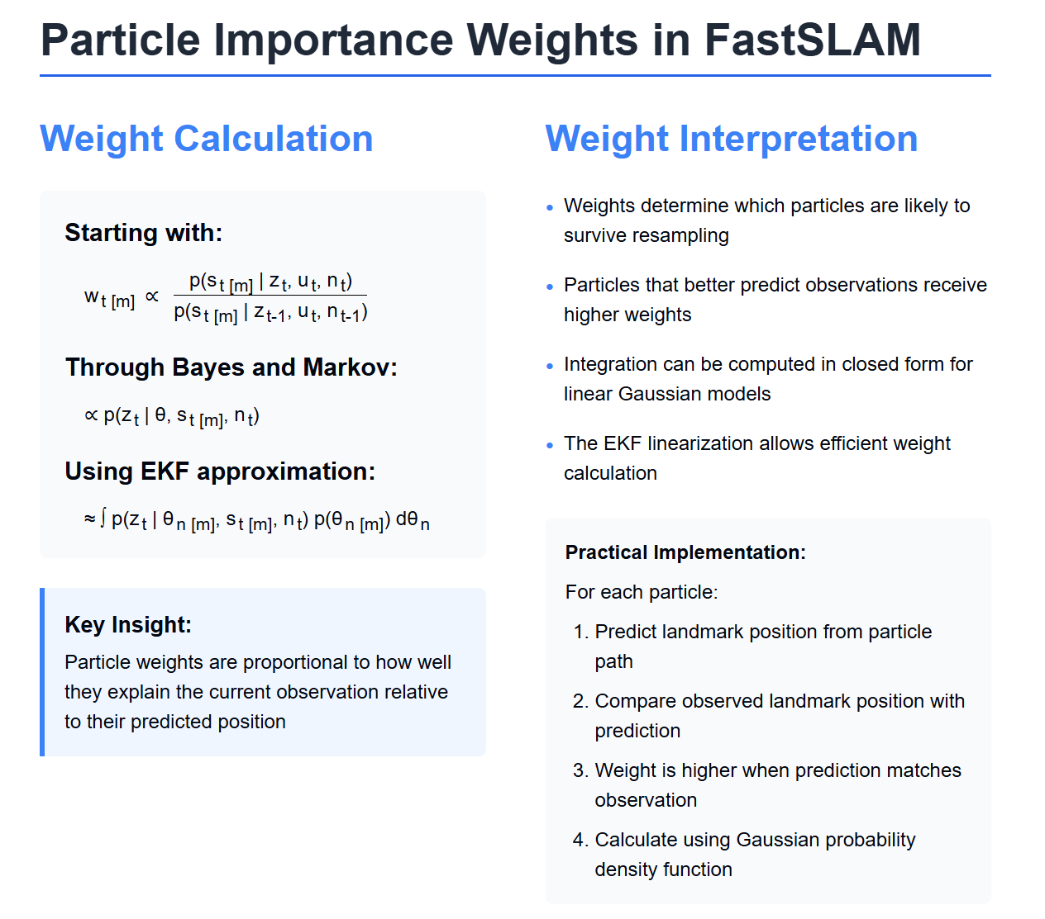

Slide 11
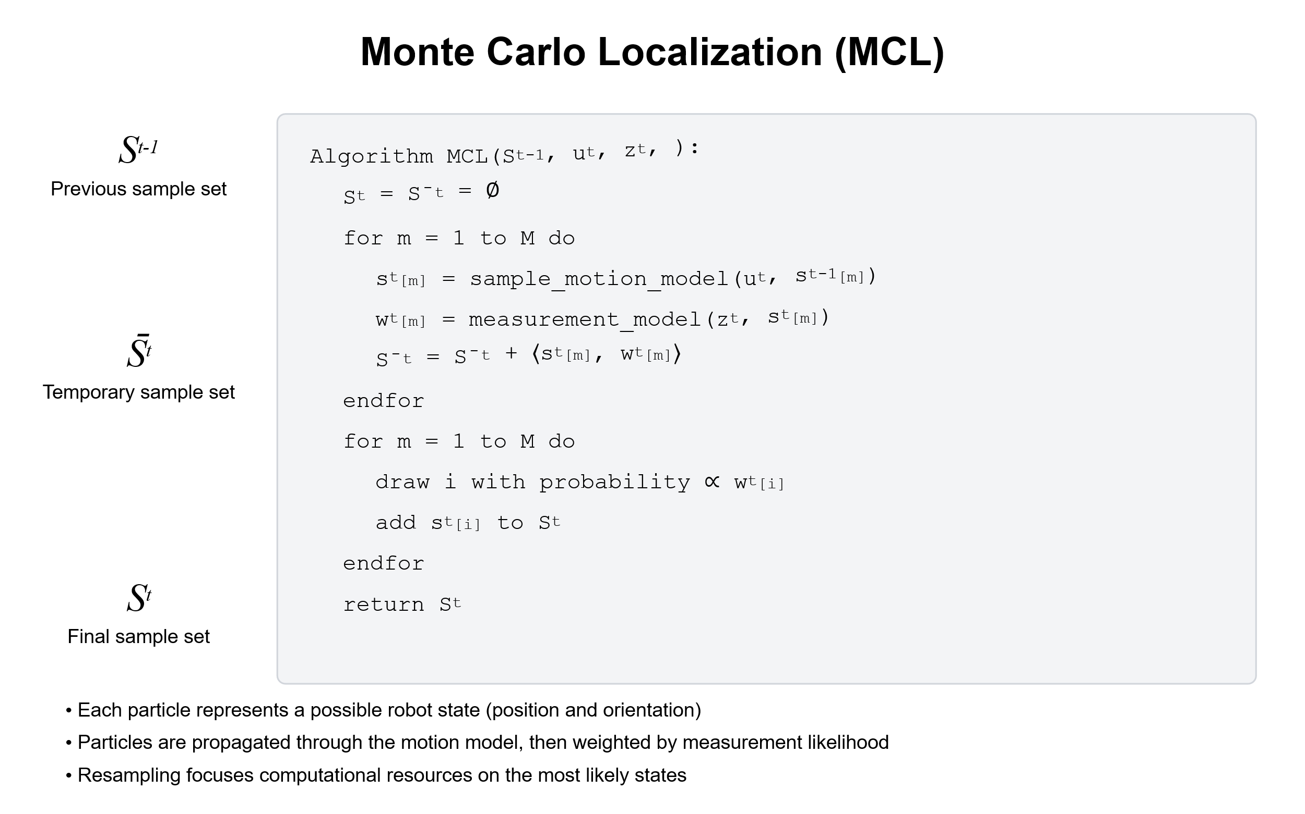

Prediction
+ Correction
$$s_{t}^{\left\{\left[m\right]\right\}}∼p\left(s_{t} ∣ u_{t}, s_{\left\{t−1\right\}}^{\left\{\left[m\right]\right\}}\right)$$
Resampling

Slide 12
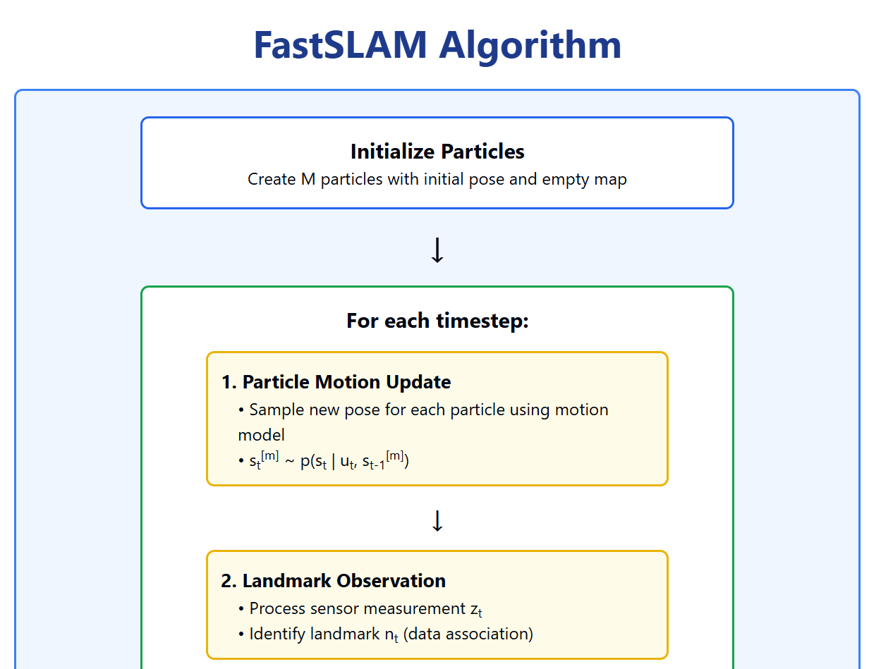

Slide 13
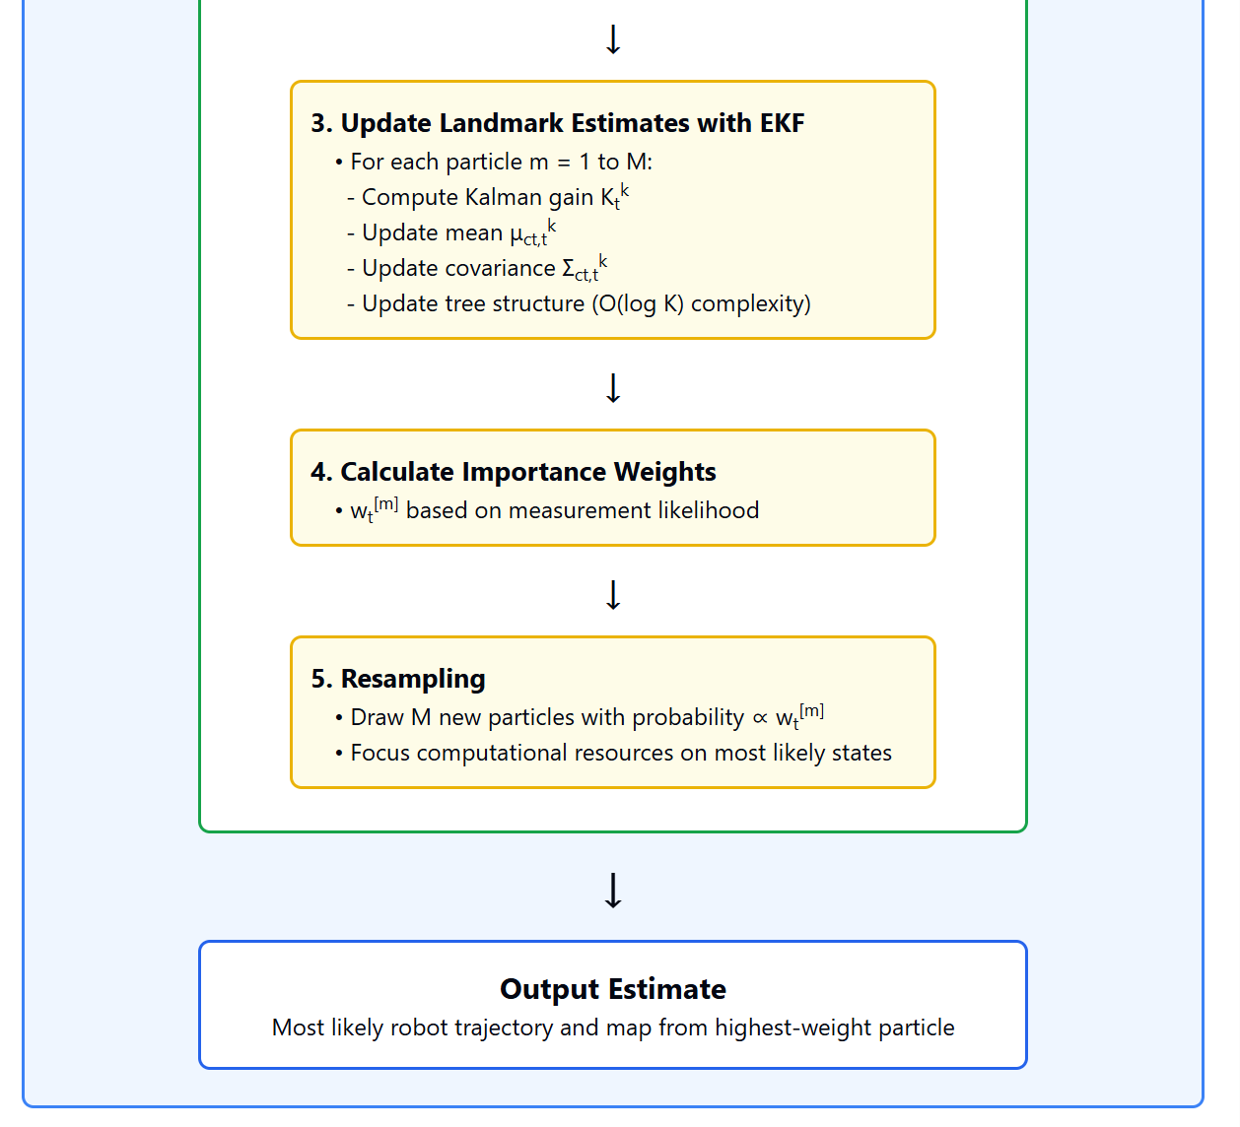

Slide 14
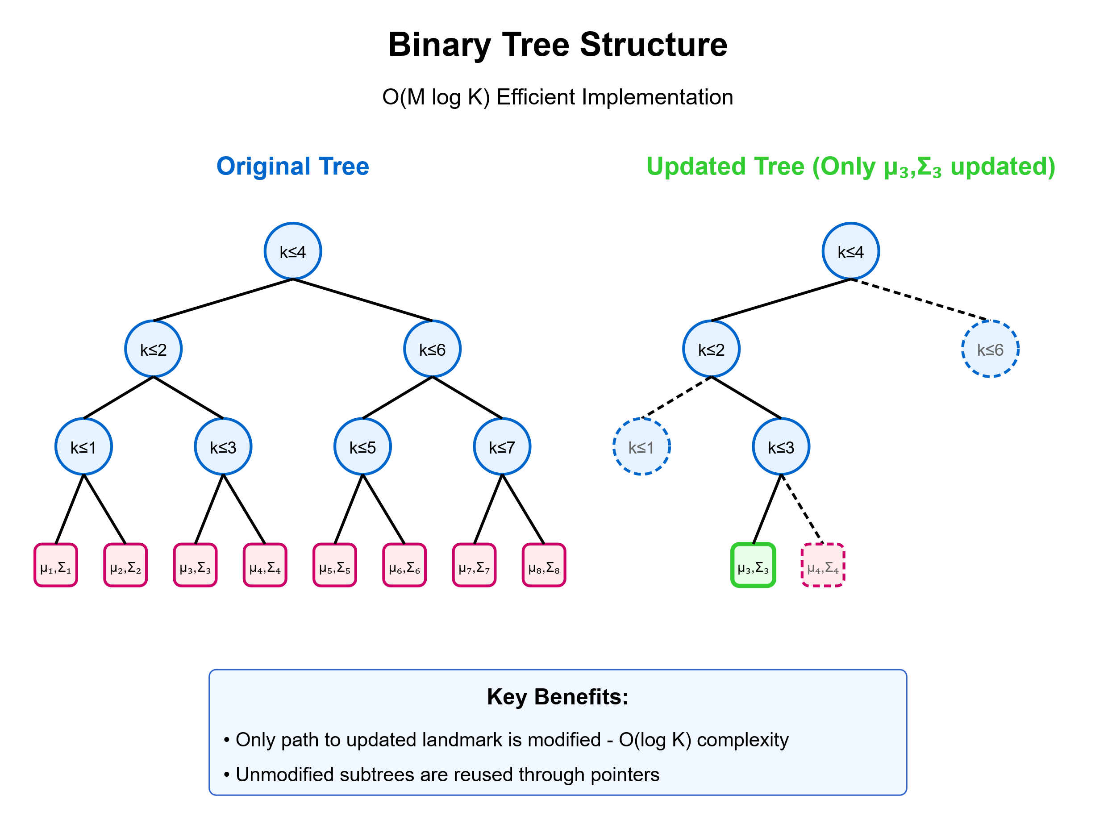

Slide 15
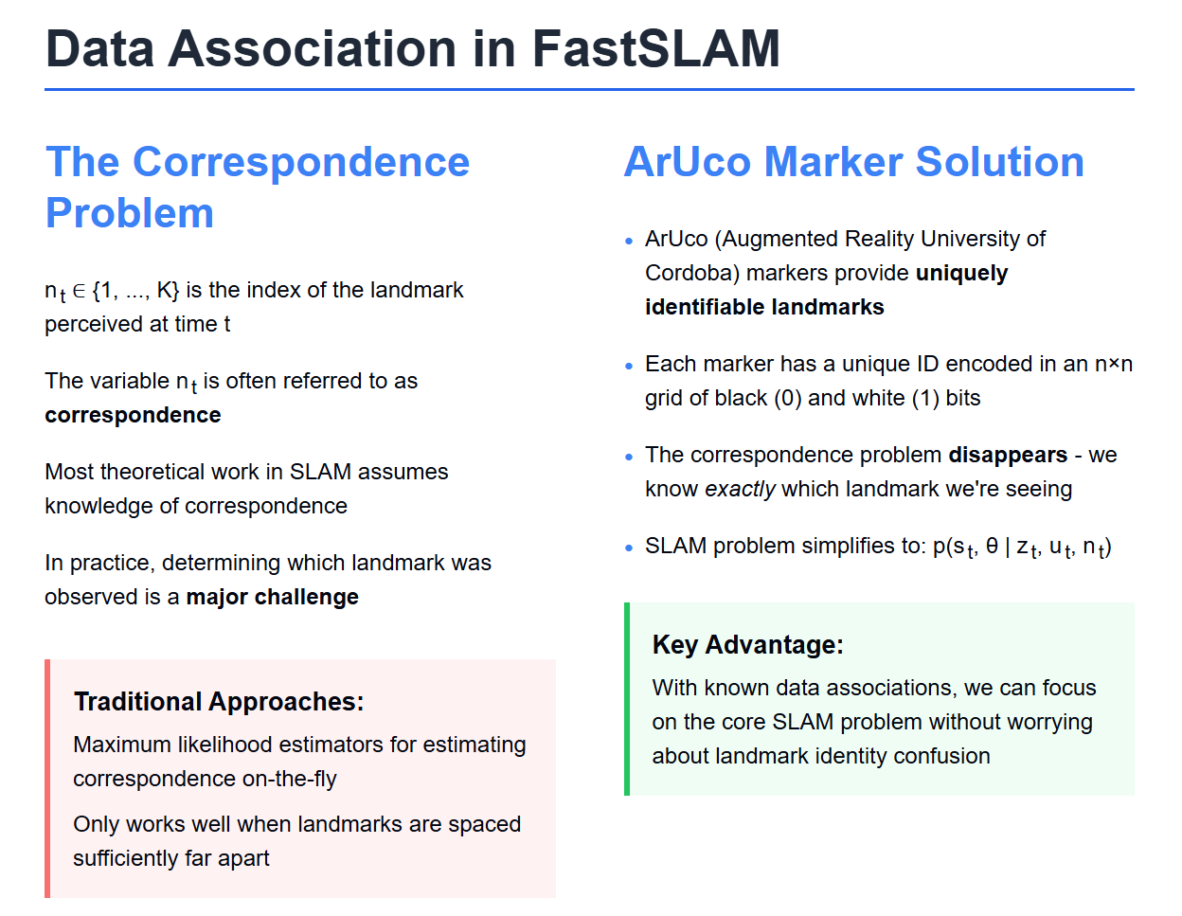

Slide 16
