Slide 1

PREDICTING GARMENTS
WORKERS
PRODUCTIVITY

Slide 2


Introduction
The garment industry is an important part of the global economy. It depends heavily on workers because most tasks are done by hand. Worker productivity is very important to meet global demand and deliver products on time. This dataset includes key production details and employee productivity data to help track and improve performance.

Slide 3









Time
Work Force
ABOUT THE
DATASET
DAY
DATE
QUARTER
OVER TIME
TEAM NO
NO OF WORKERS
IDLE MEN
INCENTIVE
DEPARTMENT
15 Variables
1197 Observations
Production Factors
Productivity Performance
NO OF STYLE CHANGES
STANDARD MINUTE VALUE
WORK IN PROGRESS
IDLE TIME
TARGET PRODUCTIVITY
ACTUAL PRODUCTIVITY

Slide 4
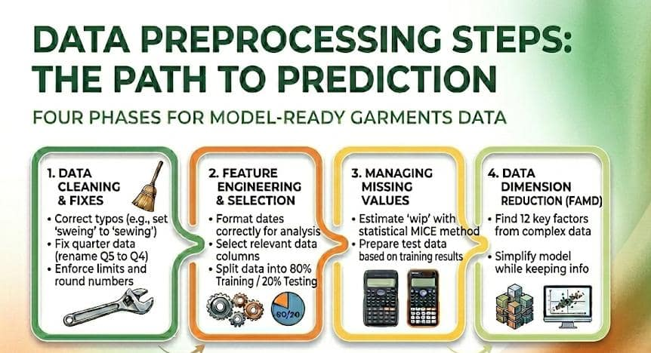
Variables Type Setting
(415)

Slide 5
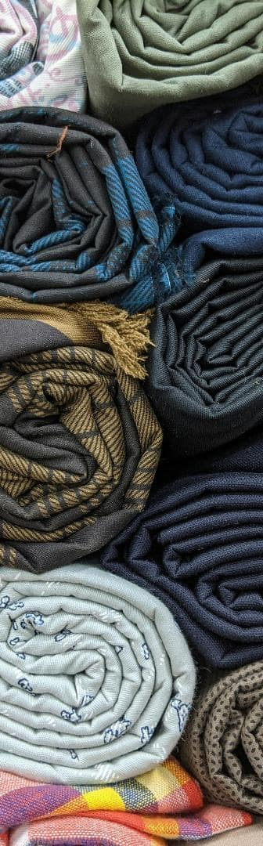
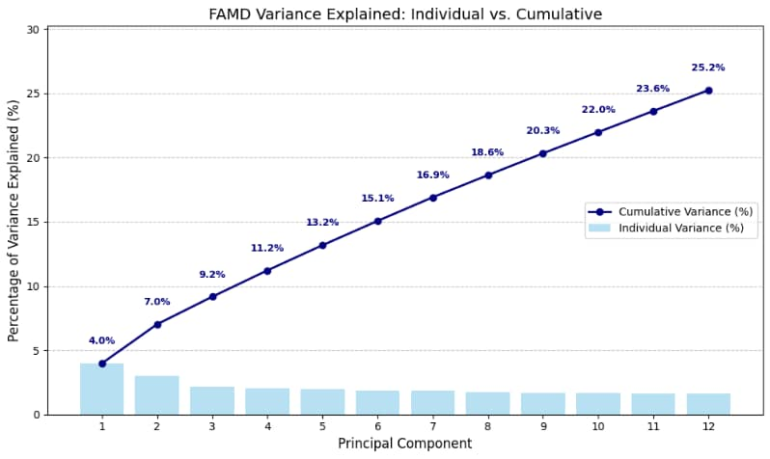
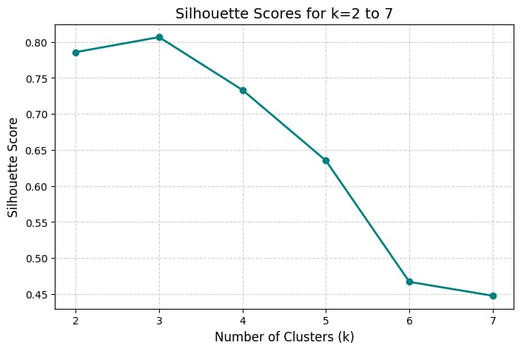
CLUSTER ANALYSIS
FAMD was used to reduce the dimention.
And then did Kmeans Clustering .

Slide 6
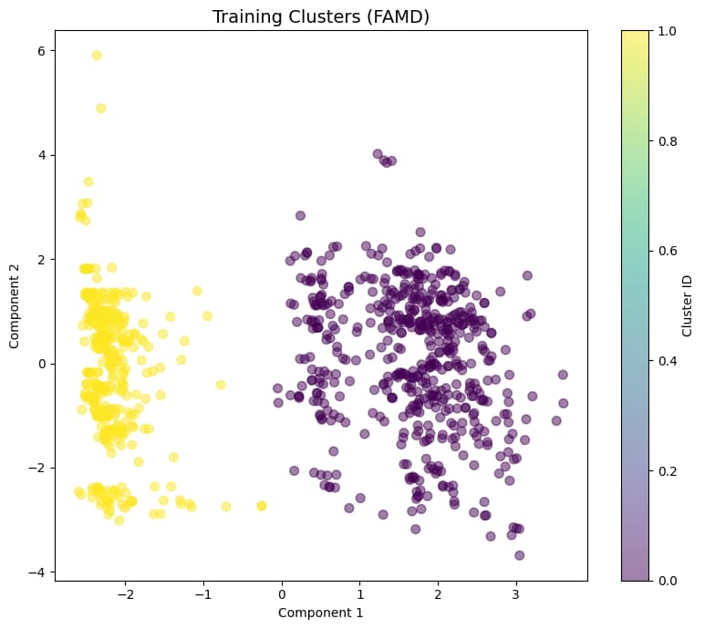
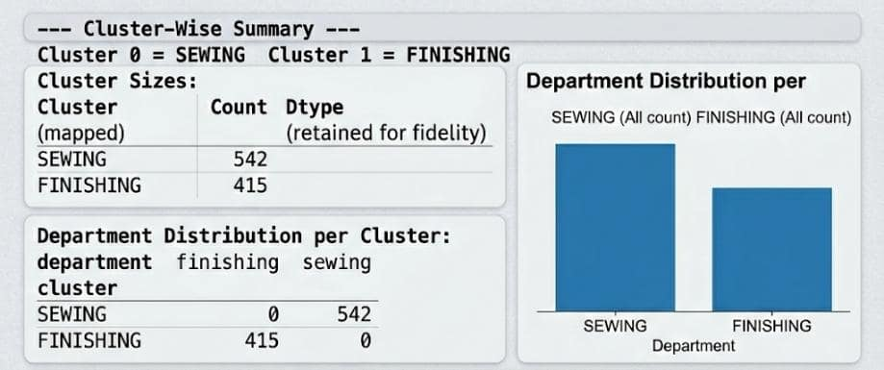
Cluster-wise Summary
Here, silhouette score (0.7857) is greater than 0.5, Clusters are significant.
Mann-Whitney U Test
P-Value: 1.1237e-05
(p < 0.05).
There is a statistically significant difference
between the productivity levels of the two clusters

Slide 7


objectives
1.Predicting worker productivity in the Sewing department
2.Predicting worker productivity in the Finishing department

Slide 8

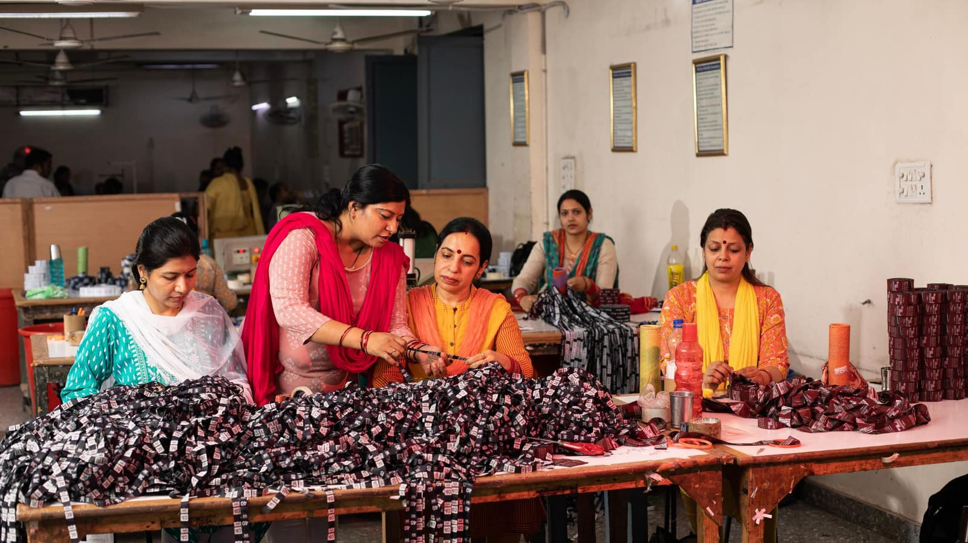



SEWING AND FINISHING
WORKFLOWS
Sewing
Joins cut fabric pieces, create complete garment parts.
Finishing
Inspects, trims, irons, and prepares the completed garments for final quality check and shipment.

Slide 9
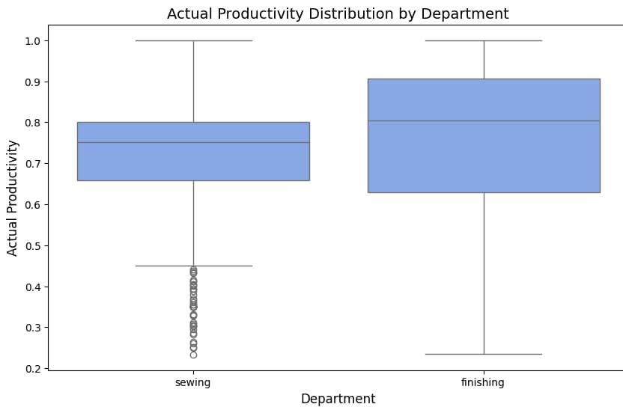


Actual Productivity
Shapiro-Wilk test:Check the normility of Actual productivity in two groups
H0: The data is normally distributed
H1: The data is not normally distributed
Actual Productivity is not normally distributed for both department.
H0:There is no difference in the distribution of productivity between departments
H1:There is difference in the distribution of productivity between departments.
Mann-Witney test (Non parametric)
Suggesting that there is a statistically significant difference in Actual productivity between the two departments

Slide 10

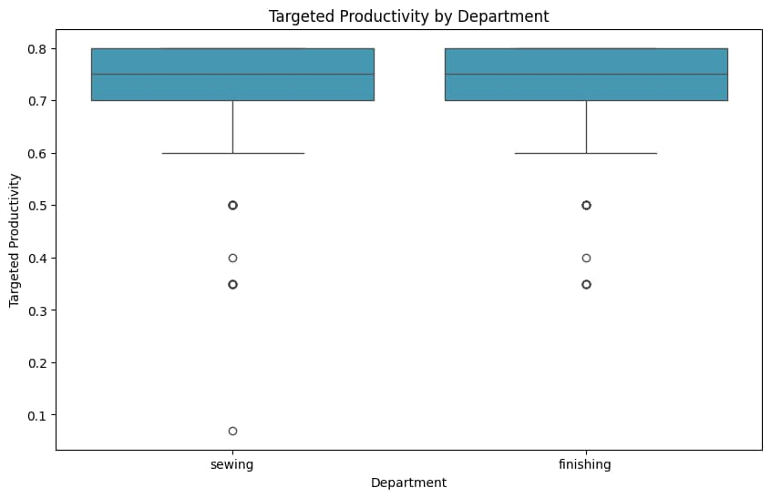

Targeted Productivity
Shapiro-wilk test
p-value<0.05
Targeted productivity is not normally distributed for both department
Mann-witney test
p-value>0.05
There is no statistically significant difference in targeted productivity between the two departments
Productivity goals are same for both department

Slide 11


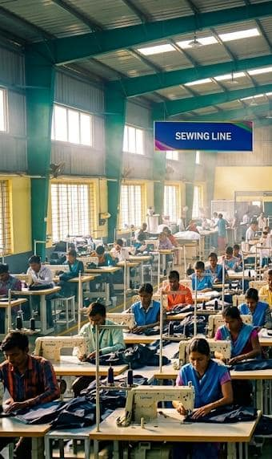
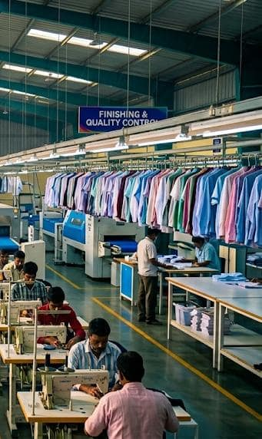
Explanatory Data Analysis
For Sewing department

Slide 12
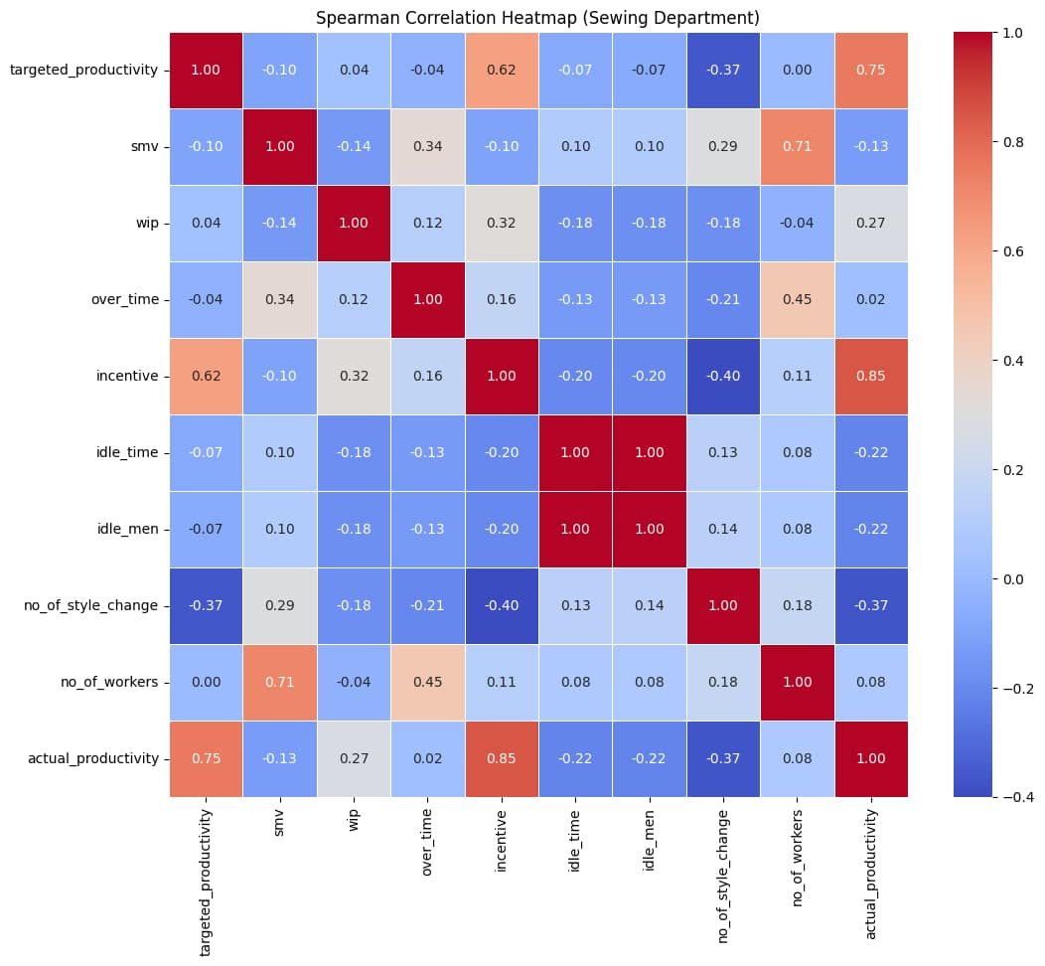
CORRELATION HEETMAP
Targeted productivity and incentive have strong positive relationship with Actual productivity.
Moderate Correlated Predictors
NNo of workers and SMV
incentive and target productivity

Slide 13

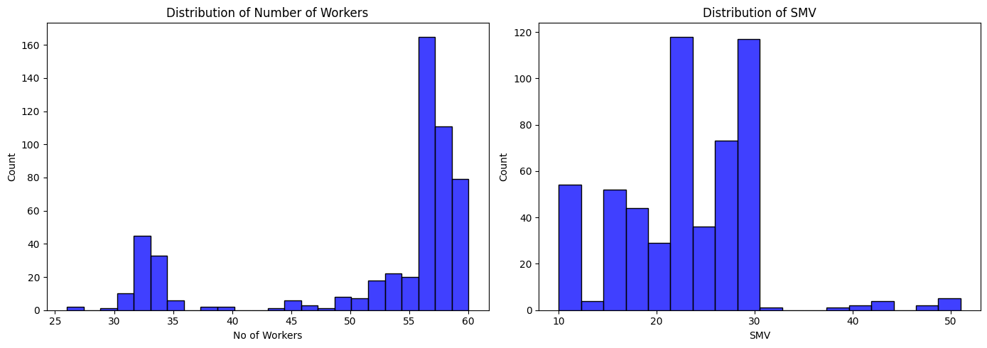
Range:10 to 51 minutes
Most of SMV values are around 18–30, showing that most sewing lines have similar standard operation times
Range:26-60 workers
Most sewing lines operate with 50–60 workers indicating standardized line balancing and similar production setups across lines.
Investigating the number of workers and Standard Minute Value (SMV) for the sewing Department

Slide 14

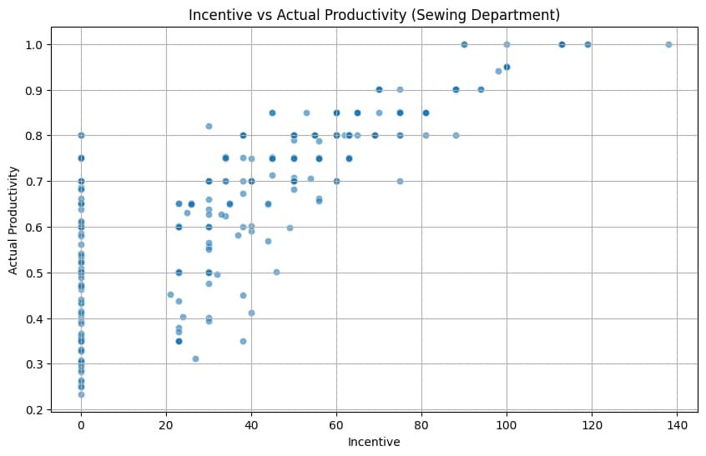
Spearman correlation test
p-value<0.05
So, There is a relationship between these two variables.
H0: There is no relationship between variables
H1:There is a relationship between variables
Incentive Vs Actual Productivity
This suggests that incentive scheme is currently very effective at driving output.

Slide 15

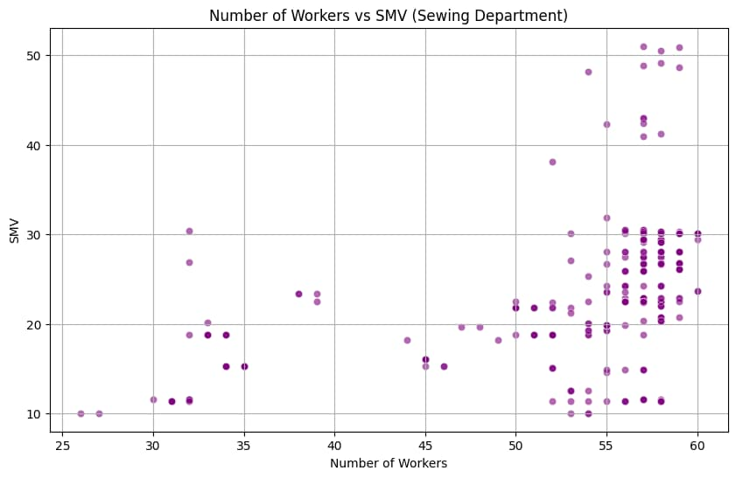
Spearmen correlation test
p-value<0.05
So, There is a relationship between these two variables.
No of workers vs SMV
Shows a fairly strong positive relationship with no of workers (0.71), suggesting more complex tasks require larger production line

Slide 16
Explanatory Data Analysis
For Finishing departments

Slide 17
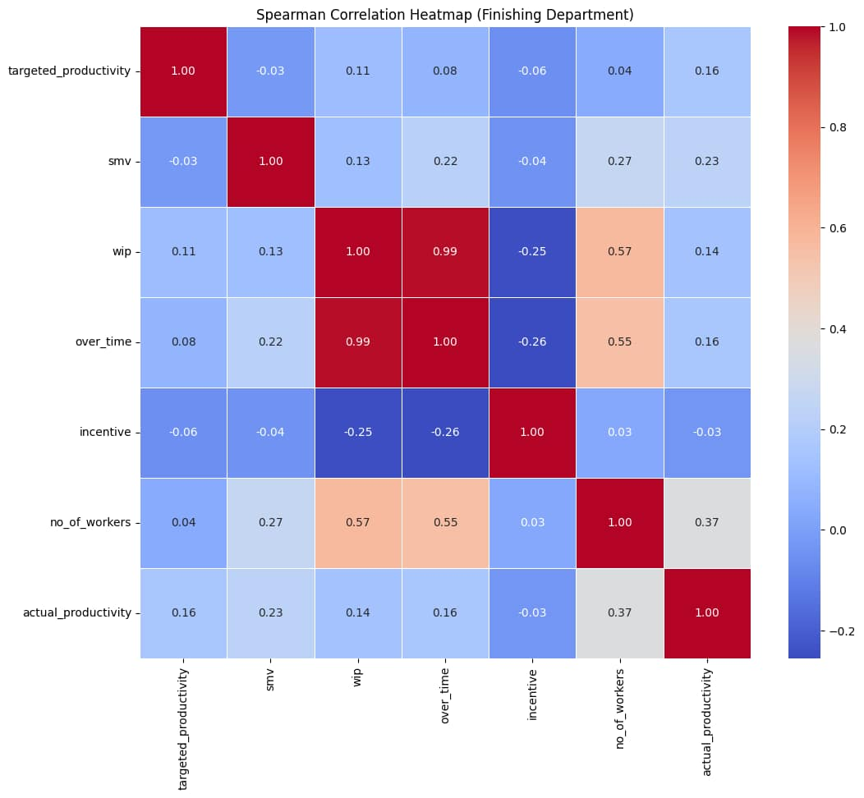
CORRELATION HEETMAP
Actual productivity has positive relationship with no of workers and smv.
High Correlated Predictors
wip and over time
Moderate Correlated Predictors
wip and no of workers
over time and no of workers

Slide 18

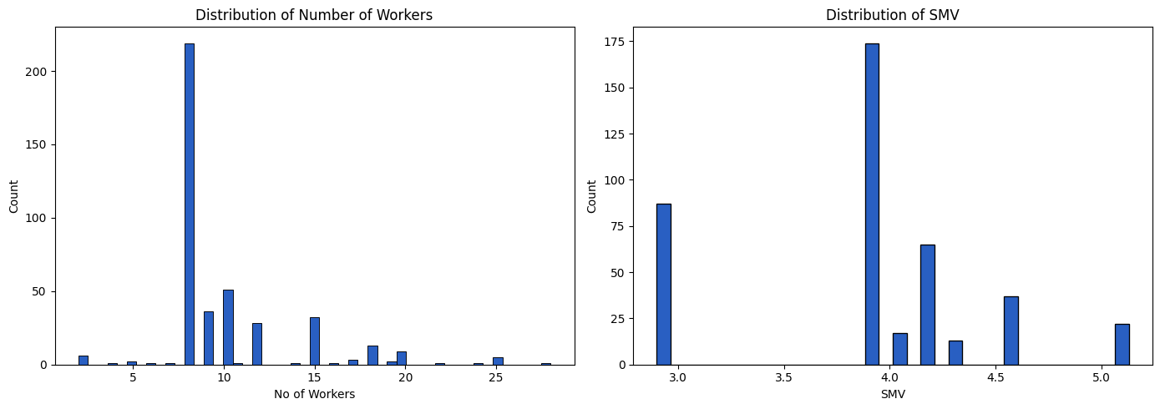
Range:2-28 workers
Most finishing operations use around 7 to 12 workers, showing the typical team size.
Range:2.9 to 5.1 minutes.
Most SMV values are between 3.8 and 4.2, indicating standard finishing operations.
Investigating the number of workers and Standard Minute Value (SMV) for the finishing Department

Slide 19
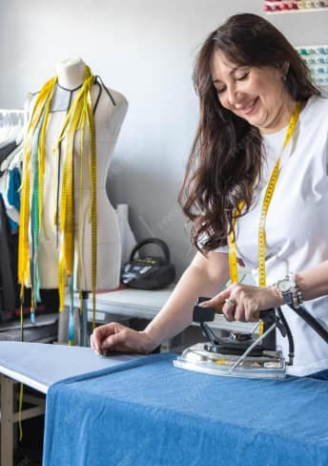
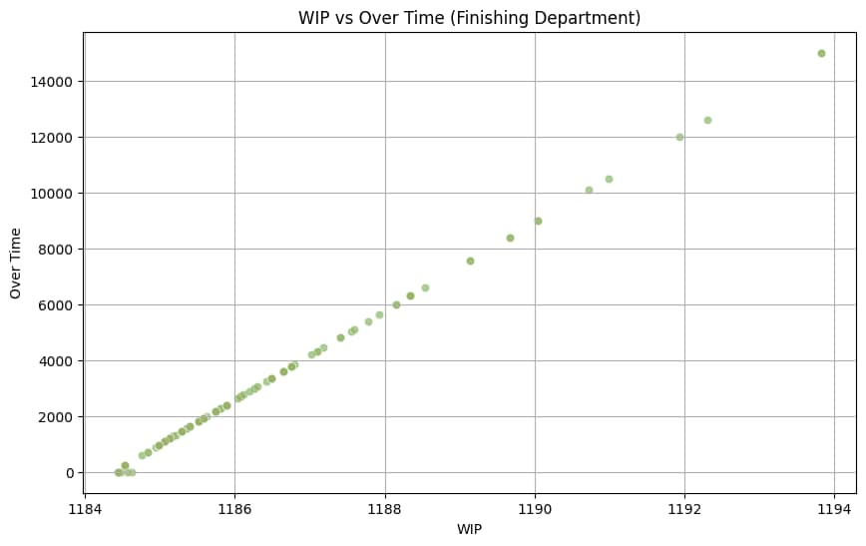

Spearman correlation test
p-value<0.05
So, There is a relationship between these two variables.
So, There is a relationship between these two variables.
WIP vs over time
Basically, whenever there is more work filling up waiting to be finished, the team has to work more overtime hours to keep up.

Slide 20
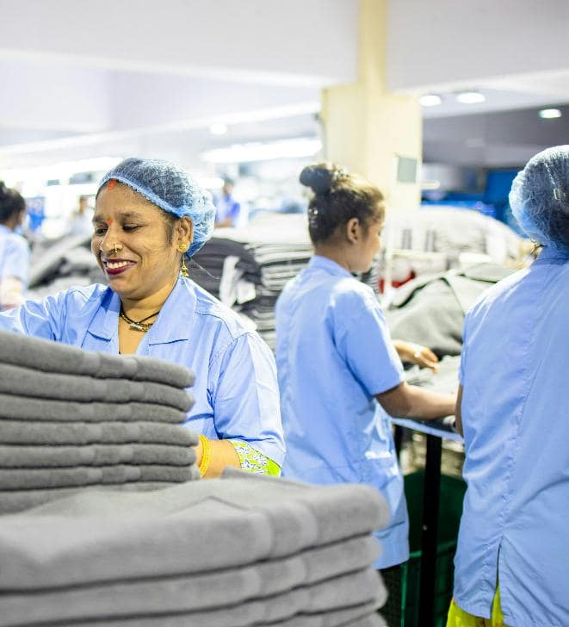
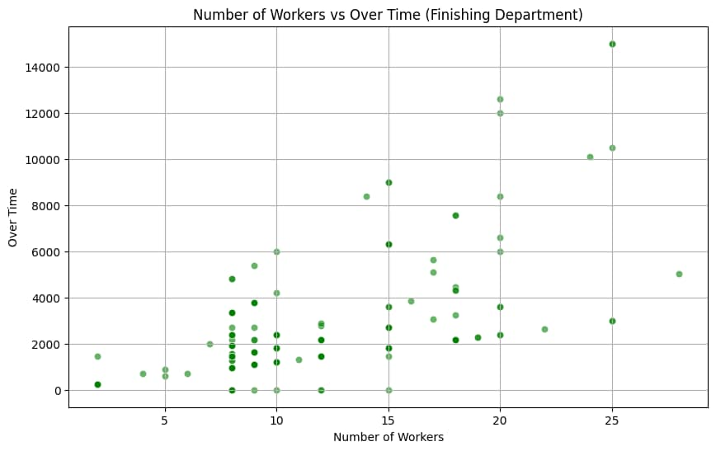

Spearman correlation test
p-value<0.05
So,There is a relationship between these two variables..
Overtime vs no of workers
When work piles up, overtime goes up automatically, but simply hiring more people doesn't guarantee less overtime.

Slide 21
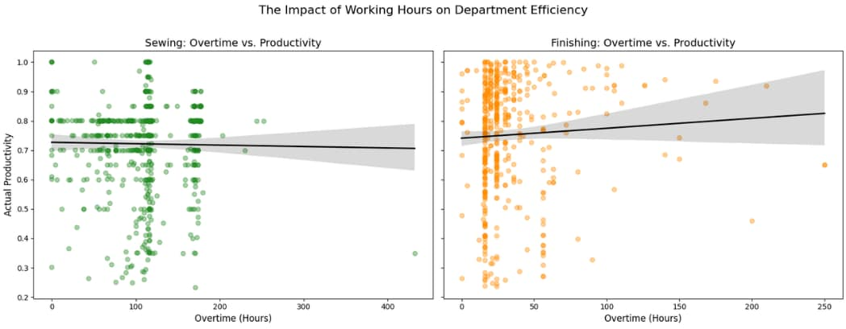
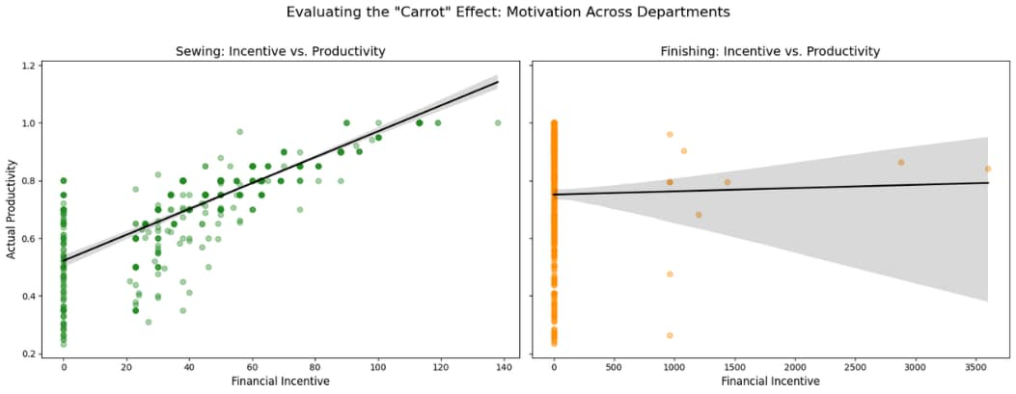
Key Insights
Since finishing is the last stop before a shipping deadline, this department often uses overtime to catch up on delays from earlier stages.
Factories often pay bonuses based on exceeding productivity targets. This is why "Incentive" is such a critical variable , it directly motivates operators to work faster while maintaining quality.

Slide 22
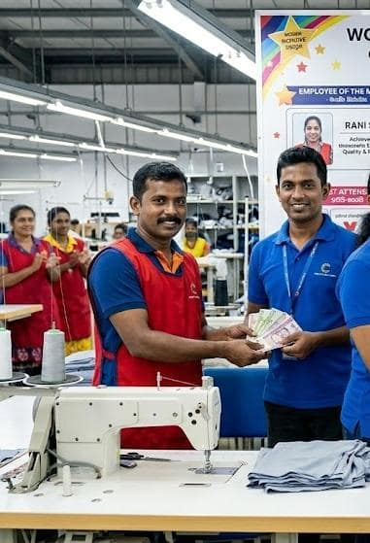
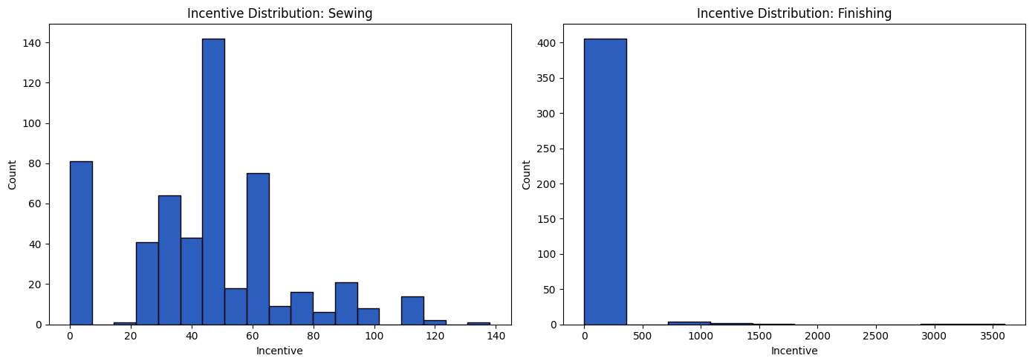
Incentives are fairly consistent, meaning workers receive regular and balanced payments, indicating stable productivity.
Incentives vary widely, with many low incentives and a few very high payments, suggesting uneven workload or performance differences
Investigating
Incentive of both department

Slide 23

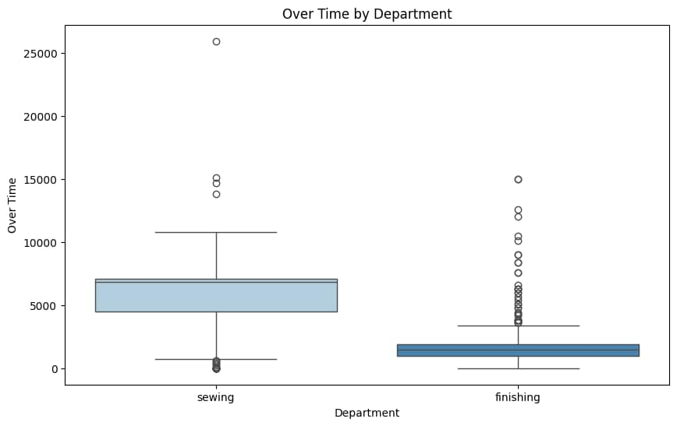

Shapiro-wilks test
p-value<0.05
Over time is not normally distributed for both department
Mann-Whitney test
p-value<0.05
Over time is distributed as differently over department
Investigating Over Time for
both department
The sewing department works longer and more regularly, while the finishing department has changing workloads with some days having more work and some days having less work.

Slide 24
Conclusion from the EDA
Sewing Department
The sewing department has a larger workforce and more complex tasks, so its productivity varies more and depends on multiple factors like workload,worker efficiency, overtime, and incentives.
Finishing Department
The finishing department has fewer workers and its productivity is influenced by clear, structured factors like workload and overtime, making its performance more stable and easier to manage.

Slide 25
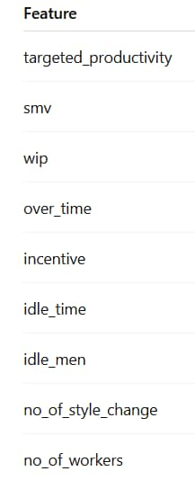
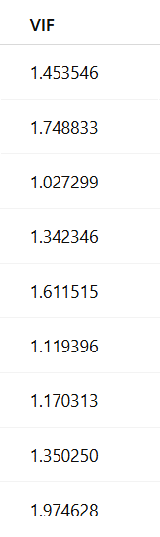
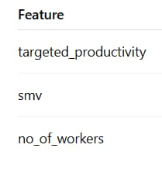
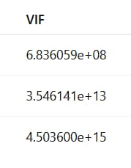
VIF VALUES
SEWING
FINISHING
Multicollinearity exists in the Finishing department, but not in the Sewing department.

Slide 26
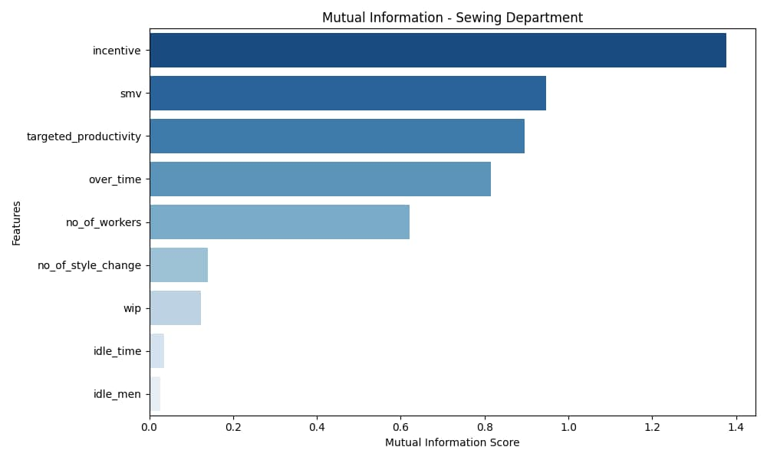
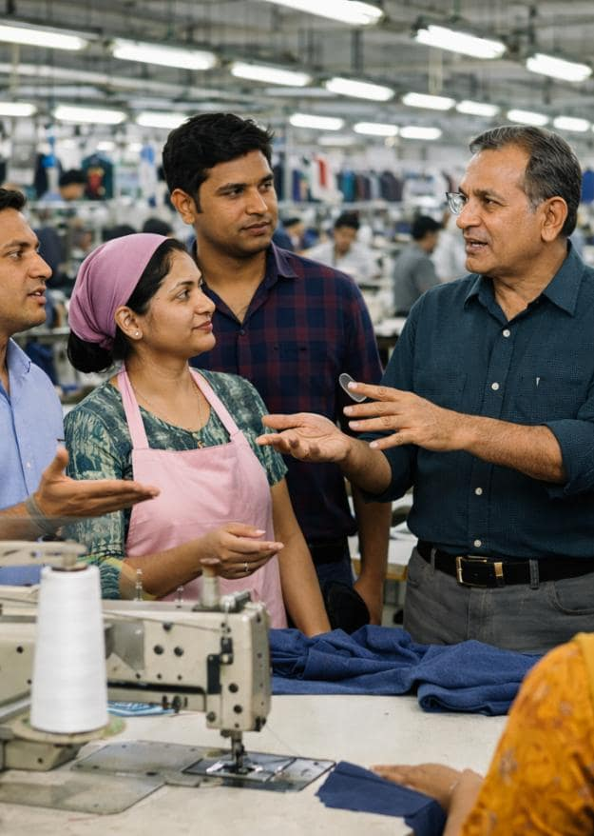
MUTUAL INFORMATION - SEWING
incentive
smv
targeted_productivity
over_time
no_of_workers
Most
Impotant Features

Slide 27
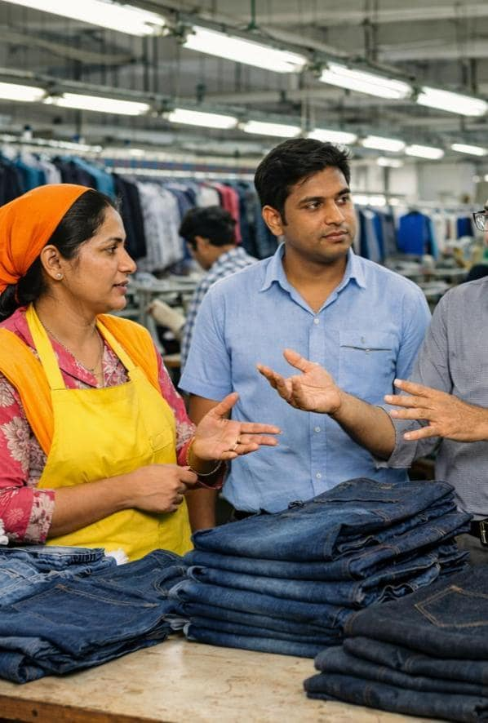
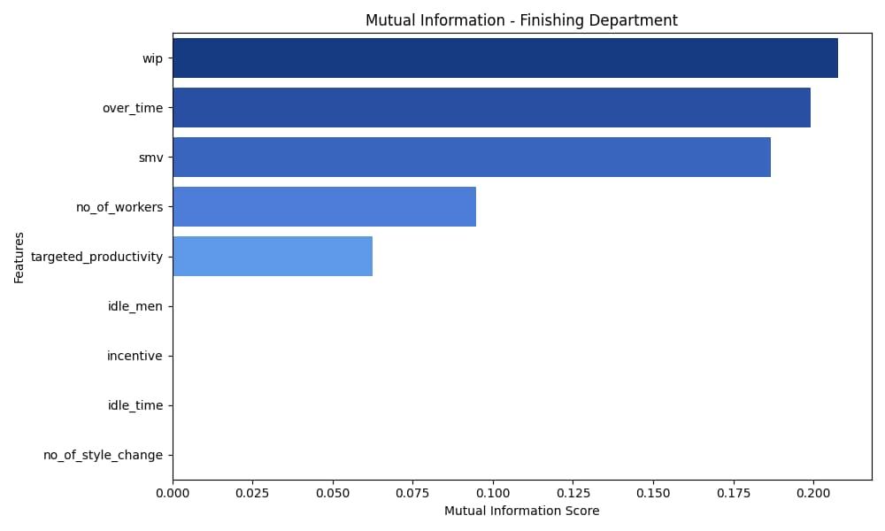
MUTUAL INFORMATION - FINISHING
Zero importance
Impotant features
wip
over_time
smv
no_of_workers
targeted_productivity
idle_men
incentive
idel_time
no_of_style_change

Slide 28


Model Building
For sewing department

Slide 29
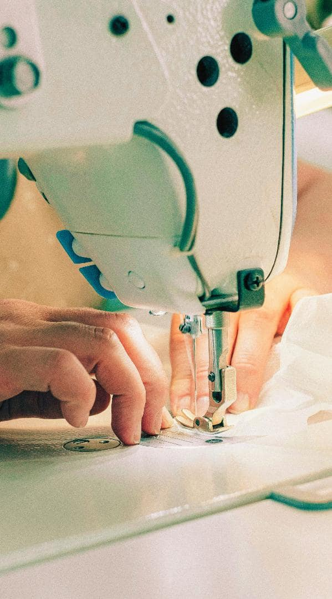
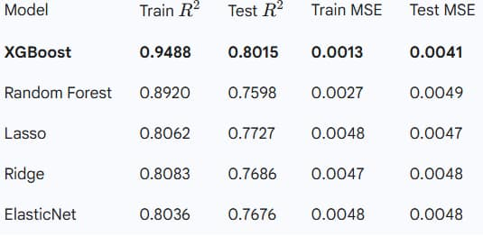
MODEL SUMMARY (SEWING)
BEST PREDICTIVE MODEL
XGBOOST

Slide 30
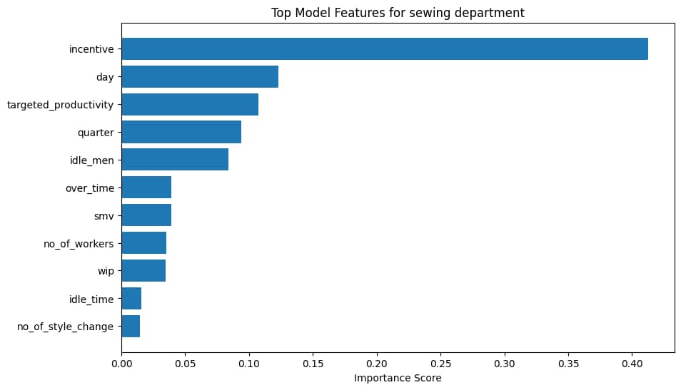
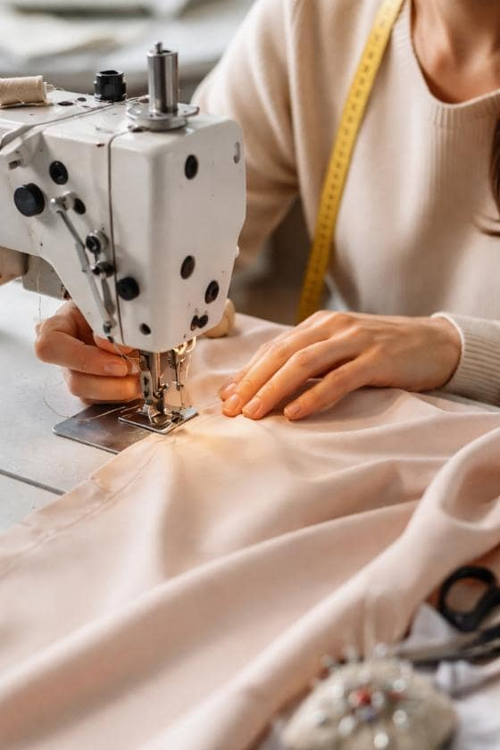
FFEATURE IMPORTANCEF
XGBOOST
Impotant features
These features were obtained from the mutual information too.
incentive
smv
targeted_productivity
over_time
no_of_workers

Slide 31

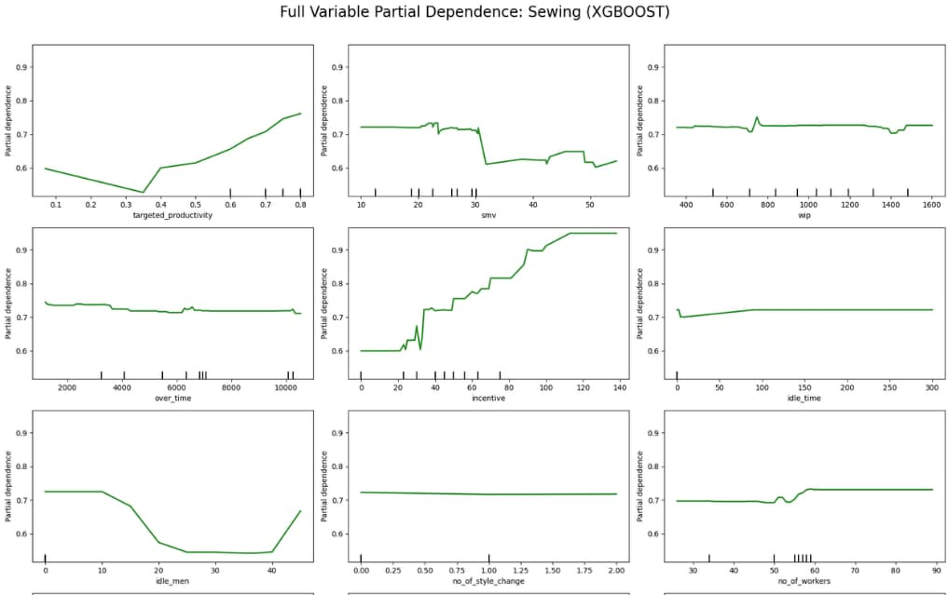
Partial Dependency Plots
Positive Impact on Productivity
Targeted Productivity
Incentive
No. of Workers.
Negative Impact on Productivity
SMV
Over Time
Idle Time
Idle Men.
Minimal Impact on Productivity
WIP
No. of Style Change.

Slide 32
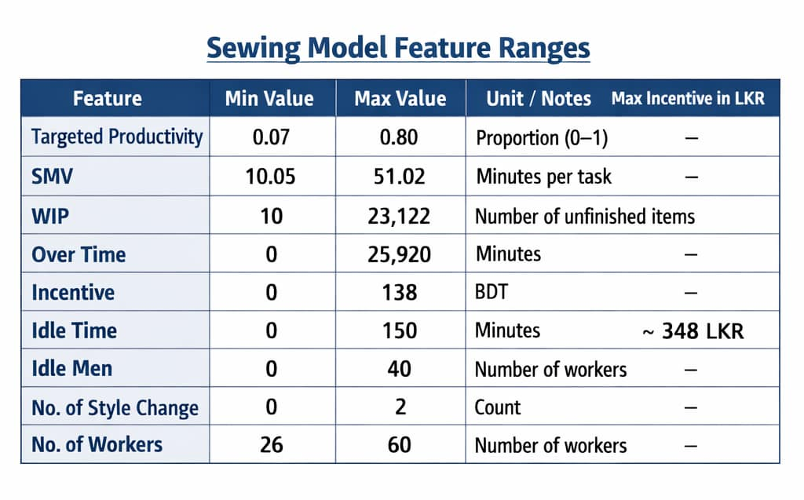

Slide 33
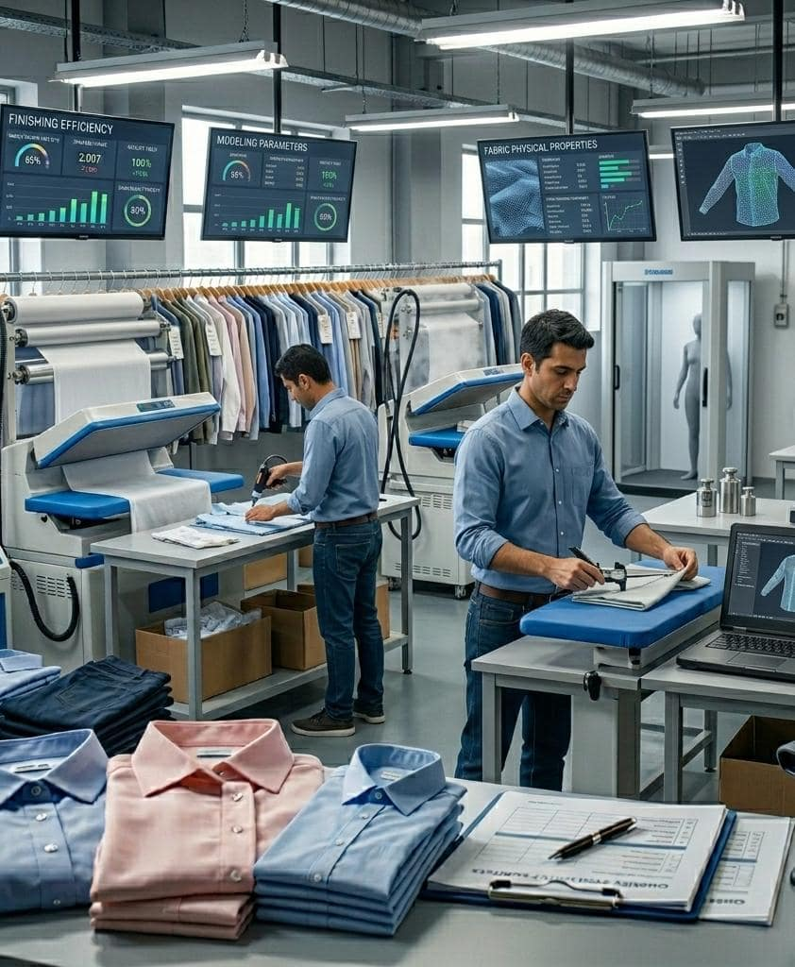
Model Building
For finishing department

Slide 34

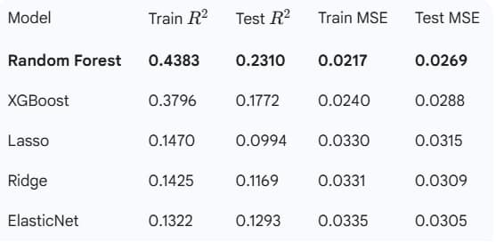
MODEL SUMMARY (FINISHING)
BEST PREDICTIVE MODEL
RANDOM
FOREST

Slide 35
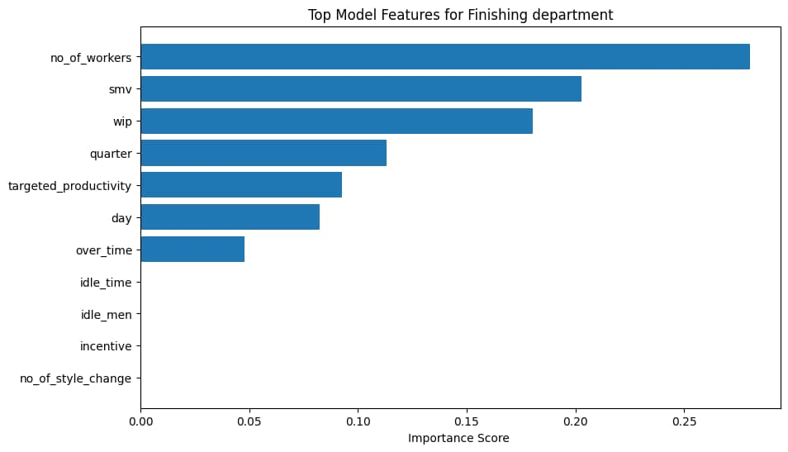
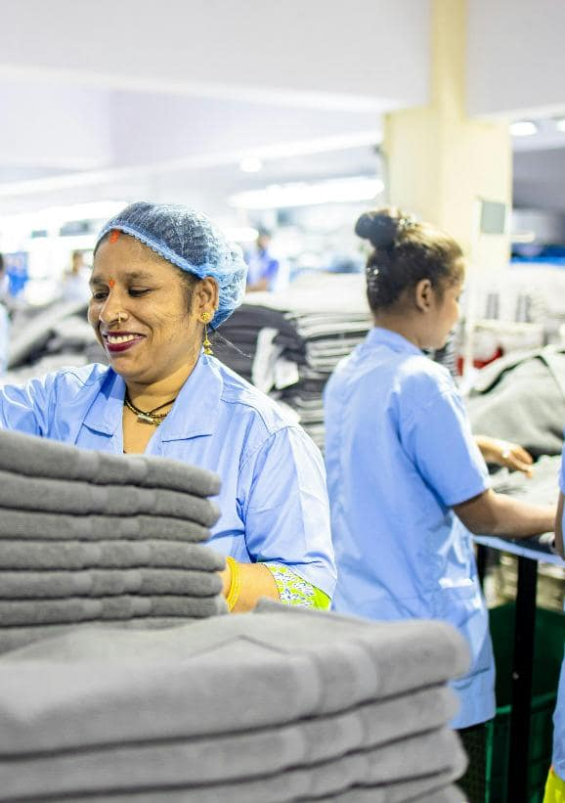
FFEATURE IMPORTANCEF
RANDOM FOREST
Impotant features
Similar features were obtained from the mutual information too.
wip
over_time
smv
no_of_workers
targeted_productivity

Slide 36
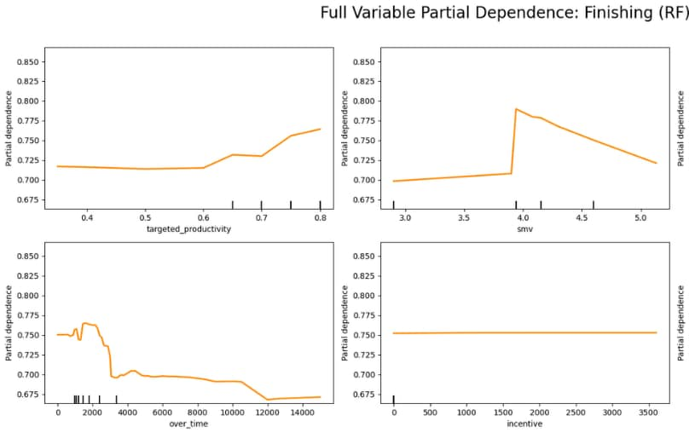
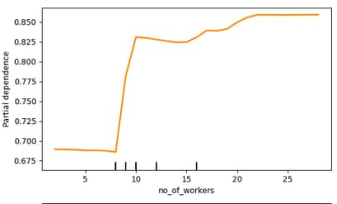
Partial Dependency Plots
Positive Impact on Productivity
Targeted Productivity
No. of Workers
Negative Impact on Productivity
Over Time
SMV
Minimal Impact on Productivity
Incentive

Slide 37
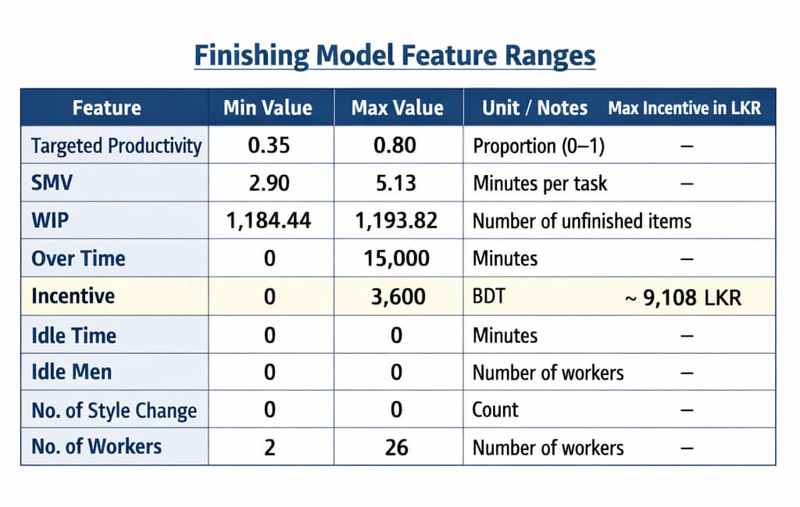

Slide 38
CONCLUSION FROM THE ADVANCED ANALYSIS
For the Sewing department, XGBoost performed best, indicating productivity is driven by multiple interacting factors such as SMV, workforce size, overtime, and incentives.
For the Finishing department, the best model was Random Forest, showing finishing productivity is influenced by several decision-like rules (like workforce size , overtime, and workload).
The sewing operations are more complex and nonlinear, so an advanced boosting model gives better accuracy.
Finishing tasks are comparatively simpler and stable, so a tree-based ensemble model can capture the patterns effectively.
Overall, using different models for each department improves prediction accuracy and helps managers make better workforce and production planning decisions.

Slide 39
Python code:
https://colab.research.google.com/drive/1Jhi3-aTLwcIAuWTyPexfK7h0JGGeSTRe?usp=sharing
Dataset:
https://www.kaggle.com/datasets/ishadss/productivity-prediction-of-garment-employees

Slide 40
References
https://www.statisticshowto.com/probability-and-statistics/statistics-definitions/parametric-and-non-parametric-data/
https://empuls.xoxoday.com/glossary/employee-productivity-analysis
https://www.mdpi.com/1424-8220/23/21/8694
https://medium.com/@mbkioko/employee-performance-analysis-d5bf904b8039

