Slide 1
Version control
Melinda Varo
INTRODUCTION TO COMPUTER SCIENCE, 3 ECTS

Slide 2
Projects Sequence of tasks that leads to a certain outcome
Life cycle:
Initiation
Planning
Execution
Monitoring and controlling
Closing
Boundaries:
Scope
Schedule
Resources
People

Slide 3
Trello
Project management and collaboration tool
Sticky note board appearance
Projects and tasks organized in columns
Transparency in workflow and status of the project
One account supports multiple boards (projects)
No coding skills needed, easy to use
Supports third-party apps and services, such as Google Drive, OneDrive, GitHub, Slack, Jira, and many more.
Read more here

Slide 4
Version control Generally
Method for storing files, source code, documentation, keeping record of changes
Individually:
Backup for the code
Reverting errors
Easy to modify
Team:
Collaboration: makes possible team development remotely

Slide 5
Version control tools All open sources and free of charge
Git
CVS
SVN
Read more here

Slide 6
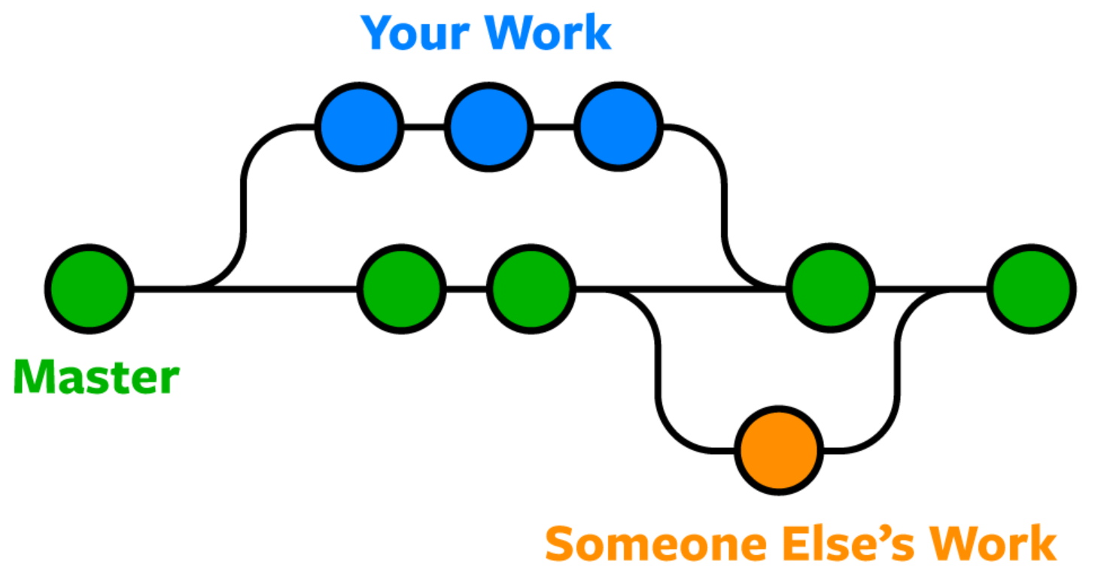
Git
Most commonly used version control software
Can be access via a command line (terminal), or a desktop app that has a GUI
GitHub is a cloud base platform built around Git
Recommended to have GitHub account with your uploaded projects what can be shared in CV/ LinkedIn

Slide 7

Git installation
Can be installed on most common operating systems
First check if is already installed by opening Command prompt or Git Bash and type : git version
Step by step instructions you can find here
This Photo by Unknown Author is licensed under CC BY-SA-NC

Slide 8
Git Commands
git config Sets author name and email address
git init Starts a new repository
git clone Gets repository from existing URL
git add Adds files
git commit Records files permanently
git status Lists all committed files
git branch Lists all branches in the current repository
git checkout Switching from one branch to another
git push Sends committed changes
git pull Fetches and merge changes

Slide 9
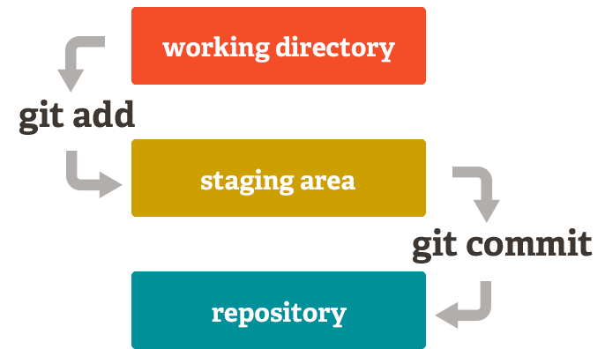
Best practice
Commit often
Test before committing
Document everything
All commits should have a short description of the made change

