Slide 1
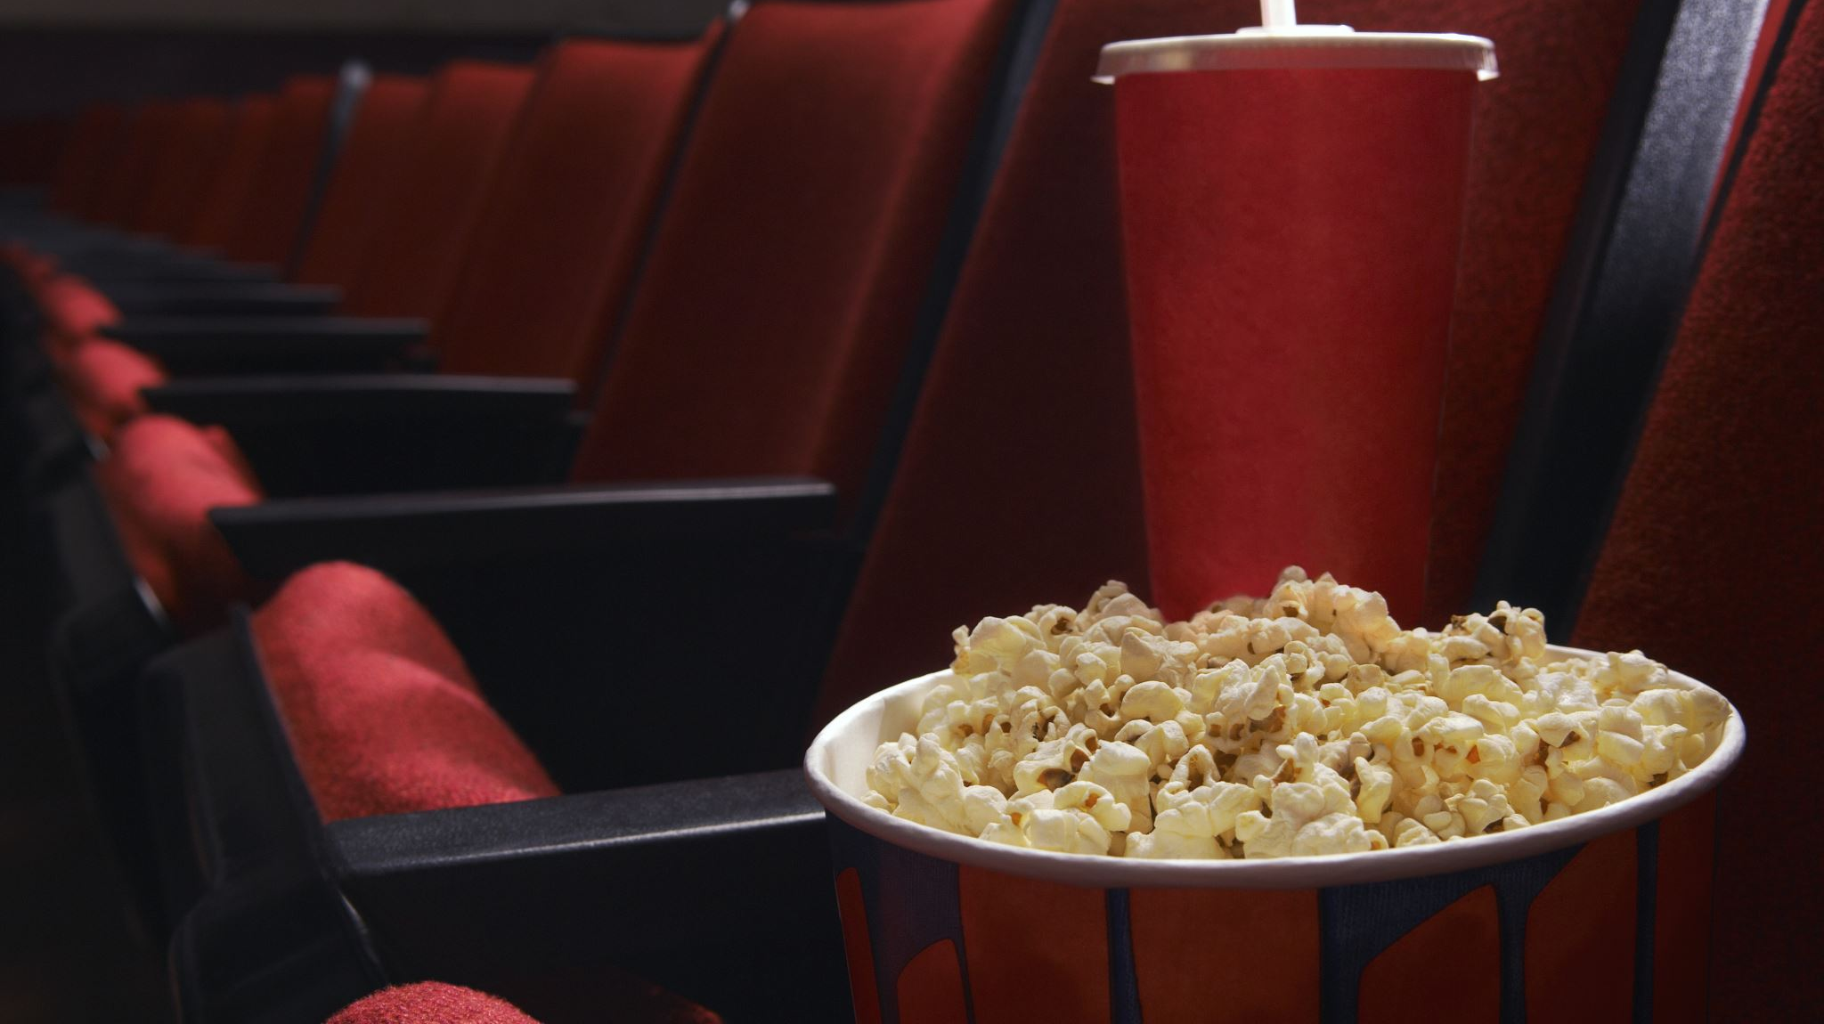
MOVIE RECOMMENDATION SYSTEM

Slide 2

Manideep Prathipati _ 700726314 Chouturi Praneeth babu _ 700742707 Shaik Shameer – 700740584 Akhila Boddu _ 700742171

Slide 3

Roles and responsibilities:
Team
Team Member 1. worked on model implementation as well as documentation for the project to move forward.
Team
Team member 2 worked on the Feature extraction and also the documentation for the project.
Team
Team Member 3 worked on the data collection and documentation for the project
Team
Team member 4 worked on the model implementation and modifications on the documentation for the project.

Slide 4
Motivation:
A movie recommendation system can be motivated by a desire to improve the user experience for movie lovers.
Many people struggle to find movies that suit their preferences, MRS address this by suggesting movies that are likely to be of interest based on user’s past viewing history.
Movie recommendation systems can benefit movie streaming platforms by increasing user engagement and retention.
MRS can provide value to both users and businesses by making it a compelling area of research and development.

Slide 5

Objectives:
The objective of a movie recommendation system is to give personalized movie recommendation experience for each user.
To suggest movies that meet the user's interests and preferences, so that the system can improve the user's satisfaction and increase their engagement with the movie streaming service.
Another objective is to increase the revenue for the movie streaming service.
Overall, the objective of a movie recommendation system is to create a win-win situation for both the user and the movie streaming service by providing personalized movie suggestions that meet the user's interests and increasing revenue for the service.

Slide 6

Related work:
In this, we will construct a movie recommendation system project and find out about the machine learning project lifecycle. The issue proclamation is that to view a movie based on ratings then our application ought to be viable to give an exact prediction.
Even though it seems to be a straightforward task or simply fostering a model, the dataset we have is uproarious and needs loads of element designing, and preprocessing that will drive your advantage in fostering this venture.

Slide 7

Problem Statement:
The goal of a movie recommendation system using machine learning is to develop a system that can suggest movies to users based on their past movie preferences. The system should be able to analyze user behavior, such as movies they have watched, rated, or reviewed, and use that data to predict which movies they may enjoy.
The problem can be formulated as a supervised learning problem, where the model is trained on a dataset of movie ratings and features such as genre, director, cast, and plot summary. The dataset should also include information about users, such as their demographic information and past movie preferences Providing related content out of relevant and irrelevant collection of items to users of online service providers.

Slide 8

Proposed Solution:
The Data is visualized based on the output of the machine learning algorithm and the data is mapped with different types of graphs to analyze and visualize the exact data to the user for the prediction. Matplot libraries are implemented to map the results based on the user requirements.
Exploratory analysis is a process to explore and understand the data and data relationship in a complete depth so that it makes feature engineering and machine learning modeling steps smooth and streamlined for prediction. EDA involves Univariate, Bivariate, or Multivariate analysis. EDA helps to prove our assumptions true or false. In other words, it helps to perform hypothesis testing.

Slide 9
Results\Simulations:
Since our project is movie recommendation system .one can develop a movie recommendation system by using Random forest classifier and Logistic Regression Classifier.
On various samples, Random forest classifier constructs decision trees and uses their average for classification and majority vote for regression. Machine learning uses the categorization method known as logistic regression. The dependent variable is modeled using a logistic function. In our project we have developed a hybrid approach i.e., combination of both content and collaborative filtering .Both the approaches have advantages and dis-advantages.
In our project we have developed a hybrid approach i.e., combination of both content and collaborative filtering .Both the approaches have advantages and dis-advantages. In content based, filtering the it based on the user ratings or user likes only such kind of movie will recommend to the user
Advantages: No need domain knowledge because the embeddings are automatically learned. The model can help users discover new interests
Dis-advantages: The prediction of the model for a given (user, item) pair is the dot product of the corresponding embeddings. So, if an item is not seen during training, the system can't create an embedding for it and can't query the model with this item. This issue is often called the cold-start problem.

Slide 10
References:
[1]. Alexandra Fanca, Adela Puscasiu ” Recommendation Systems with Machine Learning”. 978-1-7281-1951-9/20/$31.00 ©2020 IEEE.
[2]. Nan Zhi-hong, Zhao Fei” Research on Semi-supervised Recommendation Algorithm Based on Hybrid Model “978-1-7281-9638-1/20/$31.00 ©2020 IEEE.
[3]. Haili Wang, Nana Lou. “A Personalized Movie Recommendation System based on LSTMCNN” , 2020 2nd International Conference on Machine Learning, Big Data and Business Intelligence (MLBDBI).
[4] Gutiérrez a, Bobadilla J, Hernando a, Ortega F. Recommender systems survey. Knowledge Based System 2013; 46:109–32.
[5] Semeraro G, De Gemmis M, Lops P. Content-based recommender systems: state of the art and trends. Recommender System Handbook 2011:1–33.
[6] Billsus D, Pazzani MJ. Content-based recommendation systems 2007:325–41.
[7] W. Croft, T. Strohman, and D. Metzler. Search Engines: Information Retrieval in Practice. Addison Wesley, 2010.
[8] Zhang R, Wang Y, Bao H, Liu X, Sun H. Recommender systems based on ranking performance optimization. Front Computer Sci China 2015;1–11.
[9] Su X, Khoshgoftaar TM. A survey of collaborative filtering techniques. Adv Artificial Intelligence 2009; 2009:1–19.
[10] Zeng D, Huang Z, Chen H. A comparison of collaborative-filtering algorithms for ecommerce. IEEE Intelligent Systems 2007

Slide 11


