Slide 1
耗材管控系统SOP Administration System SOP

Slide 2
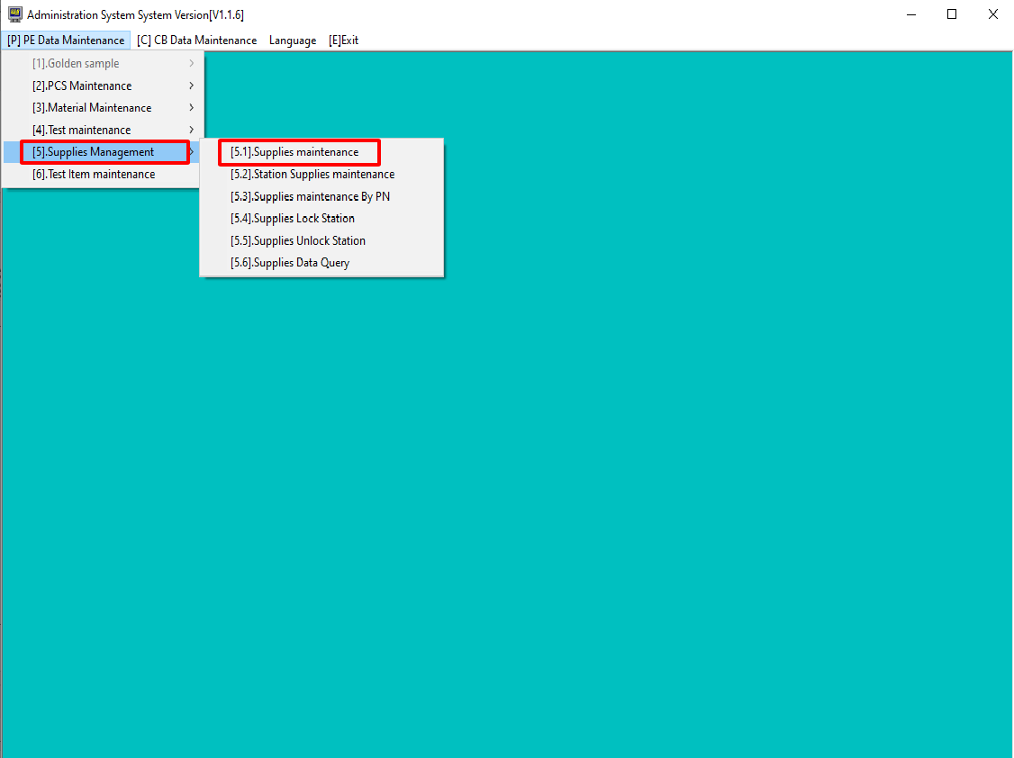
I. Add Supplies Maintenance
1. Enter Supplies Maintenance Display
-Step 1: choose [5]. Supplies Management
-Step 2: choose [5.1]. Supplies Management
Step 2
Step1

Slide 3
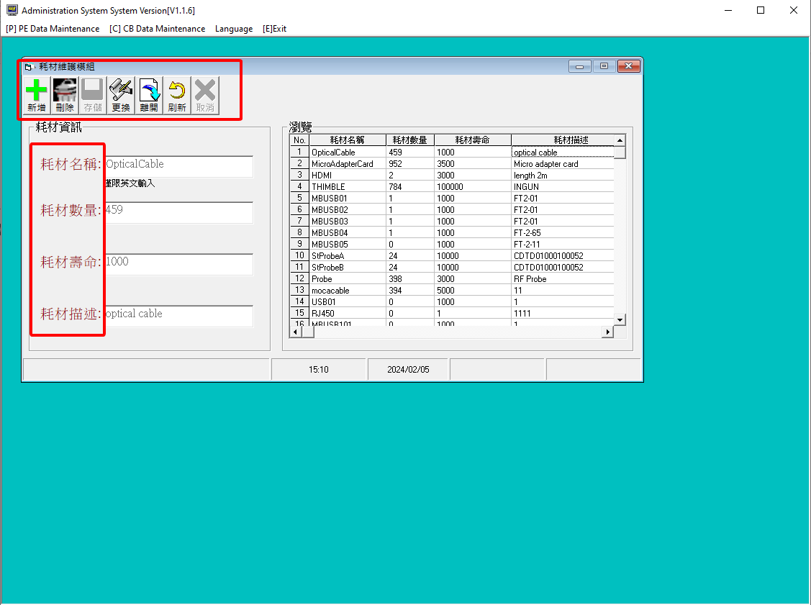







2. Supplies Management Display Introduction
1
Add supplies
1
Delete supplies
2
Save
Replace
Leave
Reset
Cancel
2
耗材名称：Supplies Name
耗材数量：Supplies Inventory number
耗材壽命：Consumable Life
耗材描述：Supplies Description

Slide 4
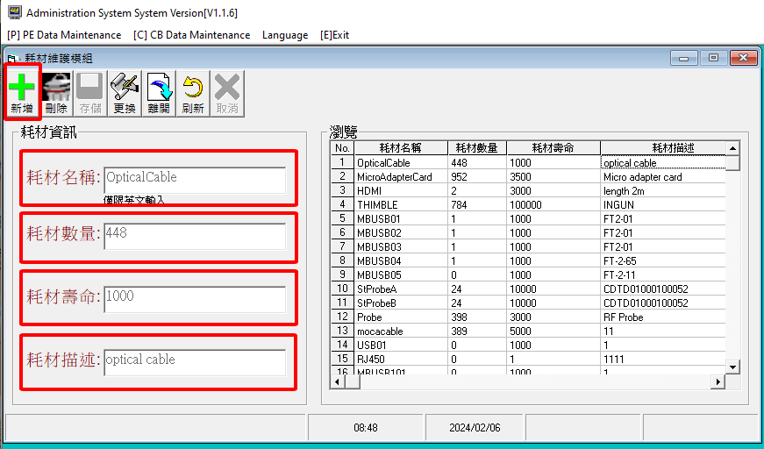
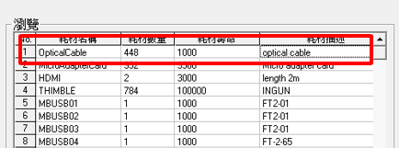
3. Add Supplies Item
Step 1: Choose item to add new supply
Step 2: Type in information
For example: Supplies which you need to add has Optical Cable, just type in information as this following:
耗材名称 [ Supplies Name ]: Optical Cable
耗材数量 [ Supplies Inventory number ]: 448
耗材壽命 [ Consumable life ]: 1000 (according to supplier)
耗材描述 [ Supplies Description ]: Discription
Step 3: Choose item to save information
If item “OpticalCable” appears in the next frame like this
It’s mean update completed

Slide 5
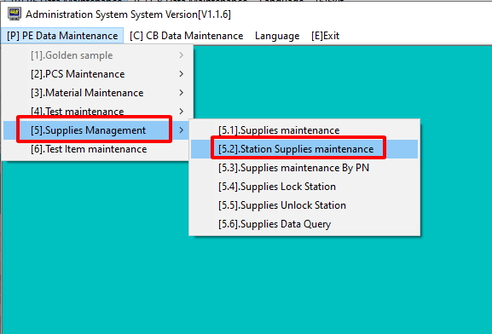
II. Add Station Which is Use Supplies
1. Enter Station Supplies Maintenance Display
Step 1: choose [5]. Supplies Management
Step 2: choose [5.2]. Station Supplies Management

Slide 6
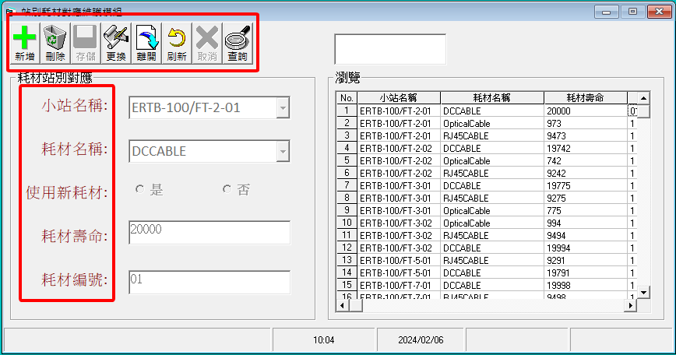


2. Station Supplies Management Display Introduction
Add station
Delete
Save
Replace
Leave
小站名稱: Station Name
耗材名稱: Supplies Name
使用新耗材: Use old or new Supplies
耗材壽命: Consumable Life (provide by Vendors)
耗材編號: Supplies Number (prescribed by EQ)
Reset
Check

Slide 7
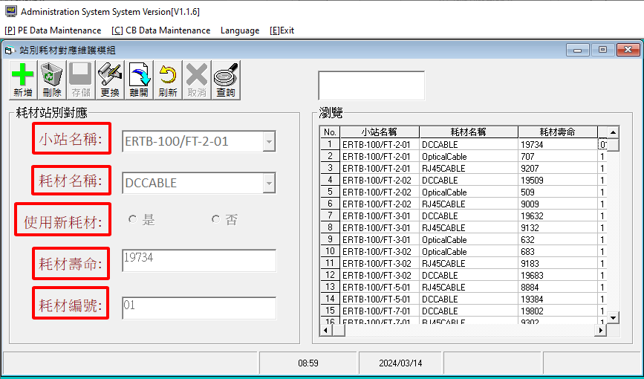

3. Add Station Which is Use Supplies
Step 1: Choose item to add supplies to station
Step 2: Type in information of station which you want to add supplies
For example, Model ERTB-100 FT-2-01 need to use DCCable, type in information as this following:
小站名稱 [Station Name]: ERTB-100/FT-2-01
Station name you type in on this system need to be the same as the station name on production line
耗材名稱 [Supplies Name]: DCCABLE
Only can add which supply you’ve already added to supply management section ( I )
使用新耗材 [Use old or new Supplies]: choose 是 if DCCable is new, 否 if DCCable is old
耗材壽命 [Consumable Life]: (provide by Vendors)
耗材編號 [Supplies Number]: (prescribed by EQ)

Slide 8

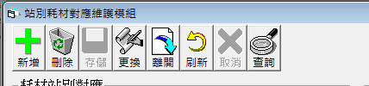
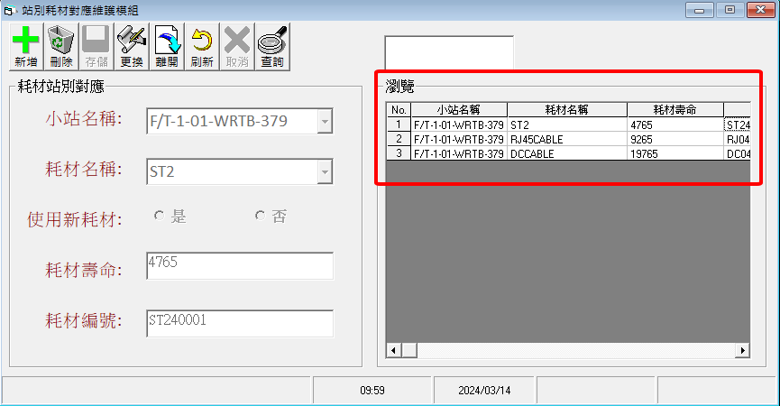
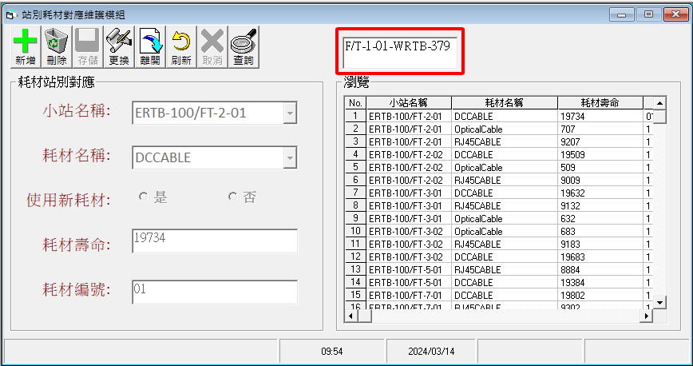
4. Confirmation
Step 1:
At this test box, type in which station you want to confirm
For example, we want to confirm model WRTB-379, just type in station as following picture
Step 2:
Choose item to find
If supply system appear information like this
It’s mean update completed

Slide 9
Thank You!

