Slide 1
MVVM

Slide 2
Agenda
Intro : Traditional UI developments.
MVVM in Deep :
What iss MVVM?
Model / View Model /View.
Classes interaction.
MVVM and other patterns.
MVVM Advantages /Disadvantages.
Conclusion & Recommendations.

Slide 3
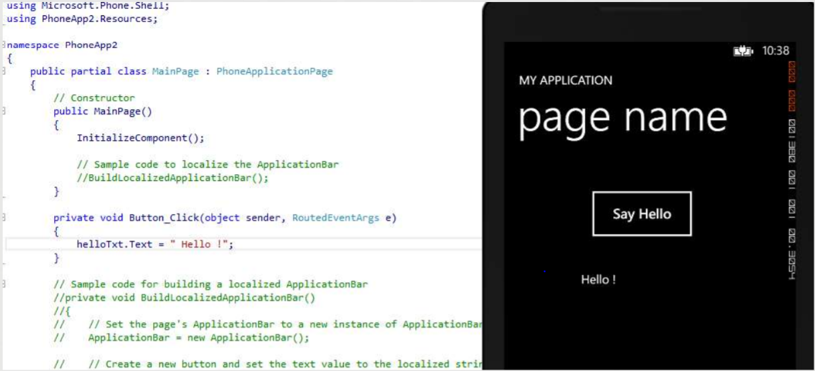
Traditional UI Development

Slide 4
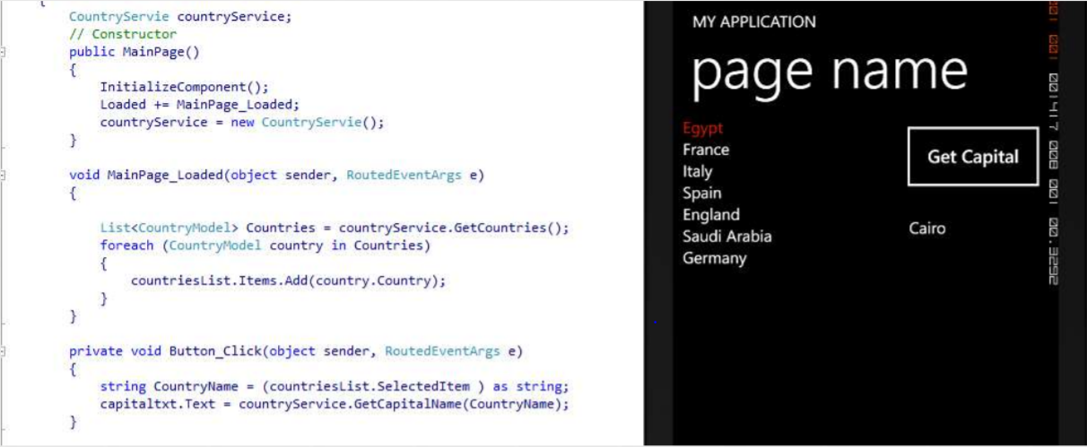
Traditional UI Development
More work, more problems.

Slide 5
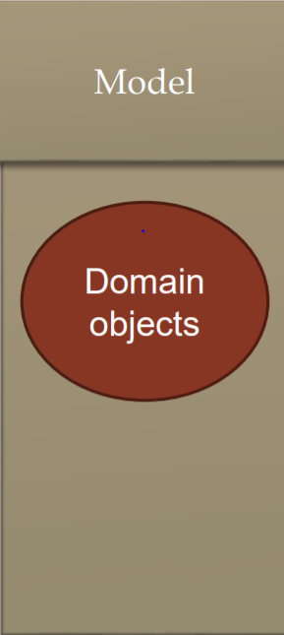
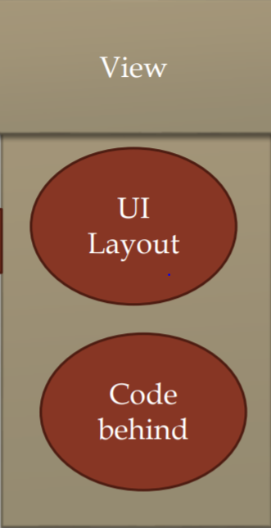
Traditional UI Development
Update and get data

Slide 6
Traditional UI Development
Constraints:
Difficult to test .
Encourages using UI as data storage
Complex classes and a huge mount of code.
No code sharing.
Very strong dependency between UI & Logic.
Redesign UI.

Slide 7
What is MVVM?
The Model View ViewModel.
Introduced by Microsoft in 2006.
Not a design pattern it is an architectural pattern.
It is a specialization of the presentation model pattern.
VIEW
ViewModel
(State and Operation)
Model

Slide 8
What is MVVM?
Components to be swapped
Internal implementation to be changed without affecting the others
Components to be worked on independently
Isolated unit testing
VIEW
Send Notifications
Data Binding and Commands
ViewModel
(State and Operation)
Model
ViewModel updates the Model
Send Notifications

Slide 9
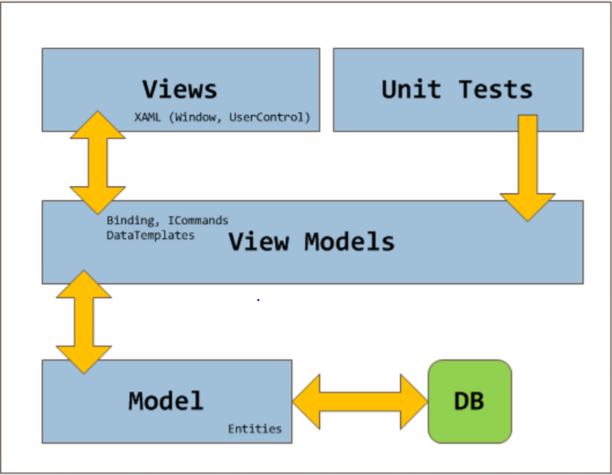
What is MVVM?

Slide 10
Model
Non-visual classes that encapsulate the application's data and business logic.
Can’t See View Model or View.
Should not contain any use case–specific or user task–specific behavior or application logic.
Notifies other components of any state changes.
May provide data validation and error reporting

Slide 11
ViewModel
Non-visual class encapsulates the presentation logic required.
Can’t See View (no direct Reference).
Coordinates the view's interaction with the model.
May provide data validation and error reporting.
Notifies the view of any state changes.

Slide 12
View
Visual element defines the controls and their visual layout and styling.
Can see all others components.
Defines and handles UI visual behavior, such as animations or transitions.
Code behind may contain code that requires direct references to the specific UI controls.

Slide 13
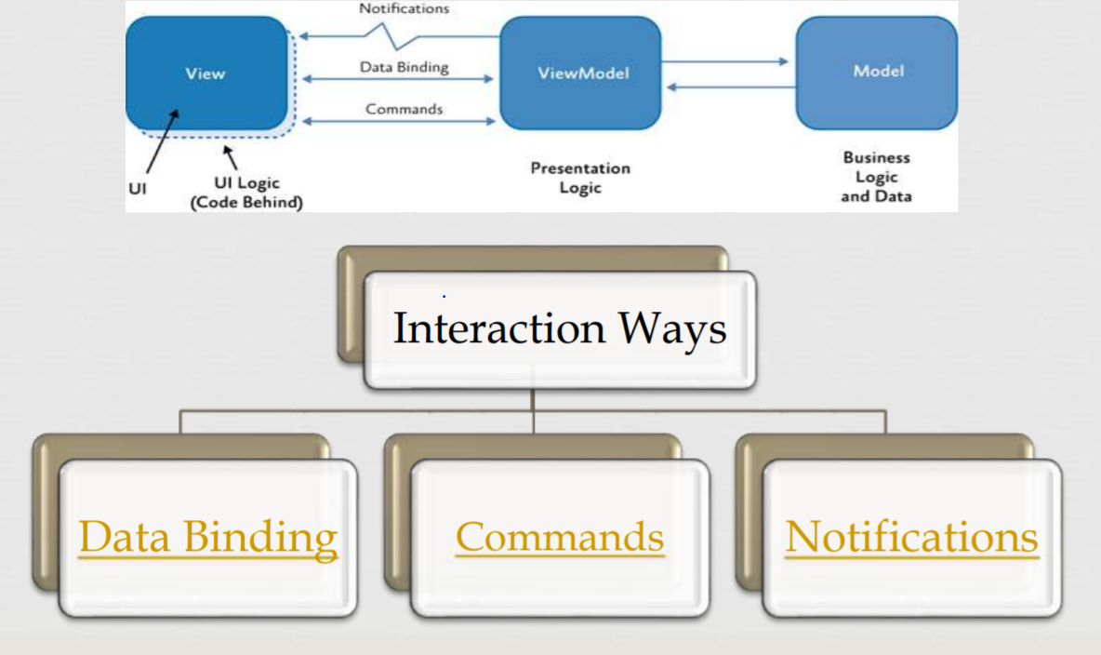
Classes interaction.

Slide 14
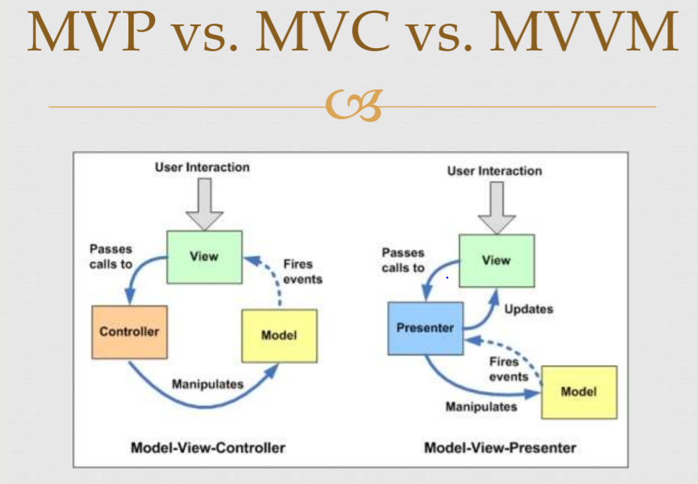
MVVM and other patterns.

Slide 15
MVVM and other patterns.
MVP (Presenter) | MVC (Controller) | MVVM (View Model)
View communicates with the presenter by directly calling functions on an instance of the presenter. | View sends input events to the controller via a callback or registered handler. | View binds directly to the View Model.
The presenter communicates with the view by talking to an interface implemented by the view . | View receives updates directly from the model without having to go through the controller. | Changes in view are automatically reflected in View Model and changes and vice versa.
Use where binding via a data context is not possible. | Use where the connection between view and the rest of the program is not always available. | Use where binding via a data context is possible.

Slide 16
MVVM Advantages
Separation of concerns.
Can use unit tests.
Designers and developers can work synchronously.
Easy to redesign the UI .
Can share code easily.

Slide 17
MVVM Disadvantages
Harder to debug.
May affect performance.
More files to serve the architecture.

Slide 18
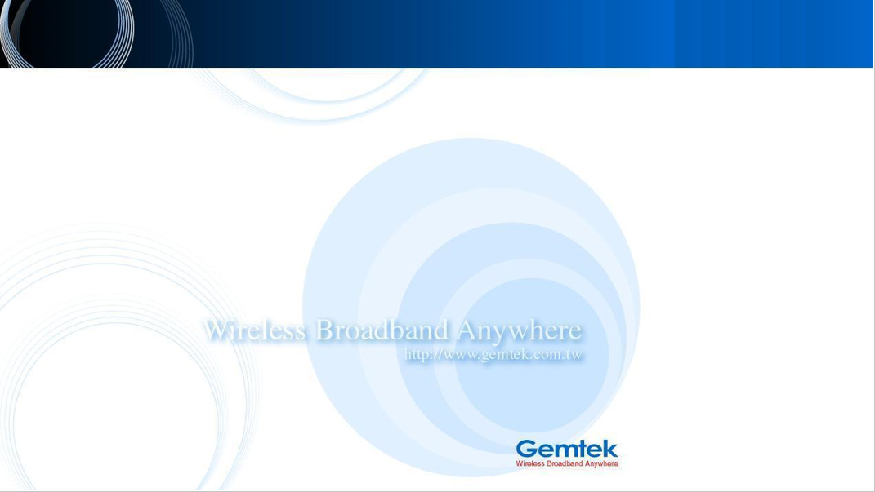
The End Thanks

