Slide 1
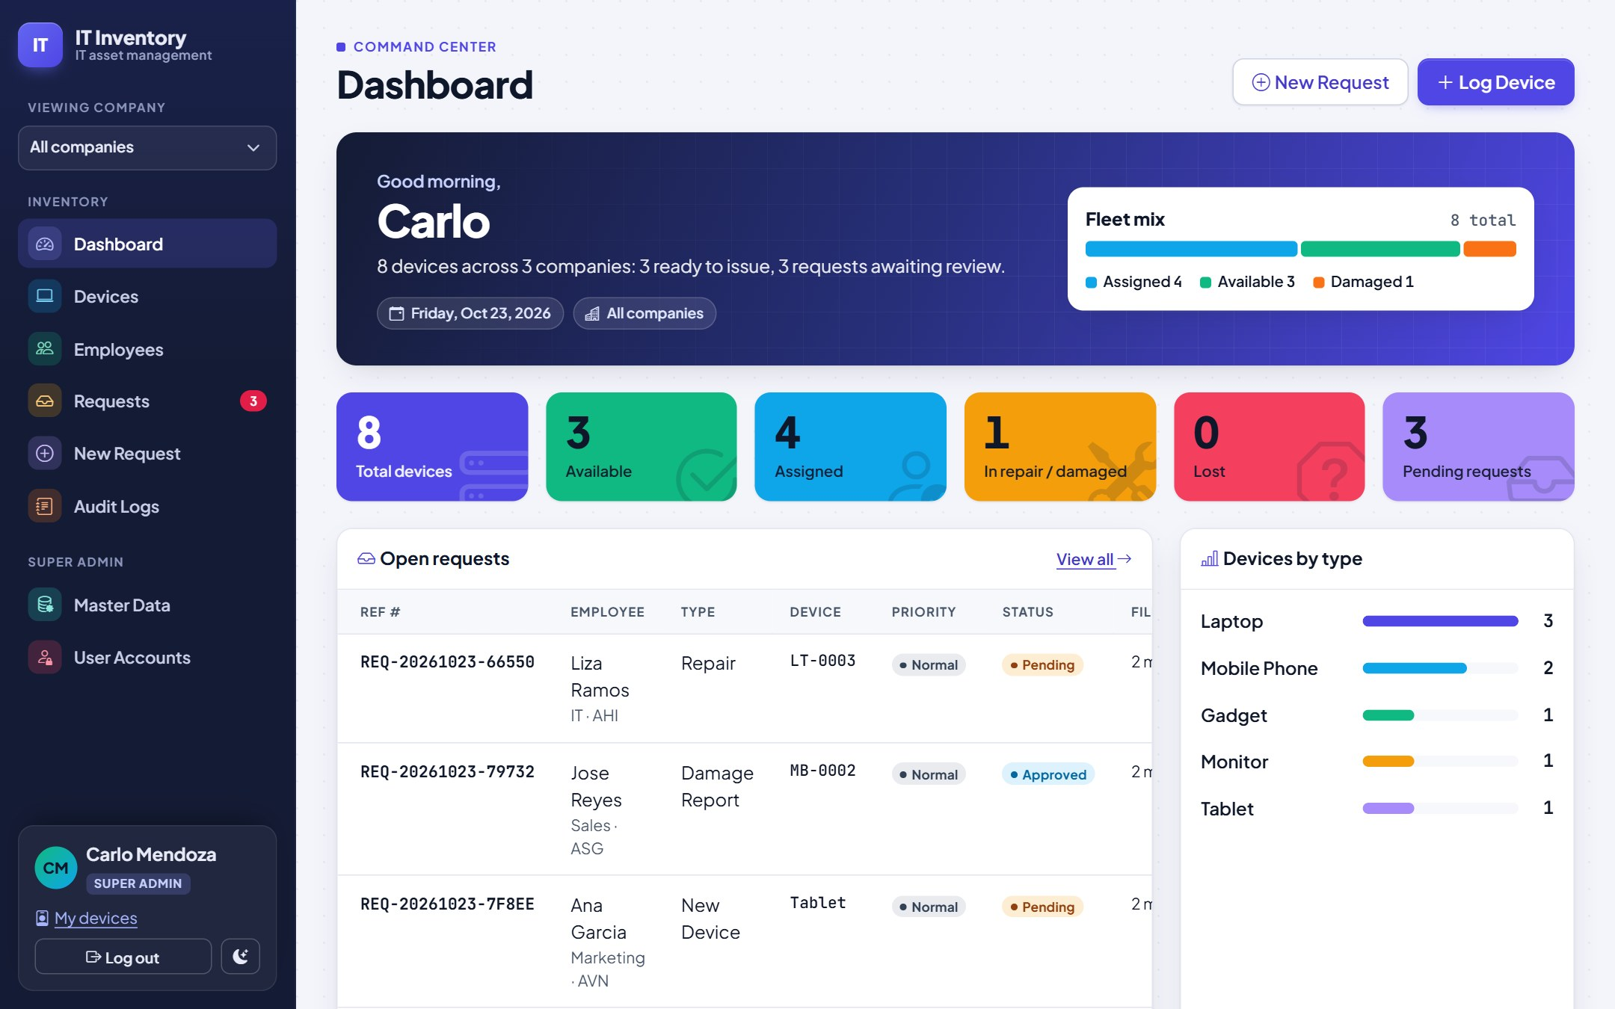
IT Inventory User Guide
IT ASSET MANAGEMENT
Track every device, employee and request across all your companies. For IT Support staff: Super Admin and Admin.
Version 1.0 · October 2026
Notes:
Welcome. This guide walks IT Support staff through the IT Inventory system: signing in, the dashboard, devices, employees, requests, the audit log and the Super Admin tools. Screens shown use demo data.

Slide 2






What this guide covers
01
02
03
Getting started
Devices
Employees
Signing in, the screen layout, the dashboard and switching companies
Logging devices, specs, PO files, assigning and returning
Employee records, the devices they hold and their history
04
05
06
Requests
Audit & administration
Tips & help
New devices, repairs, damage, lost and return reports
Audit log for everyone; master data and accounts for the Super Admin
Dark mode, phones and answers to common questions
Notes:
Six parts. Everything is for both roles except the master data and user account slides near the end of part 5, which are for the Super Admin.

Slide 3


Two roles, both IT Support
Super Admin
Admin
Head of IT / system owner
IT Support staff
Everything an Admin can do
Maintains master data: companies, device types and asset-tag prefixes, every dropdown list
Can type a brand-new dropdown value while filling a form
Creates and manages user accounts
Can process any request, including their own
Logs devices and employees
Assigns, returns and changes device status
Files requests for employees and processes them
Views and exports the audit log
Picks dropdown values from the lists only; cannot approve requests for their own devices
Employees do not sign in. IT Support files requests on their behalf.
Notes:
There are only two roles, and both are IT staff. The Super Admin owns the master data and accounts. Admins do the daily work. Employees never log in: when someone needs a device or reports a problem, IT files the request for them.

Slide 4

01 Getting started
Sign in, learn the layout, and choose which company you are looking at.

Slide 5
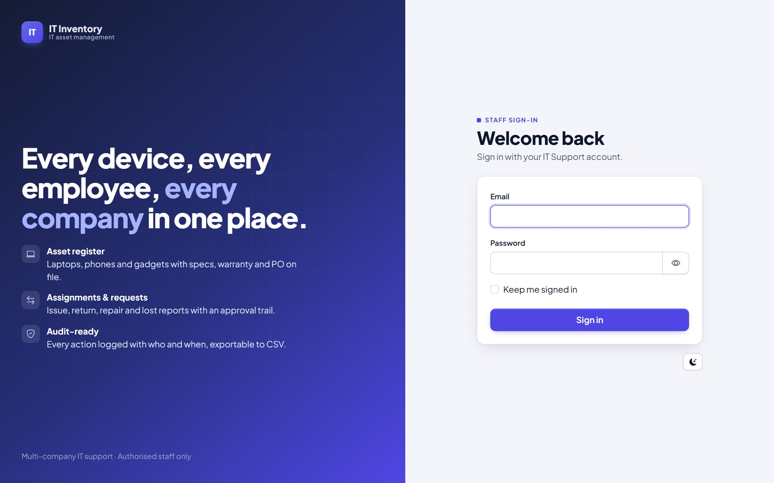
Signing in
1
Open the system
Use the address IT gave you (bookmark it).
2
Enter email and password
Use the eye icon to check what you typed. Tick "Keep me signed in" on your own computer only.
3
Forgot your password?
Ask the Super Admin to set a new one in User Accounts.
4
Light or dark
The moon/sun button switches the theme; the system remembers your choice.
Notes:
Sign in with your work email and the password the Super Admin gave you. Disabled accounts cannot sign in. Repeated wrong passwords are briefly blocked.

Slide 6
Finding your way around
1
Viewing company
3
Pick one company to filter every list and the dashboard, or "All companies".
1
2
Menu
Dashboard, Devices, Employees, Requests (red count = pending), New Request, Audit Logs. Super Admins also see Master Data and User Accounts.
2
3
Page header
Page name, the company badge when filtered, and the page's main buttons.
4
4
Your account
Your role, "My devices", Log out and the light/dark switch. Always at the bottom.
Notes:
Every page has the same frame: menu on the left, page title and main buttons at the top. On a phone the menu folds behind the button at the top right.

Slide 7
The dashboard
1
Summary
Devices in view, how many are ready to issue and requests waiting.
1
2
2
Fleet mix
Share of devices by status.
3
3
Status tiles
Click a tile to open the matching filtered list.
4
5
4
Open requests
Pending and approved requests; click one to act on it.
5
Devices by type
Scroll down for warranties ending soon and the per-company table.
Notes:
Start each day here. The tiles are shortcuts: clicking "Available" opens the device list filtered to available devices.

Slide 8
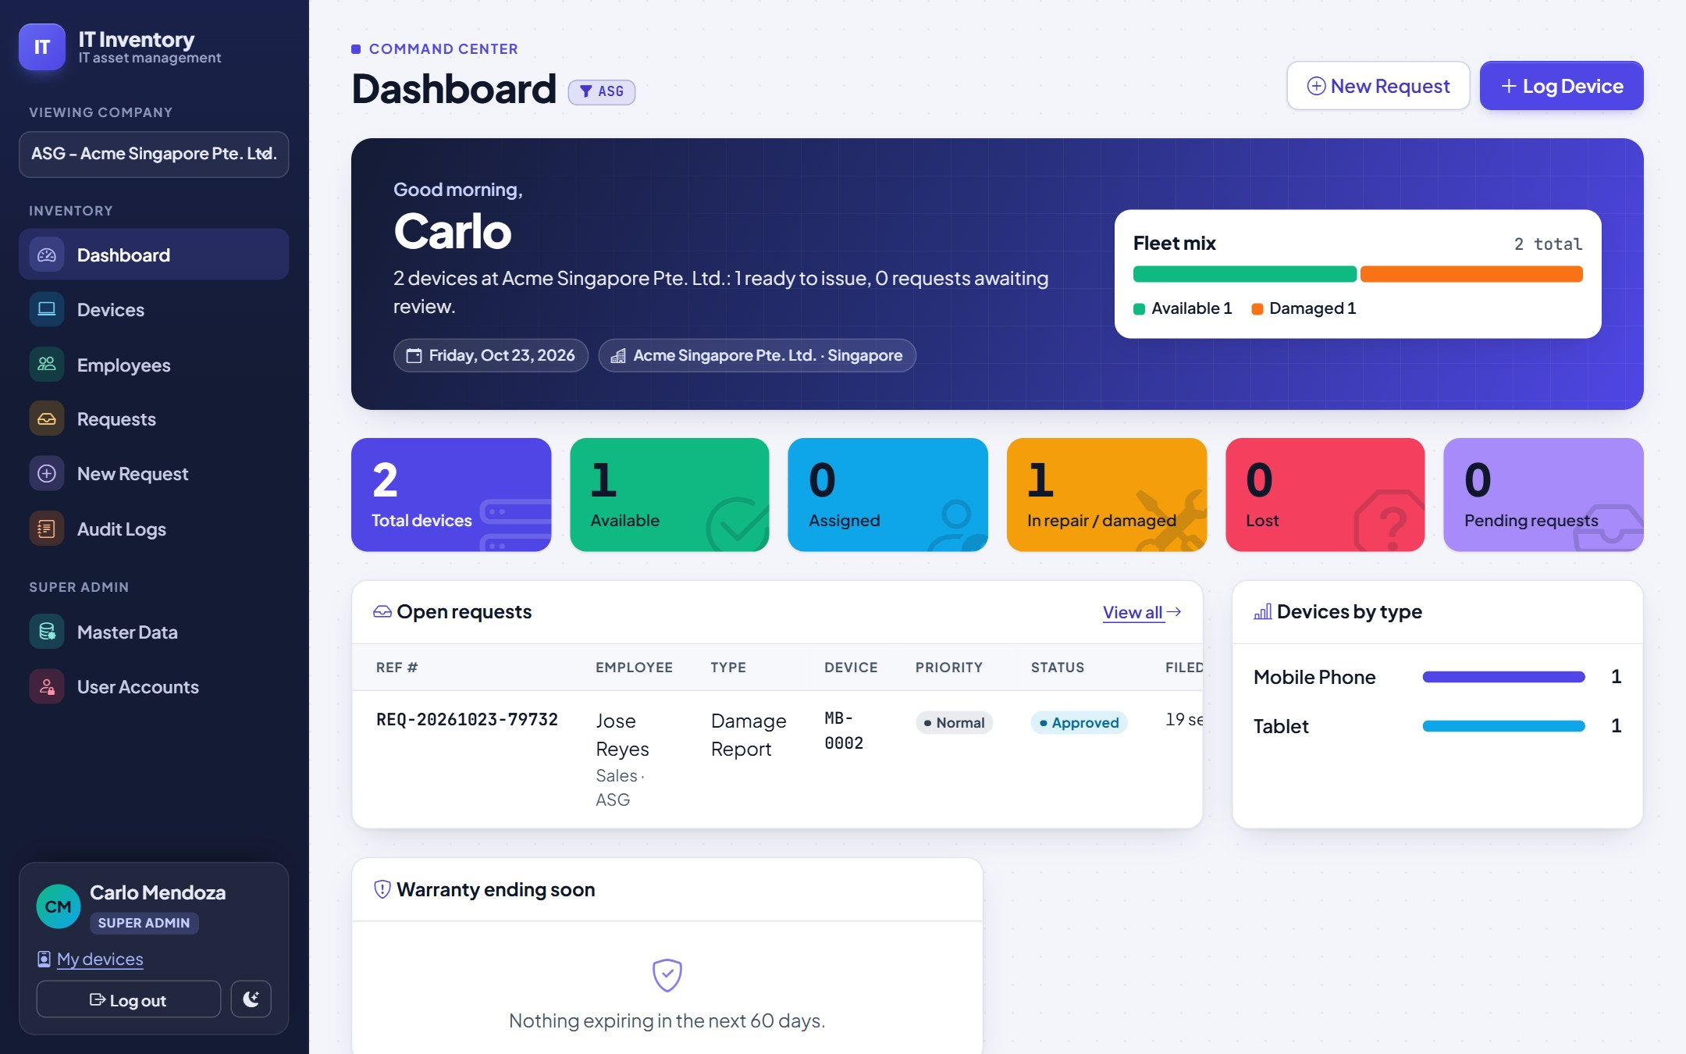
Working with several companies
HOW IT WORKS
Choose a company in "Viewing company"; the dashboard, lists and audit log show only that company
A badge with the company code appears next to every page title while filtered
New devices and employees default to that company
Choose "All companies" to see the By company summary
A device can be lent to someone in another company; the system records it as a loan
Notes:
The company filter only changes what you see, not what you are allowed to do. Device pages and forms still work across companies so you can lend equipment.

Slide 9

02 Devices
Log equipment, keep specs and the purchase order on file, and hand devices out.

Slide 10
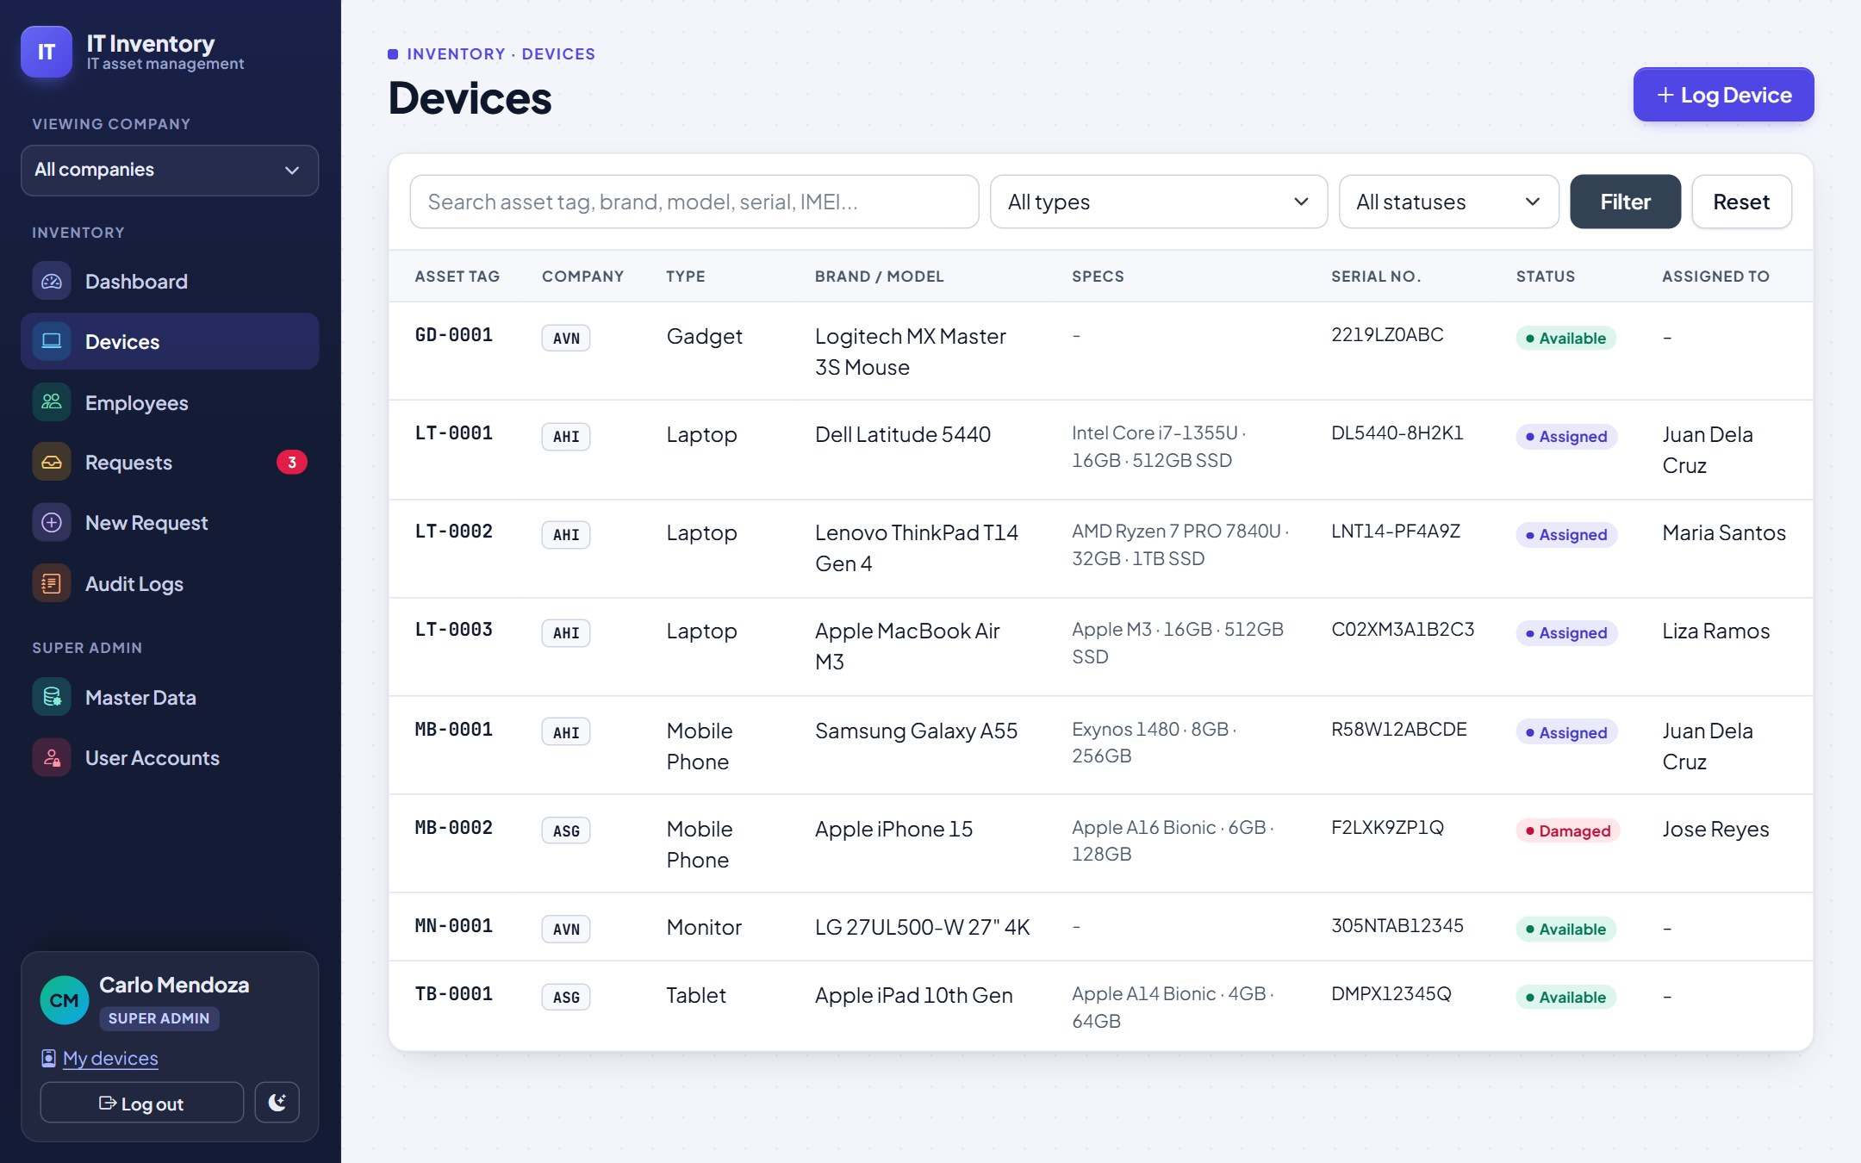
The device list
FIND A DEVICE
Search by asset tag, brand, model, serial number or IMEI
Filter by type and status, then Filter
Click any row to open the device
STATUSES
Available
in stock, ready to issue
Assigned
with an employee
In repair
sent for repair
Damaged
needs a decision
Lost
reported lost
Retired
out of service
Notes:
Asset tags are unique labels generated by the system, for example LT-0001 for the first laptop. Stick the tag on the device.

Slide 11
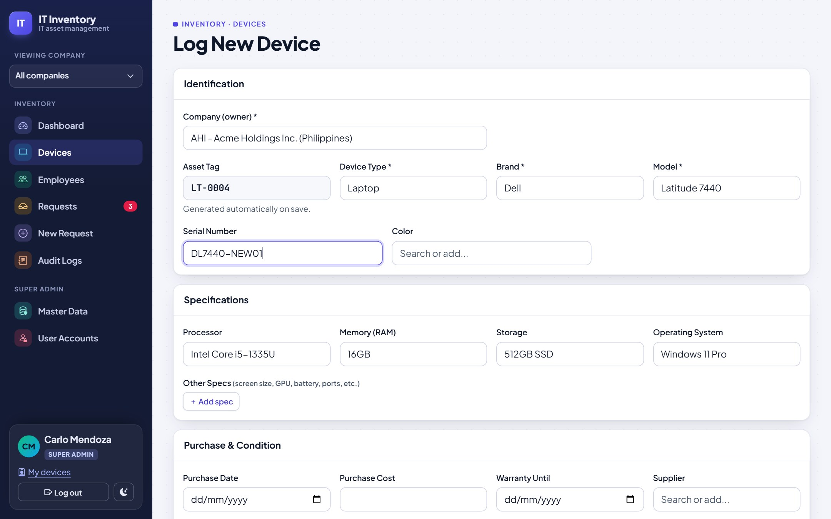
Logging a new device
1
Company
Which company owns (paid for) the device.
1
2
Type: tag is automatic
2
3
Choosing the type creates the asset tag, e.g. LT-0004, and shows the right spec fields.
3
Brand, then model
4
The model list only shows that brand's models.
4
Specs and purchase
Processor, memory, storage, OS, extra specs, warranty, supplier and the PO file. Then Save Device.
Notes:
Only the fields that make sense for the type are shown; a monitor has no processor field. Required fields are marked with an asterisk.

Slide 12
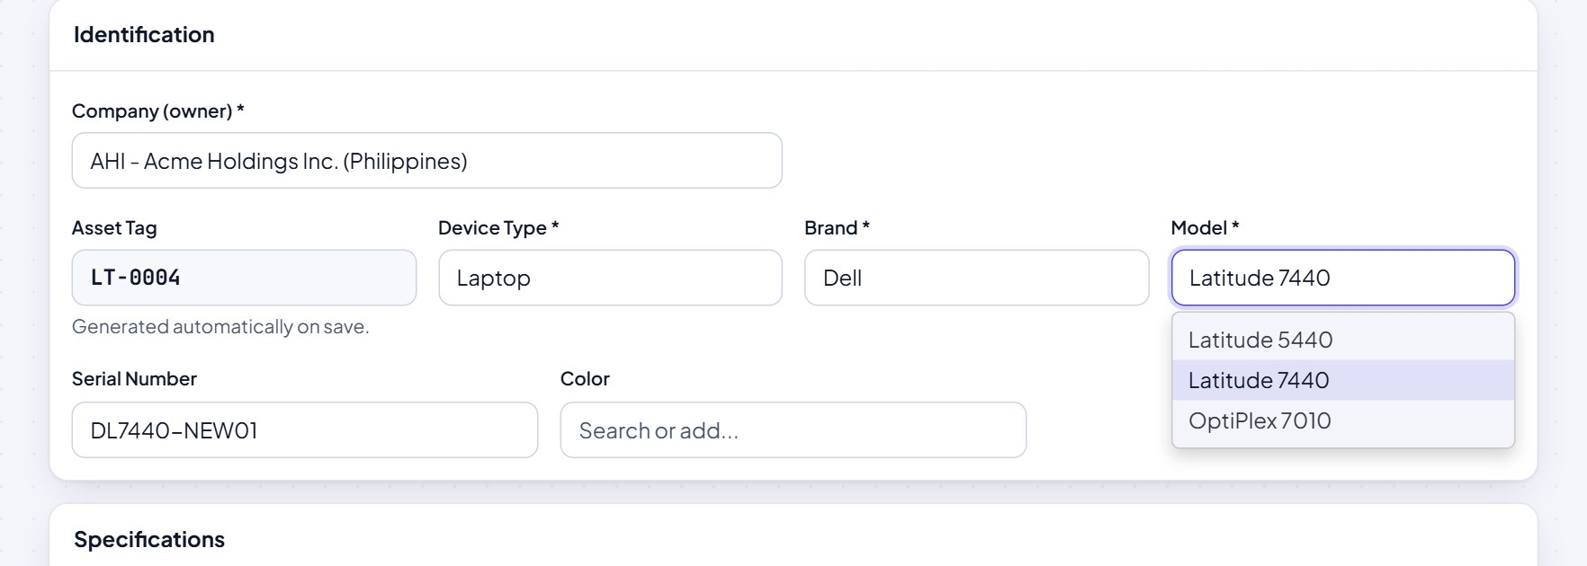
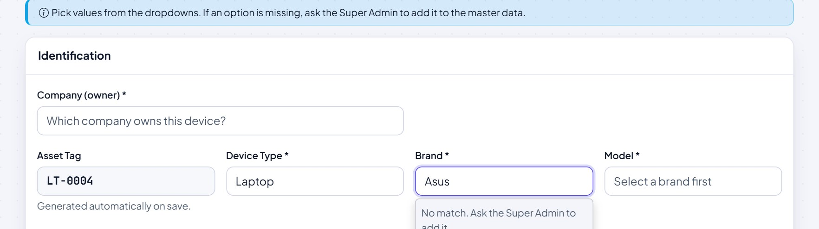
Searchable dropdowns
Type a few letters to filter the options, then pick one.
Admins: if a value is missing, ask the Super Admin to add it to the master data.
Super Admins can type a new value; it becomes an option for everyone when the form is saved. This keeps names consistent (no "Dell" vs "DELL" vs "Dell Inc.").
Notes:
Brands, models, processors, memory, storage, operating systems, colors, suppliers, departments and positions all come from shared lists.

Slide 13
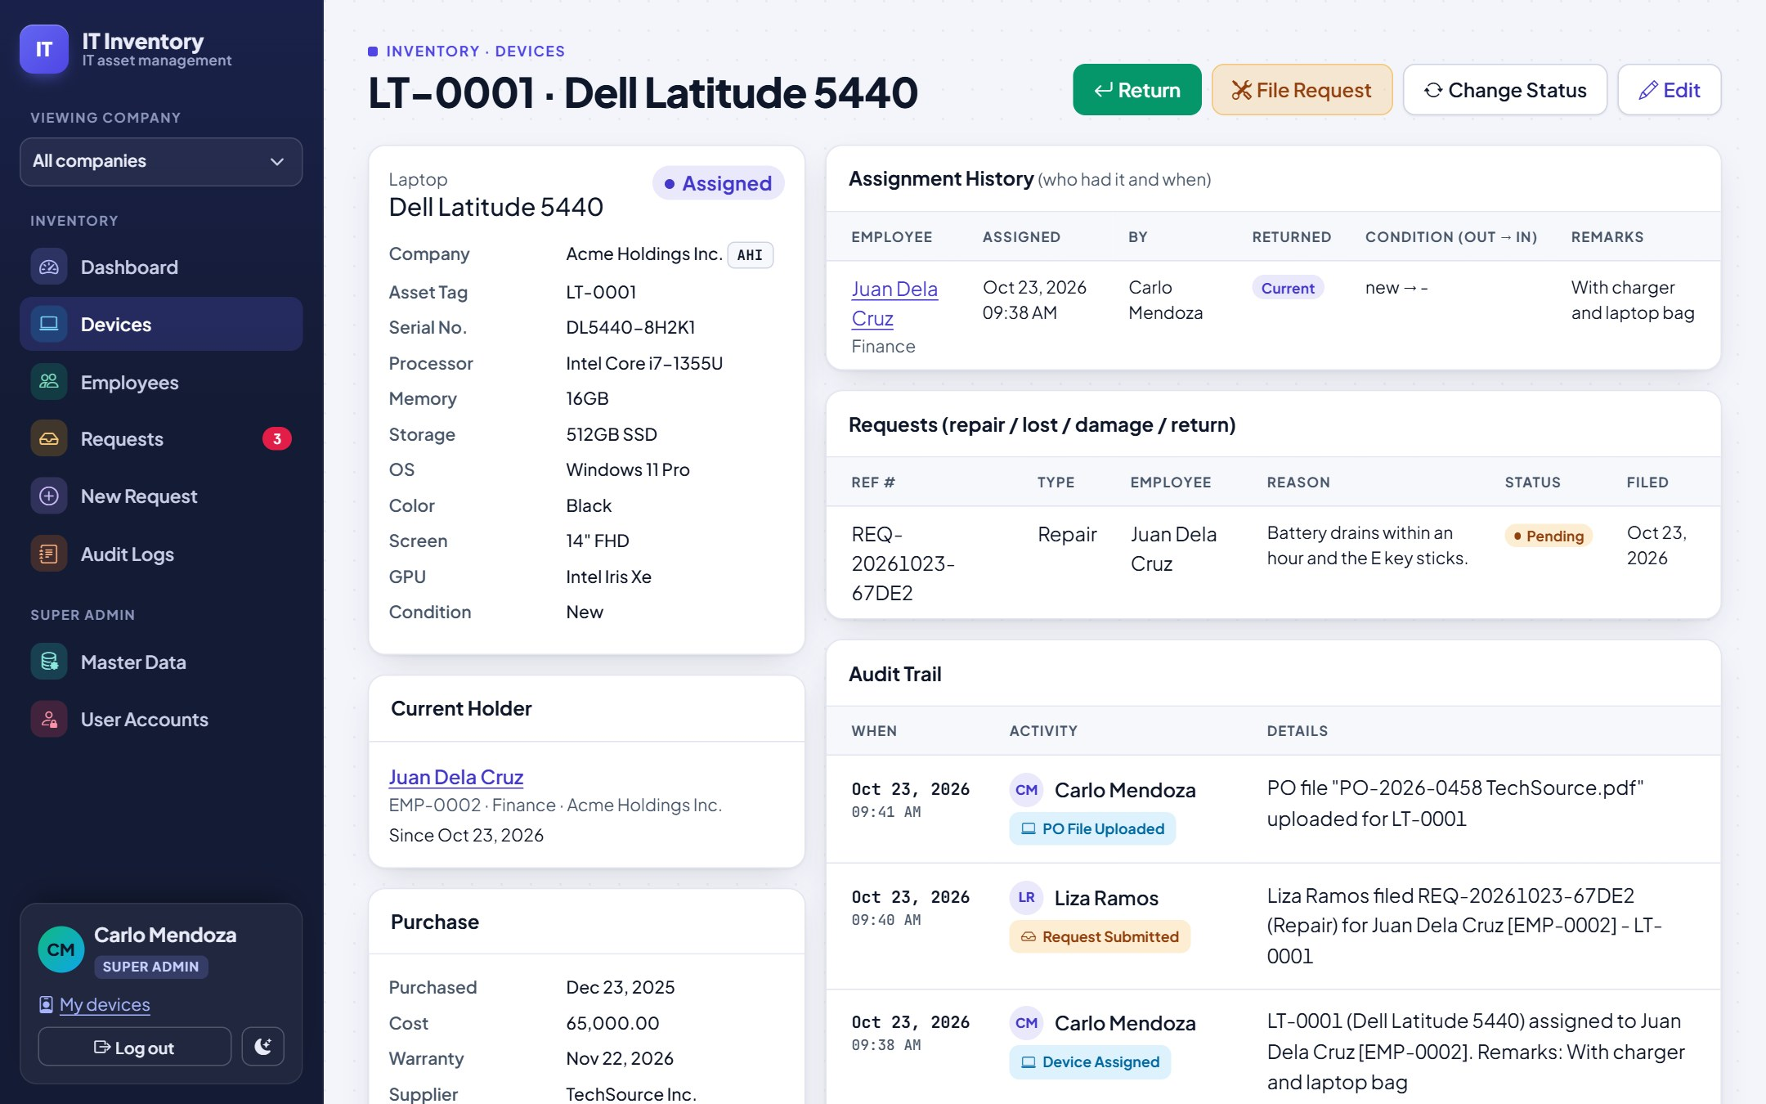
The device page
1
Actions
1
Return, File Request, Change Status, Edit (Assign appears when in stock).
3
2
2
Details
Company, tag, serial, specs; below: current holder, purchase info and PO file.
3
Assignment history
4
Who had it, when, who issued it, condition out and in.
4
Requests and audit trail
Every request and every change, with who and when.
Notes:
Click the PO file name in the Purchase box to open the purchase order. To replace or remove it, use Edit.

Slide 14
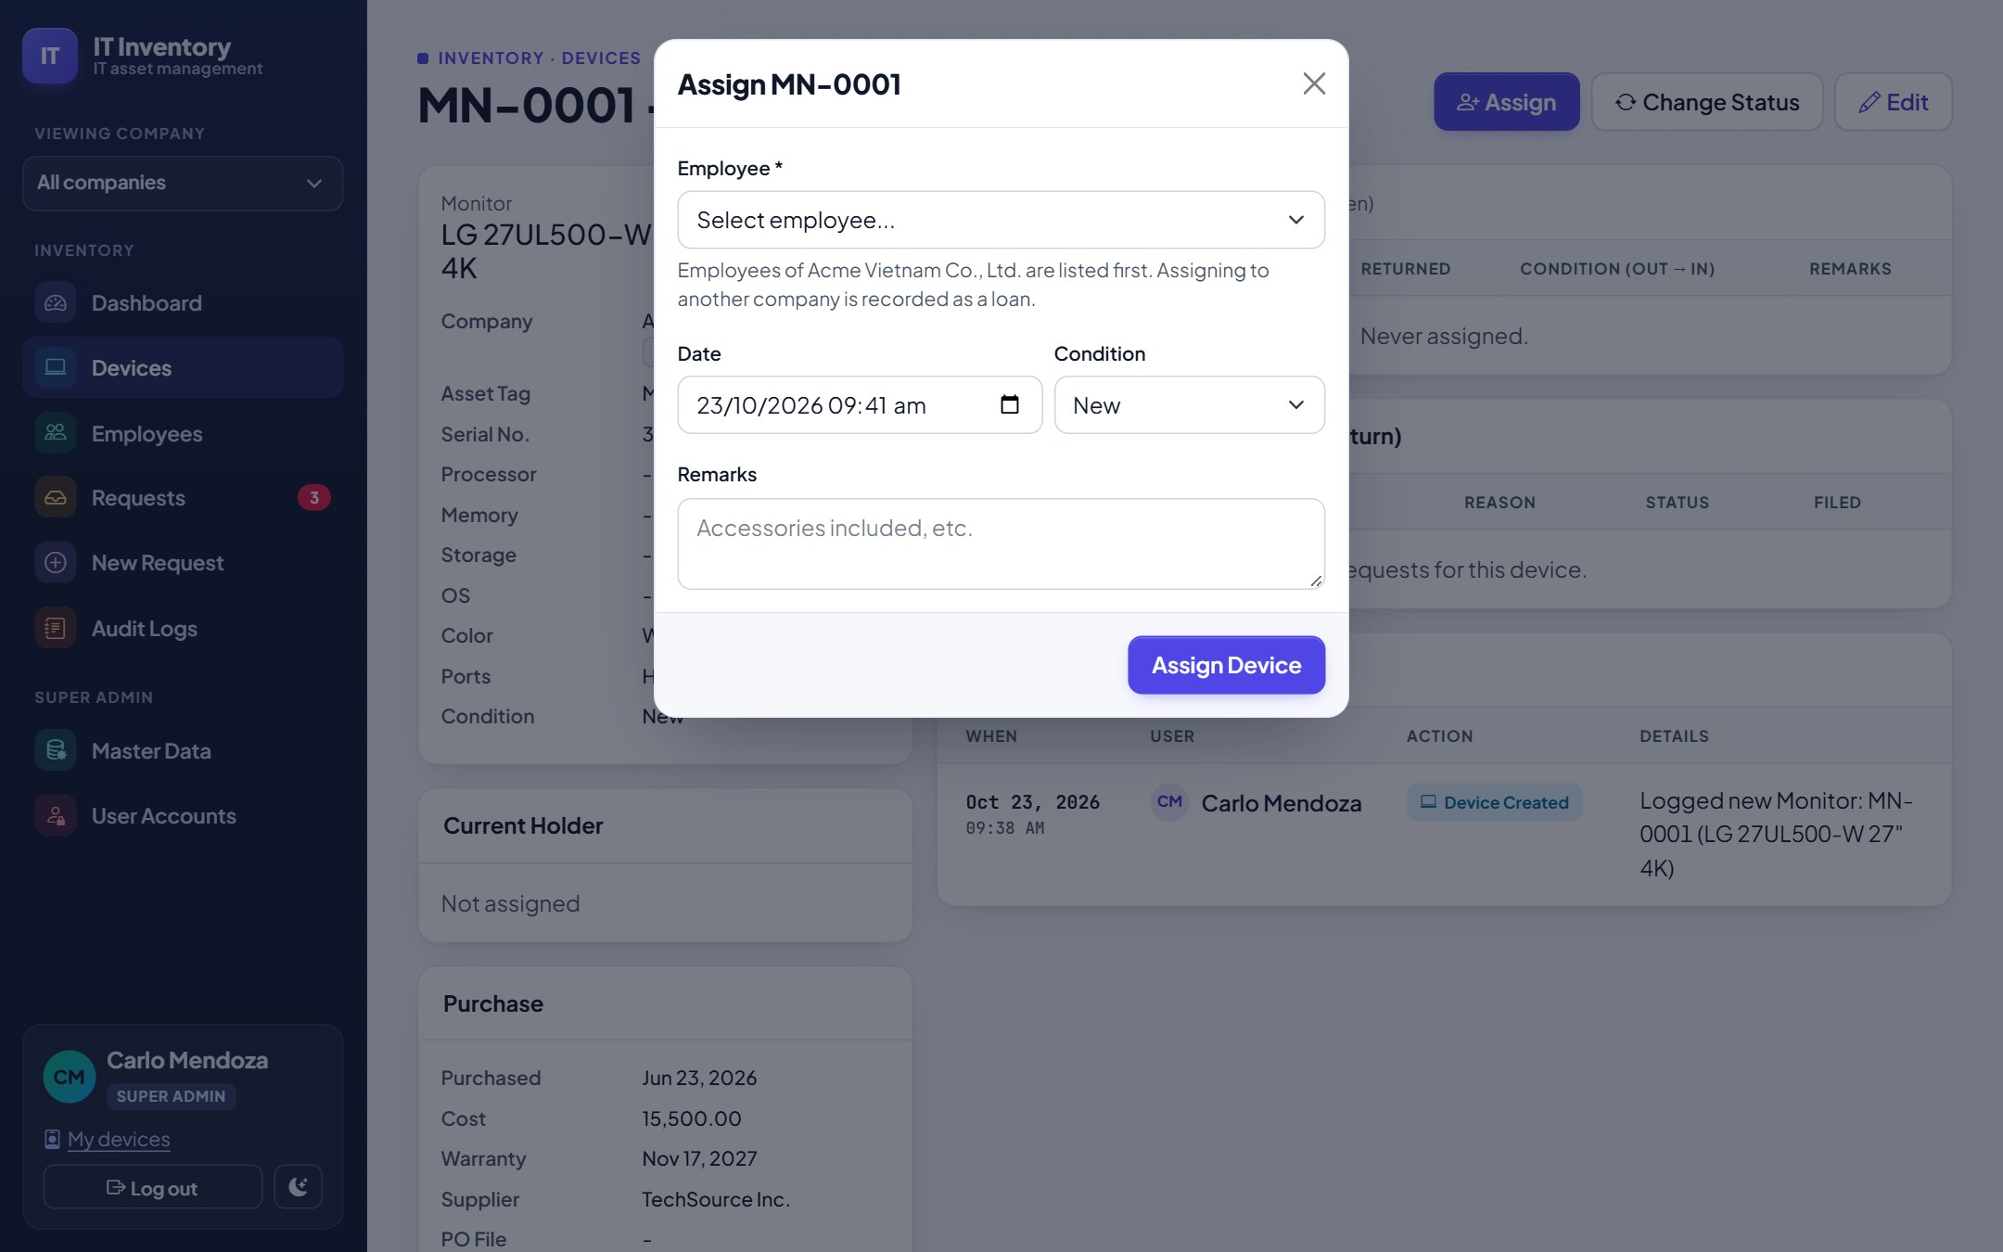
Assign, return and change status
Button | Use it when | Result
Assign | Handing an in-stock device to someone | Assigned; history row opened
Return | The device comes back | History closed; choose stock, repair, damaged, lost or retired
Change Status | Status changes but holder stays | e.g. Assigned to In repair
File Request | Repair, damage, lost or return needs approval | Opens the request form, pre-filled
Employees of the device's company are listed first. Choosing someone from another company records the hand-over as a loan.
Notes:
Use Assign and Return for quick, direct hand-overs. Use requests when something needs approval or an outcome, such as repairs and lost devices.

Slide 15

03 Employees
The people devices are issued to, in every company.

Slide 16
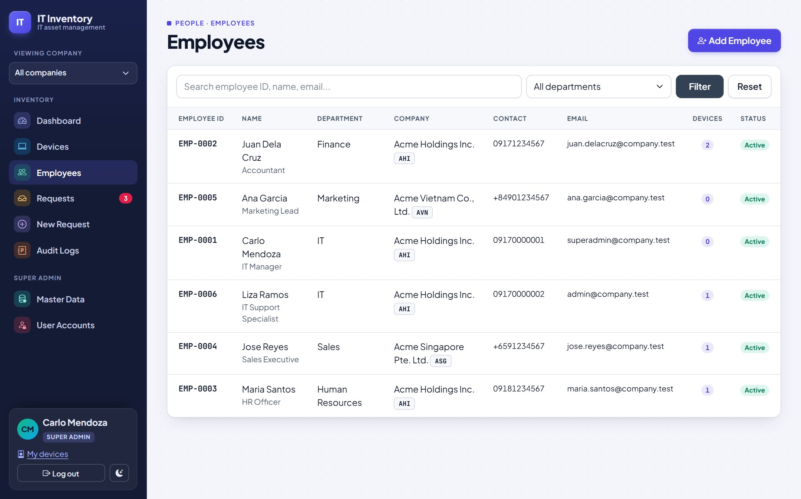
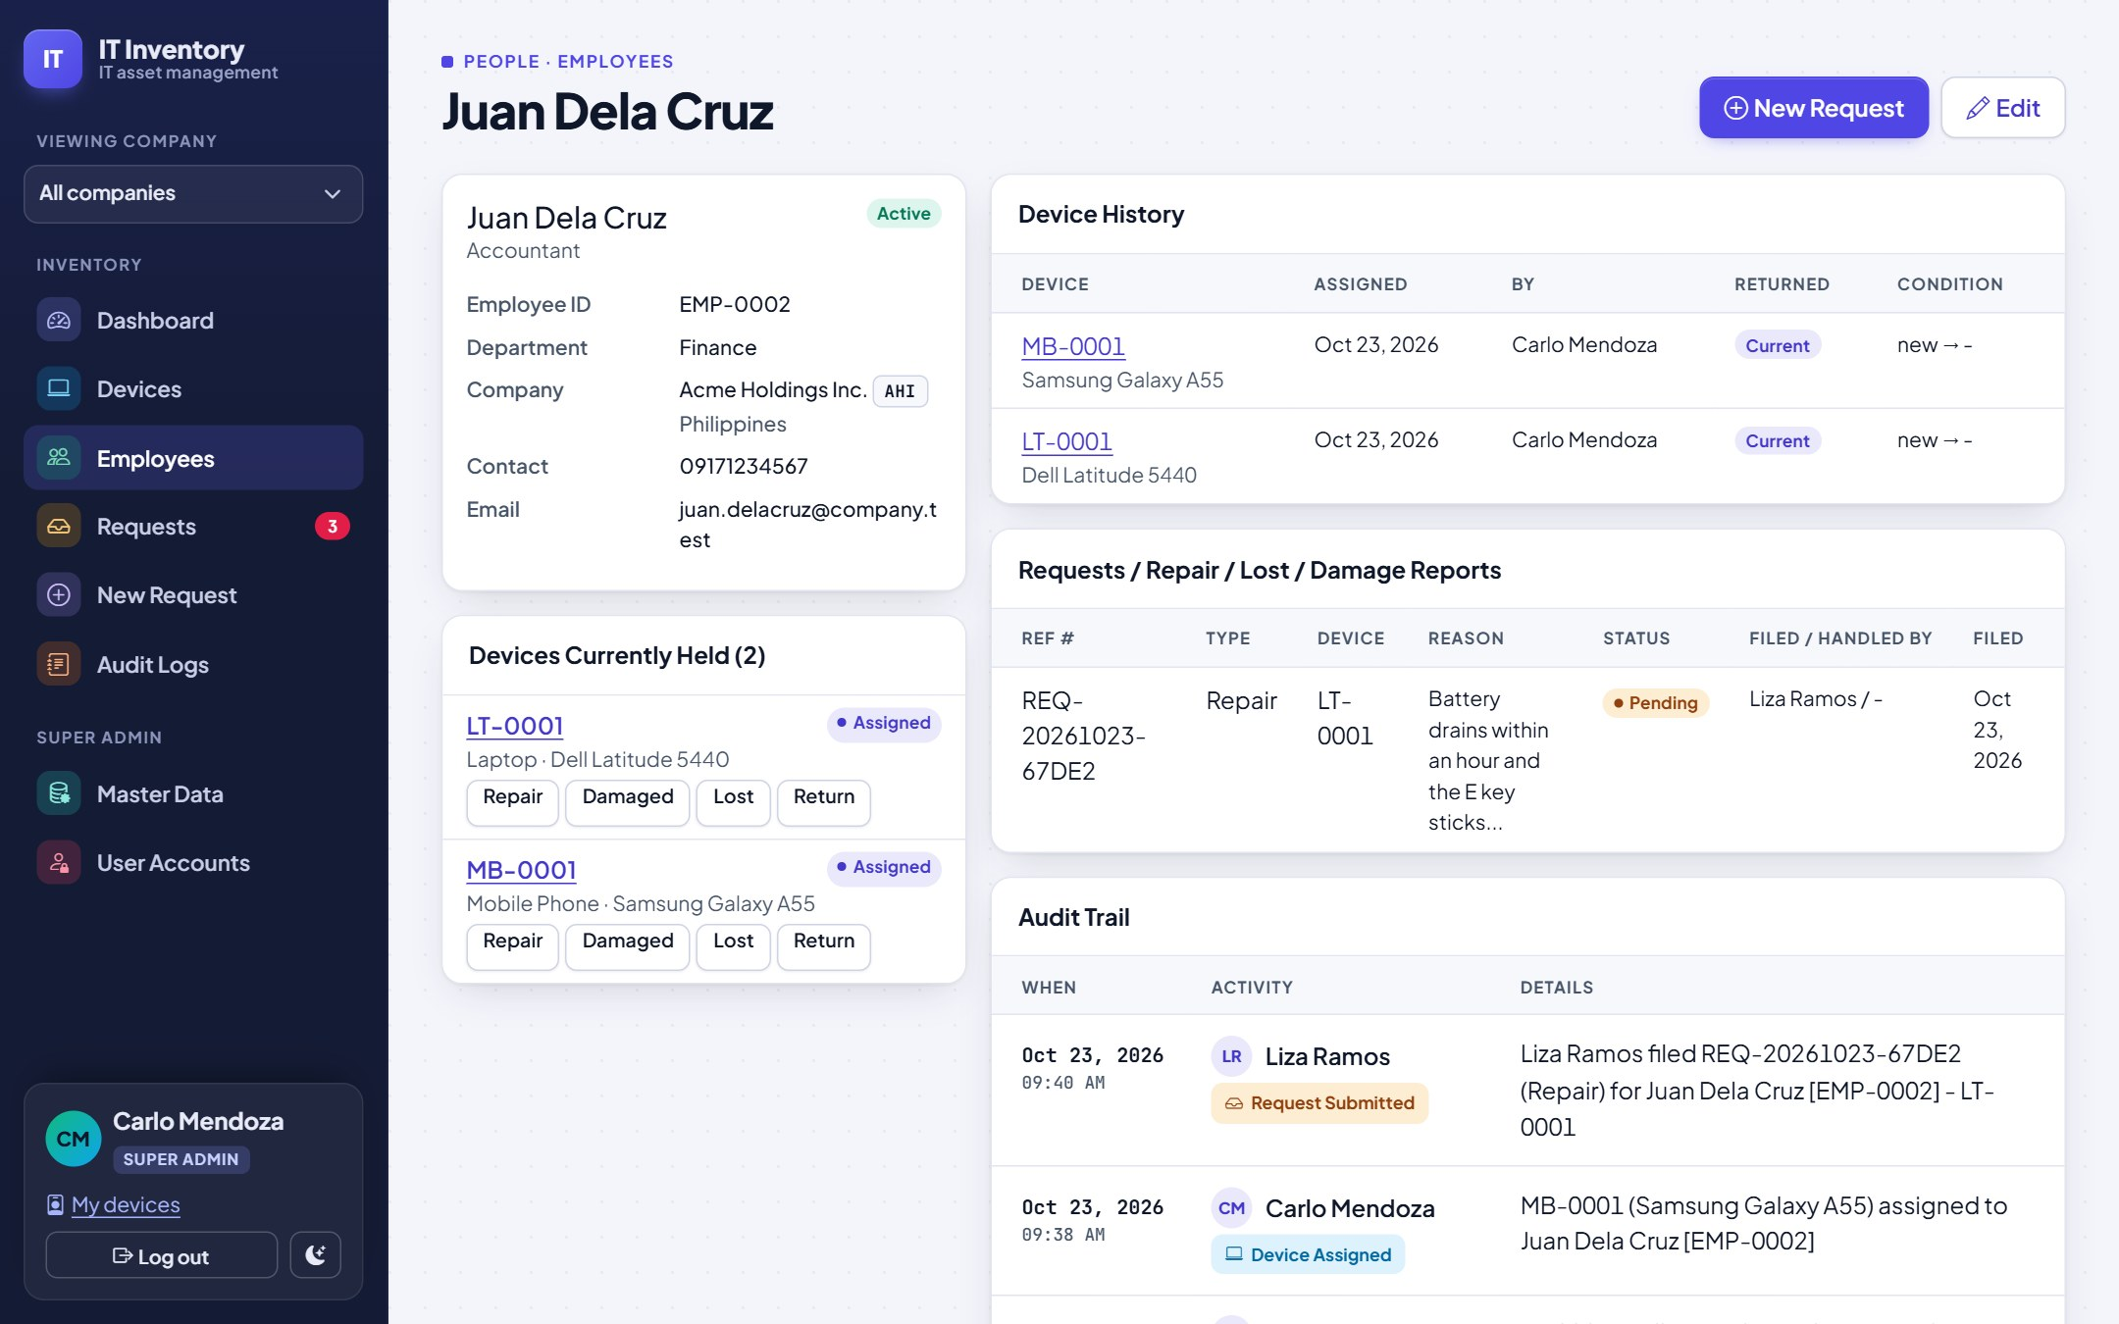
Employee list and profile
LIST
PROFILE
Search by ID, name or email; filter by department. "Add Employee" for new staff; department, company and position come from the lists.
Devices held with quick Repair / Damaged / Lost / Return buttons, device history, all requests and the audit trail. Deactivate leavers instead of deleting them.
Notes:
Employees are never deleted, so their history stays complete. Untick "Active employee" when someone leaves; they disappear from the dropdowns.

Slide 17

04 Requests
New devices, repairs, damage, lost and return reports, with an approval trail.

Slide 18
How a request moves
Pending
filed by an admin
Approved
by another admin
Completed
outcome applied
Rejected
reason required
Cancelled
while still pending
Type | On approve | On complete
New device | nothing yet | Pick an available device to assign
Repair | Device to In repair | Back to employee, stock, damaged or retired; optional replacement
Damage report | Device to Damaged | Same choices as repair
Lost report | Device to Lost; holder cleared | Stays lost, found (stock) or retired; optional replacement
Return | nothing yet | Device back to stock with its condition
One open request per device at a time.
Every step is stamped with who did it and when, and appears in the request's log and the audit log.
Notes:
Approval is the decision; completion is the physical outcome. For example, approve a repair when the laptop goes to the repair shop, complete it when it comes back.

Slide 19
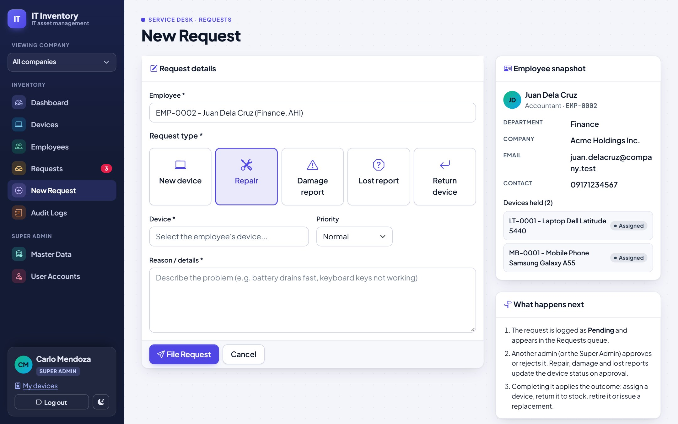
Filing a request
1
Employee
Search by name or ID.
4
1
2
Request type
New device, Repair, Damage, Lost or Return.
2
3
Device and details
Pick their device (or the type needed), priority, incident date for damage/lost, and the reason.
3
4
Employee snapshot
Their details and devices, to double-check before filing.
Notes:
Shortcut: on an employee's profile, the Repair, Damaged, Lost and Return buttons next to each device open this form already filled in.

Slide 20
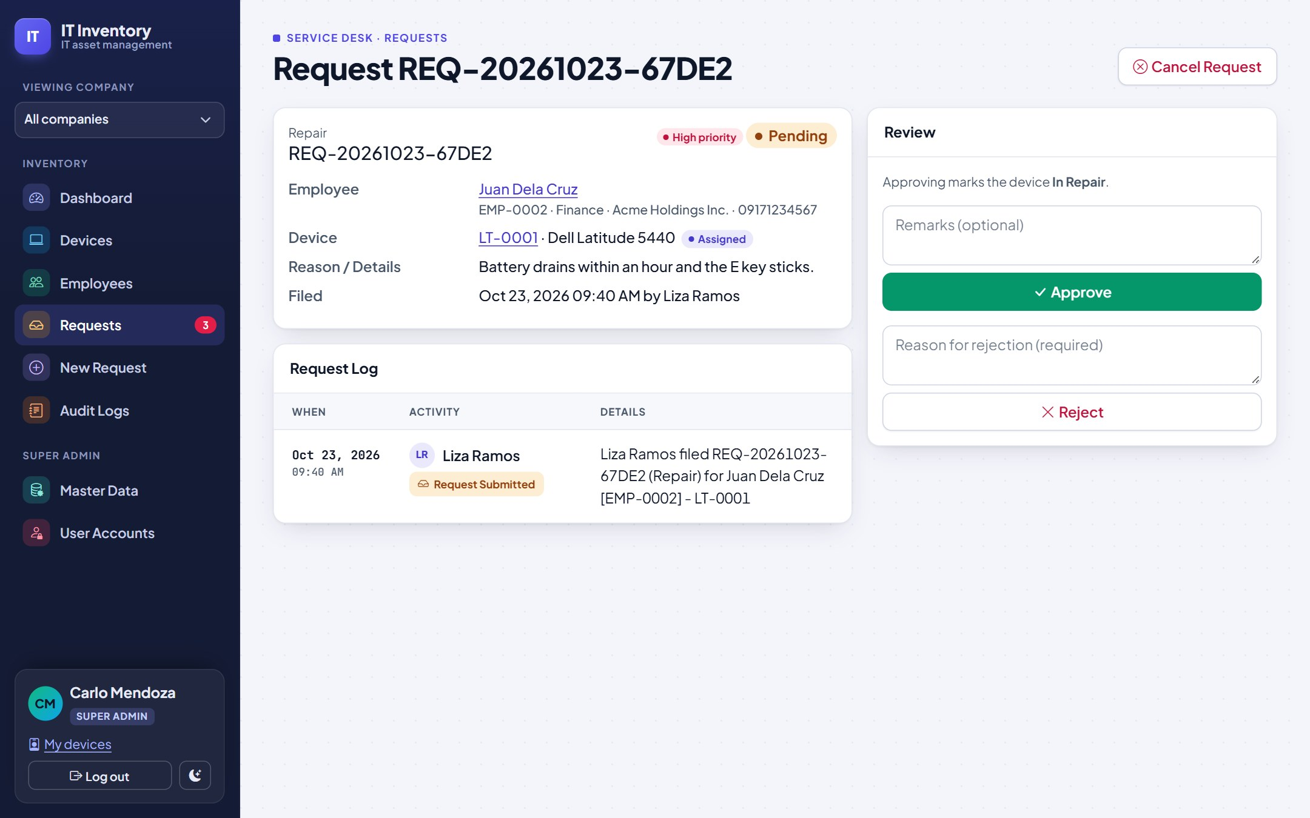
Reviewing: approve or reject
IN THE REVIEW PANEL
Approve, with optional remarks; repair, damage and lost reports update the device straight away
Reject, with the reason (required)
Cancel Request (top right) withdraws a pending request
High-priority requests sit at the top of the Requests list
Notes:
Open Requests from the menu. The list shows open requests by default; use the tabs for completed, rejected or all.

Slide 21
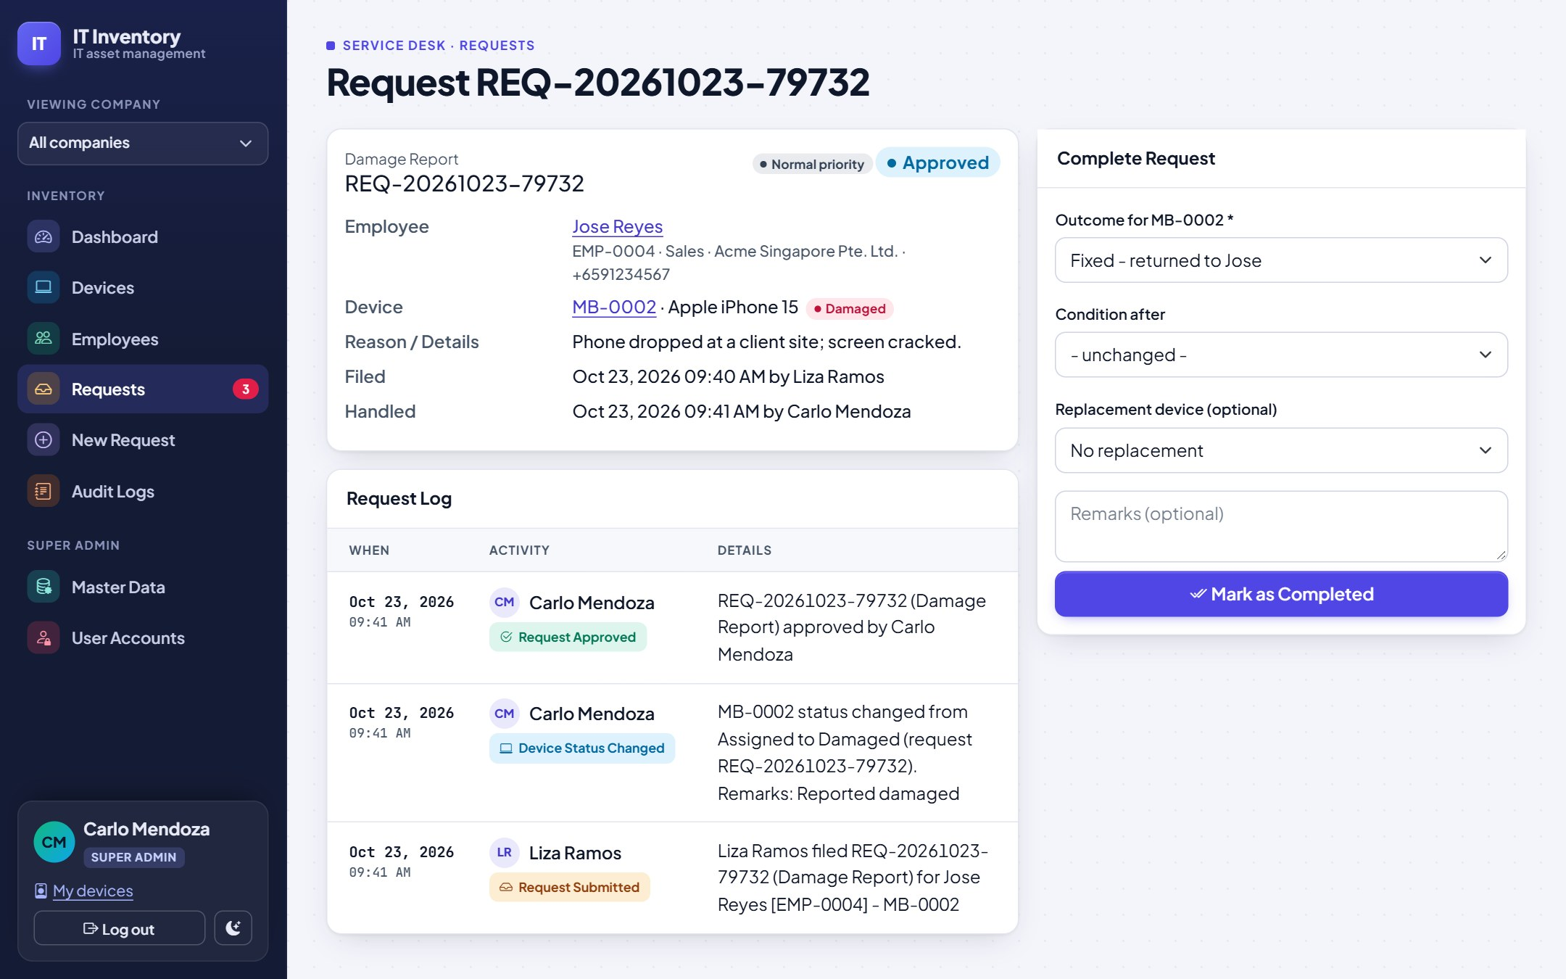
Completing a request
IN THE COMPLETE PANEL
Choose the outcome for the device (e.g. fixed and returned, back to stock, retire)
Record its condition
Optionally issue a replacement from available stock (the employee's company is listed first)
Mark as Completed; history and audit log update automatically
Notes:
For a new-device request the panel asks only for the device to assign. Matching types are listed first.

Slide 22
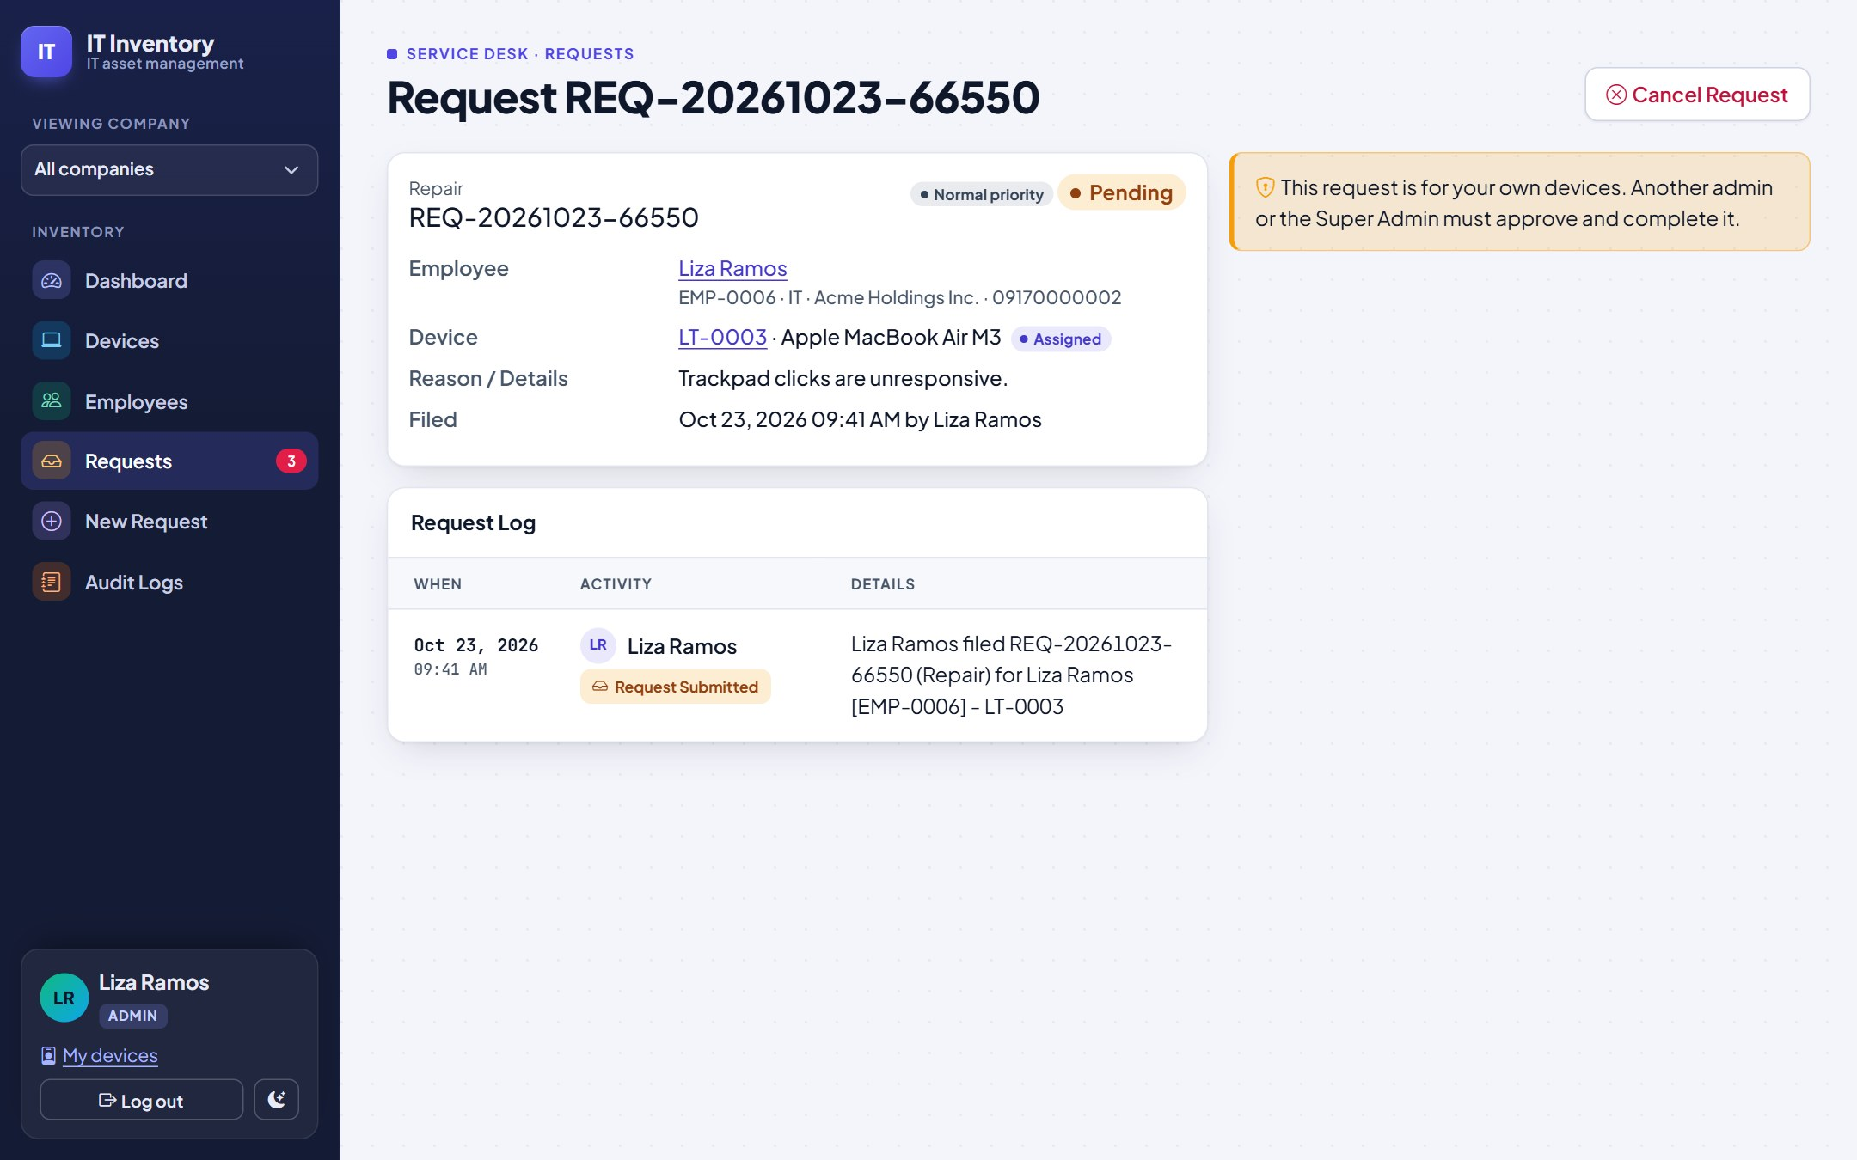

Requests for your own devices
Separation of duties
Admins can file requests for themselves, but cannot approve, reject or complete them
Another admin or the Super Admin must handle it
The approve buttons are hidden and the system refuses the action
Notes:
This keeps the audit trail trustworthy: nobody signs off their own new laptop.

Slide 23

05 Audit & administration
The audit log for everyone; master data and accounts for the Super Admin.

Slide 24
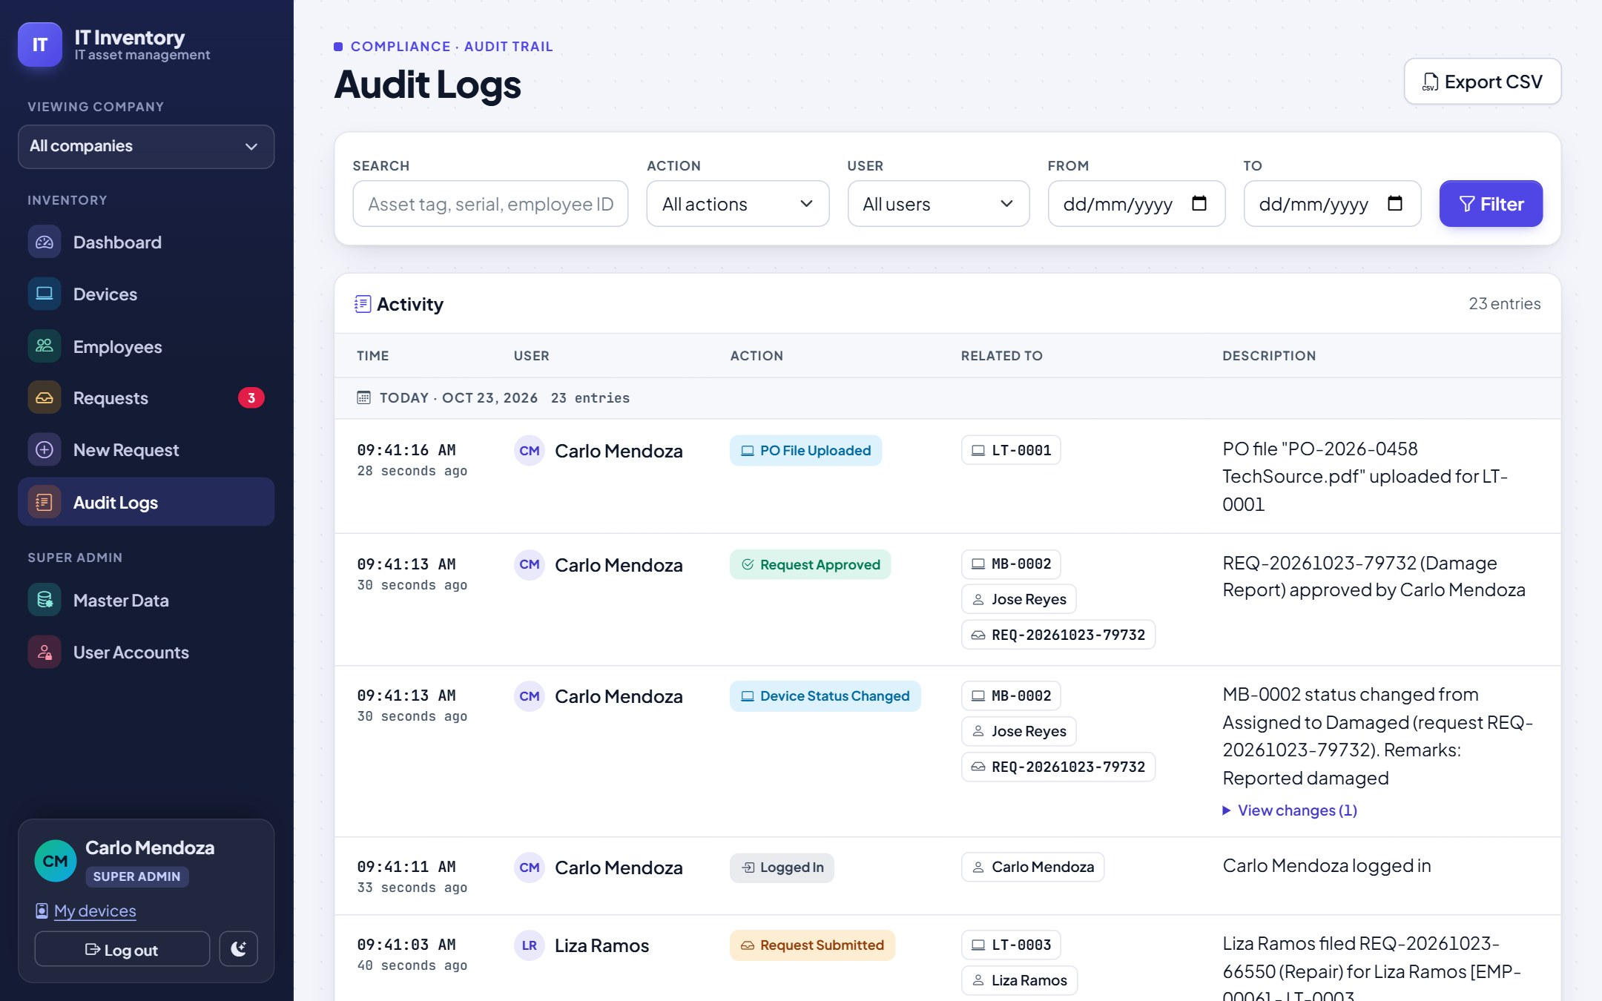
The audit log
1
Filters
4
Search text, action, user and a date range, then Filter. X clears them.
1
2
Grouped by day
Each entry: time, user and a colour-coded action.
2
3
Related to
Click the device, employee or request chip to open it. "View changes" shows old to new values.
3
4
Export CSV
Downloads exactly what the filters show, for audits and reports.
Notes:
Nothing in the log can be edited or deleted. It records sign-ins, device changes, hand-overs, requests, PO uploads and master data changes.

Slide 25
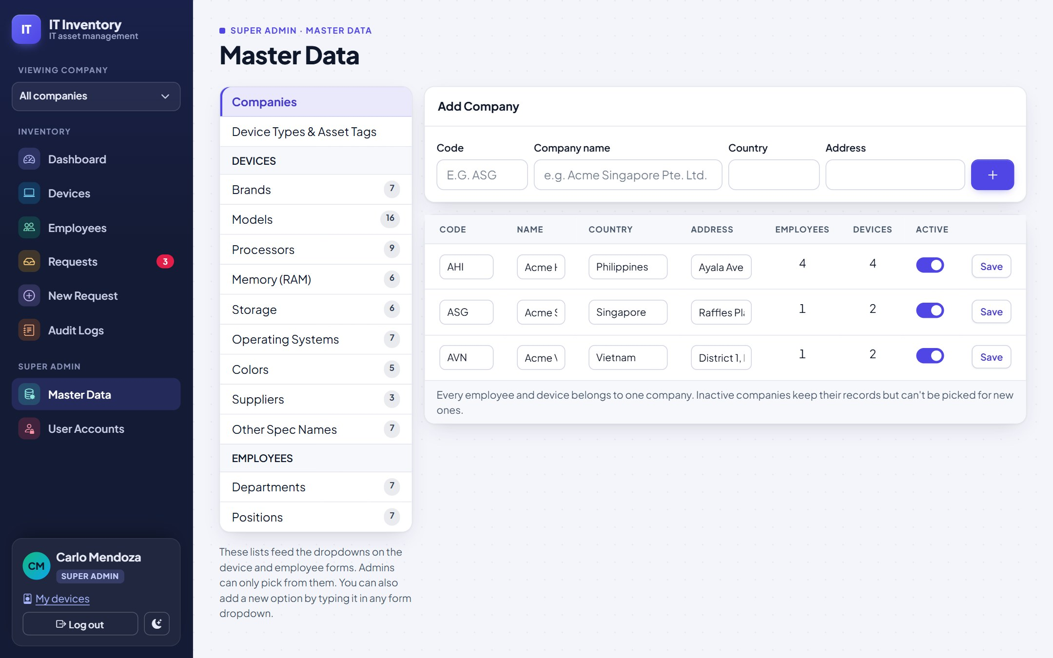
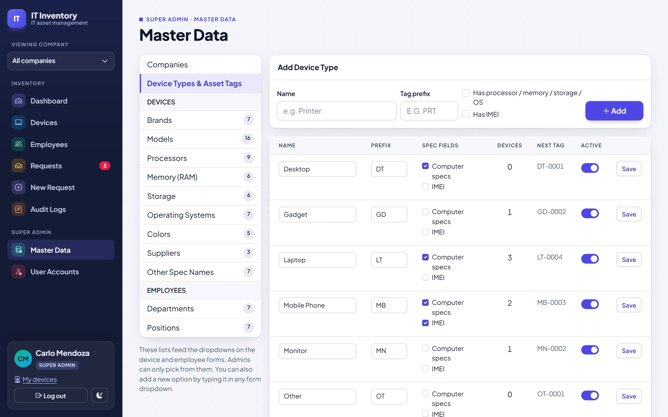
Master data: companies and device types
SUPER ADMIN
COMPANIES
DEVICE TYPES AND ASSET TAGS
Add each company of the group with a short code (AHI, ASG...), country and address. Deactivate instead of deleting.
Each type has a tag prefix (LT gives LT-0001...) and flags for computer specs and IMEI. A new prefix affects only new devices.
Notes:
Master Data is in the Super Admin part of the menu. Admins get "Access restricted" if they open it.

Slide 26
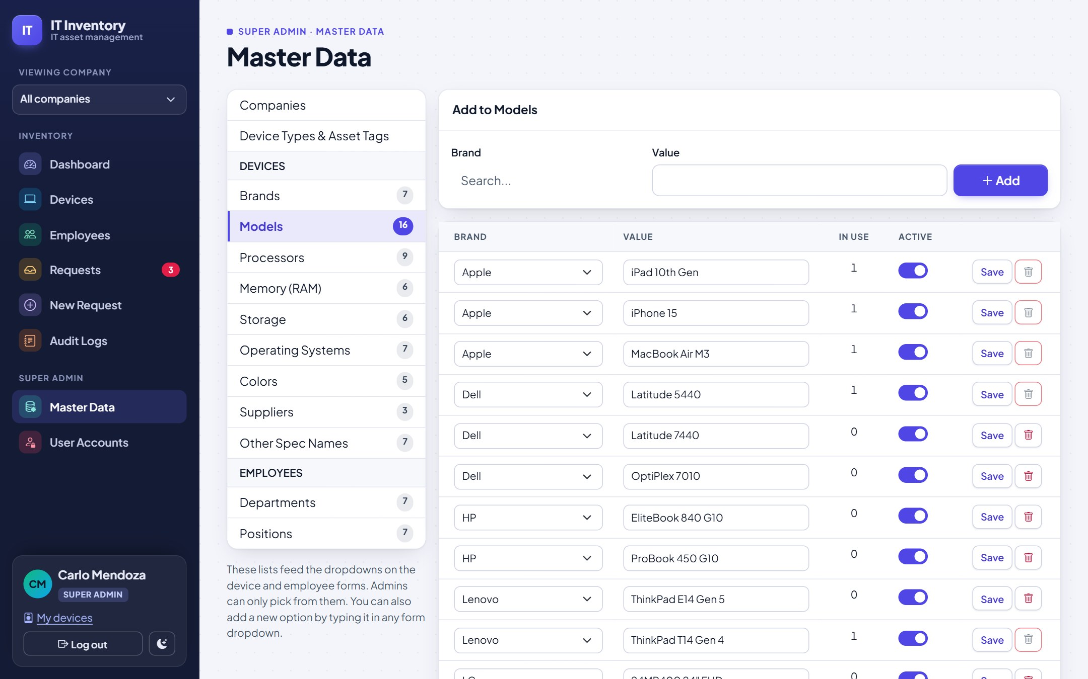
Master data: dropdown lists
SUPER ADMIN
Pick a list on the left: brands, models, processors, memory, storage, OS, colours, suppliers, spec names, departments, positions
Add: type the value (models also need their brand), then Add
Rename: edit and Save; every device or employee using it is updated
Deactivate: switch off to hide it from dropdowns; records keep it
Delete: only when "In use" is 0
Notes:
Keeping these lists tidy keeps reports clean. Deactivate old models rather than deleting them.

Slide 27
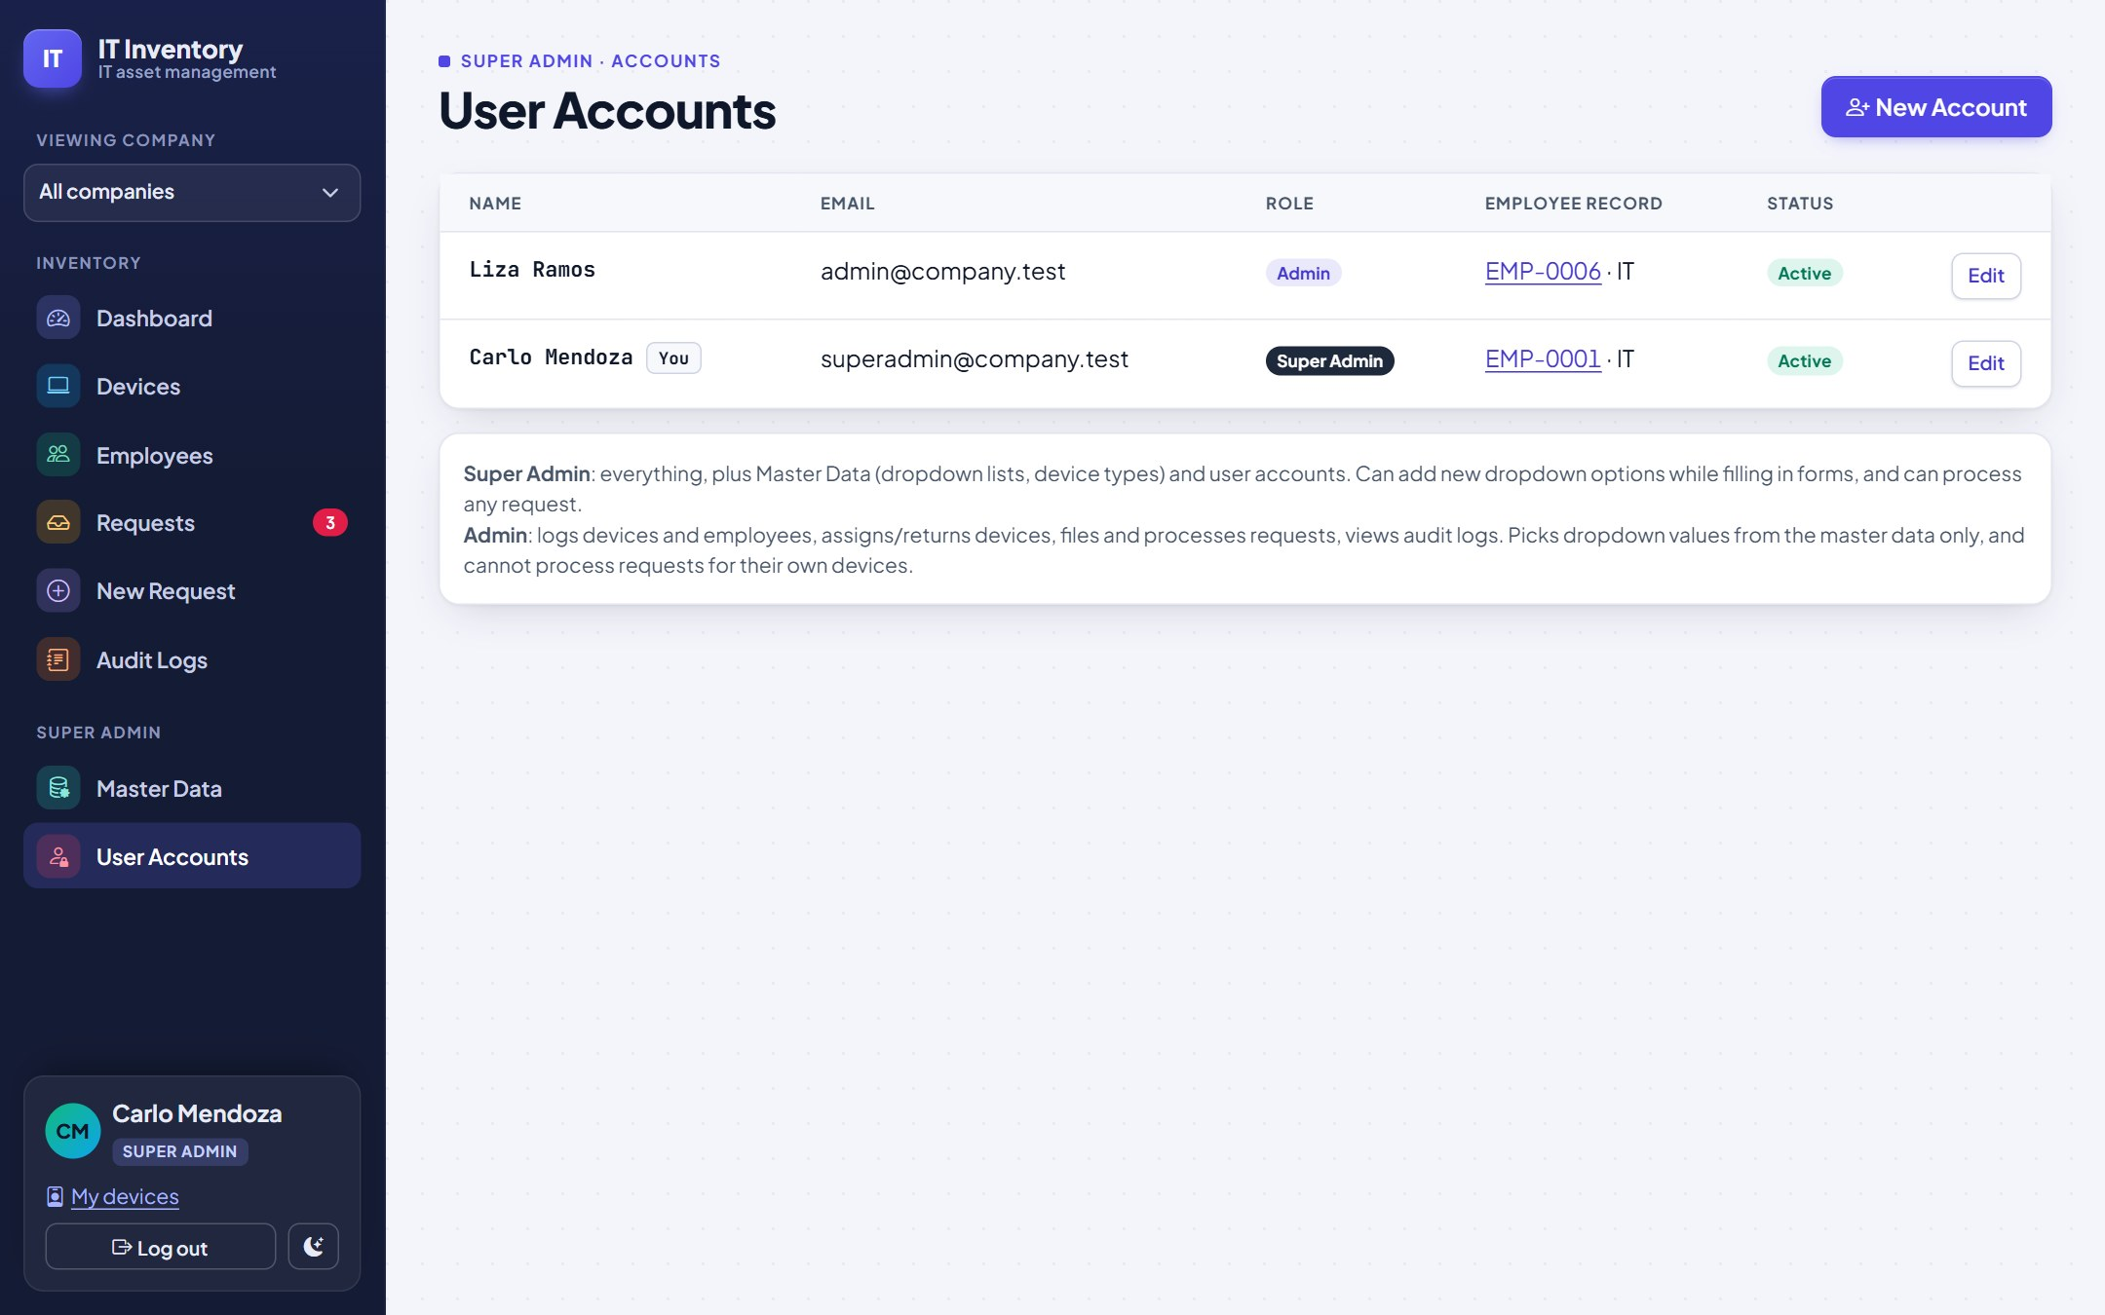
User accounts
SUPER ADMIN
New Account: pick the staff member's employee record to fill in name and email, choose a role, set a password
Edit to change role, reset the password (leave blank to keep it) or disable the account
Disable leavers; never share accounts
You cannot remove your own Super Admin role or disable yourself
Notes:
Linking an account to the person's employee record is what enables the own-request rule, so always link IT staff accounts.

Slide 28

06 Tips & help
Dark mode, phones, and answers to common questions.

Slide 29
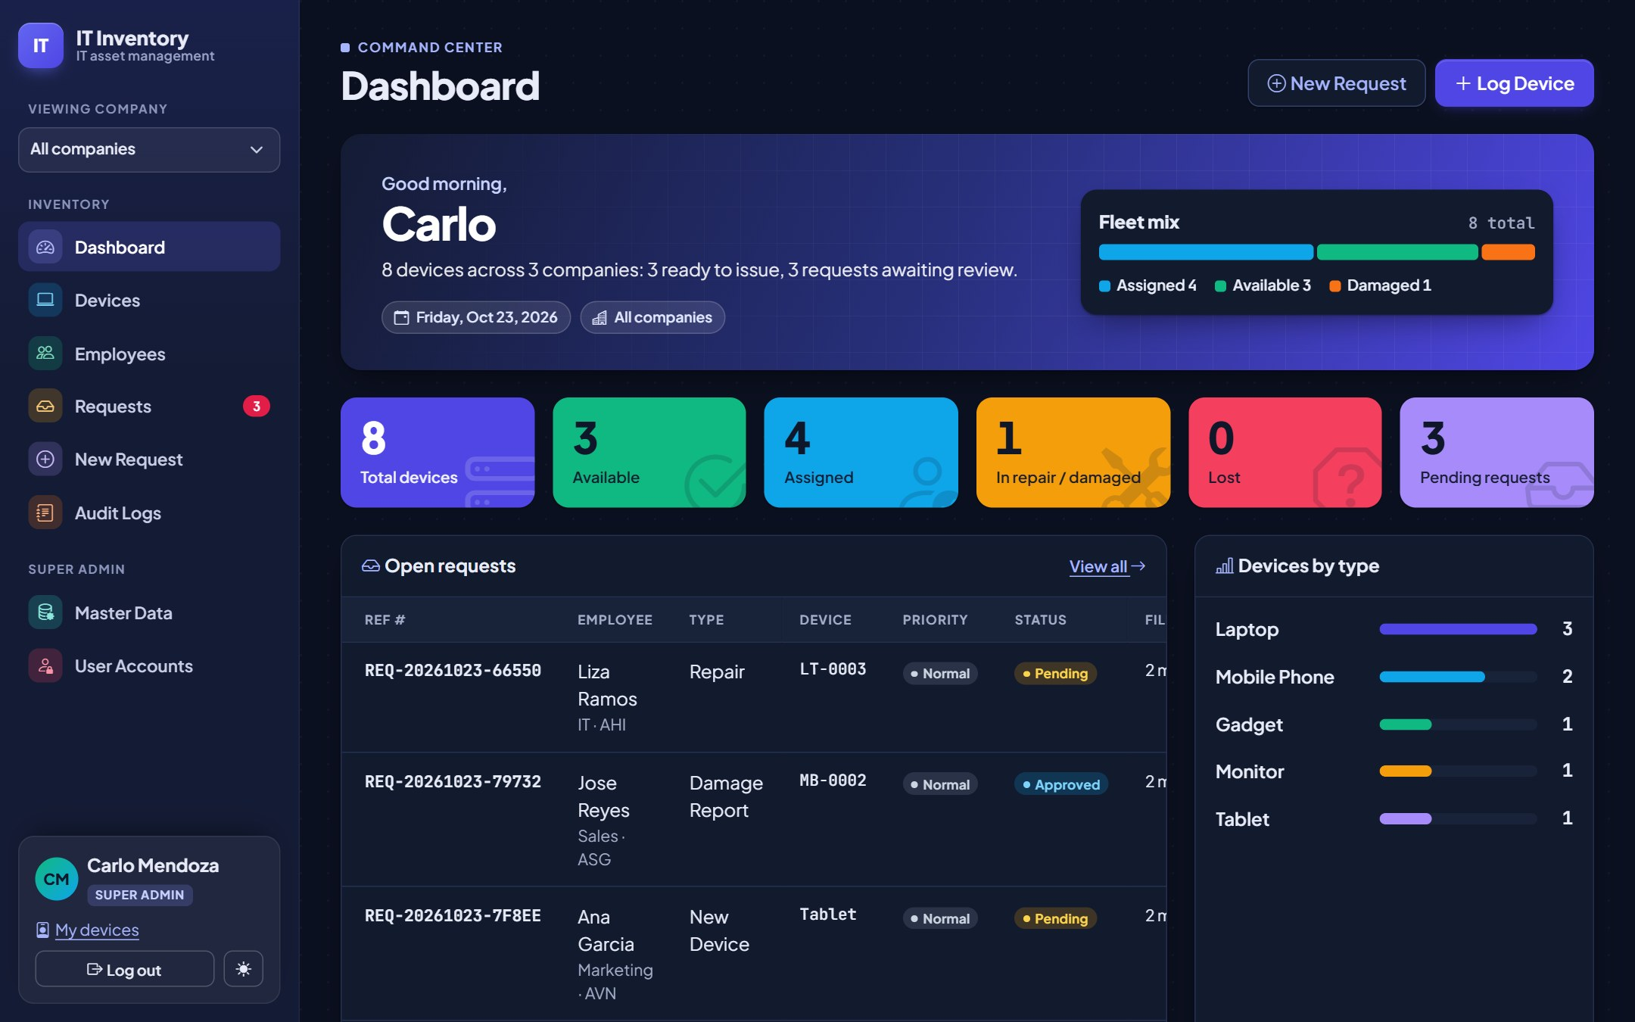
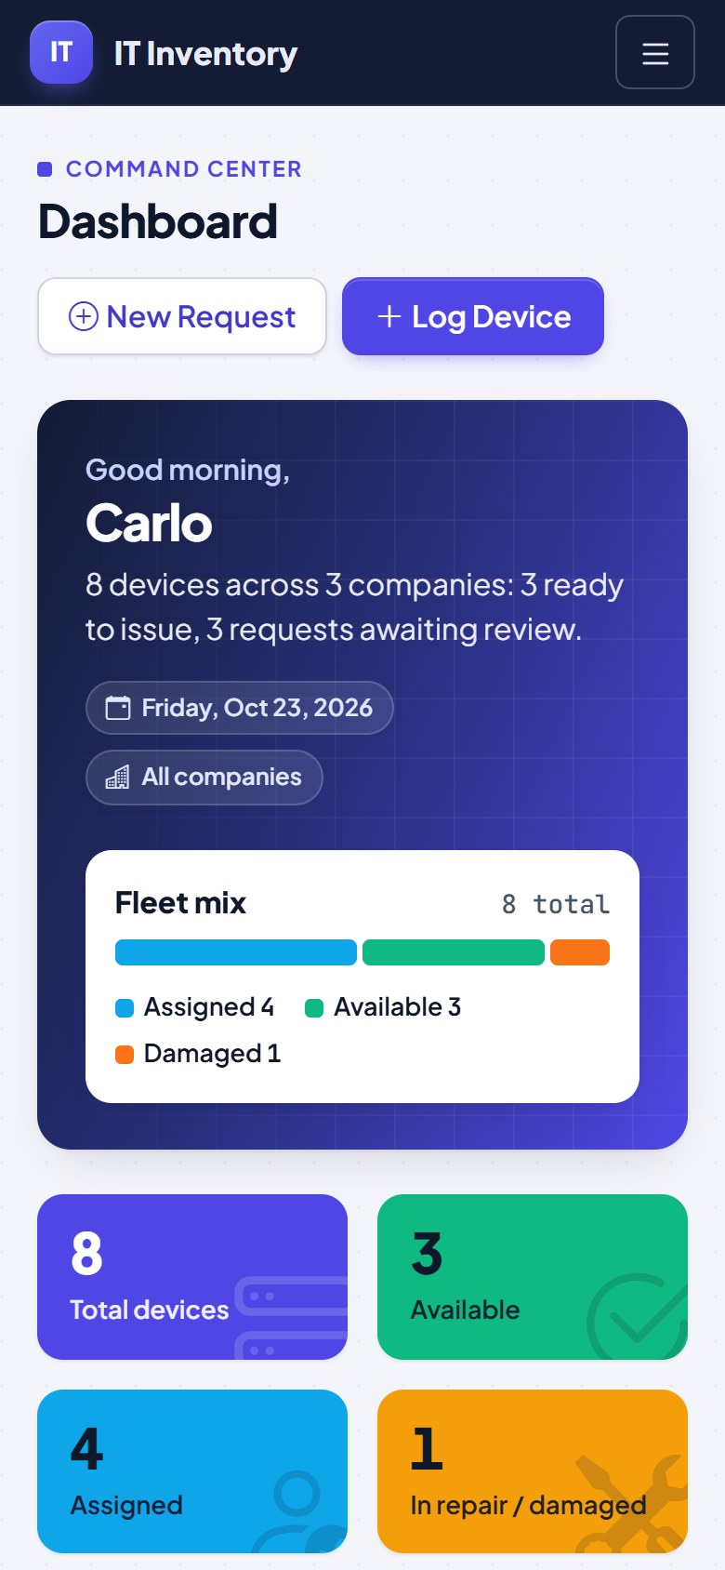
Dark mode and phones
Dark mode follows your computer's setting; the moon/sun button switches it.
Notes:
The system works in any modern browser and on phones and tablets. On a phone, tap the menu button at the top right.

Slide 30
Common questions
Situation | What to do
The value I need is not in a dropdown | Ask the Super Admin to add it in Master Data (or check the spelling, since lists search as you type).
"Access restricted" page | That page is for the Super Admin only.
"Session expired" page | You were idle too long. Go back, refresh the page and try again.
I can't approve a request | It is for your own devices, or it is no longer pending. Ask another admin.
A device is missing from the Assign list | Only Available devices can be assigned. Return it or change its status first.
A list looks too short | Check "Viewing company" in the menu; switch to "All companies".
I made a mistake | Edit the device or employee. The audit log keeps both the old and new values.
Notes:
Nothing is permanently deleted in daily use, so mistakes can always be corrected and are traceable.

Slide 31
Need help?
QUICK REFERENCE
Log a device
Devices > Log Device
Hand a device out
Device page > Assign
Contact your IT Super Admin for accounts, new dropdown values, companies and device types.
Report a problem
New Request
Find who had a device
Device page > history
Check what happened
Audit Logs
Notes:
Thank you. Keep this guide handy; the developer documentation is in docs/DEVELOPER_GUIDE.md for the technical team.

