Slide 1

SpotifyStats
BASI DI DATI II
Raimondo Rapacciuolo
Prof.ssa Tortora
Prof.ssa Caruccio

Slide 2
L’Idea
Realizzare una web application che permetta l’interrogazione di un database NoSQL orientato ai documenti, contenente informazione riguardo i brani più ascoltati su Spotify presenti nella Top 200 Weekly (Global).

Slide 3





Tecnologie Utilizzate

Slide 4
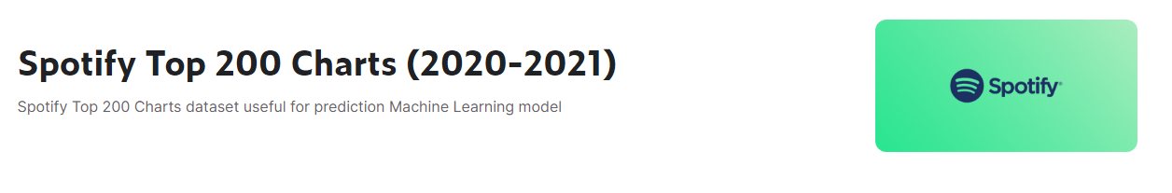
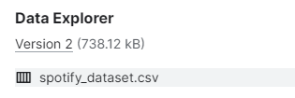
Dataset
https://www.kaggle.com/datasets/sashankpillai/spotify-top-200-charts-20202021

Slide 5
Dataset
{
"_id": {
"$oid": "635c026b2afbdb945583eb3f"
},
"Index": "1",
"Highest Charting Position": "1",
"Number of Times Charted": "8",
"Week of Highest Charting": "2021-07-23--2021-07-30",
"Song Name": "Beggin'",
"Streams": "48,633,449",
"Artist": "Måneskin",
"Artist Followers": "3377762",
"Song ID": "3Wrjm47oTz2sjIgck11l5e",
"Genre": "['indie rock italiano', 'italian pop']",
"Release Date": "2017-12-08",
"Weeks Charted": "2021-07-23--2021-07-30\n2021-07-16--2021-07-23\n2021-07-09--2021-07-16\n2021-07-02--2021-07-09\n2021-06-25--2021-07-02\n2021-06-18--2021-06-25\n2021-06-11--2021-06-18\n2021-06-04--2021-06-11",
"Popularity": "100",
"Danceability": "0.714",
"Energy": "0.8",
"Loudness": "-4.808",
"Speechiness": "0.0504",
"Acousticness": "0.127",
"Liveness": "0.359",
"Tempo": "134.002",
"Duration (ms)": "211560",
"Valence": "0.589",
"Chord": "B"
}

Slide 6
Preprocessing
Data Cleaning: Eliminazione dei dati con valori nulli
Feature Selection: Elminazione delle colonne non utili allo scopo del progetto:
Energy, Loudness, Acustiness, …
Index Selection: Scelta di un indice basato sulle query ricorrenti

Slide 7

Dataset
{
"_id": {
"$oid": "63581b0cfd43aeca66cdb109"
},
"Index": 1,
"Highest Charting Position": 1,
"Number of Times Charted": 8,
"Week of Highest Charting": "2021-07-23--2021-07-30",
"Song Name": "Beggin'",
"Streams": 48633449,
"Artist": "Måneskin",
"Artist Followers": 3377762,
"Song ID": "3Wrjm47oTz2sjIgck11l5e",
"Genre": "['indie rock italiano', 'italian pop']",
"Release Date": "2017-12-08",
"Weeks Charted": "2021-07-23--2021-07-30\n2021-07-16--2021-07-23\n2021-07-09--2021-07-16\n2021-07-02--2021-07-09\n2021-06-25--2021-07-02\n2021-06-18--2021-06-25\n2021-06-11--2021-06-18\n2021-06-04--2021-06-11",
"Popularity": 99,
"Danceability": "0.714",
"Liveness": "0.359",
"Duration (ms)": 211560,
"Chord": "B"
}

Slide 8
Funzionalità
Ricerca canzoni per titolo
Ricerca canzoni per artista
‘Most Followed Artists’
‘Most Streamed Songs’
‘Looking For’

Slide 9
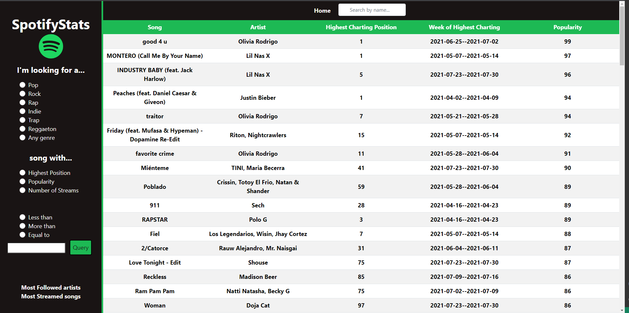
songs.ejs

Slide 10
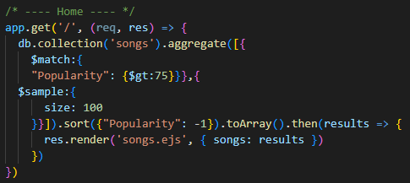
songs.ejs - Home

Slide 11
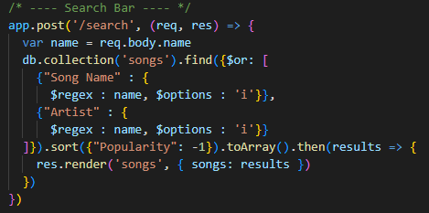
songs.ejs - Search Bar

Slide 12
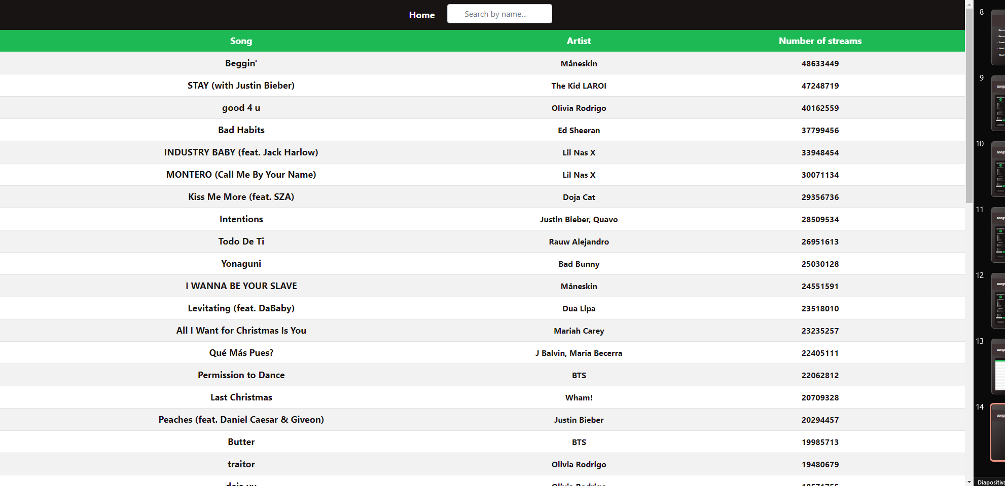
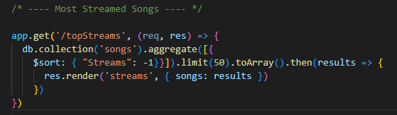
songs.ejs – ‘Most Streamed Songs’

Slide 13
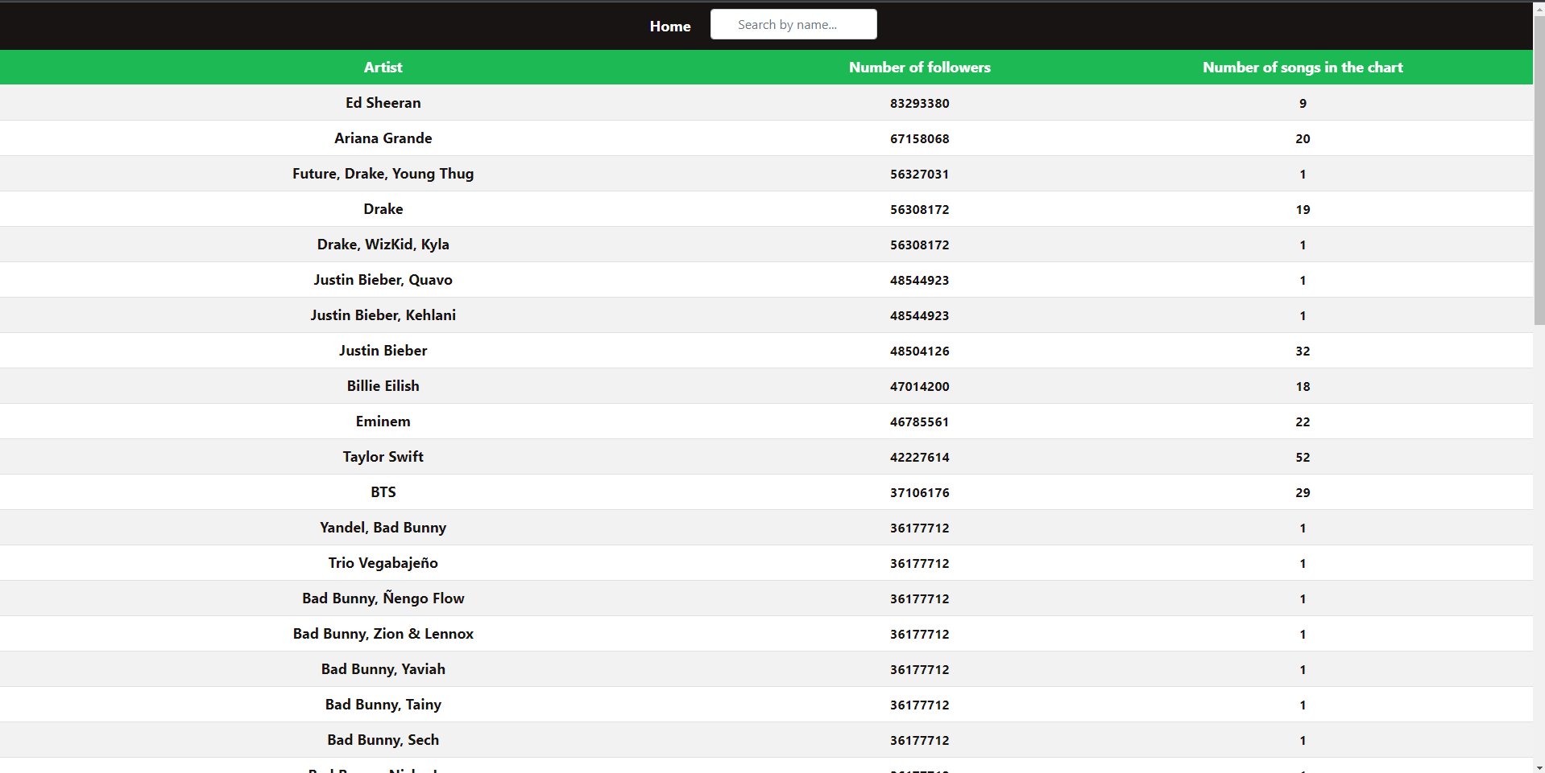
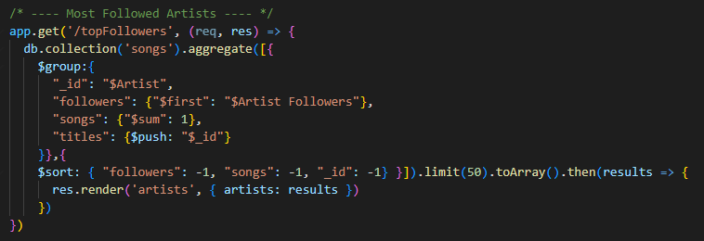
songs.ejs – ‘Most Followed Artists’

Slide 14
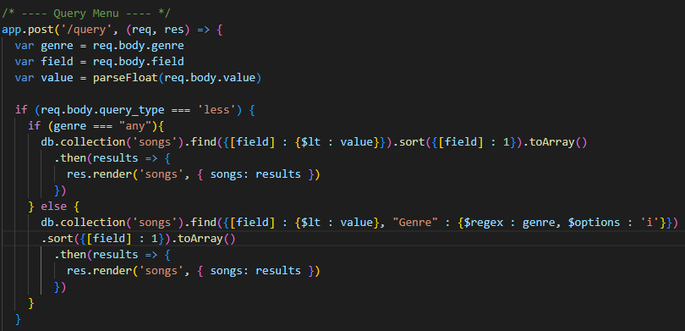
songs.ejs - ‘Looking For’

Slide 15
SpotifyStats
Grazie per l’attenzione!

