Slide 1
Professional Studies 1
Jordan Wesson
DUE DATE: 9/04/2021

Slide 2
Introduction
Introduction:
This assessment will cover the process of planning actions that could further your career goals and then undertaking actions that move you forward on a career pathway.
The assessment will include:
Nominating career goal.
Listing and undertaking short-term actions
Planning long term actions
Collect feedback on the actions you plan and undertake
Evaluate your processes and actions
The assessment instructions:
All sections marked in green must be edited/filled out by you.
Screen cap images are requested for some information. This is to ensure information is not lost due to internet hyperlinks becoming broken. Please ensure you screen capture information clearly so it can be read and assessed.

Slide 3














Introduction
Introduction:
This assessment will cover the process of planning actions that could further your career goals and then undertaking actions that move you forward on a career pathway.
Conclusion – 33
Self Evaluation – 4 - 7
Occupations – 16 - 17
Networks 2 – 24 -25
Soft skills – 8 - 11
Tech skills – 18 - 19
Information – 26 - 28
Financials – 29 - 30
Hero reference – 12 - 13
Studios – 20 - 21
Cool tools – 14 - 15
Networks 1 – 22 - 23
Job Adverts – 31 - 32

Slide 4
Self Evaluation | Self Introduction
What are your goals? What are the right goals for you? What do you need to do to achieve your goals?
The questions below are designed to give you an overview of yourself to help plan where you should focus your time and energy. This will give you better insight to choose goals and plan how to achieve them.
Take some time to answer these questions (and consider others like them).
 | Self Introduction
Why are you studying at AIE? | To learn game programming, one of the best courses in the country.
What hobbies do you have that are closely related to your AIE course work. | Gaming, Minecraft Redstone
Do you have hobbies that are not at all related to your course work? | Building Lego, drawing, beat boxing, streaming, YouTube.
Do you think you have an “artistic” side to your character? | Yes I can draw, love coming up with stories in my head, when not listening to music I’m regularly playing beats in my head, build and design structures in Minecraft, can 3D model (rarely do it though), love designing houses in The Sims, designing cities in Cities: Skylines and Banished, create interesting imagery in my head, I have a bunch of ideas for games I want to create.
Do you think you have an “technical” side to your character? | Basic 3D modelling knowledge, can solve conventional and non-conventional rubik’s cubes, Minecraft redstone, basic knowledge on how to play drums, beatboxing, gaming, Beat Saber, drawing, C#, C++.

Slide 5
Self Evaluation | Self Introduction
 | Self Introduction
Do you feel you are a creative person? How can you be sure? | Yes, I can be sure due to my drawing skill, regularly playing beats in my head, love creating interesting imagery in my head, designing structures and cities in games.
What job role specialisation do you find most interesting, right now? Why? | Game Programming, knowledge to code will give me the freedom of bringing the game idea I have to life.
What software is the most interesting to you, right now? Why? | Visual Studio, I’m learning to code in it.
Can you describe a strength that might serve you well whilst studying to become a professional? | I focus easier in a work environment.
Can you describe one weakness relevant to your study you feel might need some improvement? | I find it really hard to just sit down at my computer at home and do work, I get way too easily distracted outside of a work environment so I really need to work on ignoring temptation to play games when I need to get stuff done.

Slide 6
Self Evaluation | Self Introduction
 | Self Introduction
Describe one of your strengths that might give you an advantage in the workplace? | When in a work environment, I focus well on what I’m working on.
Describe one of your weaknesses that might give you trouble in the workplace? | I’m forgetful, if I don’t have something in easy line of sight or written down on something that is in an easy line of sight, I can very quickly forget something, especially if I find it boring or my brain sees it with less importance than other tasks.
Do you think you are an introvert or an extrovert? | It depends on the situation and how comfortable I feel with the people around me, I don’t need to have known them prior, just need to be comfortable with their personality and characteristics.
Do you find it difficult or easy to communicate concepts and ideas to other individuals? If not why? | Depends on the idea or concept, I’ve been able to explain code to class mates and have them understand, I can describe a story or a game idea, but there are times where I can’t find the words to convey an idea, concept, or thought.

Slide 7
Self Evaluation | Self Introduction
 | Self Introduction
Do you like to express your self in writing? Do you feel you write well? | Yes, in high school I loved creative writing exercises in English, I also have a few ideas for books that I would love to write one day. I feel like I can write well, when in the shower I like describing in my head how the images I create in my head look, feel, smell, sound, and taste.
Do you feel you are good with math and numbers? Could you write, read or use a math formula? (Eg: F=ma or S=d/t or C=2πr) | Yes, in high school I was in the second best standard math class in year 11 and 12. I was able to quickly learn how to read and use formulars, allowing me to usually be ahead of the rest of the class.
Do you have any coding, scripting or programming skills? | Yes, in high school I did a software design and development subject for 3 years, I learnt basic Lua, and did a bit of Visual Basic, I now also have knowledge in C# and C++.
Do you have traditional or digital art skills? (Eg: drawing, illustration or painting skills?) | Yes, I have a sketch book with lead sketches and drawings, I have also done a little bit of digital drawing in MS Paint of all things.

Slide 8
Soft skills | Definition
Research what is meant by the term “Soft skills”.
In your own words write a short, accurate description of what the term “Soft Skills” means in the context of a workplace.
The meaning of the term Soft Skills in a work context.
Soft skills is your ability to fit into a work environment, how you hold yourself, how well you work, and how easily you engage in conversation.

Slide 9
Soft skills | List of skills and meanings
What are common soft skills? What do they mean?
Compile a list of different but common types of soft skills (approx. 7).
Write in your own words a description of each soft skill
Types of soft skills | Different words used describe the same type of soft skill
Self Confidence | How confident you are in terms of ability, appearance, and behaviour in a social setting.
Positive Attitude | Being happy and optimistic, nice to others and being able to reflect that onto others.
Organisation | How well you manage time, people, and yourself.
Leadership | How well you can organise and guide people effectively, and take control of a situation.
Team Work | How well you work with others to get a task done.
Cultural Fitness | Being able to fit into the work culture of the company or organisation.
Motivation | Being able to start working on a task and continue working on a task without getting distracted.

Slide 10
Soft skills | Personal vs Team
Research soft skills that have a team focus and ones that have a personal focus.
In your own words make 2 lists.
One list of soft skills that are largely personal
One list of soft skills focused around teams in a workplace context.
Soft Skills – Personal focus | Soft Skills – Team focus
Work ethic Self confidence Positive attitude Flexible Organisation Emotional awareness Time management Innovation Self motivation Stress management Self management | Communication Initiative Negotiation Leadership Teamwork skills Accountability Cultural fitness Networking Decision making Punctuality People skills

Slide 11
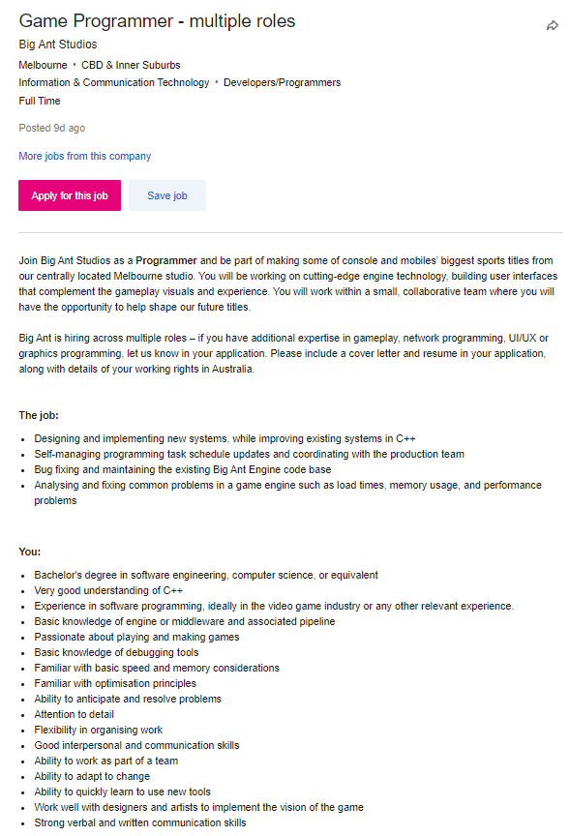
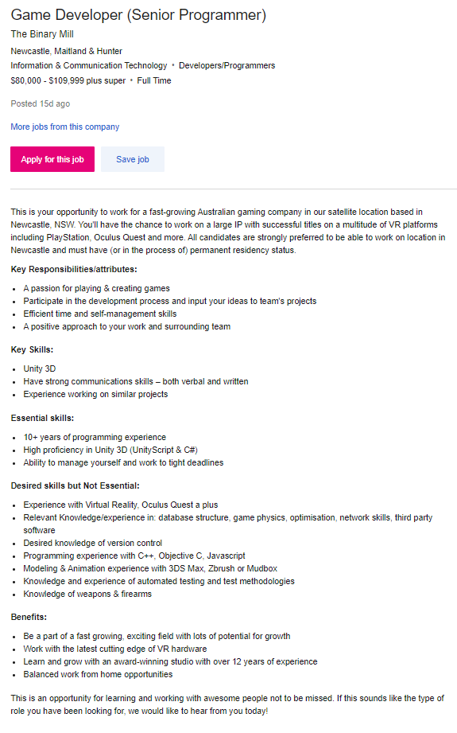
Soft skills | Identify
Take a screen shot of a 2 job adverts.
Identify and highlight some of the soft skills listed in each advert.
Job advertisement #1 | Job advertisement #2
Work Ethic Communication Organisation Time Management Team Work Accountability Self Management Punctuality Problem Solving Initiative Cultural Fitness Networking Decision Making | Punctuality Flexibility Time Management Leadership Accountability Stress Management Cultural Fitness Networking Self Management Decision Making Work Ethic People Skills Communication

Slide 12
Hero Reference | Cool people
Research professionals currently working in industry.
Find 2 professionals who's work you find inspirational.
Post a link to their portfolio or examples of their work and explain what inspires you.
List of cool pros | Name | Link to work examples | Why are you inspired?
Cool pro #1 | Gabe Newell | https://en.wikiversity.org/wiki/Digital_Media_Concepts/Gabe_Newell | He has a very successful career, and has development some of the most popular games in the world.
Cool pro #2 | Aaron Cox | https://au.linkedin.com/in/aaron-cox-40578744 | Really good at teaching code, makes me want to teach how to code in the future.

Slide 13
Hero Reference | Pro Skills
What skills do your chosen pros have? What soft skills do you think they might need to have?
What software do they use? If you don’t know the software, they use what software do you expect they use?
What job roles do they have? What job roles could they have?
In your own word write a short description of the skills these people have and the software they use. Also describe the job title they actually hold or what job title you think they could hold.
List of cool pros | Tech skills and soft skill set | Software knowledge | Actual or Possible Job title.
Cool pro #1 | Work Ethic, Critical Thinking, Adaptability, Decision Making, Motivated, Networking, Initiative, Leadership, Teamwork, Stress Management | Source | Game Developer, CEO of VALVe
Cool pro #2 | Work Ethic, Critical Thinking, Adaptability, Decision Making, Motivated, Networking, Initiative, Stress Management | C#, C++ | Programming Teacher

Slide 14
Cool tools | Software
List 2 pieces of software you think are really cool.
In your own words explain what the software actually does.
Explain what about the software interests you?
List of cool software tools | Name | What does it do? | Why does it interest you?
Software #1 | Visual Studio | Runs, compiles, and visualises code. | It’s easy to use and I can code with it.
Software #2 | Git CLI | Sends files and pulls files from GitHub | Easy to use.

Slide 15
Cool tools | Software developers
Who develops the software?
Does the developer provide support to the user base? For example do they post tutorials on their website? Do they have forums for discussions? Does the developer post videos on YouTube?
Does the developer have some type of active social media?
List of software tools devs | Name | What training support is offered? | Are official forums available? | Do they have an active social media presence?
Software developer #1 | Visual Studio | Online documentation | Yes | No
Software developer #2 | GitHub | Online guide | Yes | No

Slide 16
Occupation | Job Roles
Research 3 studio job roles.
Identify 3 actual job titles use by professionals and studios.
In your own words give a brief description of what that job role is.
Job Title | Description of job role
Game Programmer | Makes everything in the game do what it’s supposed to do.
Game Animator | Makes everything that’s supposed to move in a certain way, move.
Game Designer | Comes up with the game idea, mechanics, art style.

Slide 17
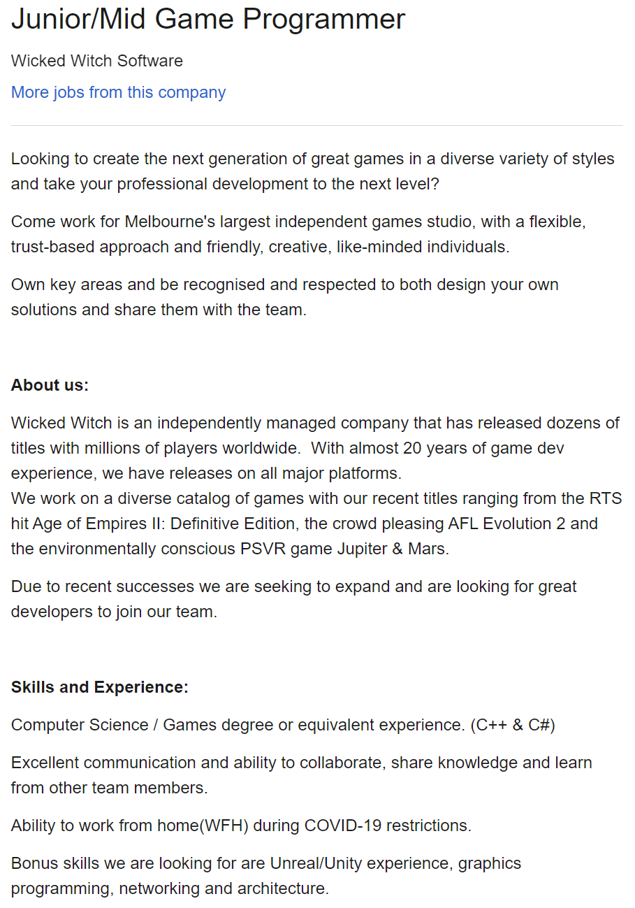
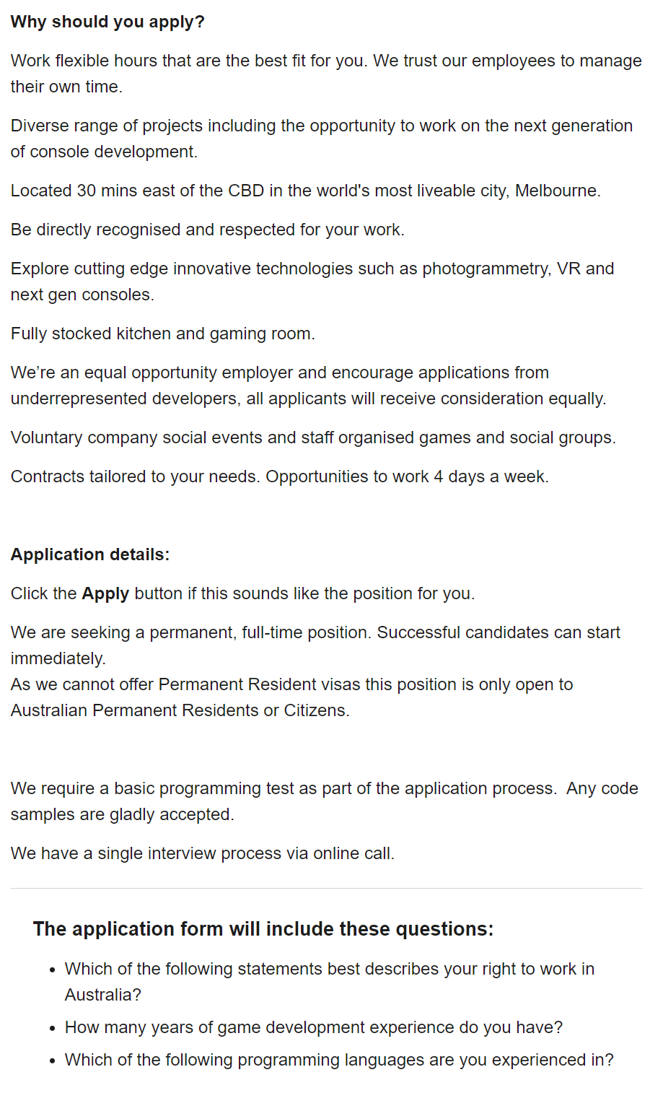
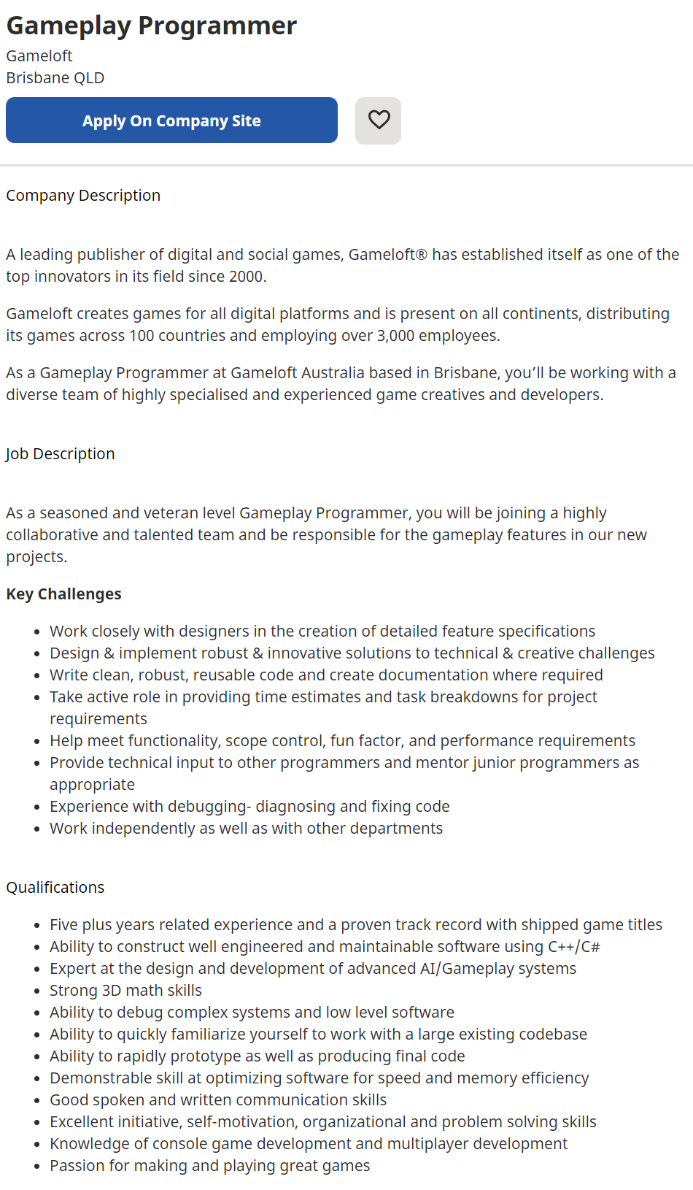
Occupation | Job Roles
Find 2 job advertisements you'd be interested in, each from a different source.
Highlight the source and paste a screen shot of each job advertisement below.
Also post a link to the source of the job adverts
Job advertisement #1 | Job advertisement #2
https://www.seek.com.au/job/52025101?type=standard#searchRequestToken=835bf70f-12ee-4558-b6a7-9ae47ae67764 | https://au.indeed.com/viewjob?jk=d15fa7cbe6ad9f61&tk=1f417hps1rjdb801&from=serp&vjs=3

Slide 18
Tech skills | List
Compare 2 of your technical skills. These could be things like animating, modelling, rigging, unwrapping etc.
Discuss one technical skill you feel you are currently “good” at and would find easy to learn more.
Discuss one technical skill you feel you are currently “poor” at and would find it difficult to learn more.
Discuss why one skill is easy for you and the other is difficult.
Easy and confident skill technical skill | Difficult and poor technical skill
Solving Rubik’s Cubes. Rubik’s cubes are easy because it’s just applying algorithms to move the pieces around, depending on where certain pieces are is what algorithm you use. | Minecraft Redstone. It’s like coding but in a 3D gridded space, and the way that things interact means you need to space it out, but the more spaced out it is the slower it is, so finding the balance between compacting something and making it function can be difficult. The way that things interact also allows for lots of different ways of doing one thing, so finding the most optimal for what you’re building can also be a challenge.
Rubik’s cubes are easy because all you have to do is remember patterns and what algorithm to apply to that pattern.
Minecraft Redstone is hard because if something goes wrong, there’s no debug, so you have to manually go through and find what’s broken, space is also an issue, the more spaced out something is the longer it takes to run through, so you have to compact it as much as possible, but the way different Redstone components interact means different parts have to be spaced.

Slide 19
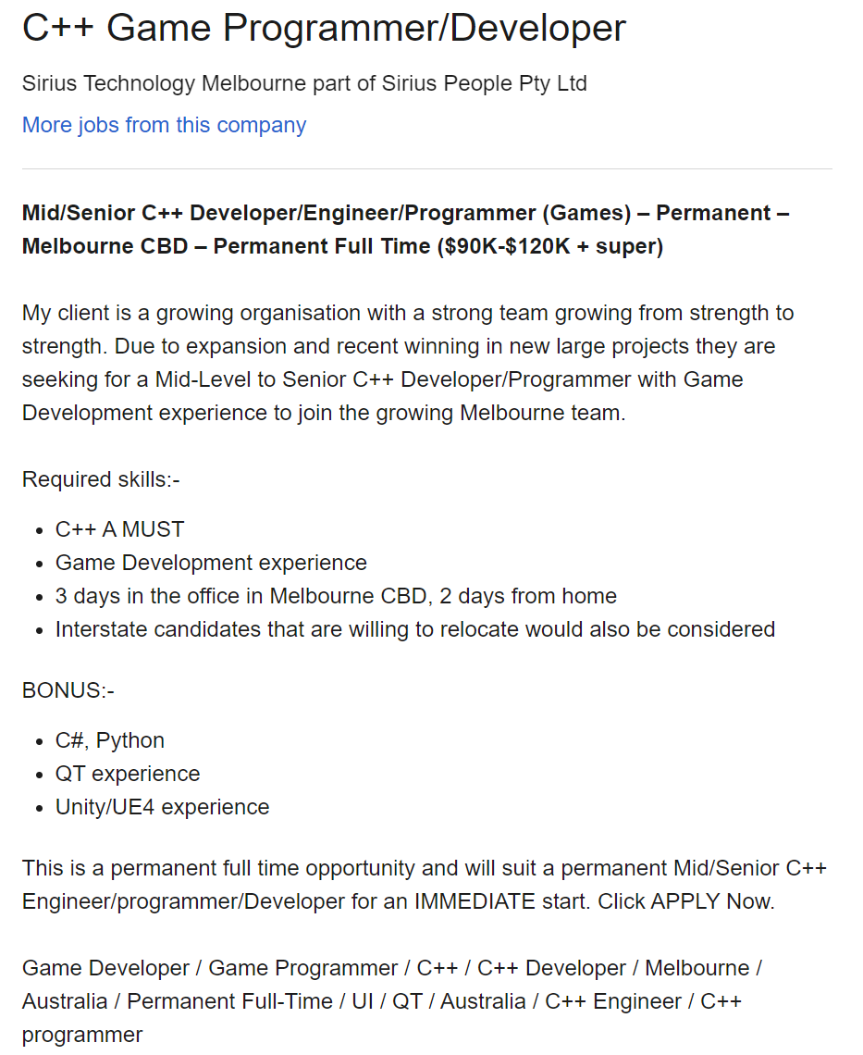
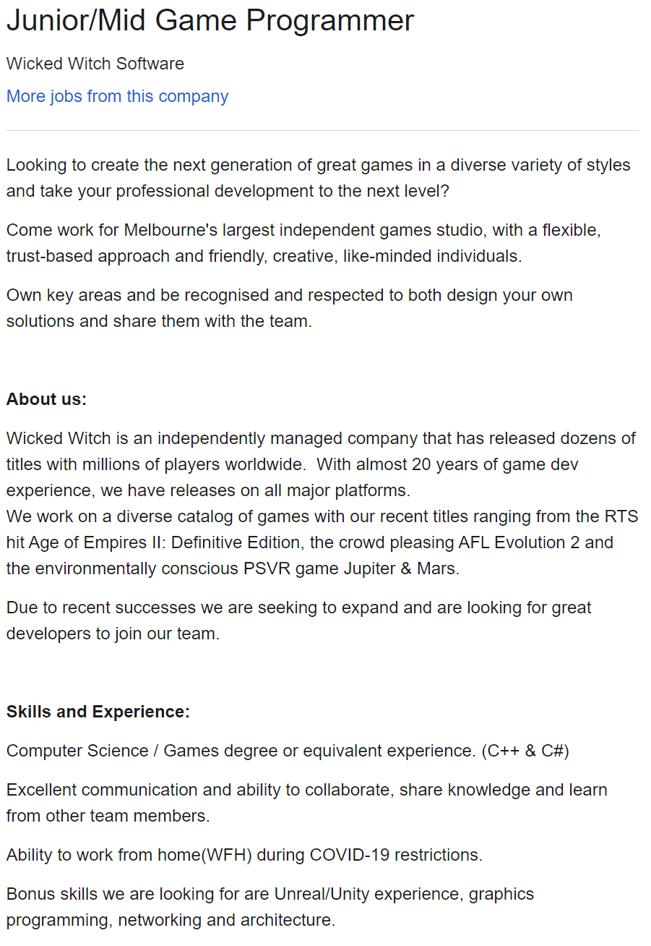
Tech skills | List
Take a screen shot of 2 job adverts.
Identify and highlight some of the technical skills in each advert.
Job advertisement – Tech Skills #1 | Job advertisement – Tech skills #2
C++ Game Development C# QT Unity UE4 | C++ C# Unreal Unity Graphics Programming Networking Architecture

Slide 20
Studios | Studio list
Identify a few studios near to you (local studios) and post a link to their website. (3)
Identify some international studios and post a link to their website. (3)
Local studio name | Link to studio website
Chaos Theory | https://www.chaostheorygames.com/
Mode Games | https://mode-games.com/
Logic Simplified | https://logicsimplified.com/newgames/
International studio name | Link to studio website
Bethesda | https://bethesda.net/en/dashboard
Bungie | https://www.bungie.net/
Valve | https://www.valvesoftware.com/en/

Slide 21
Studio | Studio review
Choose one local and one international studio from your list.
Research them and report on some findings, focusing on what they produce or how they produce it. Ensure you are reporting accurate information.
Find out what software they use?
Find out how many staff they employ?
Find other information about how the studio produces its products?
Studio name | Production trivia
Chaos Theory | Maya, Adobe Creative Suite, and Unity 14 employees How they produce games: Set objectives, Plan, Development, Supporting Growth
Bethesda | The Create Engine 420+ employees Havok Behavior is a tool used to blend between animations seamlessly. An upgraded version of Radiant AI to allow NPCs to react and interact with the environment.

Slide 22
Network 1 | Personal close
Think about your immediate personal network. Think about the people who can offer you advice and feedback.
These are people who you can talk directly with. These people may include family, friends, fellow students, trainers, work colleges, etc
How many people in your immediate personal network could you:
call on for advice on artistic / technical matters.
call on for advice on soft skills related matters.
call on for advice on employment and job-related matters.
 | Personal close network (approximate size)
Artistic / technical matters | 16
Soft skill related matters | 5
Employment / job related matters | 3

Slide 23
Network 1 | Personal Extended
Your personal extended network is made up of people who you are not in direct contact with.
This could include people you don’t know in person, but are a member of a group you are a part of (eg a social media group)
This could also include people you know of. You may need to talk “through” other people to make contact.
These people are “2 steps” away.
In the box below describe the scope and extent of your personal extended network.
Do you “know of” some people who could help you develop as a professional?
Do you have access to a group of people who could potentially support you? (eg a Facebook group)
Do you have some form of extended network you can get feedback or even advice from?
 | Extended network
Describe the extended network you have right now! | I have friends on discord who code and do art, I’m also in a small public art sever.
Are there any easy steps you could take to expand you current extended network? | Network on social games like VRChat and in discord servers I’m in.

Slide 24
Network 2 | Community close
Look for 2 local communities you could personally interact with that could help you develop professionally. Focus on finding local groups that are near to where you are now, that you could have easy access to.
The community could offer …
A competition
Interaction with like minded people
Networking
Feedback
Answering questions
Describe (and link to) the communities in the box below.
 | Close / local community
Physical community | This community offers networking and keeping up to date with what’s happening within the region, answering questions, interaction with like minded people who are passionate about coding, and feedback. https://www.meetup.com/en-AU/Newcastle-Coders-Group/
Online community | I’m in a steam group that has a discord server for gamers that live in my area, they can help with feed back, answering questions, and possibly networking. https://steamcommunity.com/groups/newygamer

Slide 25
Network 2 | Community Extended
Look for a big external event that would be valuable for you to attend. This could be a conference or expo that hosts industry developers, speakers and community. Write a short description of why it would be valuable to attend.
Find out the basic details of the event.
Link to the website
When is it on this year?
How much would it cost to attend. (approx.) Include ticket prices, travel, accommodation and anything else needed.
event name | Link to website | When is it on | Ticket prices | Travel expenses (approx.) | Accommodation expenses (approx.) | Other expenses (approx.) | Total cost
Pax | https://aus.paxsite.com/ | 8-10 Oct | $65 | $130 - $240 ~$200 | $330 - $1000 ~$650 | $150 | $1065
Why would it be worth attending?
There are representatives from large development companies and other small indie developers, these people are good for networking. There’s tech demos so you can see and test new up coming technology and systems. If you have a game you would like to show off, you can and get feedback as well.

Slide 26
Information | Sources News
Look for 2 information sources on industry news.
Carefully choose your sources to ensure you get industry news that is of good quality.
This could be from the following –
Social media source
Website / news articles
A specific individual
Briefly describe and link to the sources below.
 | Link | Name of source | Describe source | Why is it a “good quality” source?
News source #1 | https://www.gamasutra.com/ | Gamasutra | Gamasutra focuses on all aspects of game development, it has daily news posts, community discussion, developer game postmortems and critical essays, job recruitment ads, and user applications for contracted work. | Game developers post updates, and information on their games, users can leave reviews of games, and articles are written by users about games.
News source #2 | https://www.gameinformer.com/ | Game Informer | Game Informer’s articles are centred around game and game related news. | The site is centred around games and has a strong reputation on having trustworthy reviews.

Slide 27
Information | Sources Skills and tools
Choose a skillset and software tool you are interested in. For example, Maya and Rendering.
Identify 2 sources of tutorial information for that skill set and software tool combination. Ensure you are choosing a good quality information sources. Link and discuss the source below.
Skill / Tool set | Link | Name of source | Describe source | Why is it a “good quality” source?
Coding / Visual Studio | https://docs.microsoft.com/en-us/visualstudio/windows/?view=vs-2019&preserve-view=true | Microsoft Visual Studio Documentation | Guidance on how to install and setup, tutorials on how to use Visual Studio, documentation on different languages. | It’s the official site and documentation for the software.
3D Modelling / Blender | https://docs.blender.org/manual/en/dev/ | Blender manual | Shows how to use user interface, editors, modelling, sculpting, animation and rigging, physics, rendering, and many more. | It’s the official site and documentation for the software, and goes into great depth.

Slide 28
Information | Future
Games and VFX for film is a fast-moving industry.
Look for some emerging technologies, software tools, processes, hardware or workflow that interest you.
In the box below describe one emerging technology. Describe a few actions items you might need to take that could move you closer to participating in this new emerging technology.
Technology name | Describe new technology | Action items for participation
Virtual Reality | Composed of a headset you wear on your head and controllers you hold in your hands that track your head and hand movement to be mirrored in game which is displayed through the headset. | Having a VR headset. Making VR games.

Slide 29
Financial | Costs
Select a small suite of software that could make the core of your professional home studio.
The suite of software should include both 2D and 3D editing tools as well as some additional software for tasks such as sculpting or rendering.
Ensure you are considering software licensing for professional (paid) work.
Software name | Link to website | Cost of professional licence
Unity Pro | https://store.unity.com/products/unity-pro | $150 /yr
Visual Studio Enterprise / VS Code | https://visualstudio.microsoft.com/vs/pricing/#tab-b8953f16f0b68f60f18 https://code.visualstudio.com/ | $250 /mo
Blender | https://www.blender.org/download/ | Free
Krita | https://krita.org/en/#:~:text=Krita%20is%20a%20professional%20FREE,affordable%20art%20tools%20for%20everyone. | Free

Slide 30
Financial | Hourly rate
Do some research on hourly rates for freelance 3D artists.
In the box below
Nominate an approximate figure you think is fair as an hourly rate.
Briefly discuss how you arrived at that figure.
 | Answers
Nominate an hourly rate | $26/hr minimum for graduate software developer based on: https://www.gameworkers.com.au/income/game-developer-employee/
Discussion of how you chose that rate | https://www.gameworkers.com.au/income/game-developer-employee/

Slide 31
Job Adverts | Find and list
Look for 2 information sources that host industry job adverts.
Carefully choose your sources to ensure they are legitimate.
This could be from the following –
Social media source
Website / news articles
A specific individual
Briefly describe and link to the sources below.
 | Link | Name of source | Describe source | Why is it a “good quality” source?
Job advert source #1 | https://www.seek.com.au/ | Seek | Seek is a job posting and seeking site that operates in 18 countries around the world. | Seek was founded in 1997 and has millions of users posting and seeking jobs worldwide with exposure to 2.9 billion people.
Job advert source #2 | https://au.indeed.com/?from=gnav-homepage | Indeed | Indeed is a job posting and seeking site that operates in 63 countries worldwide. | Indeed was founded in 2004 and is the most popular job site in the world with over 250 million unique visitors every month.

Slide 32
Job Adverts | Choose
Select 2 job adverts that you find interesting. Choose an advert for the type of job you’d like to see yourself in the future.
Ensure you are selecting from a good source. Preferably this is an info source you have reviewed and checked for quality before.
Describe why the chosen job adverts are appealing to you.
Identify what you think are the key soft skills and tech skills the job requires
 | Link to job advert | Title of position | Describe why it interests you | Soft skills and Tech skills
Job advert #1 | https://www.seek.com.au/job/52117205?type=promoted#searchRequestToken=a63710be-ba30-4323-8a64-7ab15fcf19a0 | Senior Programmer | One of the key attributes is ‘A passion for playing & creating games’, $80,000 – $110,000 /yr, based in Newcastle which is where I’m from | Soft: Motivation, Communication, Work Under Pressure, Time Management, Decision Making, Initiative, Teamwork, Work Ethic, Critical Thinking Tech: C#, C++, Objective C, Javascript, Unity, Virtual Reality, Database Structure, Game Physics, Optimisation, Network, Version Control,
Job advert #2 | https://www.seek.com.au/job/52164751?type=standard#searchRequestToken=a63710be-ba30-4323-8a64-7ab15fcf19a0 | Game Programmer | Passionate about playing & making games, Multiple Roles, $65,000 - $74,999 /yr | Soft: Motivation, Communication, Work Under Pressure, Time Management, Decision Making, Teamwork, Work Ethic, Critical Thinking, Adapt to Change Tech: C++, Lua, Python, Debugging, Gameplay, Network, UI/UX, Optimisation, Learn New Tools, Consoles

Slide 33
Conclusion | Where to next?
This document is designed to help you explore and plan your professional development.
You have added a lot of data to this document. Make use of this data and draw a conclusion.
Review and analyse the information above and summaries into a few key conclusions.
What does the data show? | Link to job advert
What is one weakness you have where you should focus more attention? | Working at home
What is one strength you have that will be valuable in the future? | Work well in a work environment
What inspires you? | My desire to bring my ideas to life
What are your goals? | Building 3 small games each in 1 month over then next year, Complete 2 year game programming course, Register an ABN near the end of the year or early next year, Start up my own indie games studio
What is a short term action item you recommend you should do? | Code when ever I have an idea
What is a long term action item you recommend you should do? | Develop my own small games, Push myself constantly learn

Slide 34
Professional Studies 1|Submission
The following files must be uploaded to Canvas for assessment. All submitted files must adhere to the provided naming conventions.
Workbook:
This Workbook
2021_Professional_Studies_1_YourName.pptx

