Slide 1

New Era Software

Slide 2
The Team
Dinolan Naidoo
Ashley Jurisich
Kiaan Moodley

Slide 3
Our Mission
Provide businesses and individuals with information about vehicle energy alternatives that benefit both the environment and economy.
Provide a web-service that allows comparisons to be made between the user's current energy usage and that of the energy usage of an electrical vehicle.

Slide 4
Keys To Success
Considering economic consequences
Providing the most optimal solution
Ensuring user interface is operative and effective

Slide 5
Long Term Objectives
Solutions become integral in business practices
Less demand for petrol/diesel
Long time subscriptions from users

Slide 6
The Website
Link

Slide 7
Technologies Used
Visual Studio for C++
CSS
JavaScript
Database SQL

Slide 8
Testing
Functionality Testing
Usability Testing
Interference Testing
Compatibility Testing
Performance Testing
Security Testing

Slide 9
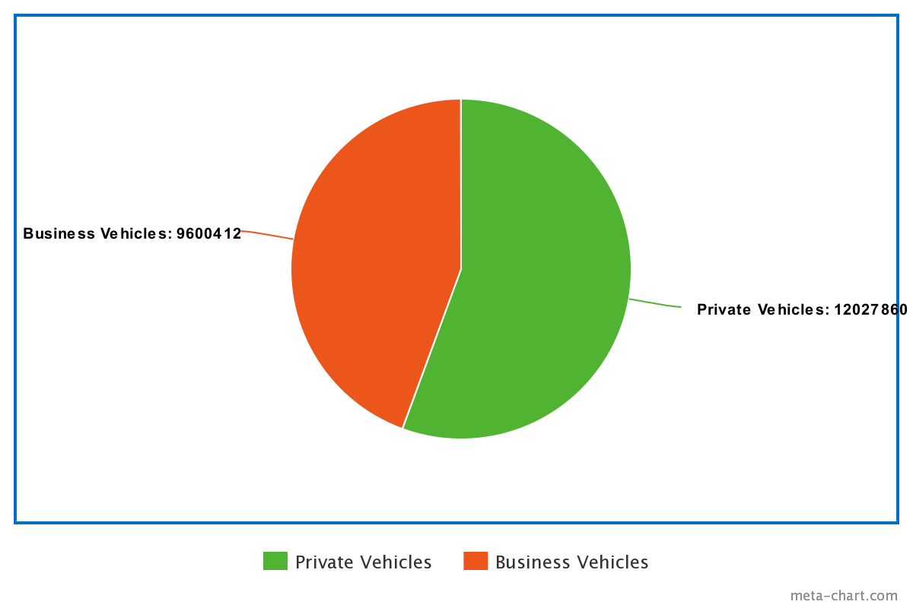
Market Analysis
Primary and Secondary Target Market
Market Segmentation
Strategy

Slide 10
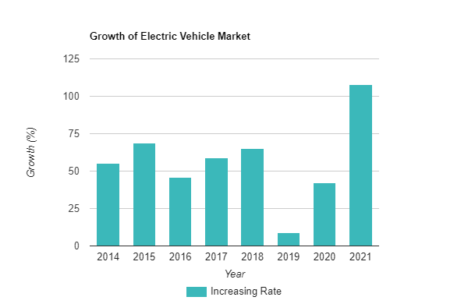
Implementation
Buying Patterns
Marketing
Sales Forecast

Slide 11
Management
Democratic team dynamic
Agile management methodology

Slide 12
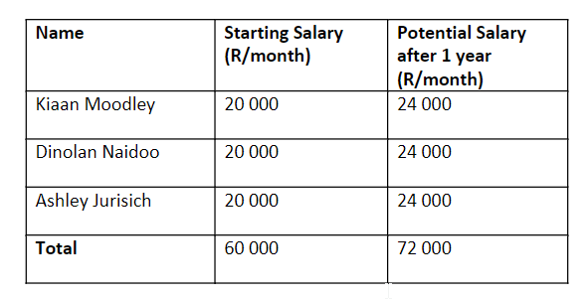
Budgetary Considerations
Inexperienced Software Developers

Slide 13
Thank You
Q & A

