Slide 1
Local Hack Day 2018
MappAthon
Papakostas Dinos
Pantzartzis Anastasios
Pantazidis Alexandros

Slide 2
Our idea...
When we came to Thessaloniki as university students, we noticed that while there were many points of interest in the city, nobody showed the appropriate interest, especially amongst the young, in them.
In an attempt to fill this gap, we decided to make an app with which the user could have immediate access to the closest landmarks.

Slide 3
What we’ll see...
Data usage from:
https://opendata.thessaloniki.gr/el
Using packages from Microsoft Azure
(Azure Maps API)
Mapping the city’s historical and tourist locations.
Guiding the user around based on his initial geographical location.

Slide 4
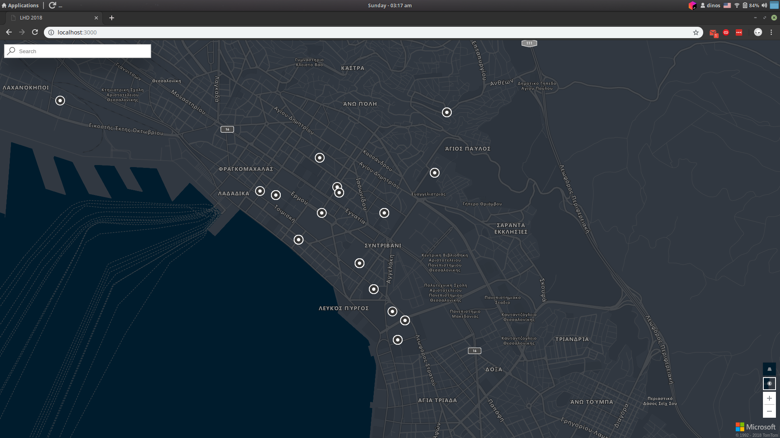
SCREENSHOTS (Homepage)

Slide 5
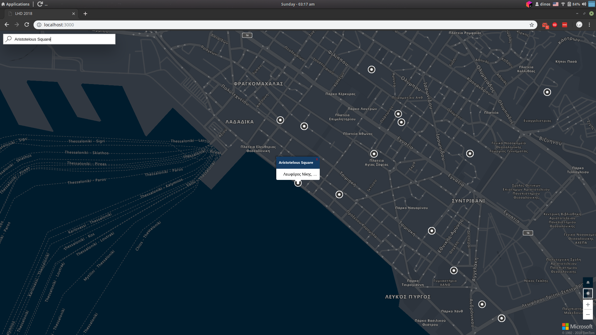
SCREENSHOTS (User Location Selector)

Slide 6
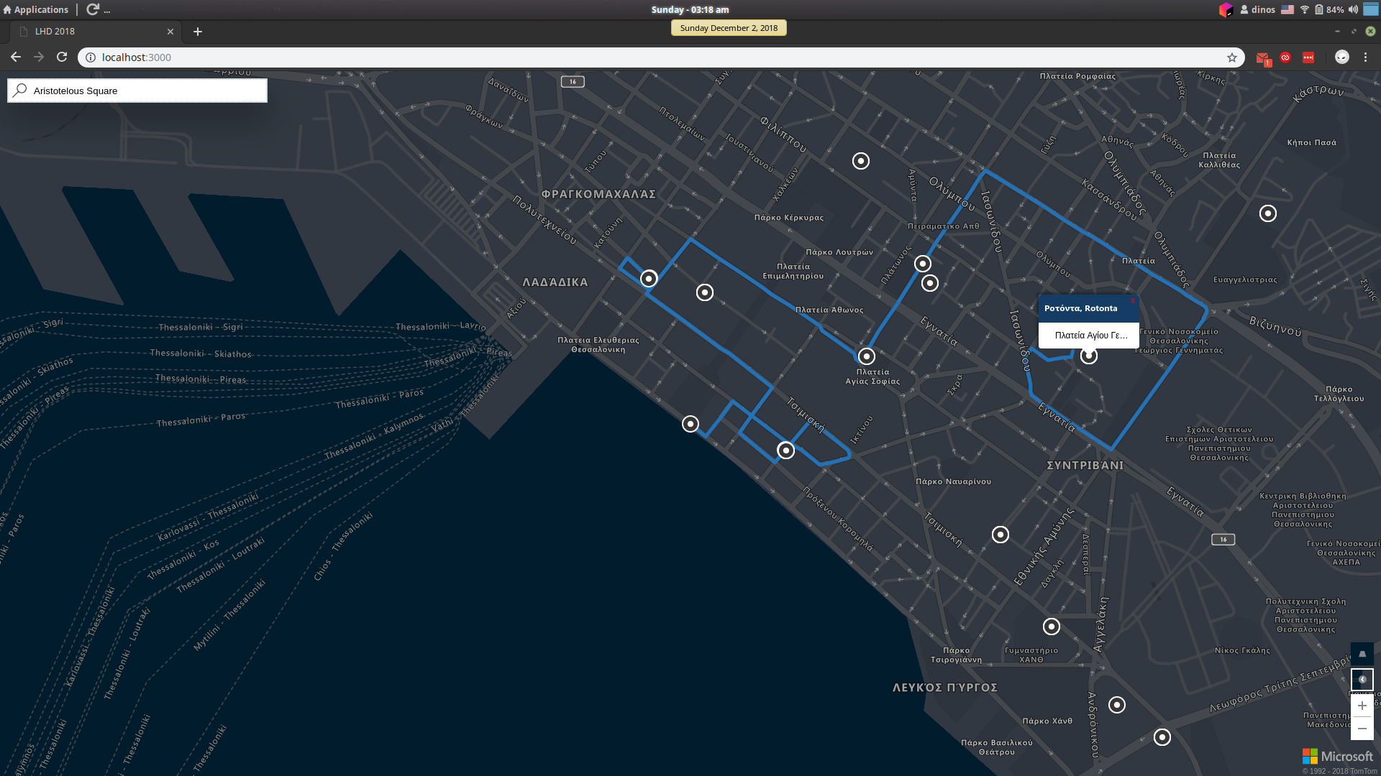
SCREENSHOTS (Route Displaying)

Slide 7
THANK YOU :’)
return 0;

