Slide 1
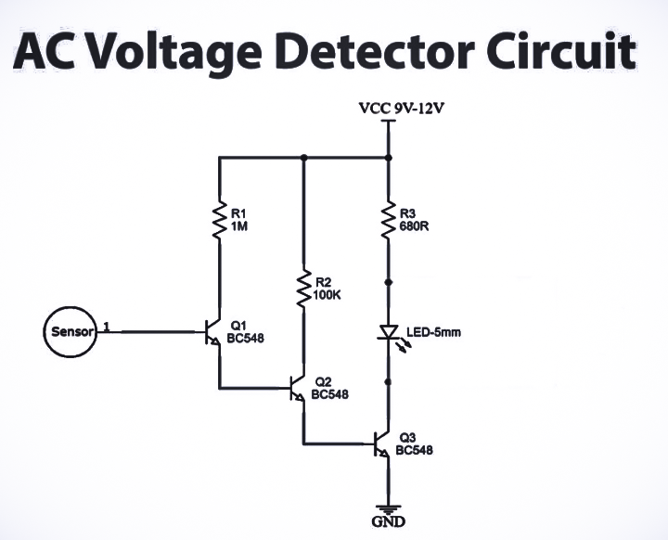
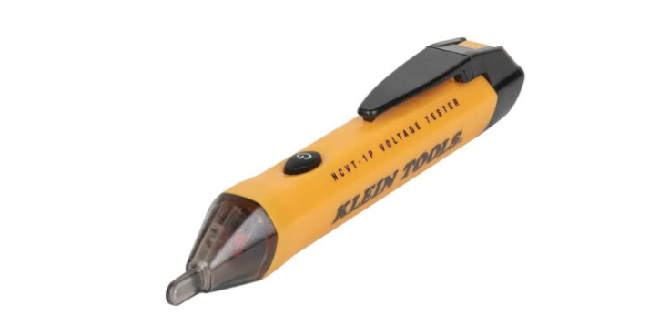
E waste mini project
Non-contact ac voltage tester
AC voltage detector and as the name implies, this circuit detects the alternating voltage without any contact
Component | Value | Qty | Price(LKR)
Transistor | BC547 | 3 | 4.00
LED | 5MM | 1 | 10.00
Resistor | 100k,680k,1M | 1,1,1 | 3.00
Sensor(copper coil) | - | 1 | 15.00
Dinujaya Thamara

