Slide 1
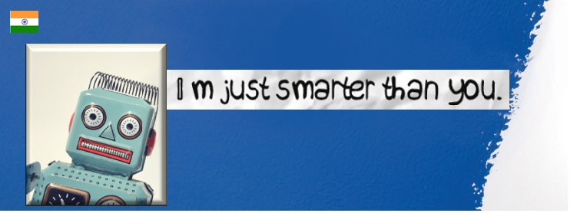
CHATBOTS The future of Retail Business
By:
Subramanyam Valli T
Vidhya Saravanan
Harshil Shah

Slide 2
FOCUS AREA
Customer Self Service
Other Opportunities
Employee Self Service
Retail – A bot that adds to Omni - Channel experience
& Many More …

Slide 3
Customer Self Service
Business Idea:
CHATBOTS (Chat Robot, a computer program that simulates human conversation, or chat, through artificial intelligence)
A chat based platform to simulate conversation with customers to ease the process of getting updates or responding with appropriate actions on product installations & various customer services by integrating with installation management systems build on Dynamics.

Slide 4
Impact
Current Solution:
Today, when customer orders for an item/Appliances/product that needs installation, an Installation job is created at Dynamics with entities that describe the job status, availability of products, the details of the installation vendor, customer information etc. The above process doesn’t provide the flexibility to customers to check their order status, delivery and an opportunity to reschedule the installation process, only way is to call the Lowe’s Customer Representative and get that done.
Impact:
To facilitate a CHATBOT on Lowes.Com to simulate conversation with customers at anytime, anywhere to ease the procedure/process of getting updates or responding with appropriate actions on product installations & various customer services.

Slide 5
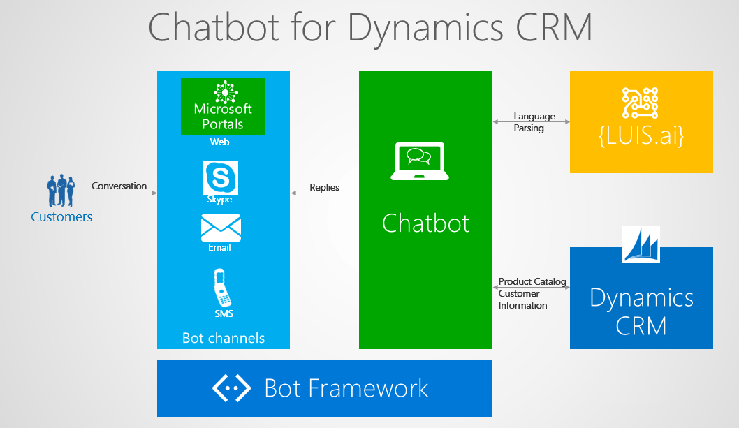

Slide 6
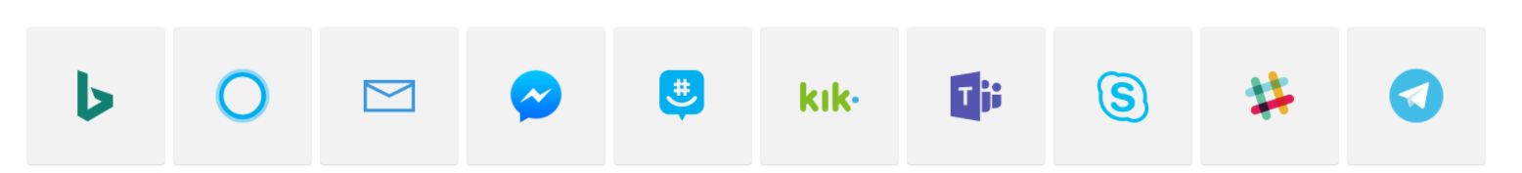
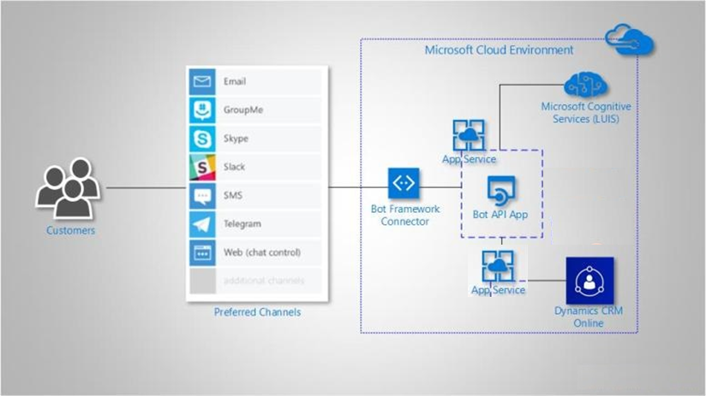
Channels
BING
CORTANA
E-Mail
FB
GroupMe
Kik
MS Team
Skype
Slack
Telegram

Slide 7
#CHATBOT
@LUIS.ai
@Omni-Channel
.NET
#BOT Framework
#Azure
@Dynamics 365
#Artificial Intelligence

Slide 8


