Slide 1
ACR & SCAN IMAGES IN ACR WITH TRIVY AND DEVOPS

Slide 2
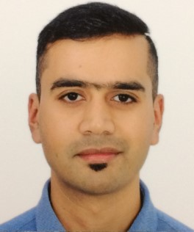




HELLO!
I am Arindam Mitra
Today, I will be talking on ACR and How to Scan Images in ACR using Trivy and DevOps.
You can look me at:
: https://www.linkedin.com/in/arindam-mitra-28981095/
: https://github.com/arindam0310018
: https://dev.to/arindam0310018/-my-contributions--3bgp
: https://sessionize.com/arindam0310018

Slide 3
AGENDA
QUESTIONS
Any Questions Please ?
LIVE DEMO
Live Demo: Experience in Real Time ?
USE CASES AND AUTOMATION
Use Cases and Automation around Azure Container Registry (ACR) ?
BEST PRACTISES
Best Practises: Azure Container Registry (ACR) ?
ARCHITECTURE
Network Architecture of Azure Container Registry (ACR) ?
CONCEPTS
Concepts and Components of Azure Container Registry (ACR) ?

Slide 4

CONCEPTS
Is Azure Container Registry a Private Container ?
What does Azure Container Registry Support ?
Tiers and Differences
Automatic Image Build
Security
Costs

Slide 5
ARCHITECTURE
Public or Private Endpoint ?
Public Endpoint with IP Whitelisting ?
Private Endpoint ?
Hub or Spoke – Where will the ACR reside ?
Design by Shared Subscriptions ?
Design by Dedicated Subscriptions and Environments ?
Peering “Must Know” Concepts ?
One ACR Across all Environments ?

Slide 6
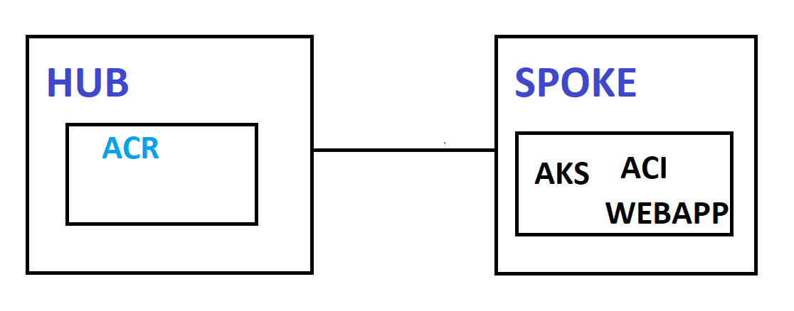
ARCH DESIGN: HUB & SPOKE
One ACR with Private Endpoint in Hub
All Spokes will be Peered to HUB (Which is Obvious)
Per Application, there will be Service Principal to build and Push Images to ACR.
Service Principal will have ACRPULL and ACRPUSH Role Based Access Control (RBAC) on the Resource Group Containing Hub ACR or Hub ACR itself.

Slide 7
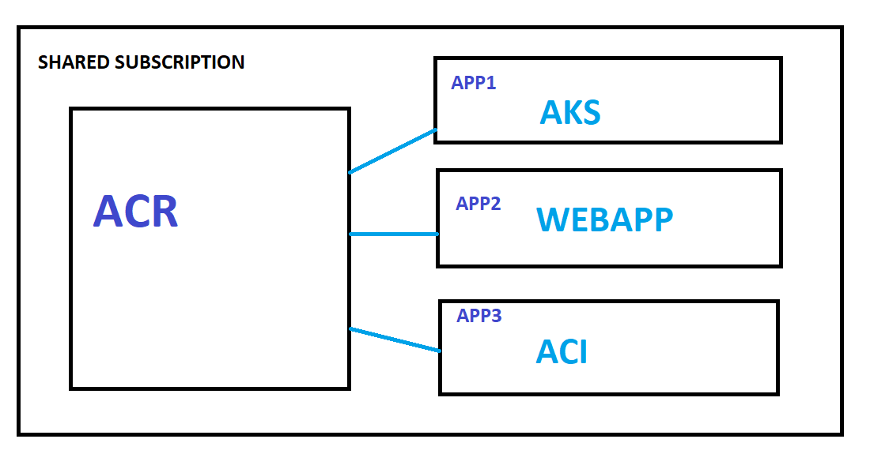
ARCH DESIGN: SHARED SUBS
Shared Subscription = Multiple Application Segregated using Resource Group.
One ACR with Private Endpoint in Shared Subscription.
All Applications in the Shared Subscription will consume the same ACR.
Per Application, there will be Service Principal to build and Push Images to ACR.
Service Principal will have ACRPULL and ACRPUSH Role Based Access Control (RBAC) on the Resource Group Containing ACR or On the Resource (ACR) itself.

Slide 8
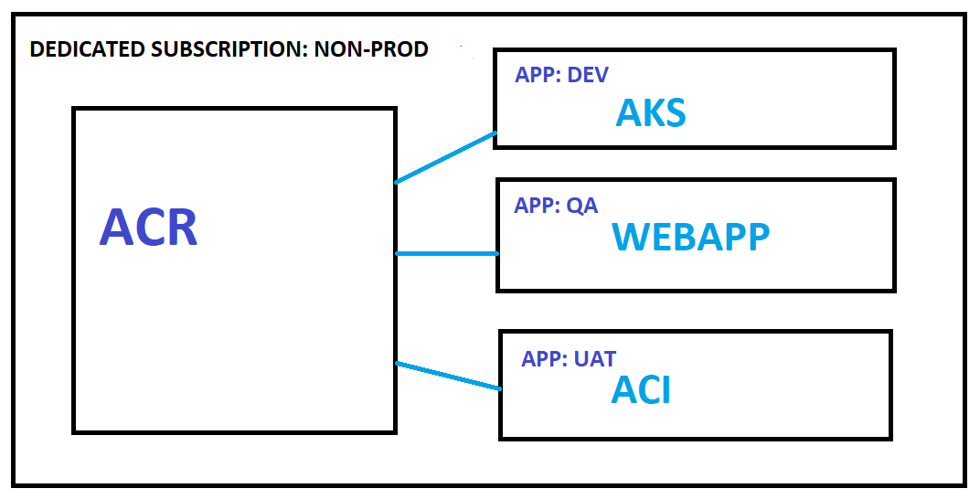
ARCH DESIGN: DEDICATED SUBS
Dedicated Subscription = One Application Per Environment and Per Subscription
One ACR with Private Endpoint in Per Application and Environment Dedicated Subscription.
For Example: Application having a Dedicated “Non-Prod” and “Prod” Subscription. So there will be 2 ACRs.
Non-Prod Subscription can further have “Dev”, “QA”, “UAT/PRE-PROD” Environment categorized in Resource Groups.
Per Environment, there will be Service Principal to build and Push Images
Service Principal will have ACRPULL and ACRPUSH Role Based Access Control (RBAC) on the Resource Group Containing ACR or On the Resource (ACR) itself.

Slide 9
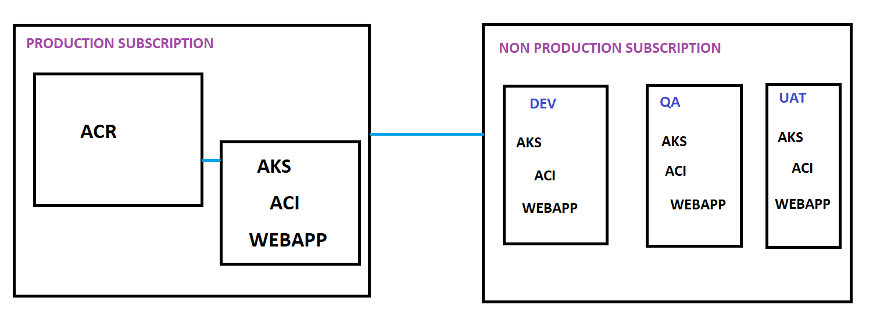
ARCH DESIGN: ALL IN ONE ACR
One ACR with Private Endpoint in Per Application Dedicated Subscription (Prod) but Shared Virtual Network (VNet).
Consider Application having a Dedicated “Non-Prod” and “Prod” Subscription.
Non-Prod Subscription can further have “Dev”, “QA”, “UAT/PRE-PROD” Environment categorized in Resource Groups.
Shared VNet will then be Peered with DEV, QA, UAT/PRE-PROD, and PROD VNet.
Per Environment, there will be Service Principal to build and Push Images
Service Principal will have ACRPULL and ACRPUSH Role Based Access Control (RBAC) on the Resource Group Containing ACR or On the Resource (ACR) itself.

Slide 10
BEST PRACTISES
Image Tagging
Image Scanning
Approval as who can push the Image with Event Notification.
Retention of Images

Slide 11
USE CASES AND AUTOMATIONS
Use Case(s): Hosts images to “Build Infrastructure at Scale“:-
Web App for Containers
ACI Instance - Container Groups and Containers
AKS - HPA and KEDA
Azure Container Apps
Automations:-
Powershell
Terraform
Biceps

Slide 12
LIVE DEMO DETAILS
Scan Image Vulnerabilities in ACR Using TRIVY and AZURE DEVOPS
Blog Link: https://dev.to/arindam0310018/devops-acr-trivy-1o05
Github: https://github.com/arindam0310018/ACR-Trivy

Slide 13
LETS EXPERIENCE IN REAL TIME !!!

Slide 14
Any Questions please, happy to answer to the best of my knowledge.

Slide 15
CREDITS
Special THANK YOU to MANUEL MEYER and THOMAS HAFERMALZ for the providing the opportunity to speak @ AZURE ZURICH USER GROUP In Person Session.

Slide 16

THANK YOU!!!
For any further questions?
You can write me at:
mail2arindam2003@yahoo.com
arindam0310018@gmail.com

