Slide 1
Trincomalee campus, Eastern University, Sri Lanka · Faculty of Applied Science · Department of Computer Science
Integrated Smart Hostel
Management System
Name:
Dinuka Shamitha Kodagoda
Reg. No.:
EUSL/TC/IS/2020/COM/105
Index No.:
20/COM/463
Degree:
BSc in Computer Science

Slide 2
01 Introduction & Background
Context
Hostel facilities traditionally rely on manual, paper-based processes
Sri Lankan residential institutions manage hundreds to thousands of students
Operations span attendance, food services, maintenance & communications
Majority of hostel systems in developing countries remain fragmented & disconnected
Absence of centralised systems leads to inefficiency, data loss & poor decisions
What This System Provides
🎓 Role-based dashboards
📋 Integrated attendance management
🍽️ Digital canteen ordering system
📣 Complaint tracking & resolution
🔔 Multi-channel notification system
⚙️ Task & maintenance management
📌 Notice board & announcements

Slide 3
02 Problem Statement & Research Gap
⏱
🍽
📋
Attendance
Canteen
Complaints
Manual marking is time-consuming, error-prone & difficult to audit
No digital ordering system — inefficiency and waste in food service
Student complaints not systematically tracked; no automatic notifications
🔔
🔧
📊
Notifications
Task Management
Data Silos
Critical updates cannot reach users via multiple channels; missed alerts
Maintenance tasks lack tracking & automated notification for assignments
Information scattered across disconnected systems; no data-driven decisions
Research Gap: No existing system in Sri Lanka provides a fully integrated, role-based hostel management platform with multi-channel notifications

Slide 4
03 Research Aim & Objectives
1. Design flexible Role-Based Access Control (RBAC) for 6 user types
Primary Aim
2. Create customised dashboards tailored to each stakeholder role
Secondary Objectives
To develop a comprehensive web-based Smart Hostel Management System that integrates attendance, canteen, complaint handling, task management, and notice distribution into a single role-based platform.
3. Implement real-time data processing & analytics for decision-making
4. Develop multi-channel notifications: email, in-app alerts, real-time updates
5. Automate email notifications for complaints, tasks, orders & notices
6. Ensure security via JWT authentication and bcrypt password hashing
7. Validate through User Acceptance Testing (UAT) and notification delivery checks

Slide 5
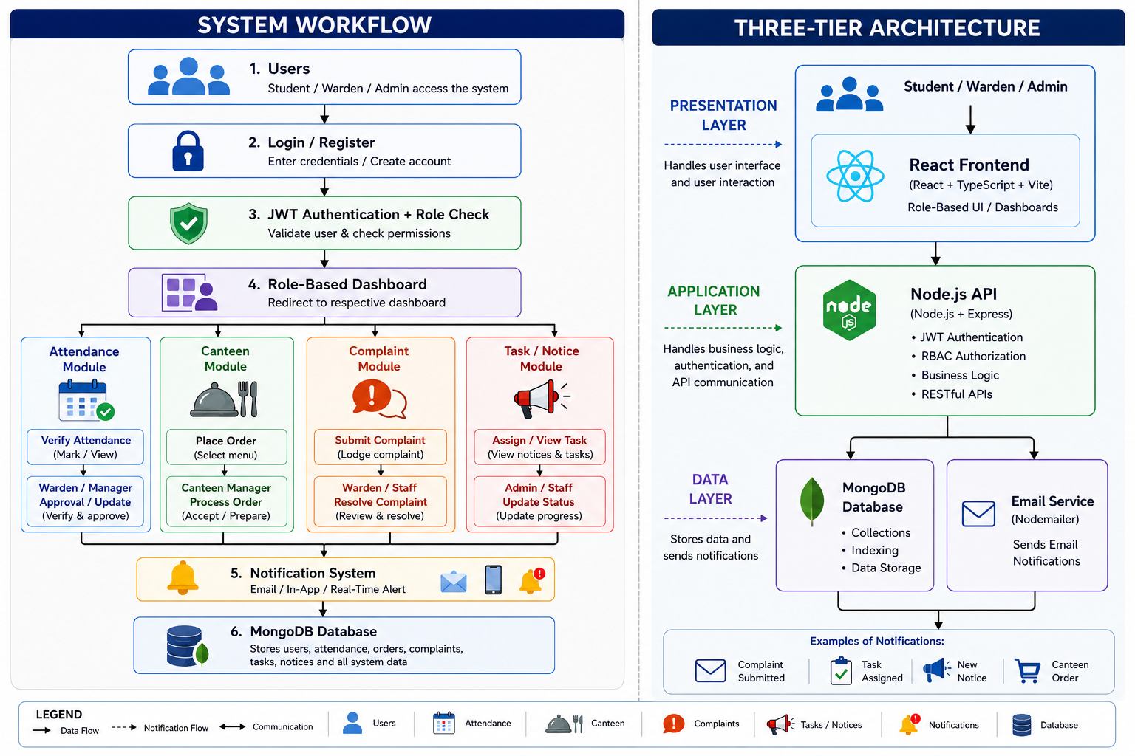
04 Methodology & Proposed Solution
Methodology
Proposed Solutions
Role-Based Access Control
Digital Attendance Management
Online Canteen Management
Complaint and Issue Management
Task Management System
Notice and Notification System
Centralized Database
1
Application Layer
2
3
Data Layer
4
Communication via HTTP/HTTPS · Git version control · ESLint + Jest + TypeScript for quality assurance

Slide 6
05 System Design & Implementation
User Roles & Dashboards
Key System Modules
Student:
Attendance, canteen orders, complaints, notices
📊 Attendance System
Real-time marking + warden verification
Warden:
Attendance verify, complaint resolution, tasks
🍽️ Canteen Module
Digital menu, order placement & tracking
Sub-Warden:
Delegated responsibilities & tasks
📣 Complaint System
Submission, tracking + auto email alerts
Canteen Manager:
Menu management & order processing
🔔 Notification Engine
Email (Nodemailer) + Socket.io real-time
Maintenance Staff:
Task assignments & status updates
📋 Task Management
Assignment, priority tracking & alerts
Marshel and Ar:
Full system access & user management
📌 Notice Board
Creation, distribution & email blasts
Security: bcrypt password hashing · JWT auth (24h expiry) · HTTPS/TLS · Input validation · CORS configuration · RBAC middleware

Slide 7
06 Results & Evaluation
✅ User Authentication & Authorization
✅ Attendance Management
🔒
📊
✅ Canteen Management
✅ Complaint Management
🍽️
📣
✅ Task & Notice Management
✅ Notification System
📋
🔔

Slide 8
✅ Successfully developed an integrated Smart Hostel Management System.
✅ Implemented secure RBAC, JWT authentication, and role-based dashboards.
✅ Reduced manual work through automation of hostel operations.
✅ Improved communication with real-time and email notifications.
✅ Enhanced transparency through attendance, complaint, and task tracking.
✅ Scalable MERN-stack architecture supports future expansion.
✅ Improved overall hostel management efficiency.
07 Conclusion & Future Work
Key Findings
Future Enhancements
📱 Mobile Application
iOS & Android with QR attendance & push notifications
🤖 AI & ML Integration
Auto complaint categorisation, predictive maintenance
📊 Advanced Analytics
Predictive insights, custom reports & visualisations
💳 Payment Gateway
Digital canteen payments & financial tracking
☁️ Cloud Deployment
AWS/Azure + Docker/Kubernetes containerisation
🔗 IoT & Blockchain
Facility monitoring + secure immutable records
⚠️ Limitations: Web-only (no mobile app) · No payment gateway · Basic analytics

Slide 9
Thank You
Questions & Discussion
K.T.Dinuka Shamitha Kodagoda
20 COM 463
Department of Computer science
Trincomalee campus, Eastern University,Sri Lanka
GitHub:
github.com/Dinukashamithakodagoda/Smart-Hostel-MS
Notes:
dinuka

